Slide 1

Humans
Notes:
Hi,
In the last video we discussed connectomes: full diagrams describing how every neuron connects to every other neuron in an animal.
We don't have a connectome for the human brain, so instead in this video, we're going to look at a more macro-level.
Linker:
But first, I wanted to point out something which we've not mentioned yet.

Slide 2
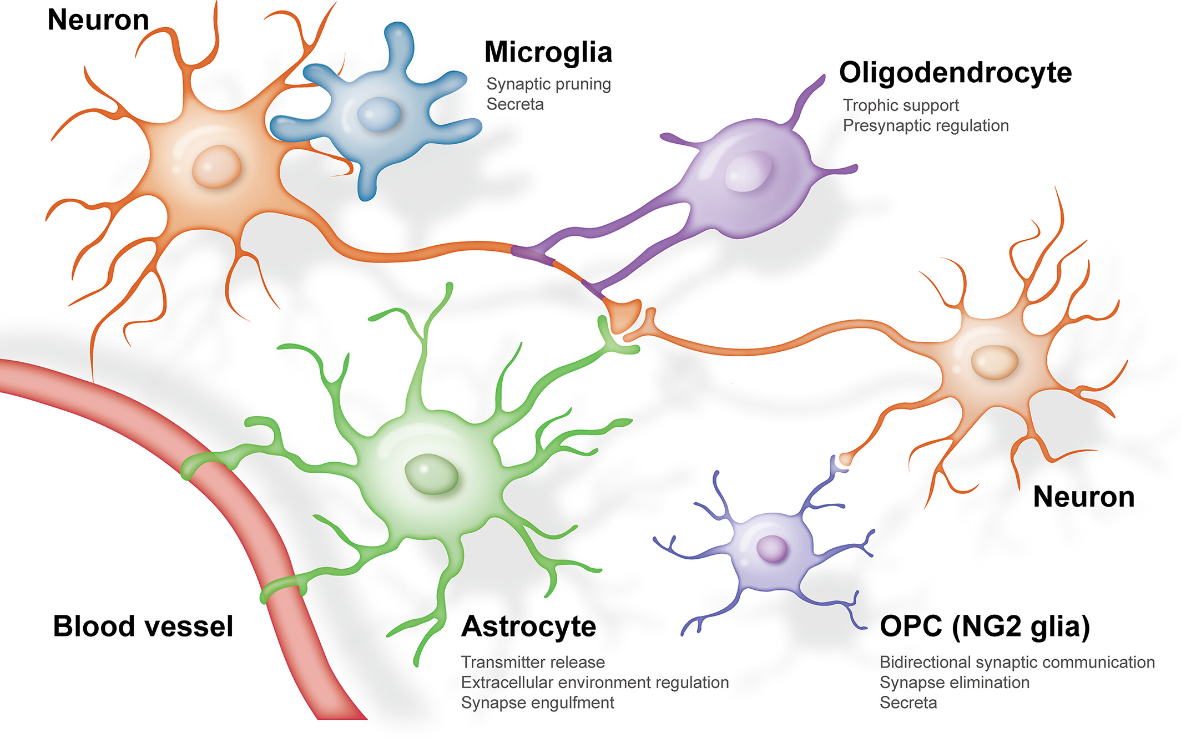
Glial cells
Liu et al., 2023 (Glia)
Notes:
Which is that neurons, may only be some of the story, as there are other cells in the brain too, known as glial cells:
In humans it's estimated that the ratio of neurons:glia is roughly 60:40.
And there are many different types of glia cells.
So what are they for?
Historically it was thought that glia mainly played supporting roles, for example:
Oligodendrocytes, shown in purple here, form the fatty myelin sheaths around axons,
While microglia, shown in blue, act as immune cells by removing dead cells and responding to pathogens.
But it's increasingly thought that glia play computational roles too.
For example, astrocytes – which have a star-like shapes and are shown here in green, can both detect and respond to neural activity through multiple mechanisms, like modulating the concentration of potassium around neurons or even using their own neurotransmitters – known as gliotransmitters.
Linker:
Putting it all together,
Papers:
https://doi.org/10.1002/glia.24343

Slide 3
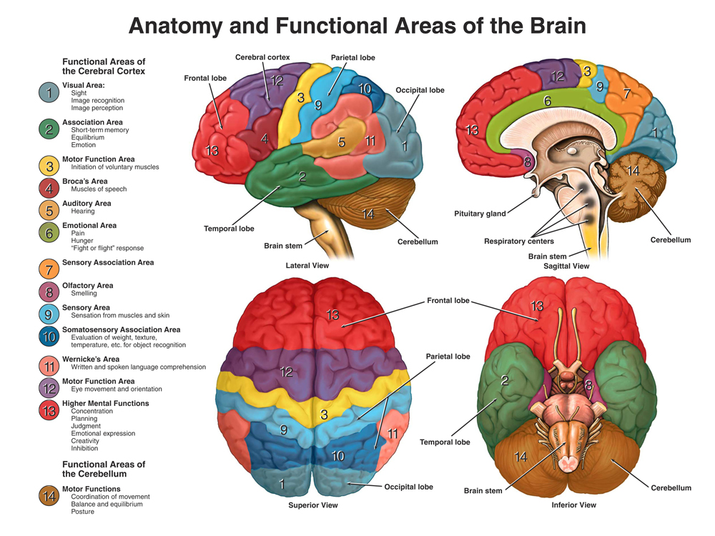
Humans (86 billion neurons, ≈10¹⁵ synapses)
Notes:
The human brain is thought to be composed of roughly 86 billion neurons, 50 billion glial cells and 10^15 synapses. Though this is hard to estimate!
At a more macro-level, these figures show the gross structure of the brain from a lateral view, as if you're looking at someone from their left hand side.
The diagram on the left shows the brain's outer surface, and there are a few interesting features to note:
The outermost layer, known as the cortex, has a folded structure, which increases it's surface area relative to brain volume. The folds are known as gyri and the depressions are known as sulci.
Larger depressions or fissures, divide the brain into four major lobes – the frontal, temporal, parietal and occipital lobes.
The cerebellum, which we discussed at a micro-level in week 2, sits at the back.
Then at the base there is the brain-stem which connects the brain to the spinal cord.
What you can't see on this diagram is that the brain is divided left/right into two hemispheres which are largely symmetrical, and are connected across the midline by a structure known as the corpus callosum.
Finally, the diagram on the right shows a sagittal section, as if we've divided the two hemispheres and removed the left.
Linker:
Taking a different view, if we now imagine looking at someone front on and then taking a perpendicular slice through the brain.
Papers:
https://doi.org/10.1002%2Fcne.24040

Slide 4
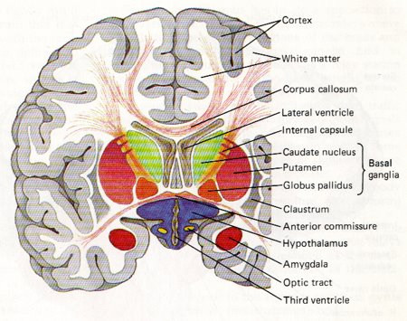
Humans (86 billion neurons, ≈10¹⁵ synapses)
Notes:
We get a coronal section, which would look something like this.
The outermost layer, the cortex, is also referred to as grey matter as it mainly contains dendrites, soma, synapses etc. Which are unmyelinated.
While, below there are tracts where myelinated axons tend to travel, which are known as white matter. For example, the corpus callosum which connects the two hemispheres.
Then deeper in the brain there are various nuclei, which are clusters of neurons.
Linker:
Zooming out one last time

Slide 5
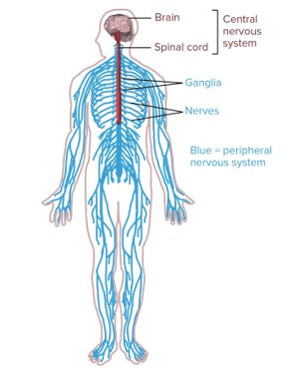
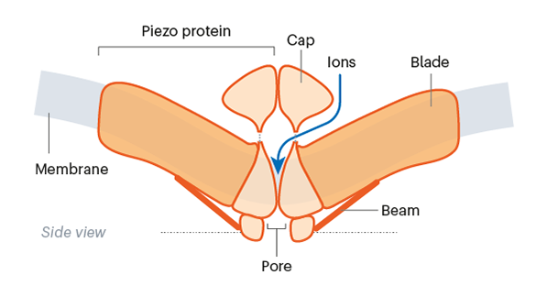
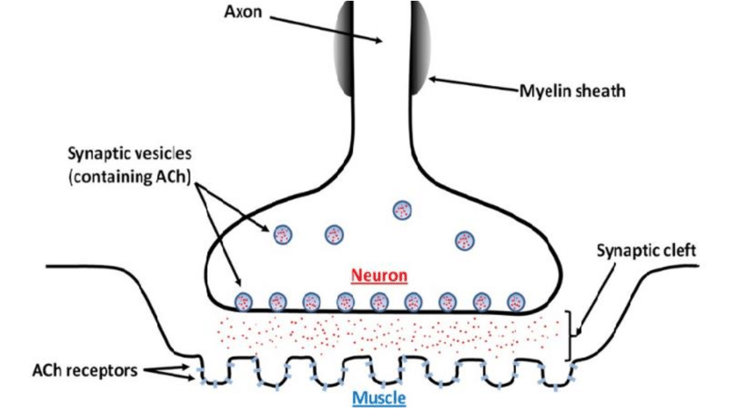
The nervous system
Sensory Neurons
Convert stimuli to spikes
Motor Neurons
Connect to muscles
Notes:
The entire nervous system is composed of two parts:
The central nervous system – which consists of the brain and spinal cord, and
The peripheral nervous system which carries information in two directions.
Sensory neurons convert external stimuli to spikes and then carry these to the spinal cord and brain. For example, neurons which sense pressure have specialized channels, known as Piezo channels, which:
Physically deform in response to pressure,
Allow ions to flow into the neuron and,
Trigger action potentials.
In the other direction, motor neurons synapse with muscles at what is known as the neuromuscular junction, where they use a specific neurotransmitter, acetylcholine, to link neural activity to movement.
Linker:
Okay, going back to the brain we often think about specific functions as being localized to specific brain areas.

Slide 6
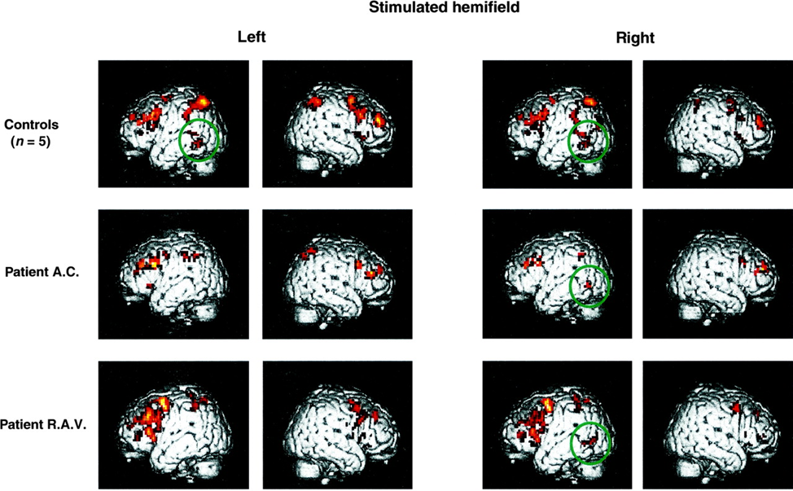
Localisation of function?
Cohen et al., 2000 (Brain)
Notes:
For example, we call part of the occipital lobe, visual cortex and part of the temporal lobe, auditory cortex. But, why?
Well broadly, we have three types of data that seem to support localization of function.
First, if we observe neural activity in response to stimuli or during tasks, we see that neurons with similar responses tend to be co-located. For example, in this study human participants were asked to read words presented to a single eye, while their brain activity was imaged using a technique known as fMRI (functional magnetic resonance imaging). The top row of the figure shows left and right views of the brain, with the inferred amount of neural activity overlaid in red, in response to words presented to either the left or right eye. So you can see that this task activates some localized areas.
Second, if we manipulate specific parts of the brain, we see specific differences in behavior. Though, while we do manipulation experiments in animal models, in humans these manipulations usually result from accidents, disease processes or surgical interventions. For example, in the same paper the authors also studied two patients who had damage to part of their corpus callosum. These patients lost relatively specific functions, and in this study they were unable to read words aloud that were presented in their left visual field. And the two rows of patient imaging data show how their neural activity differs from controls and so reflects this behavioral difference. Specifically, in control subjects, a region was activated irrespective of the stimulated hemifield, shown by the green circle, but in the patients it was only activated by right-field stimulation.
A quick aside, we'll cover observing and manipulating neural activity in more detail later in the course, but for now let's get back to my list.
Third, if we look at brain structure, connectivity is sparse and modular, as we saw in the last video. Which could imply that individual modules perform specialized functions.
Linker:
But is that necessarily the case?
Paper:
https://doi.org/10.1093/brain/123.2.291

Slide 7
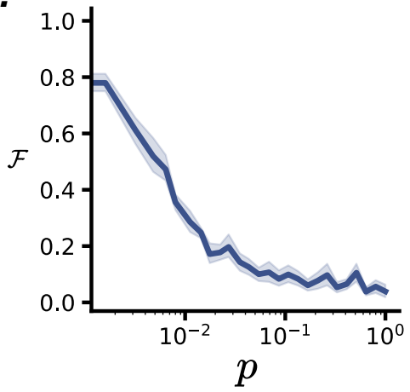
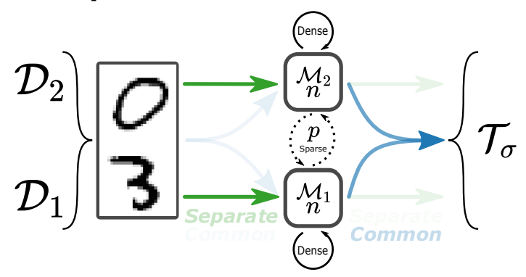
Structural vs functional specialisation
Béna & Goodman 2023 (arXiv)
Notes:
In other words, will a network with a modular structure necessarily modularize function?
To address that question this paper uses a really neat set up.
As a model they use artificial neural networks composed of modules, where each module is a recurrent neural network with dense connections internally, but sparse connections to other modules.
As a task, they input pairs of digits and train networks to output a parity-based label, which means that networks could solve the task by using a modular solution where each module would learn to recognize it's own input digit.
To measure functional specialisation they use three different metrics. One of which is a manipulation based metric, where they silence each module in turn and see how that affects the networks ability to recognize each digit. So a module would be defined as specialized if silencing it, decreased the classification accuracy for one digit but not the other.
With that set-up, they then vary the amount of connectivity between the modules, labelled a p on the left diagram, and measure functional specialization.
One of their main results is shown on the right figure where the x-axis is the amount of inter-module connectivity p and the y-axis is the level of functional specialization. And what you can see is that:
When p is low, so inter-module connectivity is sparse, functional specialization is high.
But as p increases, specialization decreases very rapidly.
What this suggests is that only networks with extremely sparse inter-module connections became functionally specialized, and together with other evidence this paper adds to a growing picture that function in the brain may be less localized than previously thought.
Linker:
Okay, that's all for this week.
Next week Dan will focus on learning rules in both neuroscience and machine learning.
Paper:
https://doi.org/10.48550/arXiv.2106.02626

