Slide 1

Spiking is not differentiable
Notes:
This week we’re going to talk about how to train spiking neural networks. But first though, in this video, we’ll see why this is difficult to do.

Slide 2


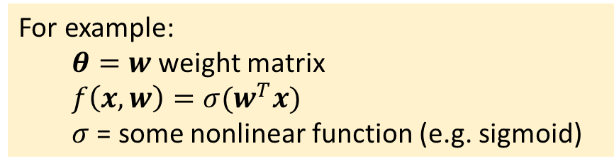
What we want to do
Recap: gradient descent for artificial neural networks
Write neural network as $y=f(x,θ)$
Parameters $θ$
Input $x$ leading to output $y$
Want to minimise loss:
Loss function $ℒ(y,y^{∗})$
Desired output $y^{∗}$
$θ^{∗}=\arg{\min_{θ}{ℒ(f\left(x,θ\right),y^{∗})}}$
Gradient descent:
$θ←θ−γ∇_{θ}ℒ(f\left(x,θ\right),y^{∗})$
Learning rate $γ$
Chain rule to compute $∇$ term
For example:
$θ=w$ weight matrix
$f\left(x,w\right)=σ(w^{T}x)$
$σ$ = some nonlinear function (e.g. sigmoid)
Computing the gradient:
Gradient ${(∇ℒ)}_{i}=\frac{∂ℒ}{∂θ_{i}}$
Vector chain rule:
${x∈ℝ}^{n}\underset{→}{f}y∈ℝ^{m}\underset{→}{g}{z∈ℝ}^{p}$
Jacobian matrix $J_{ij}^{f}=\frac{∂f_{i}}{∂x_{j}}$
Chain rule is $J^{g∘f}=J^{g}J^{f}$
Efficient: just matrix/ vector multiplications
So, let’s just do this with $f$ being a spiking neural network?
Notes:
What we’d like to do is to use the methods developed for artificial neural networks, because we know they work really well.
So let’s quickly recap how that goes. This isn’t going to be a complete or comprehensive guide, so if you haven’t encountered this before, stop now and read an introduction. I’ve put some recommendations in the reading list.
First we write the neural network as a function of inputs and parameters.
For example, for a one layer neural network the parameters could be the weights, and the function could be a sigmoid applied to the dot product of the weights and input vector.
We want to minimise some loss function that tells us how far the output of the network is from the desired output.
To do that, we apply gradient descent, moving in the reverse direction of the gradient of the loss function with respect to the parameters.
We can compute the gradient efficiently using vector and matrix multiplies using the vector chain rule.
So, can we just do this for a spiking neural network? It’s not quite so easy. Let’s see why.

Slide 3
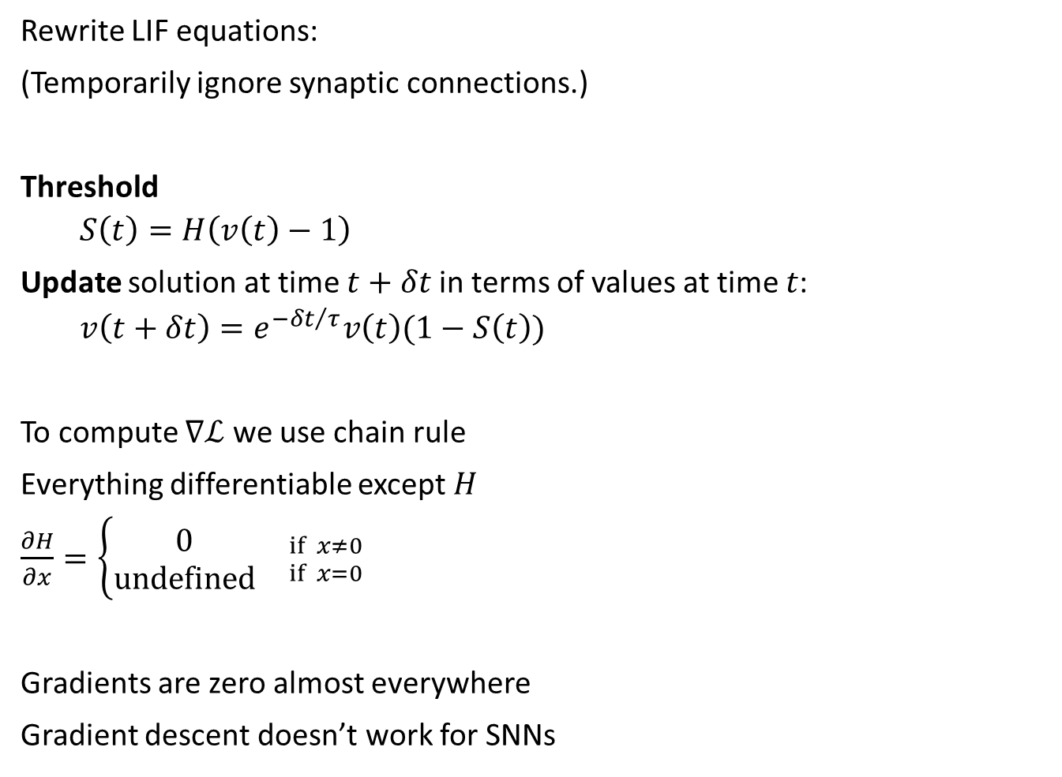
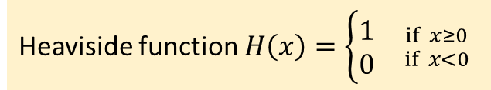
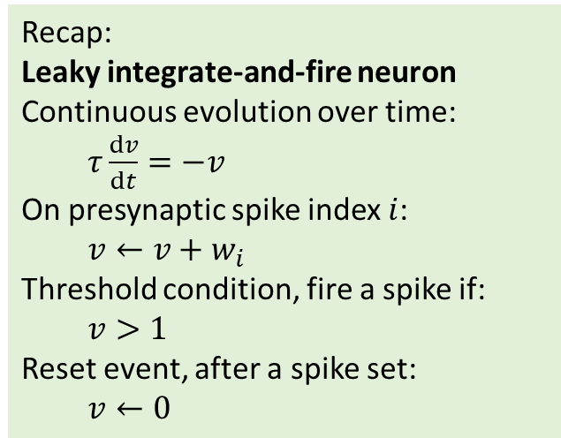
Why we can’t do it
Recap:
Leaky integrate-and-fire neuron
Continuous evolution over time:
$τ\frac{dv}{dt}=−v$
On presynaptic spike index $i$:
$v←v+w_{i}$
Threshold condition, fire a spike if:
$v>1$
Reset event, after a spike set:
$v←0$
Rewrite LIF equations:
(Temporarily ignore synaptic connections.)
Threshold
$S\left(t\right)=H\left(v\left(t\right)−1\right)$
Update solution at time $t+δt$ in terms of values at time $t$:
$v\left(t+δt\right)=e^{{−δt}/τ}v\left(t\right)(1−S\left(t\right))$
To compute $∇ℒ$ we use chain rule
Everything differentiable except $H$
$\frac{∂H}{∂x}=\left\{\begin{aligned}0 \\ undefined\end{aligned}{ \atop }{if x≠0 \atop if x=0}\right.$
Gradients are zero almost everywhere
Gradient descent doesn’t work for SNNs
Heaviside function $H\left(x\right)=\left\{\begin{aligned}1 \\ 0\end{aligned}\right.{ \atop }{if x≥0 \atop if x<0}$
Notes:
To see what goes wrong here, let’s start with a recap of the leaky integrate-and-fire neuron we’ve seen before.
Over time it evolves according to a differential equation, with instantaneous effects when a spike arrives. Whenever the membrane potential v crosses the threshold v>1 you fire a spike and instantly reset to 0.
We’re going to rewrite these equations, temporarily ignoring the synaptic connections for simplicity as you get the same problem and solution with that but it makes the notation more complicated.
The threshold we’ll write as S(t) being the Heaviside function of v(t)-1. So this will be equal to 1 if the neuron has spiked, otherwise 0.
Now we replace the differential equation with a discrete update rule. To get v at time $t+δt$ we multiply v at time t with this exponential term. We also fold in handling the spike reset by then multiplying this value by 1-S(t). So this means we multiply by 0 if it spiked, otherwise we multiply by 1. This is equivalent to setting it to 0 after a spike.
Now if we wanted to use gradient descent we'd have to compute the gradient using the chain rule.
That's unproblematic for every part of these equations except for the Heaviside function.
This function has derivative zero at every point except 0, where it's undefined.
That means the gradients are zero almost everywhere.
Which means that gradient descent will never change any parameters, making it useless for spiking neural networks.

Slide 4
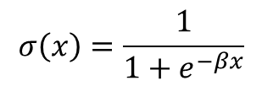
So what can we do?
Solution 1: don’t use gradients (for the spiking part)
Train the readout layer only: reservoir computing
Use global optimisation methods (e.g. evolution)
Convert an ANN to an SNN
Solution 2: restrict to a single spike
Solution 3: smooth out the spikes
Use smoothed Heaviside function or rate-based neurons
Use probabilistic methods
Solution 4: surrogate gradients
Smooth only when computing gradients
🤯 it works! We don’t really know why
Solution 5: approximate gradients
😭 You don’t train all the parameters
😭 Computationally expensive
😭 Misses spiking solutions
😭 Unrealistic and limited
😭 Not spiking
😭 Poor performance in practice
😑 Feasible but still expensive
😢 Uses global information (not bio. plausible)
😢 Worse performance
😊 Biologically plausible
Heaviside
Sigmoid = smoothed Heaviside
$$σ\left(x\right)=\frac{1}{1+e^{−βx}}$$
Notes:
So how do we solve this problem? Well there's a lot of different approaches that have been tried and that we'll talk about in the remaining videos this week. There's no ideal solution, so in this final slide of this video I'll quickly talk about the general approaches people have tried and some of their different issues.
The first idea is just not to use gradients, or at least, not to use them for the spiking part of the network.
One example of this is reservoir computing. You have a spiking neural network that you don't train with gradients, and a trainable readout layer.
This actually works surprisingly well, but it's not an efficient way to learn because you're not using all the available parameters.
Alternatively you can use global optimisation methods like evolutionary algorithms.
This works but you have to throw a lot of compute at it.
You can try taking an artificial neural network and converting it to a spiking neural network.
Again, this works reasonably well but it doesn't find solutions that make use of spiking, and so it's not using the spiking neurons efficiently.
Another type of solution is to insist that each neuron fires precisely one spike, and take derivatives with respect to the time of that spike, which is a nicely differentiable quantity. This is a clever solution that works surprisingly well in practice.
The downside is that it's unrealistic to assume only one spike per neuron, and that really limits what you can do with it.
A clever trick is to take the non-differentiable Heaviside function and smooth it out to a sigmoid that you can differentiate.
This has been shown to work in at least some cases, but it's not a spiking neural network if you do that.
A related trick is to look at probabilistic neuron models, and then the parameters of their distributions are differentiable.
This is theoretically nice, but in practice doesn't seem to scale well.
A more generally applicable approach is a method called surrogate gradients.
I'll talk more about this in a later video, but the key idea is we do the same smoothing, but only when we're computing gradients, not for the the forward pass.
It's a bit surprising, but this works. We provide gradients to a different function from the one we’re optimising, but it gives us good solutions. We have some ideas of why this works but it's not a fully rigorous explanation.
This method is still quite computationally expensive, but it is feasible to use it for networks of a few thousand neurons at least. One downside is that it uses global information that wouldn't be available to a neuron in a biological setting. This is fine if we just want to know what a good solution would look like, but makes it a bad model for how the brain learns.
To address both these issues, people use approximations that reduce the computational complexity and make the learning rules only use local information.
Performance does tend to be worse but on the upside, these rules are more biologically plausible.
OK, in the next videos we'll dive into some of the details of these different solutions.

