Slide 1
Computationally Efficient and Generalizable Machine Learning Algorithms for Seizure Detection from EEG Signals
Zheyun Shou, zheyuns@kth.se
DA236X
Systems, Control and Robotics
2025.07.01

Slide 2
Introduction
Challenge: Manual EEG analysis for seizure detection is time-consuming, subjective, and requires specialized expertise. Large volume of EEG data creates the need for seizure detection algorithms that are accurate, computationally efficient for real-time use, and generalizable across diverse patients.
Proposed Solution: Investigate the Detach-ROCKET framework to develop a seizure detection methodology that achieves a balance between these requirements.
Research Question: To what extent can the Detach-ROCKET framework achieve a superior balance of predictive performance, computational efficiency, and generalization for EEG seizure detection compared to established time-series classification benchmarks?

Slide 3
Objectives
Implement and adapt Detach-ROCKET and Detach Ensemble for the task of seizure detection from multivariate EEG signals.
Benchmark against the catch22 feature-based classifier.
Evaluate performance using both epoch-wise and clinically-relevant event-wise metrics.
Evaluate generalization on a cross-dataset task.
Analyze computational efficiency and channel relevance.

Slide 4
Background
Epilepsy
EEG
TSC

Slide 5
Related Works
Seizure detection

Slide 6
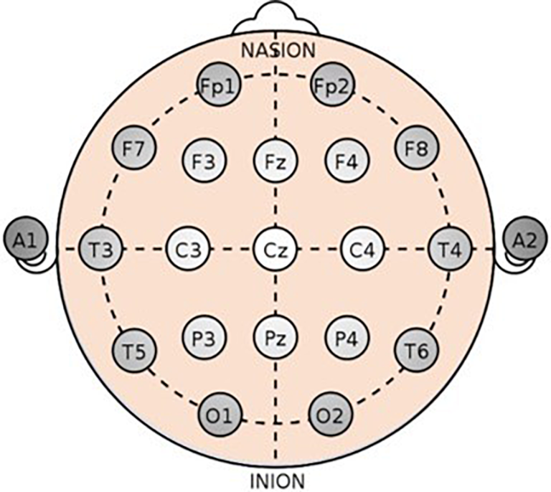
Method-Data Processing
Dataset
TUSZ
Siena
Each EEG recording consists of 19 channels corresponding to the standard 10–20 system scalp electrode montage, with a sampling rate of 256 Hz.

