Slide 1
Evaluating compatibility between regional economic growth and the Sustainable Development Goal indicators through data warehousing
Group 5 team member:
Kaipeng Han 23019676 (Team Leader)
Shengliang Zou 21008572
Zhangrui Ren 23019674 Yixuan Niu 23019678
Paper coordinator: Sanjay Mathrani
158.888 Information Technology Professional Project
Date：15/5/2024

Slide 2

OUTLINE
Introduction: Understanding the SDGs
Research question
Methodology
Results and Conclusion
References
1

Slide 3
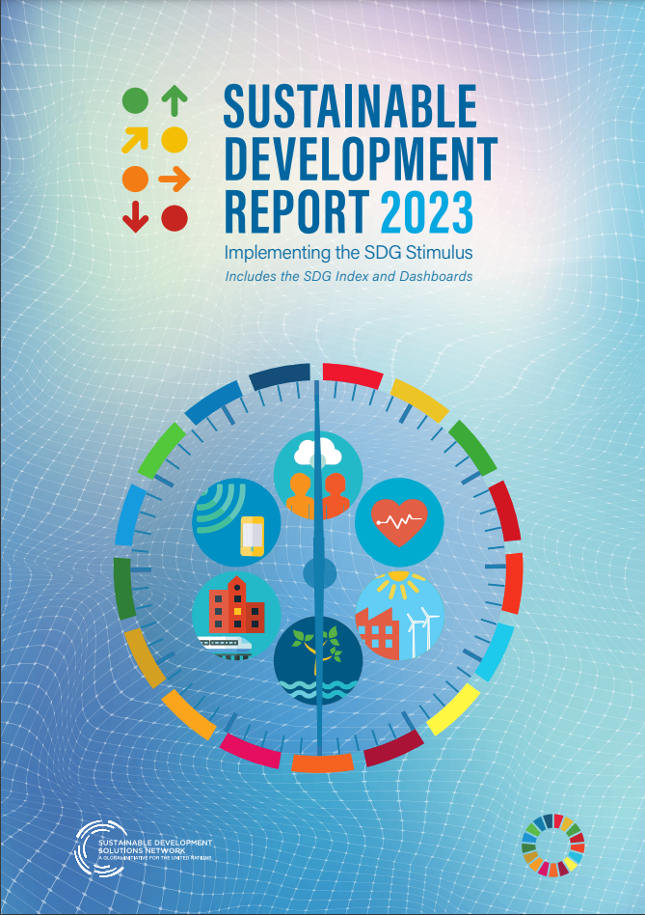
1. Introduction: Understanding the SDGs
Why is it important to study the multi-dimensional integration of SDGs?
In the global effort to achieve the Sustainable Development Goals (SDGs), interactions and conflicts between goals often arise. Therefore, understanding how these goals interact in different economies around the world is critical to developing coherent policies and achieving all SDGs.
Background
In 2015, the United Nations adopted the 2030 Agenda for Sustainable Development and set 17 Sustainable Development Goals (SDGs). It is mainly divided into three dimensions: economic dimension, social dimension and environmental dimension.
One of the design principles of goals is indivisibility, which emphasizes that when formulating and implementing policies, one should not only optimize for a single goal, but should comprehensively consider the mutual influence and balance between goals.
Although the international community has made some progress in implementing the SDGs, there are still significant challenges in how to effectively integrate and implement these goals, especially among different countries and regions.

Slide 4
2. Research Question
1. How do different SDGs interact with each other, and are they synergistic or trade-offs?
2.What is the relationship between economic growth-related SDGs and other SDGs?
3.How can digital transformation influence the achievement of SDGs, particularly those related to economic growth?
Economic growth plays a key role in achieving the SDGs. Studying the interaction between SDGs from the perspective of economic growth can capture the focus of the problem.
Specific links between SDGs related to economic growth (such as SDGs 8, 9 and 4) and other SDGs
The impact of digital technologies on national economies and their potential to contribute to the achievement of the Sustainable Development Goals focusing on decent work, economic growth and industrial innovation were assessed.

Slide 5
2. Research Question
4. How do food security, transnational business practices and agricultural productivity impact related economic sustainable development goals?
5. In an aging society, how do health, education and employment interact to drive sustainable economic development?
Analysis of the impact of environmental and social factors such as food loss and waste and wealth inequality, multinational corporate profit shifting and employment conditions on economic performance, and the impact of cereal production on poverty rates.
The impact of health and education on economic growth, and how changes in employment rates affect three key aspects of sustainable economic development in countries at different income levels.

Slide 6
3.Methodology
Big data warehouse processes data hierarchically
Autoregressive integral moving average model
Used for time series data analysis to predict the unemployment rate for the next five years (2024-2028).
Principal component analysis
Identify the direction of the largest variance in the data set and the next largest variance in its orthogonal direction to achieve the purpose of dimensionality reduction. This is used to analyze the impact of data drive on economic-related indicators.
Use the three-layer structure of ODS, DWD, and ADS to process data in a structured manner. (Completed based on the built Hadoop cluster)

Slide 7
3.Methodology
Linear regression models were used to explore the impact of food loss and waste on wealth inequality. Structural equation modeling is used to study the relationship between profit shifting, performance indicators, and unemployment rates in multinational corporations.
Apriori algorithm
Used to identify frequent itemsets in large databases and generate association rules based on these itemsets. Used to calculate the average of SDG indicators and convert each row of data into a list of transactions based on their score above or below the average.
Linear regression and structural equation model evaluation

Slide 8




3. Methodology
Linear weighting method and entropy weighting method
Used to establish an economic growth index assessment model based on SDG indicators. The entropy weight method provides a method to objectively evaluate the importance of each indicator in a comprehensive system. These steps are as follows:
(1) The normalization processing of each indicator data
In the original data file, the indicator values have been normalized with scores ranging from 0 to 100.
(2) Calculate the proportion of the indicator value:
(3) Calculate the entropy value of the jth indicator :
(4) Calculate the weight: of the jth indicator
(5) Calculate the economic growth index score of the ith country :
• Entropy is a measure of uncertainty and mainly used to judge the dispersion degree of an index. The greater the dispersion degree of the index, the greater the impact on the comprehensive evaluation .

Slide 9
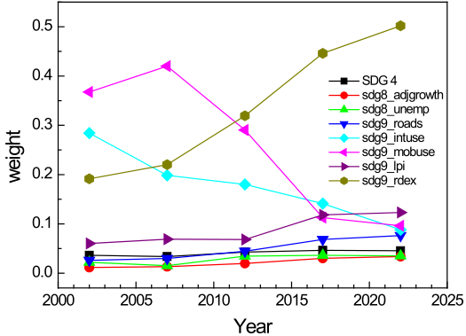
4.Results and Conclusion
Table 4.1 The calculated weights of the 8 indicators to the economic growth index in by the entropy method.
System layer | Indicator layer | Weight (2002) | Weight (2007) | Weight (2012) | Weight (2017) | Weight (2022)
Economic growth index | SDG 4 | 0.03641 | 0.03384 | 0.0428 | 0.04641 | 0.04551
 | sdg8_adjgrowth | 0.01155 | 0.0132 | 0.0197 | 0.03024 | 0.03371
 | sdg8_unemp | 0.02219 | 0.01527 | 0.03461 | 0.03632 | 0.0352
 | sdg9_roads | 0.02614 | 0.02987 | 0.04458 | 0.06844 | 0.07629
 | sdg9_intuse | 0.28423 | 0.19853 | 0.18007 | 0.14134 | 0.08805
 | sdg9_mobuse | 0.36764 | 0.4201 | 0.29043 | 0.11272 | 0.09608
 | sdg9_lpi | 0.06033 | 0.06894 | 0.06835 | 0.11838 | 0.12314
 | sdg9_rdex | 0.19153 | 0.22025 | 0.31945 | 0.44615 | 0.50201
• It can be seen that before 2012, sdg9_intuse (population using the internet) , sdg9_mobuse (mobile broadband users) and sdg9_rdex (expenditure on R&D) have a relatively large ( >0.18) weight to the economic growth index. After 2012, sdg9_rdex has a large ( ∼0.5) weight to the economic growth index.
Fig. 4.1. The weights of the eight indicators to the economic growth index in 2002, 2007, 2012, 2017 and 2022.

Slide 10
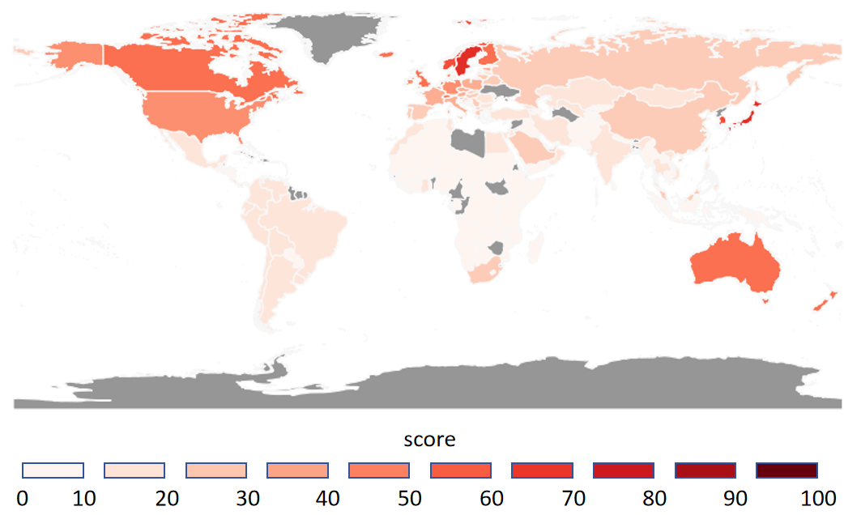
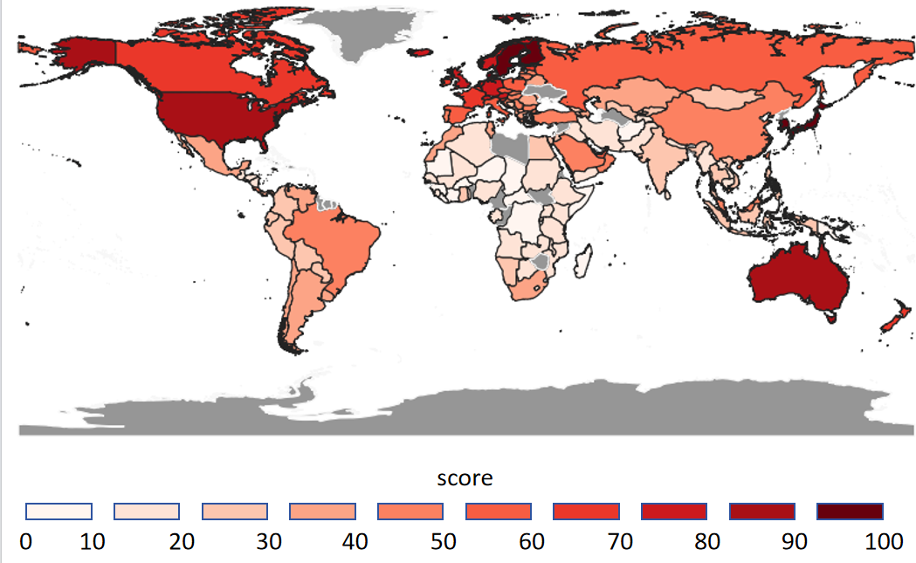
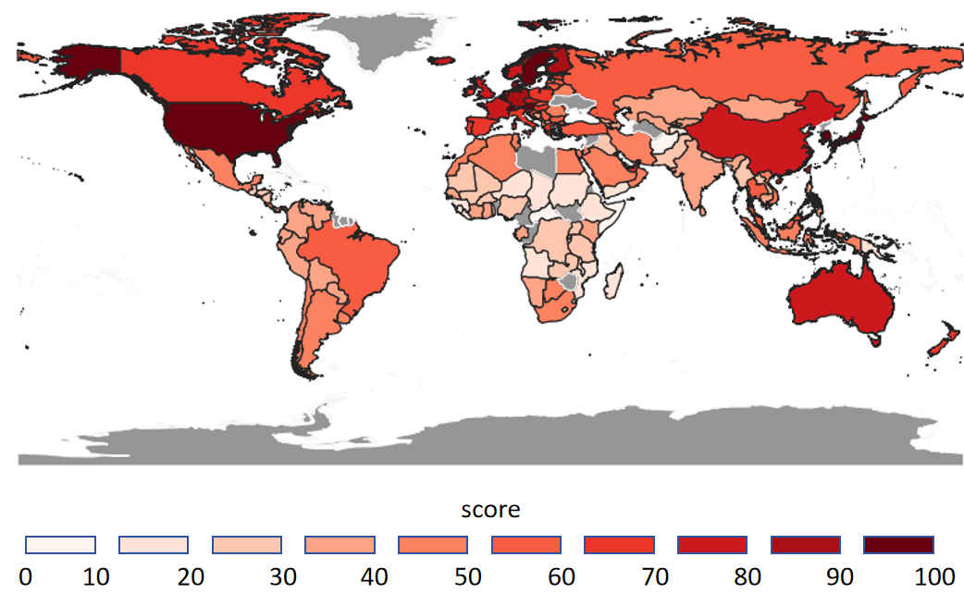
4.Results and Conclusion
Geographical distribution of economic growth index scores drawn by QGIS
Fig. 4.2. Global distribution of economic growth index scores in 2002.
Fig. 4.3. Global distribution of economic growth index scores in 2012.
• More red the color on the map, the higher the economic growth index. Grey areas represent countries with missing data, whose economic growth index is 0.
• North America, Europe and Australia have a relatively high economic growth index.
• The economic growth index of all regions shows an upward trend with the year.
• Some countries, such as the United States and China, have seen rapid economic development due to heavy investment in R&D in recent years.
Fig. 4.4. Global distribution of economic growth index scores in 2022.

Slide 11
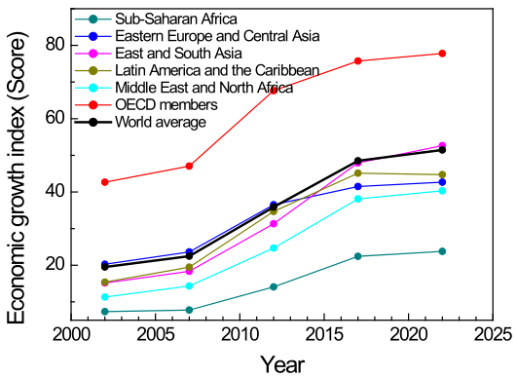
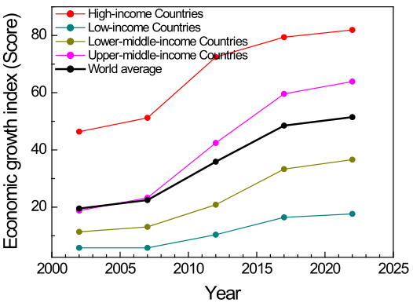
Fig. 4.5. The variation of the economic growth index of different regions by year.
Fig. 4.6. The variation of the economic growth index by year for countries with different income levels.
• The higher the income level of a country, the higher its economic growth index.
• The economic growth index of countries at all income levels increases by year.

Slide 12
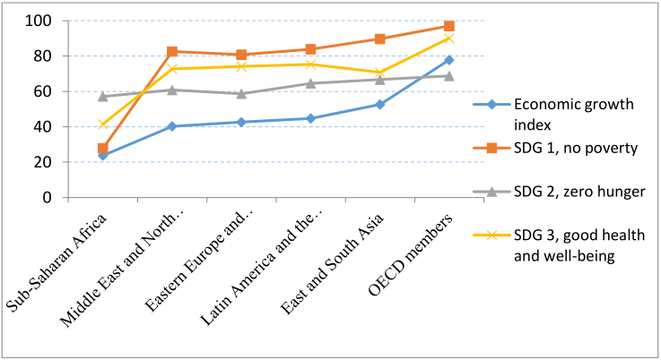
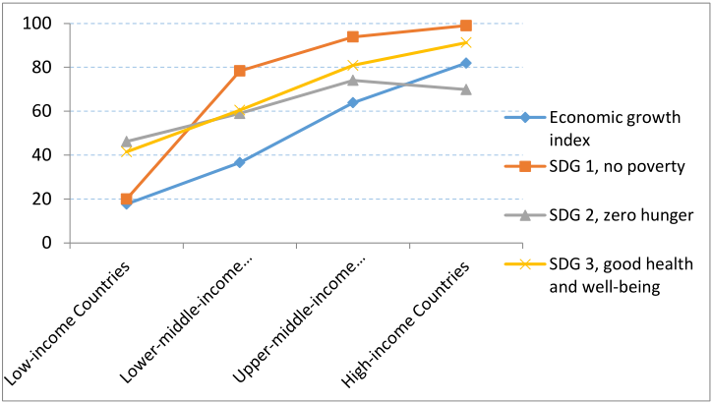
4.Results and Conclusion
Relationship between the economic growth level and the social SDGs
Fig. 4.7. Comparison of the economic growth index with SDGs 1, 2, and 3 scores for different regions of the world in 2022.
Fig. 4.8. Comparison of the economic growth index with SDGs 1, 2, and 3 scores for countries at different income levels in 2022.
• The change trend of SDGs 1-3 scores is consistent with that of the economic growth index, indicating that economic growth helps to eliminate poverty and hunger and improve people's health and well-being, because economic growth can create more jobs and produce more goods and services, thereby improve people's incomes and living standards.

Slide 13
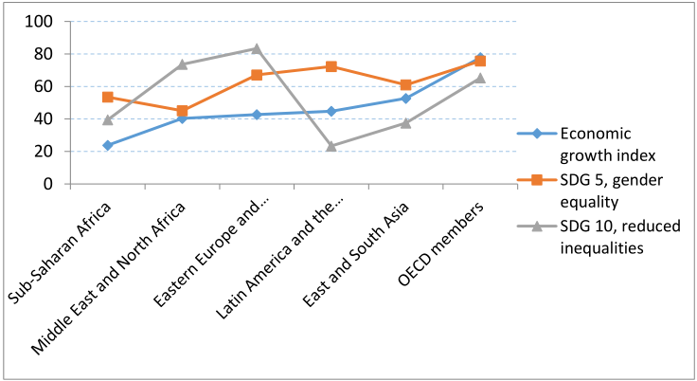
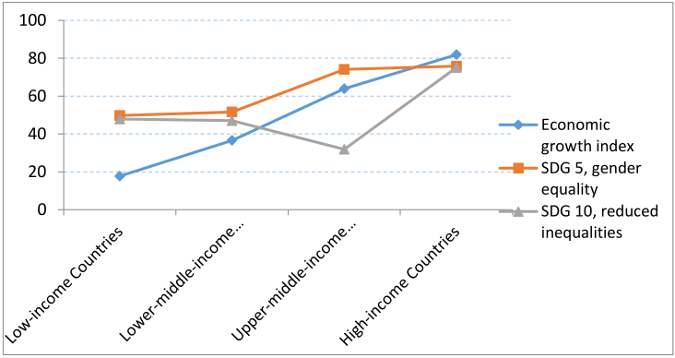
Fig. 4.9. Comparison of the economic growth index with SDGs 5 and 10 scores for different regions of the world in 2022.
Fig. 4.10. Comparison of the economic growth index with SDGs 5 and 10 scores for countries at different income levels in 2022.
• The changes of SDG 5 score with region and income level are not completely consistent with those of economic growth index, indicating that economic growth cannot significantly reduce gender inequality.
• The change of SDG 10 scores is clearly inconsistent with that of the economic growth index, indicating that economic growth cannot reduce inequality, because economic growth can widen the Gini coefficient.
• Above results show that the economic growth has a synergistic relationship with SDGs 1, 2 and 3, but has no direct relationship with SDG 5 and no correlation with SDG 10.

Slide 14
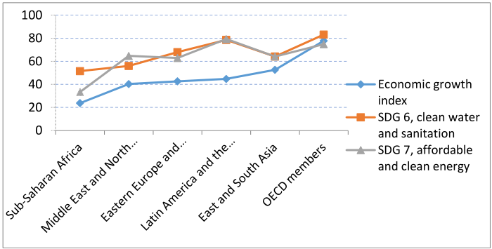
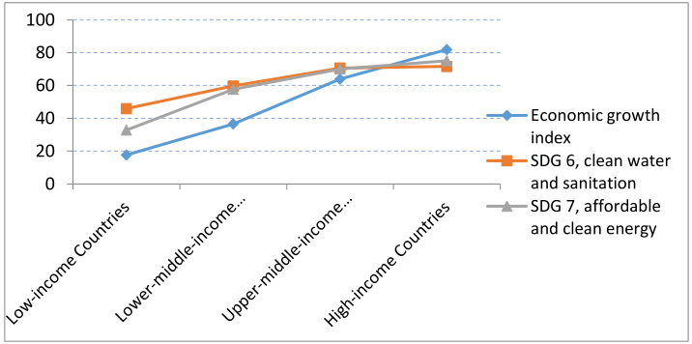
4.3 Relationship between the economic growth level and the environmental SDGs
Fig. 4.11. Comparison of the economic growth index with SDGs 6 and 7 scores for different regions of the world in 2022.
Fig. 4.12. Comparison of the economic growth index with SDGs 6 and 7 scores for countries at different income levels in 2022.
• The change trend of SDGs 6 and 7 scores is consistent with that of economic growth index, indicating that economic growth helps improve sanitation, access to clean water, increase the capacity to treat wastewater, and increase the proportion of using clean fuels and renewable energy, thus helping to protect the environment.

Slide 15
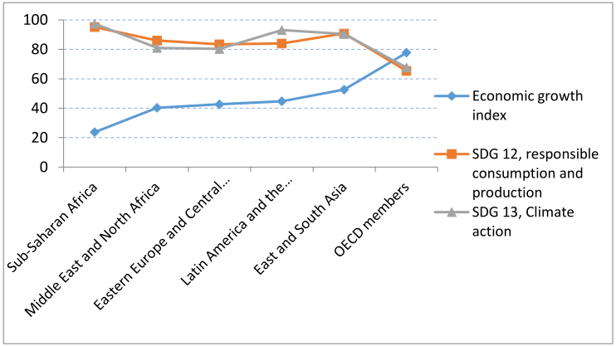
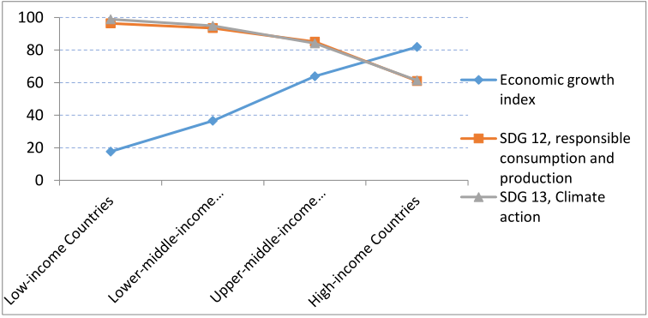
Fig. 4.13.Comparison of the economic growth index with SDGs 12 and13 scores for different regions of the world in 2022.
Fig. 4.14. Comparison of the economic growth index with SDGs 12 and13 scores for countries at different income levels in 2022.
• The change of SDGs 12 and 13 scores is opposite to that of the economic growth index, indicating that the higher a country's economic growth index, the more municipal solid waste, e-waste, sulfur dioxide emissions and plastic waste exports it produces, and the less climate action it takes.
• Above results indicate that the economic growth has a synergy relationship with SDGs 6 and 7, but a tradeoff relationship with SDGs 12 and 13.

Slide 16
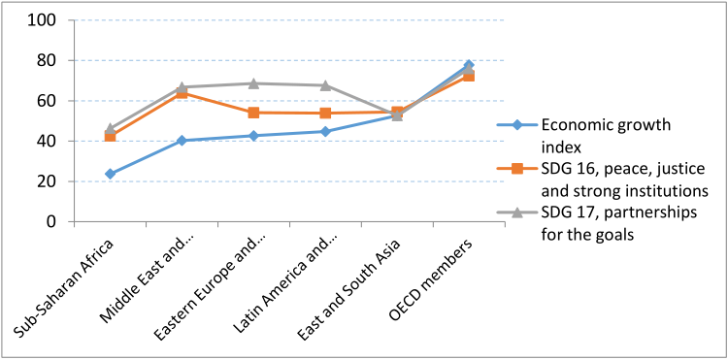
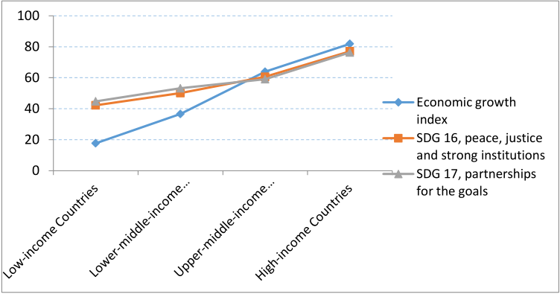
4.Results and Conclusion
Relationship between the economic growth level and the institutional SDGs
Fig. 4.15. Comparison of the economic growth index with SDGs 16 and 17 scores for different regions of the world.
Fig. 4.16. Comparison of the economic growth index with SDGs 16 and 17 scores for countries at different income levels.
The change of SDGs 16 and 17 scores is not consistent with that of economic growth index with region, but is consistent with that of economic growth index with income level, indicating that peace, justice, strong institutions, globalization and democracy are not directly correlated with economic growth, but correlated with country’s income level.
Above results show that economic growth has no direct relationship with SDGs 16 and 17.

Slide 17
4.Results and Conclusion Mining the correlation of economic related indexes in SDG through association rules Key Insights from Association Rule Analysis
SDG 8 Correlations
Negative with SDG 11:
SDG 9 Correlations
Negative with SDG 11 (Low Scores):
High occurrence and reliable prediction of dual low performance.
Trade-off with SDG 13 (High Scores):
Indicates a conflict between industrial progress and climate action.
High occurrence and reliable prediction of dual low performance, highlighting challenges in achieving sustainable urban development alongside economic growth.
Positive with SDG 1 :
Strong correlation suggesting that improvements in economic growth significantly contribute to poverty reduction.
Positive with SDG 3:
Frequent correlation, indicating that economic growth often supports better health outcomes.
Positive with SDG 4 :
Consistent association showing that economic growth is likely to enhance educational achievements.
Economic growth not only affects urban development, but also has positive impacts on health, education and poverty reduction. In contrast, while industrial progress under industry, innovation and infrastructure may improve educational outcomes, its drawbacks may hinder sustainable urban development and climate action.
Conclusion
Antecedents | Consequents | Support | Confidence | Lift
SDG8_Low | SDG11_Low | 0.427184 | 0.838095 | 1.242069
SDG8 _High | SDG1_High | 0.388350 | 0.792079 | 1.371162
SDG8 _High | SDG3_High | 0.422330 | 0.861386 | 1.466492
SDG8 _High | SDG4_High | 0.378641 | 0.772277 | 1.359736
SDG9_Low | SDG11_Low | 0.533981 | 0.852713 | 1.263733
SDG9 _High | SDG13_Low | 0.310680 | 0.831169 | 1.403449
SDG9 _High | SDG4 _High | 0.334951 | 0.896104 | 1.577756
Table 4.2 Frequent item set analysis table of economic related indicators

Slide 18
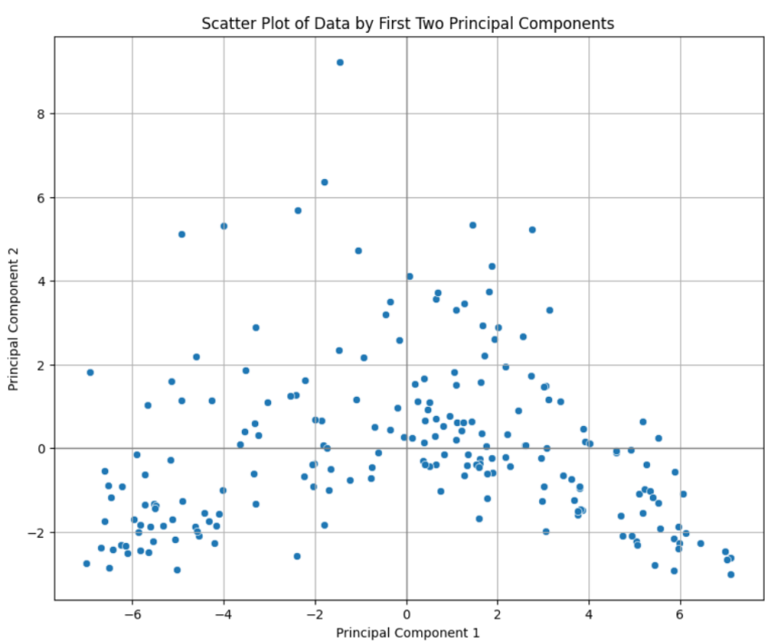
4. Results and Conclusion Internet Usage and Economic Growth in Digital Transformation Principal Component Analysis (PCA) Findings
Principal Component 1 (PC1): Represents the combined effect of internet connectivity on economic growth and environmental sustainability. Countries with higher values on this axis tend to have better internet infrastructure, which correlates with stronger economic performance and proactive environmental measures.
Principal Component 2 (PC2): Captures the quality of data systems and their role in achieving sustainable economic goals. Higher values on this axis indicate more robust data systems, which support the realization of economic objectives in a sustainable manner.
Fig. 4.17. Principal component analysis scatter plot of the correlation between country’s Internet usage and sustainable economic development

Slide 19
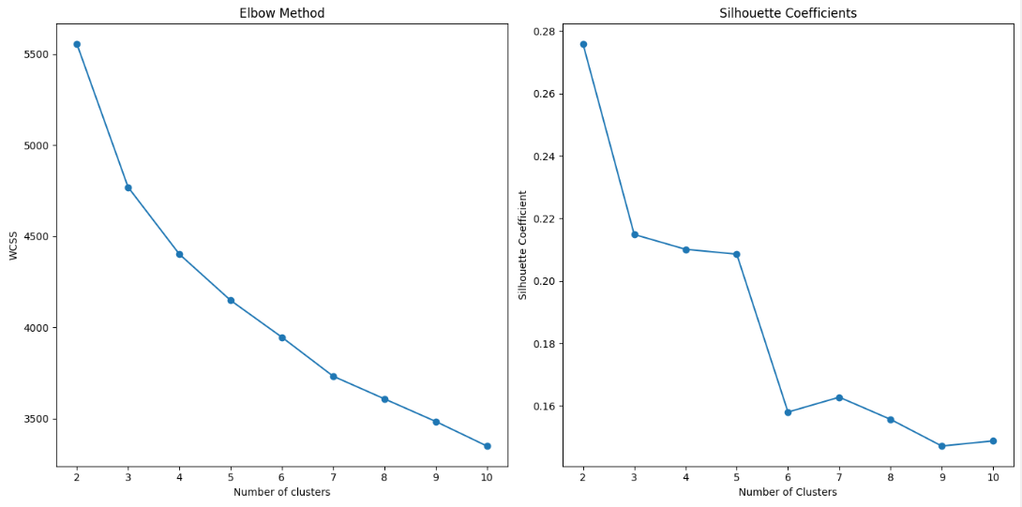
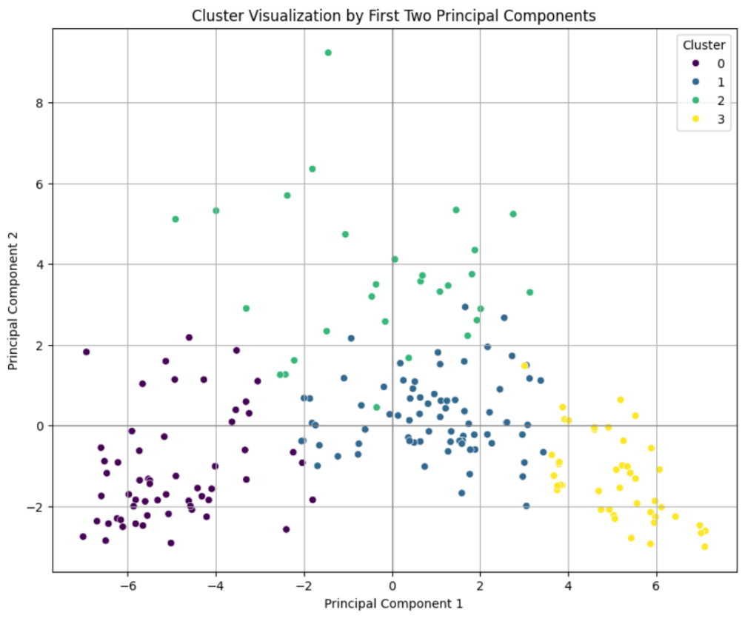
4. Results and Conclusion Internet Usage and Economic Growth in Digital Transformation Cluster analysis
Strong digital infrastructure and high internet connectivity are key drivers of economic growth and environmental sustainability
Each color represents a different cluster:
- Purple (Cluster 0): Lower performance in both economic growth and digital transformation.
- Blue (Cluster 1): Moderate performance with potential for growth in digital infrastructure.
- Green (Cluster 2): High performance in digital transformation, reflecting robust economic and environmental metrics.
- Yellow (Cluster 3): Emerging economies with developing digital infrastructure but significant strides in specific economic or environmental areas.
Fig. 4.18. National K-means cluster visualization based on the first two principal components

Slide 20
4.Results and Conclusion Food loss and food waste and wealth inequality
Table 4.3 OLS Regression Results
 | R-squared | F-statistic | probability | Log-Likelihood
Value | 0.009 | 32.72 | 1.15e-08 | -16504.
Data Sources: n_sdg2_wasting n_sdg10_gini
Method: Regression analysis
Conclusion: The impact of food loss and waste on wealth inequality is very weak, and there may be other unaccounted for factors that influence inequality in wealth distribution.
Table 4.4 OLS regression coefficient
 | Coefficient | Std. Err | t-value | P-value
Intercept | 62.9976 | 0.981 | 64.195 | 0.000
N_sdg2_wasting | 0.0762 | 0.013 | 5.720 | 0.000

Slide 21
4.Results and Conclusion Multinational profit shifting, performance index and unemployment rate
Table 4.5 SEM Path Coefficients
 | Lval | Rval
0 | Unemployment | Performance
1 | Unemployment | ProfitsTransfer
2 | Performance | ProfitsTransfer
Data Sources: n_sdg17_statperf Shifted profits of multinationals n_sdg8_unemp
Method: Structural equation modeling
Conclusion: Performance index decreases as unemployment rate increases. The impact of unemployment on profit shifting of multinational enterprises lacks statistical significance.
Table 4.6 The summary of estimates for the SEM
 | Estimate | Std. Err | Z-value | P-value
0 | -7.043351e+01 | 4.570986 | -15.408821 | 0.0
1 | 2.005531e+00 | 1.641417 | 1.221829 | 0.221772
2 | 2.847222e-02 | 0.023257 | 1.224217 | 0.22087

Slide 22
4.Results and Conclusion Impact of cereal yields on poverty
Table 4.9 Panel OLS Estimation Summary
R-squared | 0.0236 | Log-likelihood | -1.184e+04
R-squared (Between) | 0.1273 | F-statistic | 87.159
R-squared (Within) | 0.0236 | P-value | 0.0000
R-squared (Overal1) | 0.1223 | Distribution | F(1,3607)
Data Sources: n_sdg2_crlyld n_sdg_wpc
Method: Panel data model
Conclusion: The impact of cereal yields on poverty rates is statistically significant
Table 4.10 OLS regression coefficient
 | Coefficient | Std. Err | t-value | P-value
Intercept | 76.211 | 0.5683 | 134.11 | 0.000
N_sdg2_crlyld | 0.1229 | 0.0132 | 9.3359 | 0.000

Slide 23
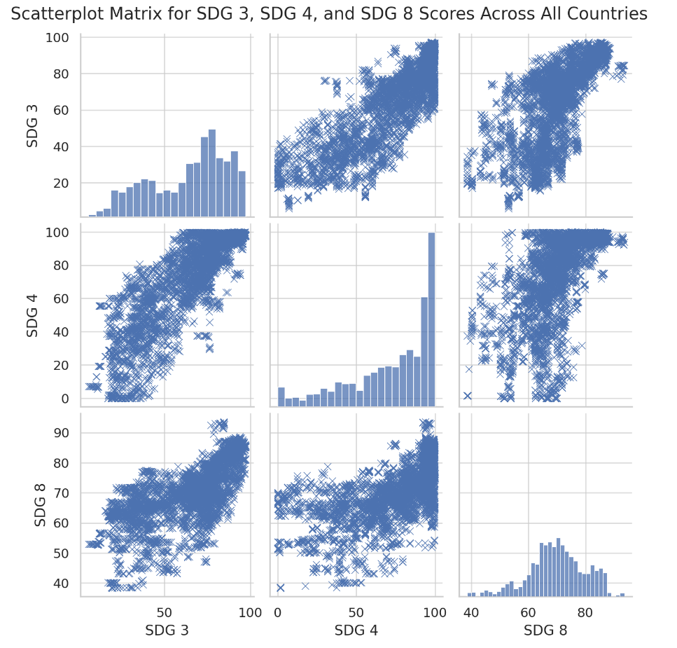
4.Results and Conclusion Economic Adjustment and Welfare Sustainability in an Aging Society
Multivariate Scatterplot Matrix
SDG3 and SDG4: Good healthcare correlates with high education standards; health investment boosts education and productivity.
SDG3 and SDG8: Healthy populations drive economic growth; good health policies are vital for sustainability; female employment boosts growth.
SDG4 and SDG8: Education enhances economic growth and job quality, especially important to align with socio-demographics in developing countries.
Fig. 4.19. Correlation Matrix of SDG 3 (Good Health and Well-being), SDG 4 (Quality Education), and SDG 8 (Decent Work and Economic Growth)

Slide 24
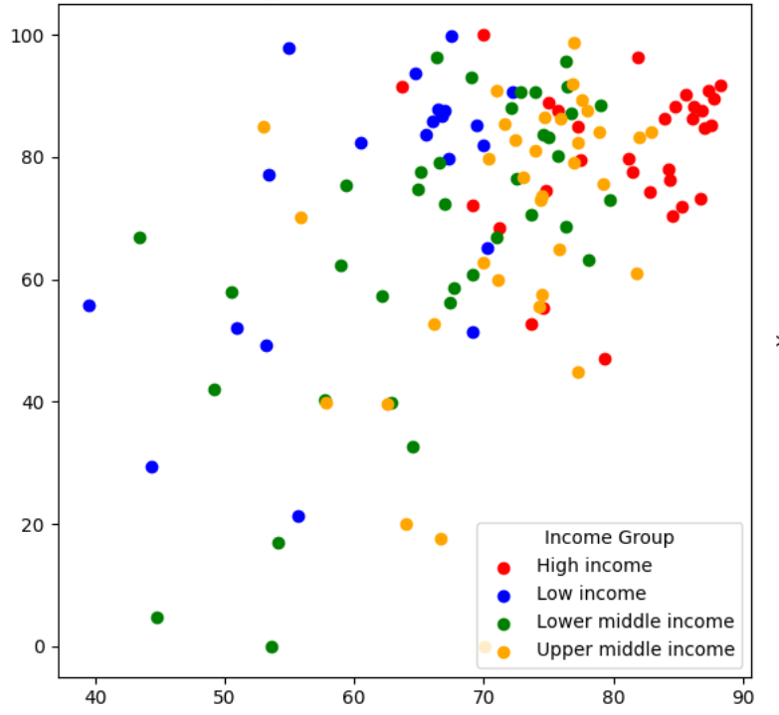
4.Results and Conclusion
Impact of employment rates on sustainable economic development
SDG8 Scores and Unemployment Rate
Income Group | SDG8_Score（in point） | Unemployment rate（in %）
Low income | 69.66 | 73.57
Lower middle income | 74.69 | 71.07
Upper middle income | 79.80 | 69.12
High income | 83.75 | 79.33
Forecast data and model selection: ARIMA model
High-income countries (red): high SDG8 scores, higher unemployment rates.
Upper middle-income countries (orange): high SDG8 scores and wide variation in unemployment rates.
Lower middle-income countries (green): medium SDG8 scores and unemployment rates, more evenly distributed.
Low-income countries (blue): lower SDG8 scores and higher unemployment rates.
Fig. 4.20. Scatter Plot of SDG8 Scores and Unemployment Rate by Income Group (2024-2028)

Slide 25
4.Results and Conclusion Impact of employment rates on sustainable economic development Adjusted GDP Growth and Unemployment Rate
IncomeGroup | Adjusted GDP growth (in %) | Unemployment rate（in %）
Low income | 40.06 | 73.57
Lower middle income | 53.51 | 71.07
Upper middle income | 64.5 | 69.12
High income | 71.95 | 79.33
Significant positive correlation
Regularity anomalies, possibly due to factors influenced by the development of smart technology

Slide 26
References (Main references)
Aleksandrova, A., Truntsevsky, Y., & Polutova, M. (2022). Digitalization and its impact on economic growth. Brazilian Journal of Political Economy, 42, 424-441.
Adrangi, B., & Kerr, L. (2022). Sustainable Development Indicators and Their Relationship to GDP: Evidence from Emerging Economies. Sustainability, 14(2), 658. https://doi.org/10.3390/su14020658
Flanagan, K., Robertson, K., & Hanson, C. (2019). Reducing food loss and waste. Setting the Global Action Agenda: Washington, DC, USA.
Maitra, B., & Mukhopadhyay, C. K. (2012). Public Spending on Education, Health Care and Economic Growth in Selected Countries of Asia and the Pacific. Asia-Pacific Development Journal, 19(2), 19–48.
Minh, Q. T., Duc, B. T., & Phat, N. H. (2022, October). Designing a Data Warehouse Framework for Business Intelligence. In 2022 International Conference on Data Analytics for Business and Industry (ICDABI) (pp. 498-502). IEEE.
Haas, M. (2017). GOING DIGITAL-Making the Transformation Work for Growth and Well-being.
Zhao, C., & Ren, J. (2017). Correlation analysis between sci-tech innovation and sustainable development in China: empirical study on entropy and grey relational model. Ecological Economy, 33(11), 58–62.

Slide 27
Thanks！

