Slide 1




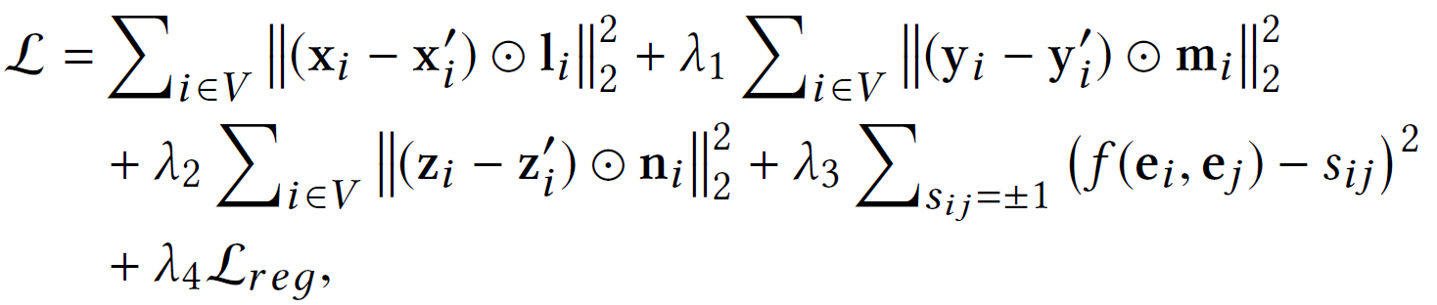
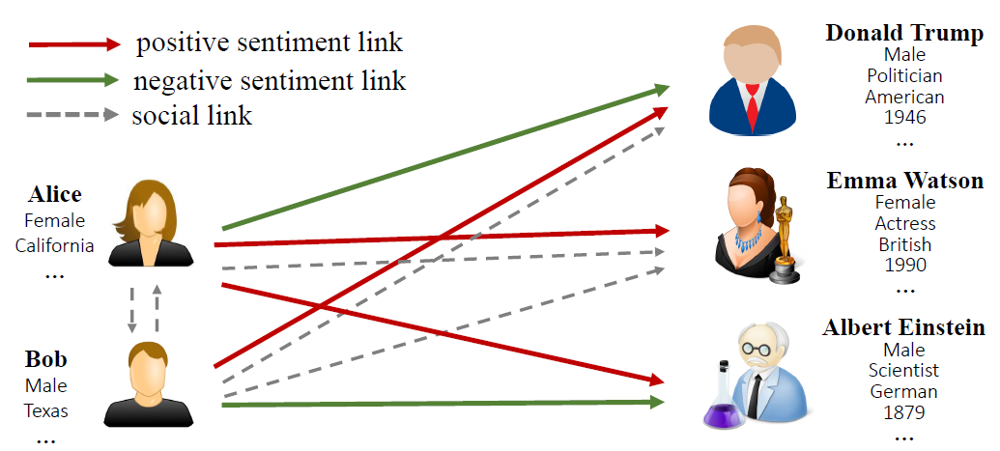
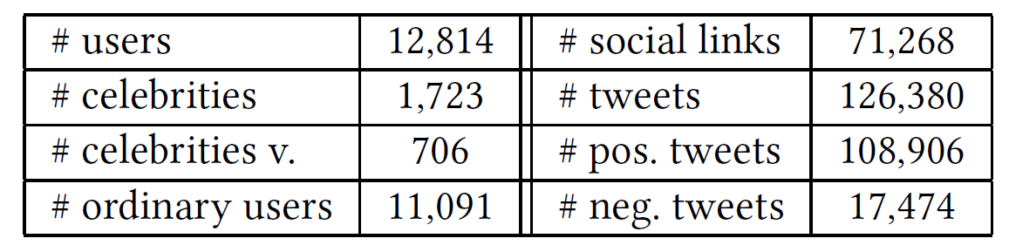
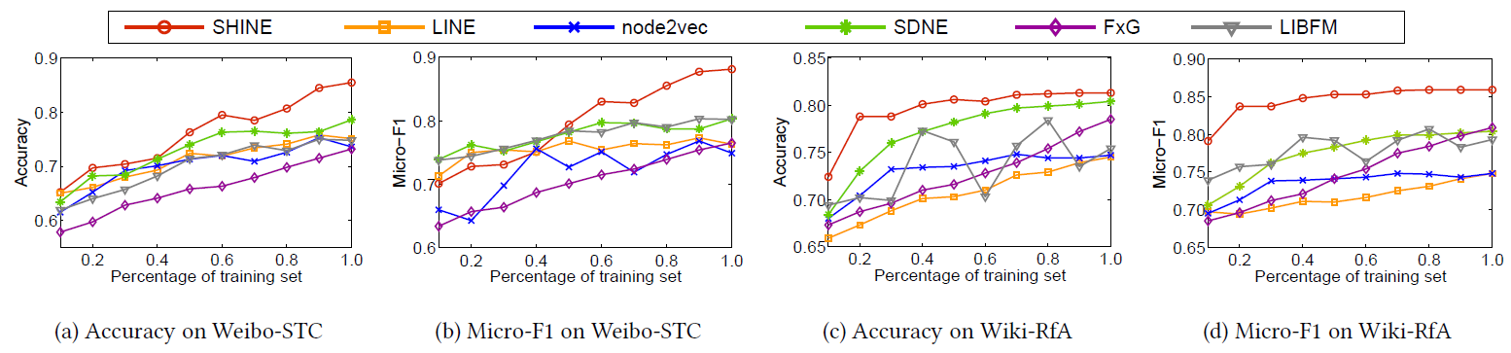
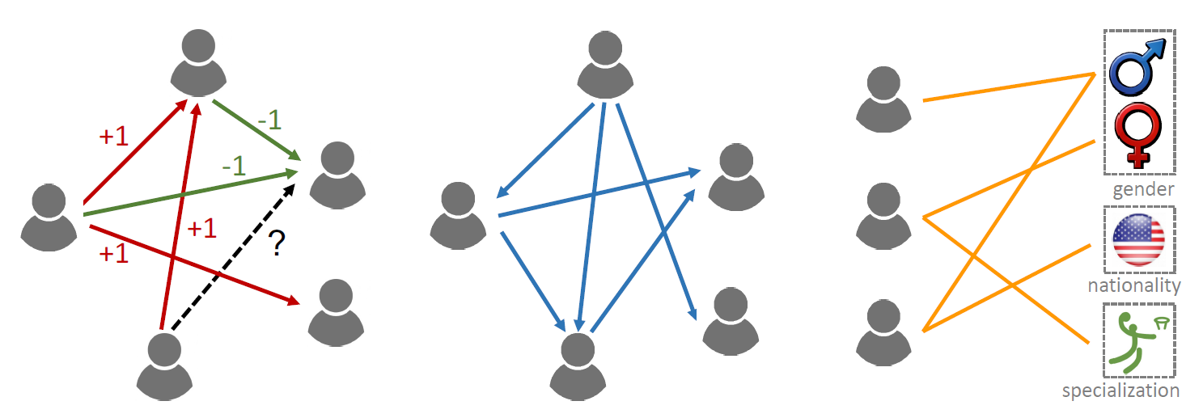
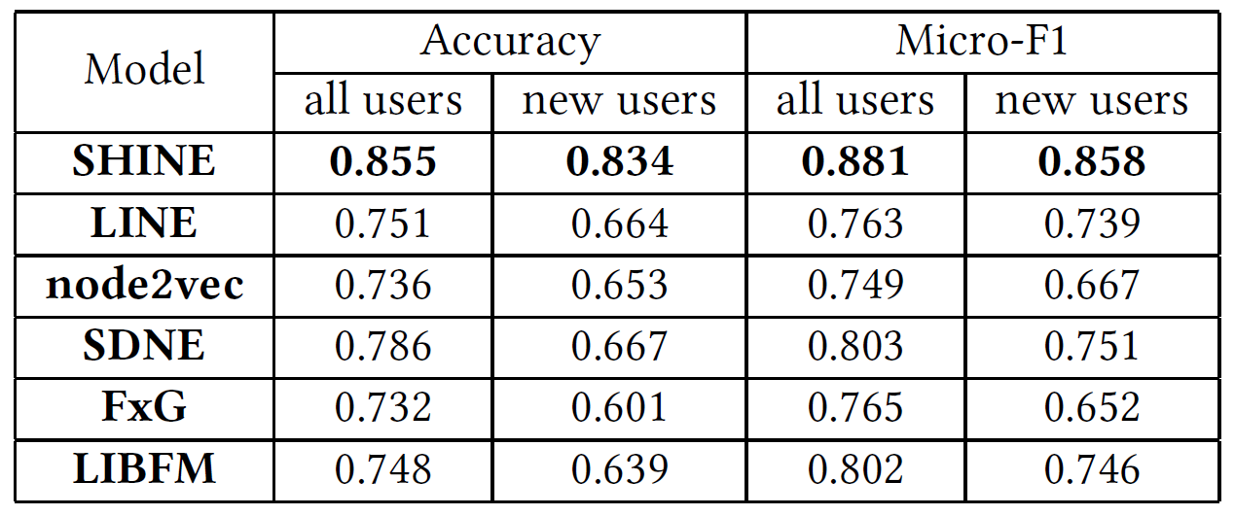
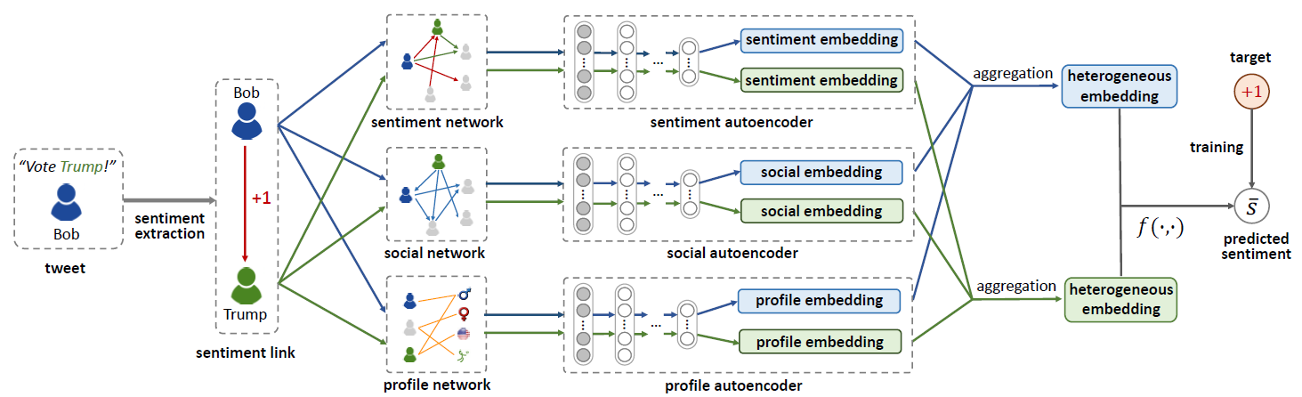
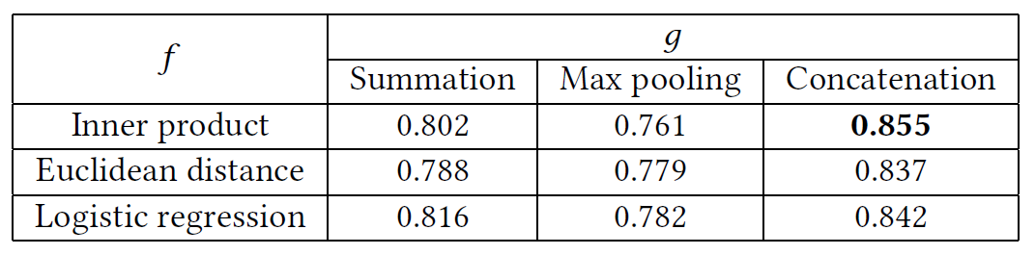
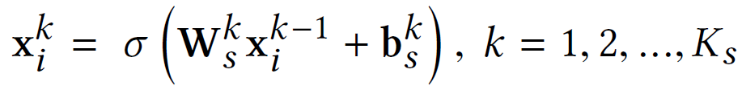
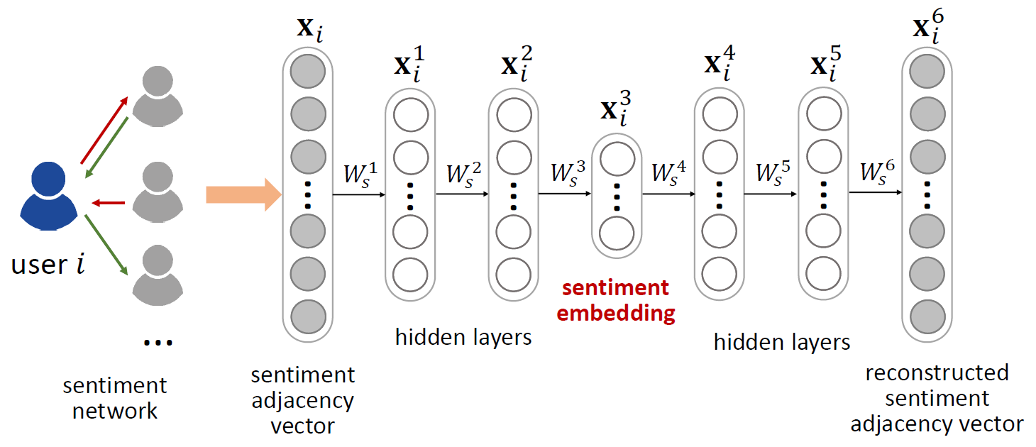
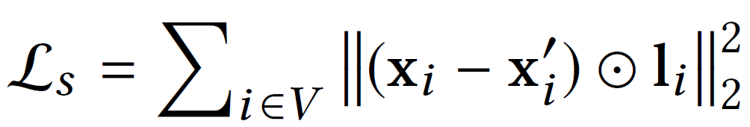
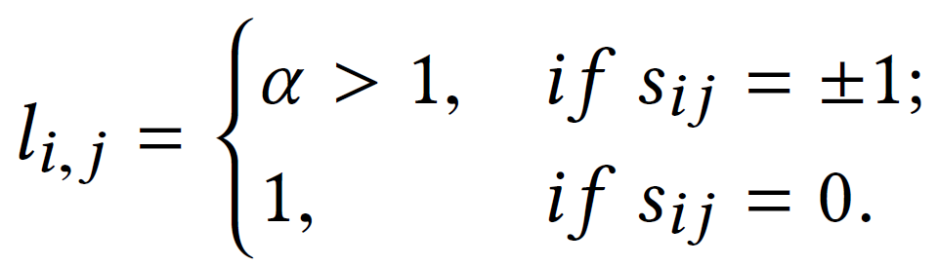

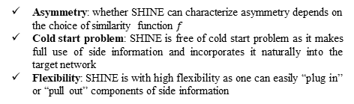
SHINE: Signed Heterogeneous Information Network Embedding for Sentiment Link Prediction
Hongwei Wang$1 2$, Fuzheng Zhang$2$, Min Hou$3 2$, Xing Xie$2$, Minyi Guo$1$, Qi Liu$3$
$$,$$
$$,$$
$1$Shanghai Jiao Tong University, $2$Microsoft Research Asia, $3$University of Science and Technology of China
Introduction
In online social networks people often express attitudes towards others, which forms massive sentiment links among users. In this paper we investigate how to predict possibly existing sentiment links in the presence of heterogeneous information.
First, we establish a labeled heterogeneous sentiment dataset which consists of users’ sentiment relation, social relation and profile knowledge by entity-level sentiment extraction method.
Then we propose a novel and flexible end-to-end Signed Heterogeneous Information Network Embedding (SHINE) framework to extract users’ latent representations and predict the sign of unobserved sentiment links. SHINE utilizes multiple deep auto-encoders to map each user into a low-dimension feature space while preserving the network structure.
We demonstrate the superiority of SHINE over state-of-the-art baselines on link prediction and node recommendation in two real-world datasets.
Loss function:
Discussion:
Asymmetry: whether SHINE can characterize asymmetry depends on the choice of similarity function $f$
Cold start problem: SHINE is free of cold start problem as it makes full use of side information and incorporates it naturally into the target network
Flexibility: SHINE is with high flexibility as one can easily “plug in” or “pull out” components of side information
Signed Heterogeneous Network
Heterogeneous networks with sentiment, social relationship and user profile:
Experiments
Statistics of Weibo sentiment datasets:
Accuracy and Micro-F1 on Weibo-STC and Wiki-RfA for link prediction:
Comparison of models in cold start scenario:
Accuracy on Weibo-STC w.r.t. the combinations of similarity function and aggregation function:
sentiment sub-network social sub-network profile sub-network
SHINE Framework
Overall framework:
A 6-layer auto-encoder for sentiment network embedding:
Conclusion
In this paper, we study the problem of predicting sentiment links in absence of sentiment related content in online social networks.
We first establish a labeled, heterogeneous, and entity-level sentiment dataset from Weibo due to the lack of explicit sentiment links.
We propose SHINE, a deep-learning-based network embedding framework to extract users’ highly nonlinear representations while preserving the structure of original networks.
Experimental results prove the competitiveness of SHINE against several strong baselines and demonstrate the effectiveness of usage of social relation and profile information, especially in cold start scenario.

