Slide 1



SHINE: Signed Heterogeneous Information Network Embedding for Sentiment Link Prediction
The 11th ACM International Conference on Web Search and Data Mining
Los Angeles, CA, 2018
Hongwei Wang^{1,2}, Fuzheng Zhang², Min Hou^{3,2}, Xing Xie², Minyi Guo¹, Qi Liu³
¹ Shanghai Jiao Tong University
² Microsoft Research Asia
³ University of Science and Technology of China
February 6, 2018

Slide 2
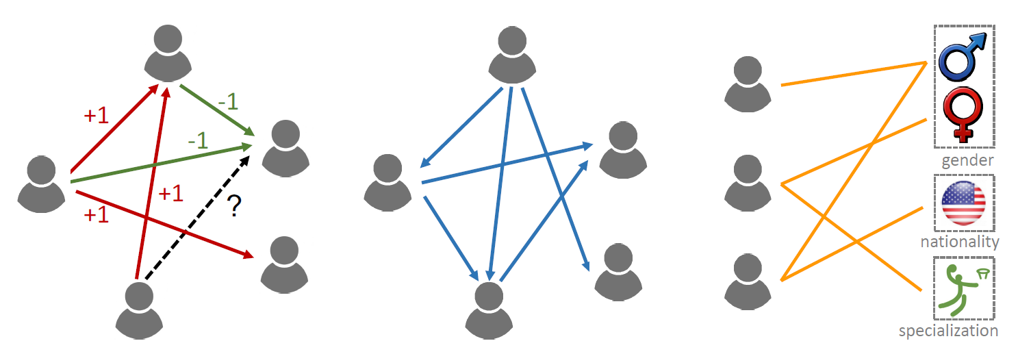
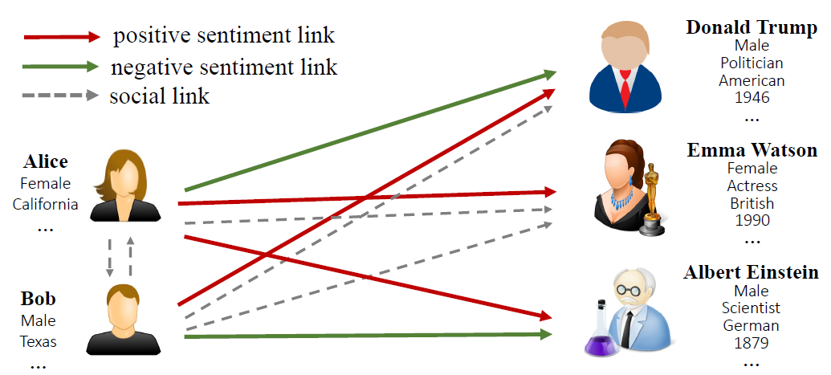
Signed Heterogeneous Network
People often express attitudes towards others in online social networks, forming massive sentiment links
Side information available:
Social network
Profile network
sentiment sub-network
social
sub-network
profile
sub-network

Slide 3
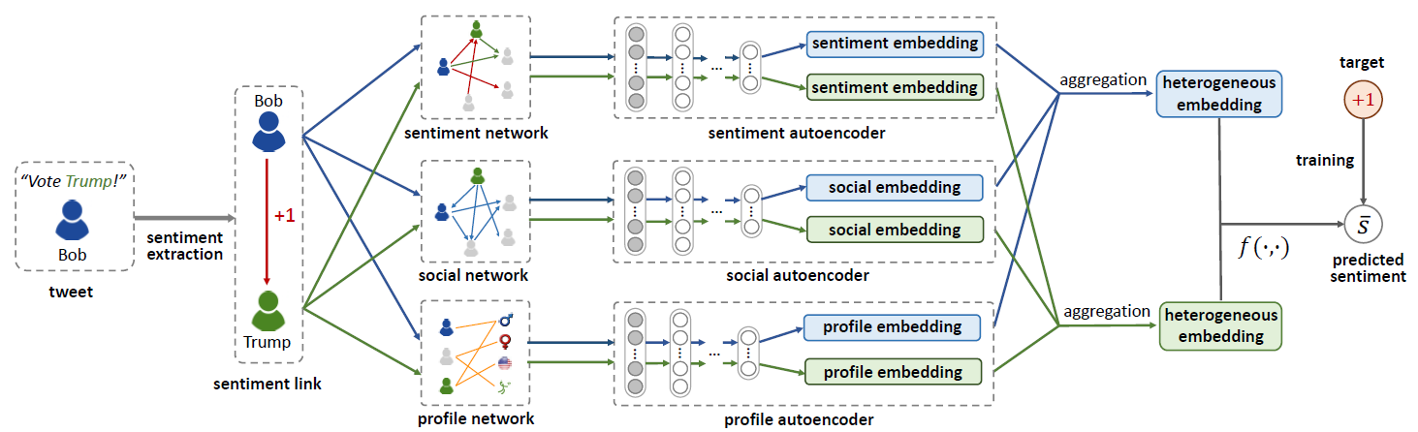
SHINE
We propose Signed Heterogeneous Information Network Embedding (SHINE) for predicting sentiment links among users
Sentiment extraction
Multiple deep auto-encoders
Aggregation function and similarity measurement function

Slide 4
Welcome to visit our poster!

