Slide 1
A Novelty-Seeking based Dining Recommender System
张富峥
微软亚洲研究院
https://www.microsoft.com/en-us/research/people/fuzzhang/
fuzzhang@microsoft.com

Slide 2
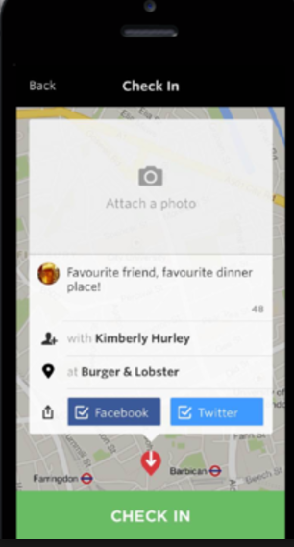
Problem Definition
?
user profiles
next dining time
historical check-ins
restaurant attributes
Where to dine next time?
Top-K restaurants recommendation

Slide 3
Possible Methods and limitations
Collaborative Filtering: user KNN, item KNN, various factorization methods….
Pros: designed for recommending new items, estimating user’s preference for these items by leveraging similar user’s taste
Cons: fail to capture repetitive pattern for familiar items
Regularity based methods: Markov based predictors, returning probability…
Pros: successfully model repetitive pattern
Cons: ignore new items in the model

Slide 4
Motivation
Collaborative Filtering is good at recommending new items, while regularity is good at recommending familiar items, why not combine them together!
The key point is to detect whether user is interested in new items!
Novelty seeking is a personality trait described as the search for unfamiliar experiences and feelings[1]
Use novelty-seeking to detect user’s intent for new items
Notes:
[1] Zuckerman, Marvin (2009). "Chapter 31. Sensation seeking". In Leary, Mark R. & Hoyle, Rick H. Handbook of Individual Differences in Social behavior

Slide 5
Novelty-Seeking Analysis
novelty-seeking status: an indicator to indicate whether this user would visit a new restaurant (s = 1) or a regular restaurant (s = 0) at a particular time

Slide 6
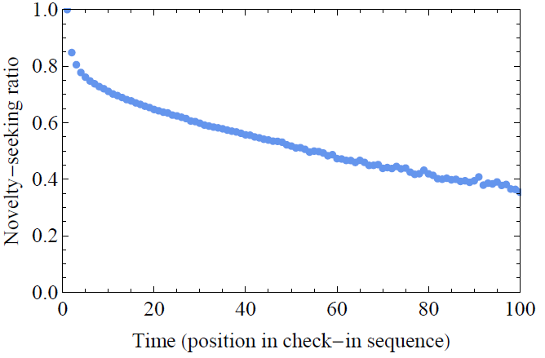
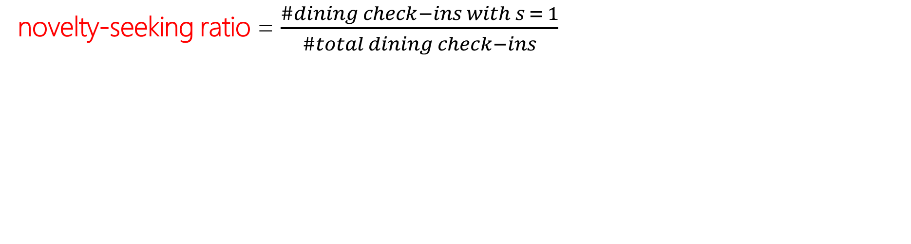
Novelty-Seeking Analysis
novelty-seeking ratio = $\frac{\#dining check−ins with s = 1}{\#total dining check−ins}$

Slide 7
Framework
Novelty seeking inference
Recommending new restaurant
Recommending regular restaurant
s = 1
s = 0
Novelty-Seeking based Dining Recommender System (NDRS)

Slide 8
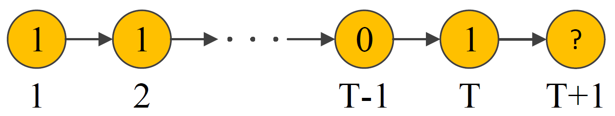
Novelty Seeking Inference
Problem description
Predict whether a user will visit new restaurants (novelty-seeking status s = 1) or patronize regular restaurants (novelty seeking status s = 0) in his next dining
Novelty-seeking status sequence

Slide 9

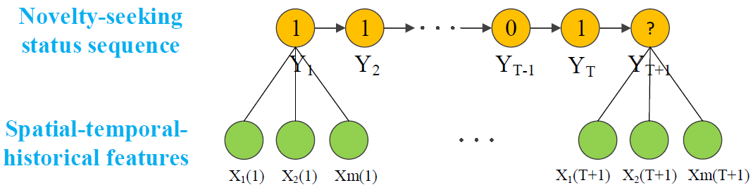
Novelty Seeking Inference
Modeling novelty-seeking behavior
Using CRF to model novelty-seeking behavior in a sequential labeling view

Slide 10
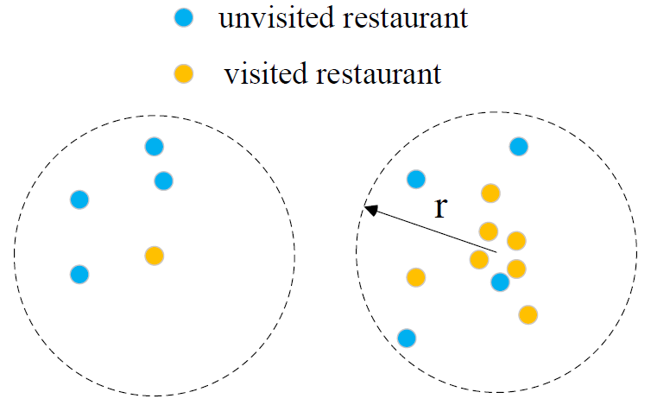
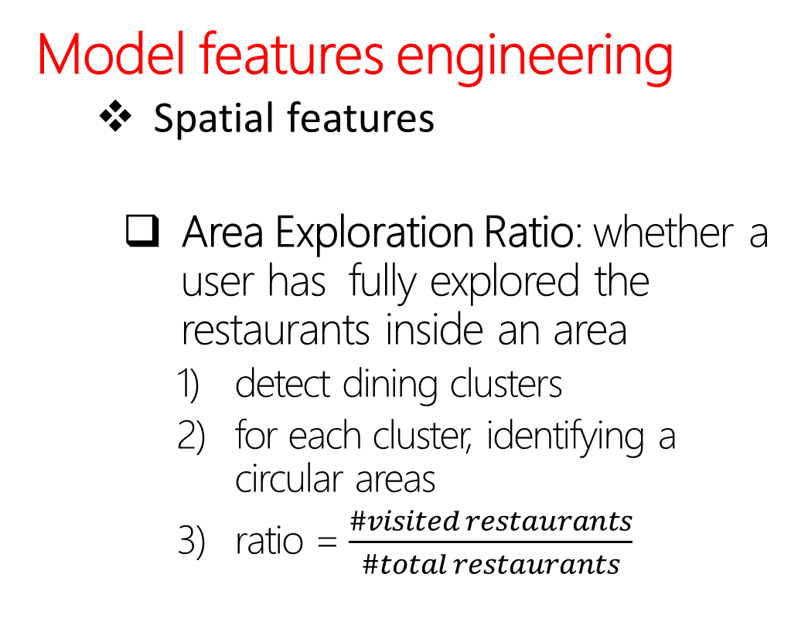
Novelty Seeking Inference
Model features engineering
Spatial features
Area Exploration Ratio: whether a user has fully explored the restaurants inside an area
detect dining clusters
for each cluster, identifying a circular areas
ratio = $\frac{\#visited restaurants}{\#total restaurants}$
Notes:
if a user prefers to explore as many restaurants as possible inside an area, it’s most probably that he is enthusiastic about novelty-seeking.

Slide 11
Novelty Seeking Inference
Model features engineering
Spatial features
Average Dining Distance: average distance of the visited restaurants
Dining Distance Variance: the variance of the distances between any two visited restaurants
Notes:
if them are both small, dining behavior is limited to a small area (e.g., nearby to home or office), the opportunity of exploring new restaurant will also be small

Slide 12
Novelty Seeking Inference
Model features engineering
Temporal features
Total Time Interval: the number of days between this dining check-in and this user’s first dining check-in
Last Time Interval: the number of hours between this check-in and the previous dining check-in
Hour of Week: se a value from {0,….,167} to represent the hour of the week

Slide 13
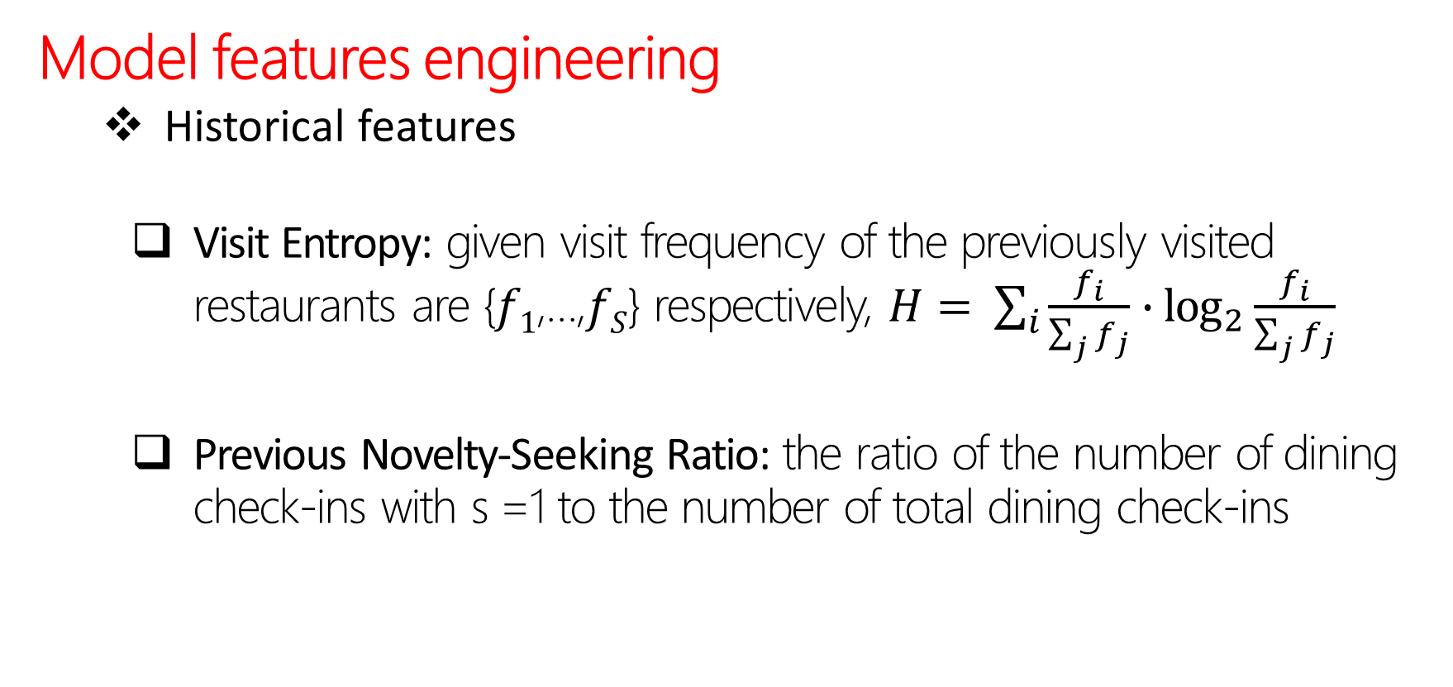
Novelty Seeking Inference
Model features engineering
Historical features
Visit Entropy: given visit frequency of the previously visited restaurants are {$f1$,…,$fS$} respectively, $H= \sum_{i}{\frac{f_{i}}{\sum_{j}{f_{j}}}∙\log_{2}{\frac{f_{i}}{\sum_{j}{f_{j}}}}}$
Previous Novelty-Seeking Ratio: the ratio of the number of dining check-ins with s =1 to the number of total dining check-ins
Notes:
Visit entropy can be regarded as a kind of reference for novelty-seeking tendency, since a smaller value of this quantity implies this user’s restaurant visit is more uniformly distributed on all the previously visited ones, and thus the probability of exploring new restaurant will be higher

Slide 14
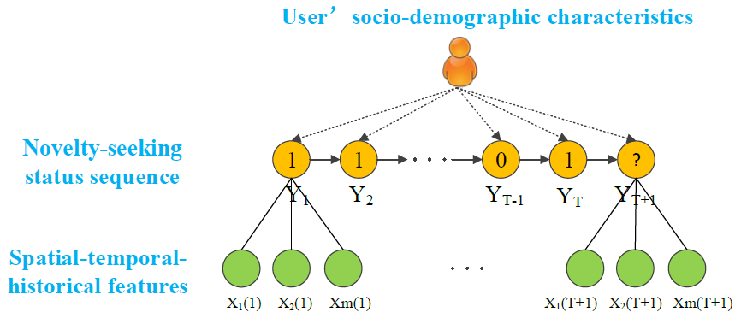
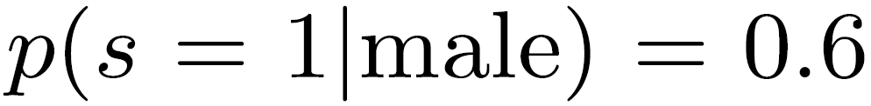
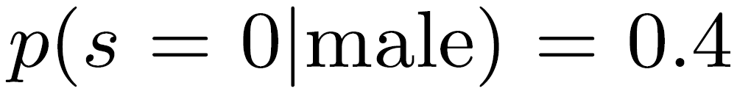
Novelty Seeking Inference
Constraints
Socio-demographic characteristics (age, gender, education status) will influence a user’s dining behavior as a whole, are more suited to be designed as a kind of priori knowledge.
target distribution : priori knowledge

Slide 15
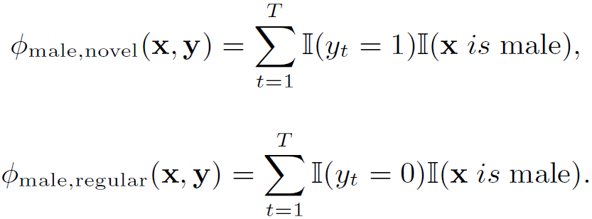
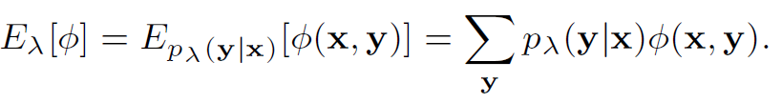
Novelty Seeking Inference
Constraints
Leveraging General Expectation Criterion to incorporate prior knowledge.
constraint feature function
model expectation over constraint feature function
final objective function
Notes:
the CRF’s conditional distribution p(y|x)
S is the score function expressing the distance (the square distance is applied in this article)
between the model expectation and the target distribution

Slide 16
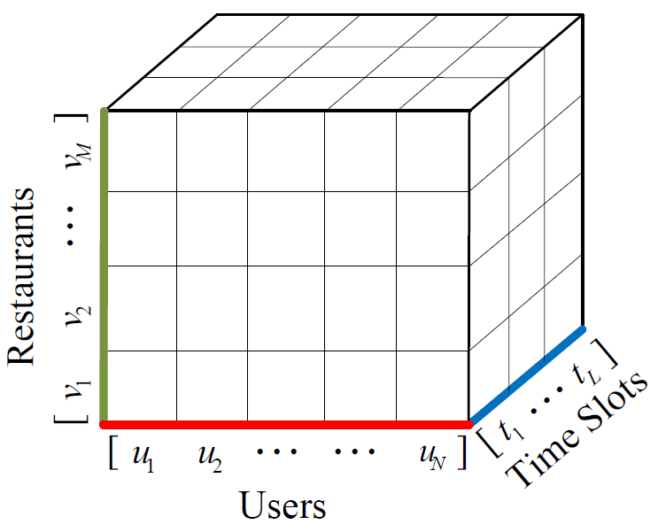
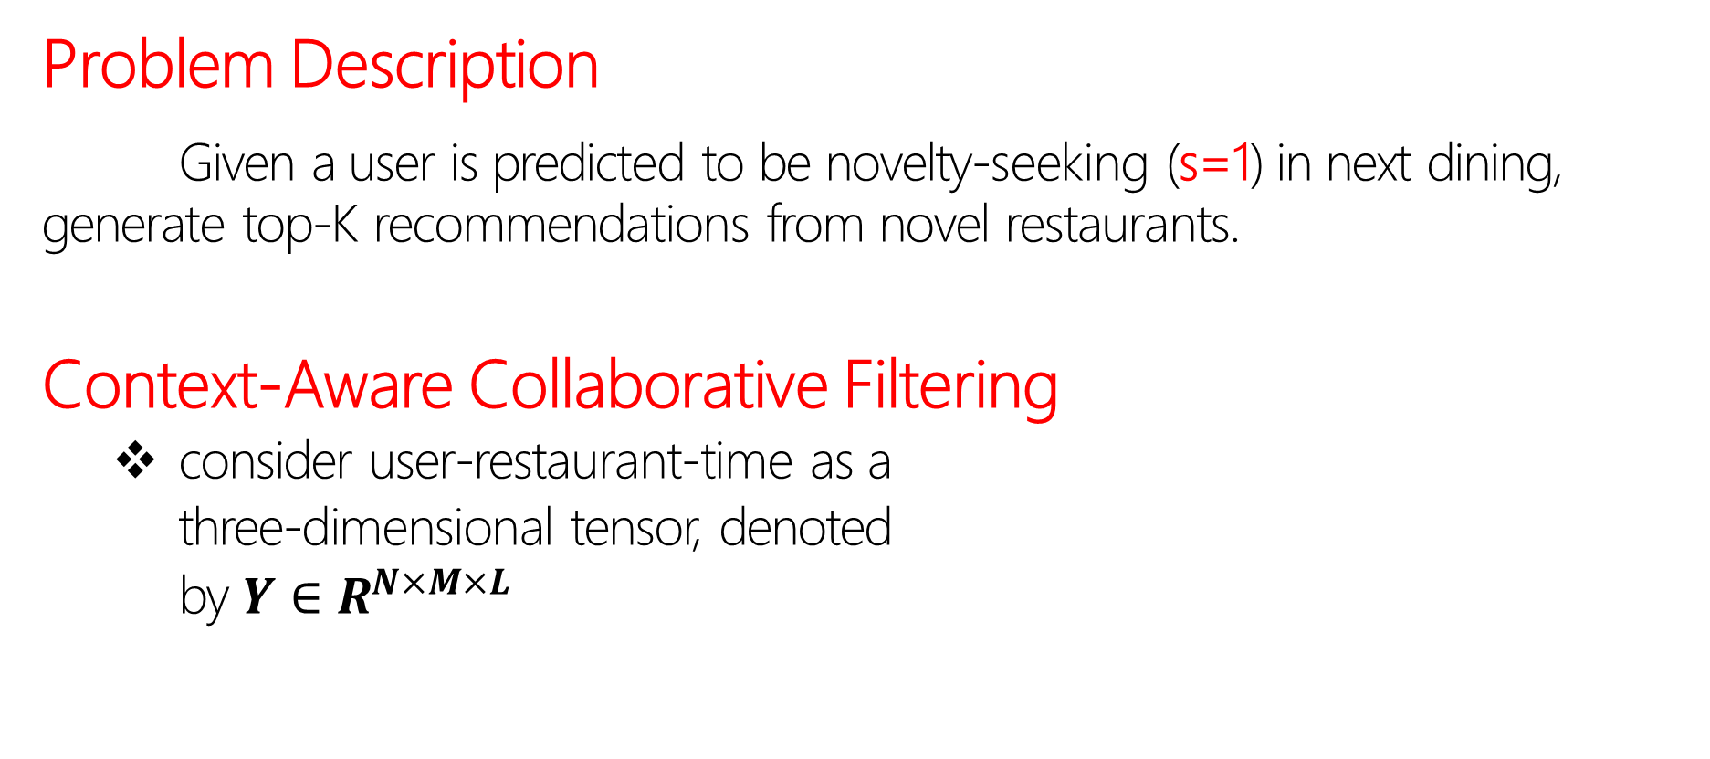
Recommending New Restaurants
Problem Description
Given a user is predicted to be novelty-seeking (s=1) in next dining, generate top-K recommendations from novel restaurants.
Context-Aware Collaborative Filtering
consider user-restaurant-time as a
three-dimensional tensor, denoted
by $Y∈R^{N×M×L}$

Slide 17

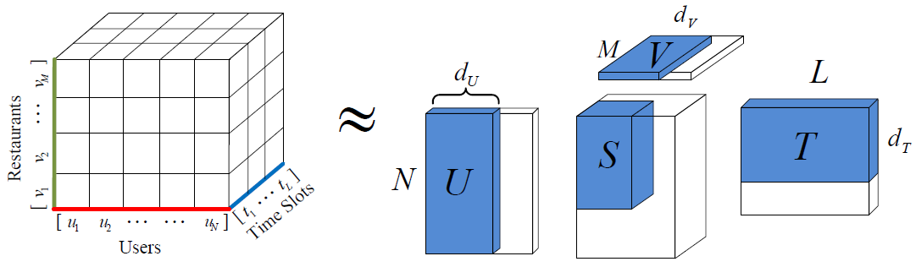
Recommending New Restaurants
Context-Aware Collaborative Filtering
High Order Singular Value Decomposition(HOSVD)

Slide 18
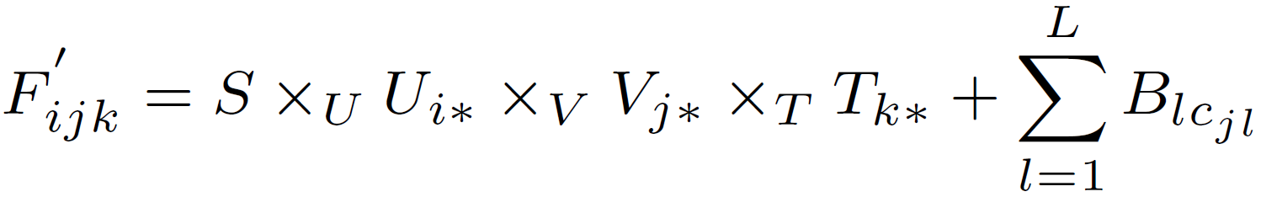
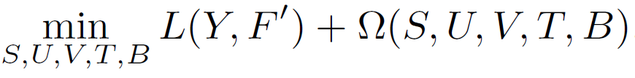
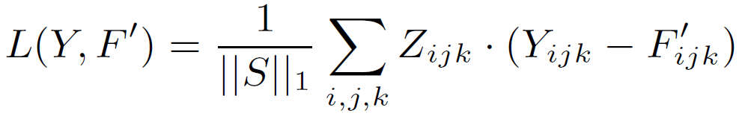

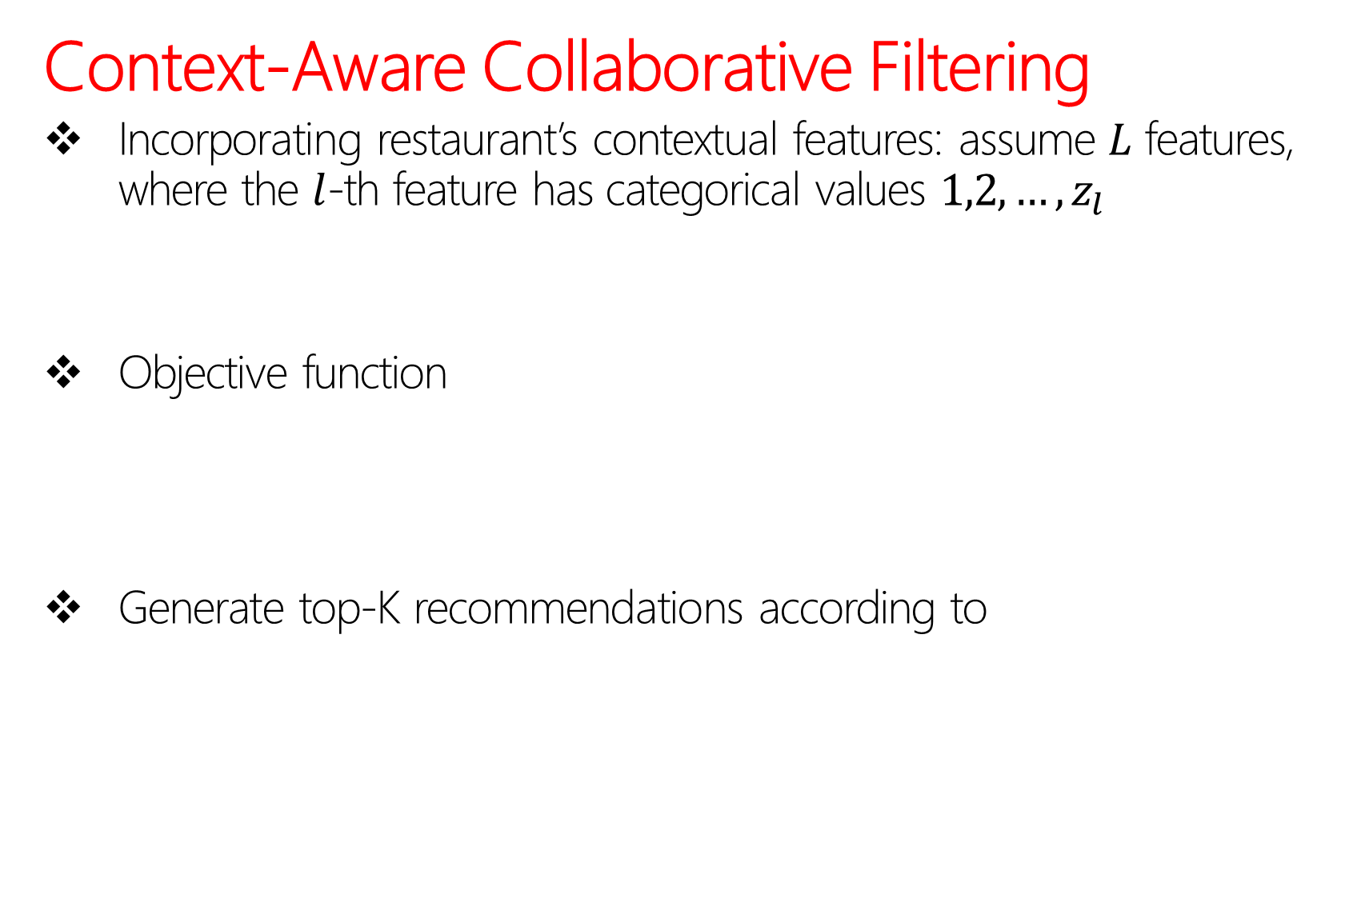
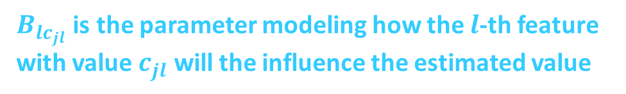
Recommending New Restaurants
Context-Aware Collaborative Filtering
Incorporating restaurant’s contextual features: assume $L$ features, where the $l$-th feature has categorical values $1,2,…,z_{l}$
Objective function
Generate top-K recommendations according to
$B_{lc_{jl}}$ is the parameter modeling how the $l$-th feature with value $c_{jl}$ will the influence the estimated value

Slide 19
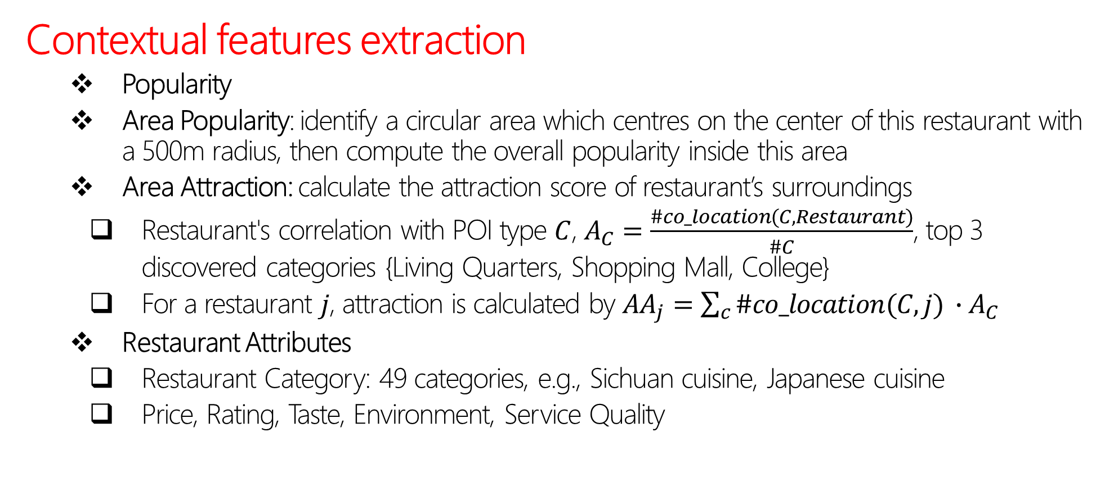
Recommending New Restaurants
Contextual features extraction
Popularity
Area Popularity: identify a circular area which centres on the center of this restaurant with a 500m radius, then compute the overall popularity inside this area
Area Attraction: calculate the attraction score of restaurant’s surroundings
Restaurant's correlation with POI type $C$, $A_{C}=\frac{\#co_location(C,Restaurant)}{\#C}$, top 3 discovered categories {Living Quarters, Shopping Mall, College}
For a restaurant $j$, attraction is calculated by $AA_{j}=\sum_{c}{\#co_location(C,j) ∙A_{C}}$
Restaurant Attributes
Restaurant Category: 49 categories, e.g., Sichuan cuisine, Japanese cuisine
Price, Rating, Taste, Environment, Service Quality
Notes:
A_C is regarded as weight, AA_j is the weight summation

Slide 20
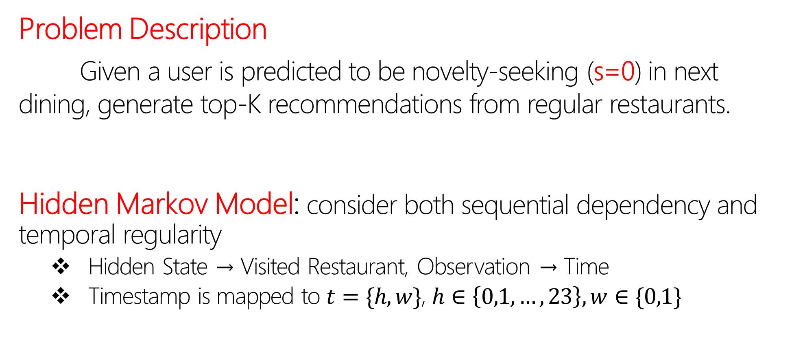
Recommending Regular Restaurants
Problem Description
Given a user is predicted to be novelty-seeking (s=0) in next dining, generate top-K recommendations from regular restaurants.
Hidden Markov Model: consider both sequential dependency and temporal regularity
Hidden State → Visited Restaurant, Observation → Time
Timestamp is mapped to $t=\{h,w\}$, $h∈\left\{0,1,…, 23\right\},w∈\{0,1\}$

Slide 21
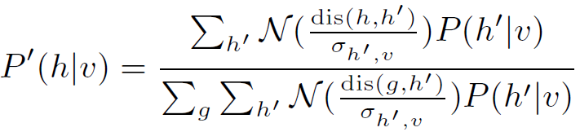

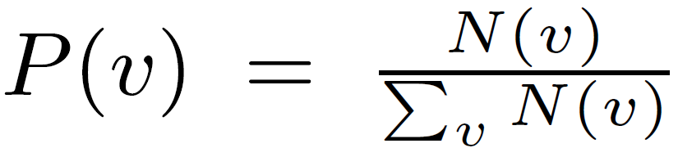
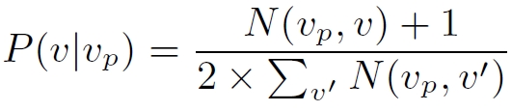



Recommending Regular Restaurants
Hidden Markov Model
Supervised learning
Emission probability
Initial hidden state probability
State transition probability
Generate top-K regular restaurants according to visit probability
$$Laplace smoothing$$
$$Gaussian Kernel smoothing$$
$$Laplace smoothing$$
Notes:
N(h; v) is the frequency of check-ins in restaurant v at hour h
ensure nearby hours have similar conditional probabilities, the emission probability for hour h is further transformed by a Gaussian kernel smoothing function
dis(h,h’)=min(|h-h’|,24-|h-h’|)
N(v) is the check-in frequency in restaurant v.
N(v_p; v) indicates the frequency of visiting restaurant v right after restaurant v_p.

Slide 22
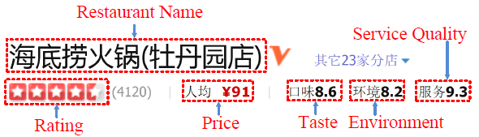
Experiments
Data Collection:
SinaWeibo Dataset
Check-ins
POIs: id, coordinates, category
User: gender, age, education
DianPing Dataset
Restaurant attributes: price, rating, taste…
Mapping Restaurant on SinaWeibo to that on DianPing
geographic filtering and title string match
explicitly observed 500 paired results, 91.5% of the pairs are correctly matched

Slide 23
Experiments
Data Filtering:
Filter the noisy data: repeated check-ins at the same place in a short interval (1hr)
Dining check-in filtering
keep dining check-ins locating in the city a user resides
remove users with less than 10 dining check-ins
for a city, if #user < 5000 or #restaurant < 1000, remove
Notes:
note that we represent the city she resides is the place where most of her check-ins locate
For example, if a user resides in Beijing, it is actually difficult and meaningless to recommend restaurants in Shanghai if she does not visit Shanghai frequently

Slide 24
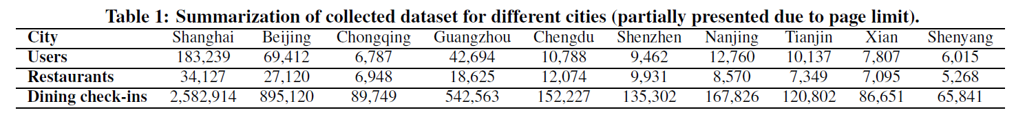
Experiments
Data Description:
361,218 unique users
167,451 unique restaurants
21 cities all over China
4,941,060 dining check-ins
$$for each user, previous 90\% dining check−ins for training, others for testing$$

Slide 25
Experiments
Novelty-Seeking Inference:
Construct target distribution according to empirical distribution in training data
Compare our method (CRF(M)+C) with four baselines:
LR: uses model features and constraint features for the Logistic Regression
CRF+C: the same with CRF(M)+C, except not model features
CRF(M): the same with CRF(M)+C, except not constraints
NSTM: Novelty-Seeking Trait Model, a sequential model considering novelty-seeking and preference
Notes:
For example, if 60% of the dining check-ins generated by the male is novel and 40% is regular, the target distribution for constraint feature “male” is p(s = 1|male) = 0.6; p(s = 0|male) = 0.4

Slide 26
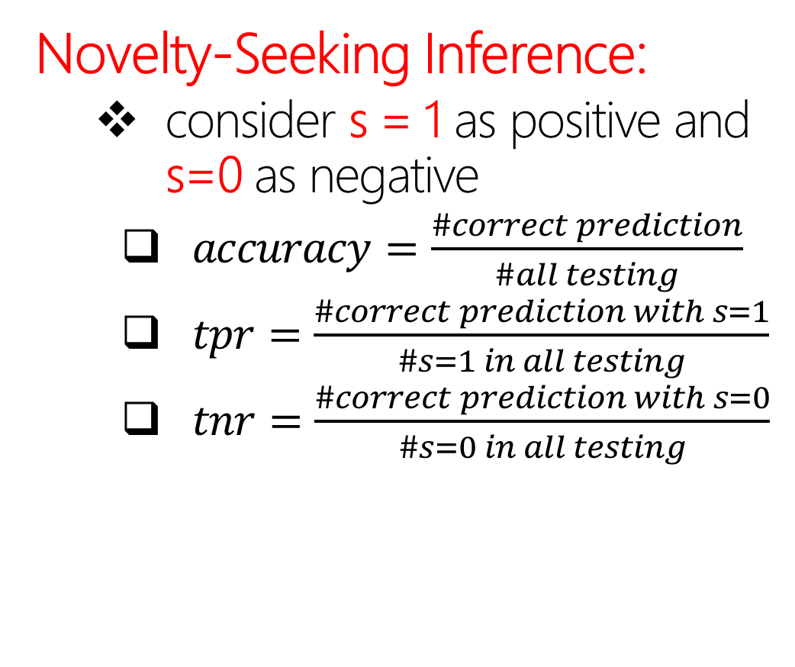
Experiments
Novelty-Seeking Inference:
consider s = 1 as positive and s=0 as negative
$accuracy=\frac{\#correct prediction}{\#all testing}$
$tpr=\frac{\#correct prediction with s=1}{\#s=1 in all testing}$
$tnr=\frac{\#correct prediction with s=0}{\#s=0 in all testing}$
Notes:
tpr: true positive rate
tnr: true negative rate
$$since recommending regular restaurants is more easy, fnr is more important!$$

Slide 27
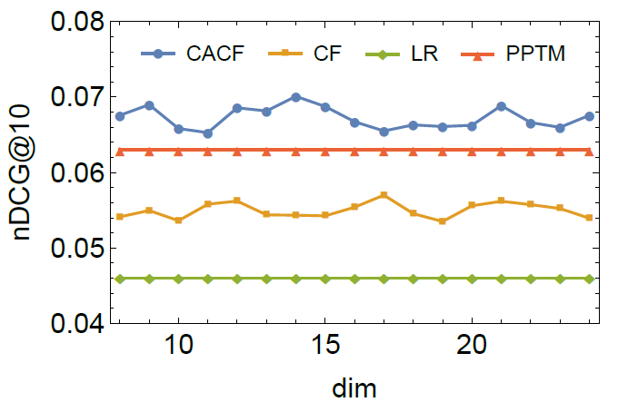
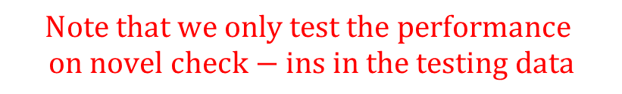
Experiments
Recommending new Restaurants:
Compare our method (CACF) with three baselines:
CF: the same with CACF, except not contextual features
LR: use a Logistic Regression with all contextual features
PPTM: Personal Popularity Tendency Matching, gives an effective novel item recommendation by reasonably penalizing popular items[1]
$$Note that we only test the performance$$
$$on novel check−ins in the testing data$$
Notes:
The table shows that CACF outperformed the baselines in various situations. Compared CACF
with CF, it shows that incorporating contextual features is effective for the recommendation. Compared CF with LR, it also implies that tensor factorization is more suitable for novel restaurant recommendation.
[1]Oh J, Park S, Yu H, et al. Novel recommendation based on personal popularity tendency[C]//Data Mining (ICDM), 2011 IEEE 11th International Conference on. IEEE, 2011: 507-516.

Slide 28
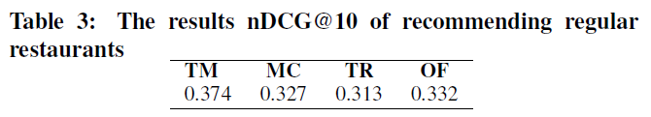

Experiments
Recommending Regular Restaurants:
Compare our temporal based HMM method (TM) with three baselines:
MC: only use transition probability in TM
TR: only use emission probability in TM
OF: give recommendation according to visit frequency
$$Note that we only test the performance$$
$$on regular check−ins in the testing data$$
Notes:
The table shows that CACF outperformed the baselines in various situations. Compared CACF
with CF, it shows that incorporating contextual features is effective for the recommendation. Compared CF with LR, it also implies that tensor factorization is more suitable for novel restaurant recommendation.

Slide 29
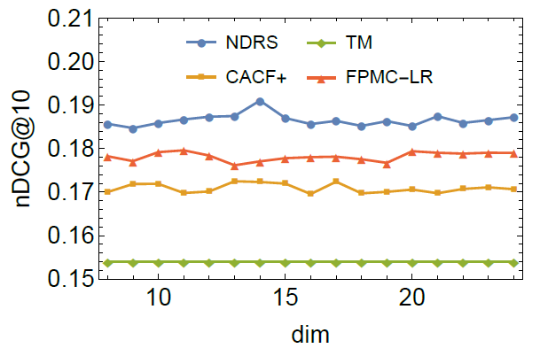
Experiments
Overall Restaurant Recommendation:
Compare our method (NDRS) with three baselines:
CACF+: the same CACF, except candidates including regular restaurants, does not emphasize regularity
TM: only recommend regular restaurants
FPMC-LR[1]: embeds user preference, personalized Markov-chains and localized region constraints
Notes:
The table shows that CACF outperformed the baselines in various situations. Compared CACF
with CF, it shows that incorporating contextual features is effective for the recommendation. Compared CF with LR, it also implies that tensor factorization is more suitable for novel restaurant recommendation
[1]. Cheng C, Yang H, Lyu M R, et al. Where you like to go next: Successive point-of-interest recommendation[C]//Proceedings of the Twenty-Third international joint conference on Artificial Intelligence. AAAI Press, 2013: 2605-2611.

Slide 30
Discussion
Limitation:
Novelty-seeking status is a binary value, smoothing recommendation strategy by considering probability
Spatial preference in dining behavior are not considered in recommending new/regular restaurants
Generalization:
General POI recommendation scenario
General item recommendation in E-commerce platform, considering whether buying new items

Slide 31

Notes:
So this is our work, any questions?

