Slide 1
zhgeeks meetup
15-May-2012
Elastic load balancing and auto-scaling
https://github.com/zhgeeks/presentations/
Muharem Hrnjadovic <mh@star.io>
@al_maisan

Slide 2
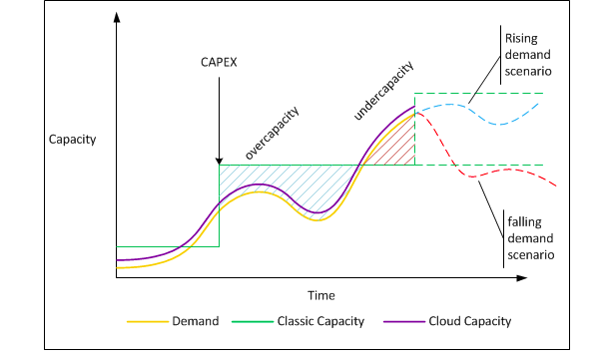
Motivation
http://www.chades.net/wp-content/uploads/2010/05/capacity-vs-demand.png

Slide 3
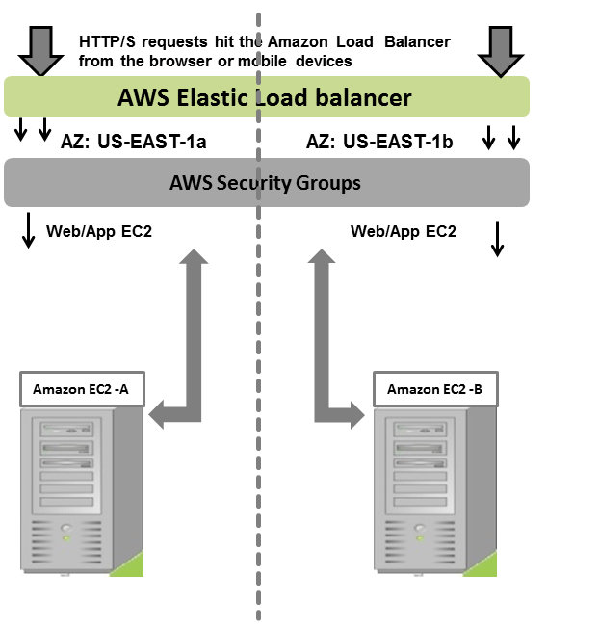
Agenda
http://harish11g.blogspot.com/2012/02/elastic-load-balancing-aws-deployment.html

Slide 4
Questions
How do I make sure my
  system scales (up|down)?
    at given times (predictable traffic)
    with more|less load (elastic behaviour)
  ec2 instance fleet stays healthy?

Slide 5
Ingredients
CloudWatch
  “monitor, manage, and publish various metrics, as well as configure alarm actions based on data from metrics”
Auto-scaling
  “launch or terminate EC2 instances automatically based on user-defined policies, schedules, and health checks”
Elastic Compute Cloud (EC2)
  “provides resizeable computing capacity, use and pay for only the capacity that you need”

Slide 6
CloudWatch
Available metrics vary per EC2, EBS, ELB etc.
EC2 instances
  CPUUtilization
  Disk reads/writes
  Network in/out
ELB
  Latency
  Request count
  Healthy/unhealthy host count

Slide 7
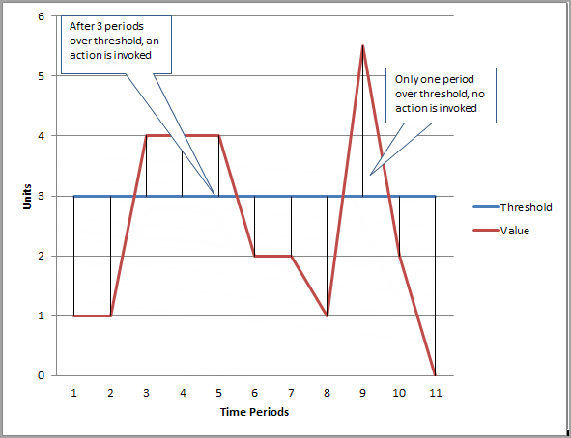
Alarms
States: OK, ALARM, INSUFFICIENT_DATA
http://docs.amazonwebservices.com/AmazonCloudWatch/latest/DeveloperGuide/images/AlarmsGraph.png

Slide 8
References
Auto Scaling Documentation
Amazon CloudWatch Documentation
Amazon EC2 Documentation
Elastic Compute Cloud
Elastic Compute Cloud

