Slide 1
3D Graphics Rendering
Using three.js as example
Notes:
Fps
The difference between 3D&2D

Slide 2
Render PipeLine
1
Design and organize

Slide 3
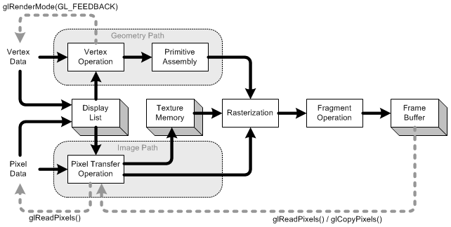
Render Pipeline

Slide 4
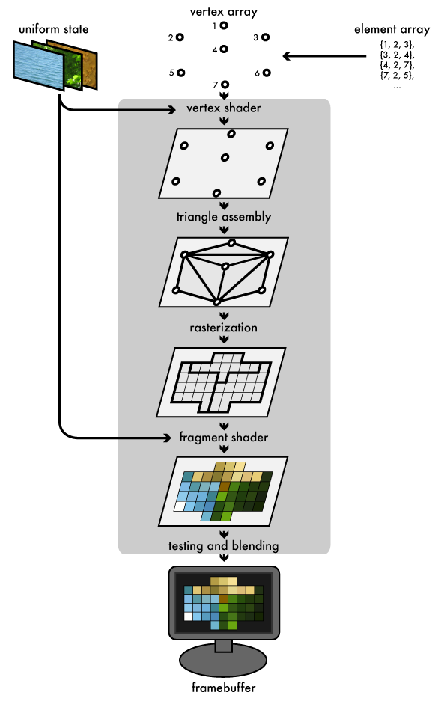
Graphics Pipeline

Slide 5
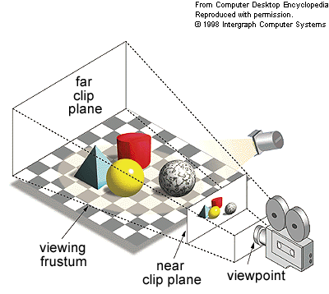
Camera
Notes:
Perspective projection and ontology projection

Slide 6
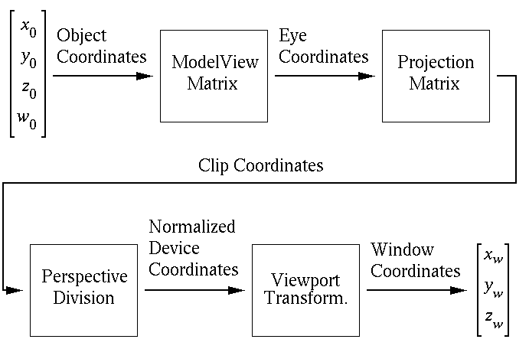
Transform

Slide 7
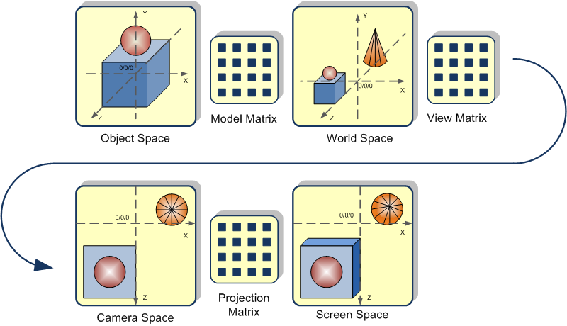
Transform

Slide 8
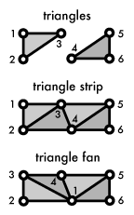

Vertex & Fragment
Vertex
Fragment

Slide 9

Geometry & Modeling
2
misc

Slide 10
Triangle Mesh
Postion
Indices
Normals
Texture Coordinates
Color

Slide 11
Modeling
Mesh based http://threejs.org/examples/#webgl_geometry_large_mesh http://threejs.org/examples/#webgl_loader_collada
Parameter based http://threejs.org/examples/#webgl_geometries

Slide 12
Light & Material
2
fragment

Slide 13
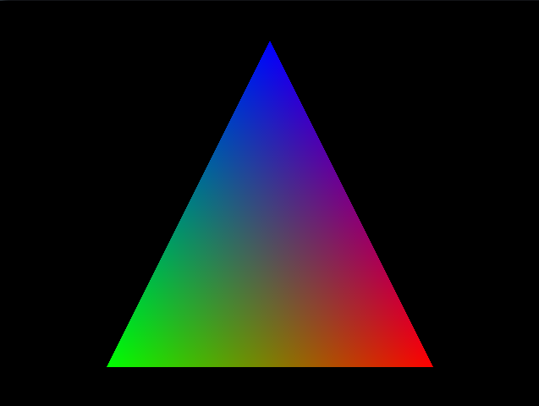
Simple Color
Notes:
Specify color for each vertex, and graphics will interpolate for you. This has nothing do with light

Slide 14
Lights (ADS model)
Ambient
Diffuse
Emissive
Specular

Slide 15






Simple Lighting Model
Ambient
Diffuse
Specular
Emmisive
Ambient With Diffuse
Ambient
Notes:
http://stemkoski.github.io/Three.js/Color-Explorer.html

Slide 16
Light model
L
N
R
θ θ
φ
V
p

Slide 17
Ambient
Imagine light which comes from no particular location because it has bounced off the surface of objects often – you can also say it comes from everywhere
A = L_{A} * C_{A}

Slide 18
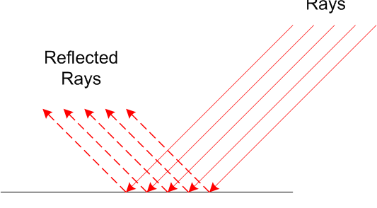
Diffuse
Imagine a light source which is at a unlimited (or really far away) location like our real sun is. Each light ray is (nearly) parallel when a object is hit:

Slide 19

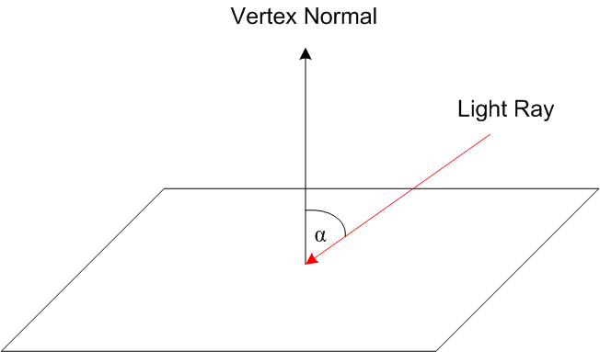
Diffuse

Slide 20
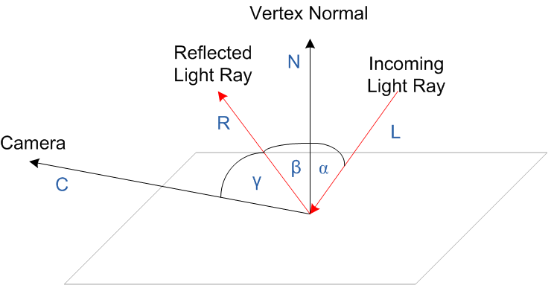
Specular
Notes:
http://threejs.org/examples/#webgl_lights_pointlights2

Slide 21
Three kinds of light
Point Light
Direction Light
Spot Light

Slide 22
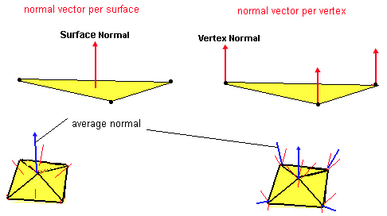
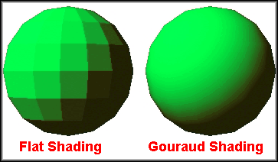
Per face normal vs Per vertex normal
Notes:
The main problem with assigning a normal per face is that the terrain looks faceted, i.e. the brightness of each face is constant, and there is a clear difference between faces with differen orientations. In order to get a smoother look normals should be computed per vertex, and not per face.

Slide 23

Texture
Texture Type
Diffuse (or Surface)
Bumpmap
Enviroment

Slide 24
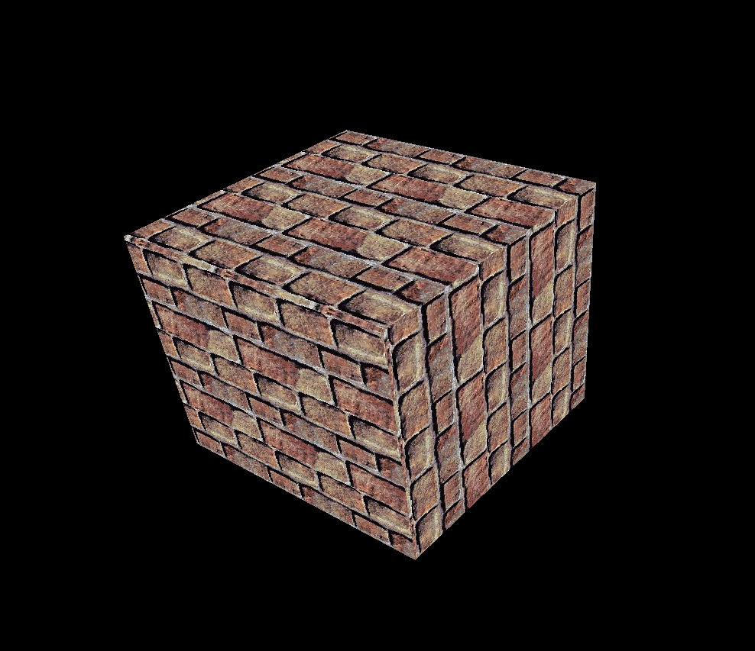
Surface Texture
Notes:
http://threejs.org/examples/#webgl_materials_texture_compressed

Slide 25
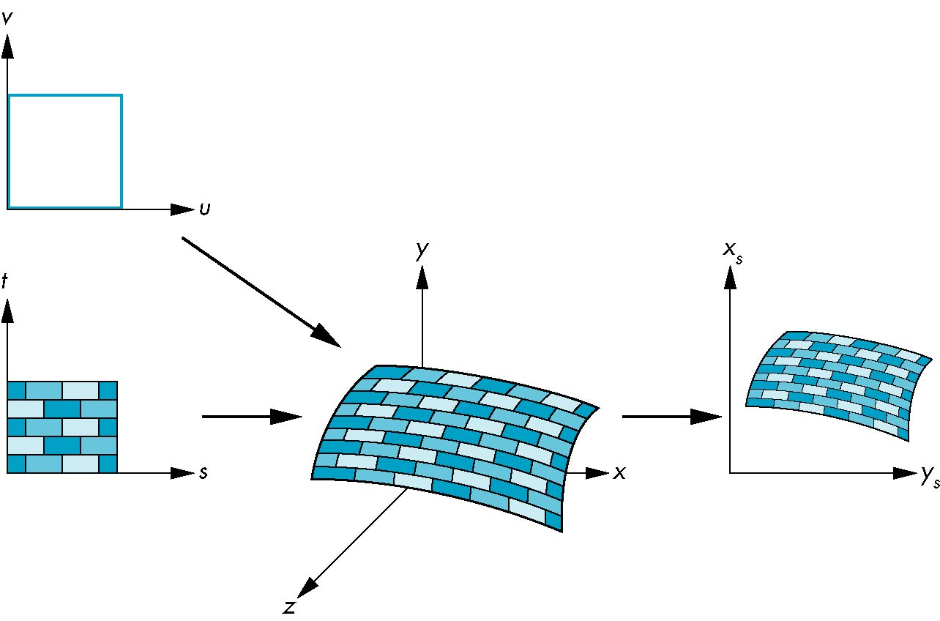
Texture Mapping
Texture Mapping
parametric coordinates
texture coordinates
window coordinates
world coordinates

Slide 26
Texture Parameters
Wrap Mode
Filtering
Mipmap
Notes:
Wrap mode is mostly for repeat

Slide 27
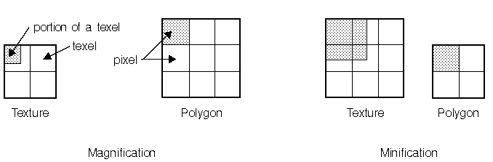
filtering

Slide 28
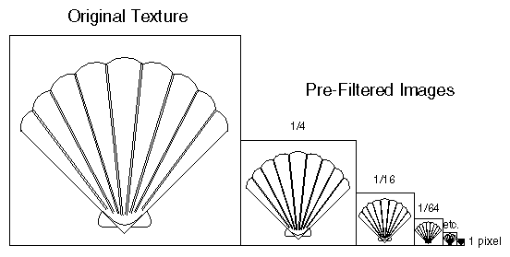
Mipmap

Slide 29



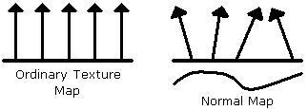
Bumpmap
Phiysical Normal is different from shader normal
+
=
Notes:
Shader normal is used for light effect
Bummap is also called per pixel lighting

Slide 30

Environment
Notes:
http://stemkoski.github.io/Three.js/Bubble.html

Slide 31
Shader
4
misc

Slide 32
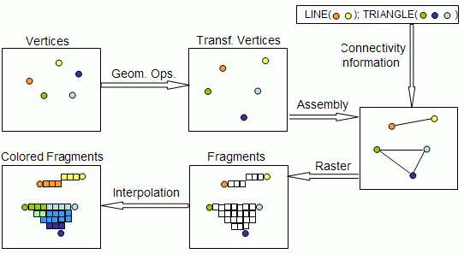
shader
Vertex shaders may be written for the Vertex Transformation stage.
Fragment shaders replace the Fragment Texturing and Coloring stage’s fixed functionality.

Slide 33
Vertex shader
Do operation on vertex:
Vertex position transformation using the modelview and projection matrices
Normal transformation, and if required its normalization
Texture coordinate generation and transformation
Lighting per vertex or computing values for lighting per pixel
Color computation

Slide 34
Fragment shader
Do operation on pixel:
Computing colors, and texture coordinates per pixel
Texture application
Fog computation
Computing normals if you want lighting per pixel

Slide 35
Example
http://threejs.org/examples/webgl_custom_attributes.html

Slide 36
Examples
http://madebyevan.com/webgl-water/
http://lights.elliegoulding.com/
http://alteredqualia.com/three/examples/webgl_terrain_dynamic.html
https://www.shadertoy.com/
http://www.bongiovi.tw/experiments/webgl/blossom/
http://workshop.chromeexperiments.com/projects/armsglobe/
http://threejs.org/examples/

Slide 37
Reference
http://www.udacity.com/overview/Course/cs291/
http://threejs.org/
http://www.alpcentauri.info/lighting_basics.html
http://www.learnopengles.com/android-lesson-six-an-introduction-to-texture-filtering/
http://cse.csusb.edu/tong/courses/cs520/notes/texture.php
http://www.blacksmith-studios.dk/projects/downloads/bumpmapping_using_cg.php
http://user.xmission.com/~nate/tutors.html

Slide 38





What’s Your Message?

