Slide 1
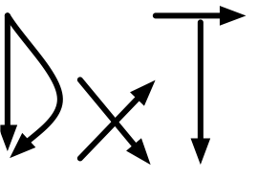
Dxt: Design by Transformation
incremental designs of dataflow applications

Slide 2
Software Architectures
Area of research starting in mid-1990s focused on models of software design, aimed at abstracting software design beyond “code”
Part of the “component” movement, which included distributed components now called services
Among the more popular architectures from that era are pipe-and-filter (PnF) designs, originated from Unix file filters – more generally it is a renaming of dataflow applications > sort myfile | grep “a” > allLinesWithA
Which was seen more visually as a graph of computations:
“MDE before MDE”

Slide 3
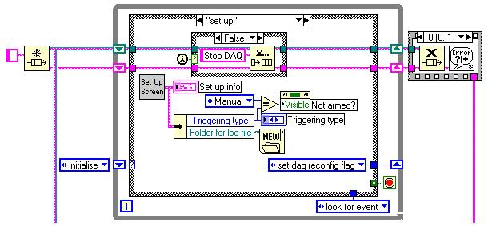
More Generally
Ideas of visual programming had been around for ages ~1980s
Example: LabVIEW
Idea: wire boxes together. Boxes are components/computations. Wires are dataflow paths. Natural way of thinking for certain problem domains, especially ECE

Slide 4
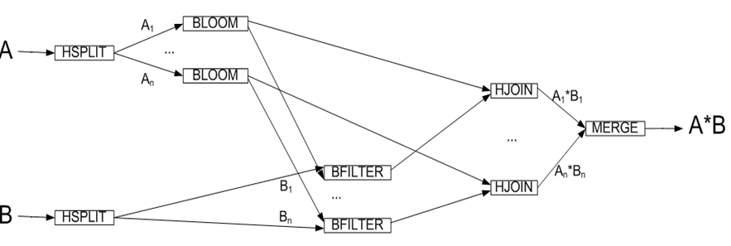
Motivation
We faced the task of re-engineering spaghetti diagrams of PnF dataflow architectures
Here is a simple one:
what does this mean and why does it work?
“parallel hash join”

Slide 5
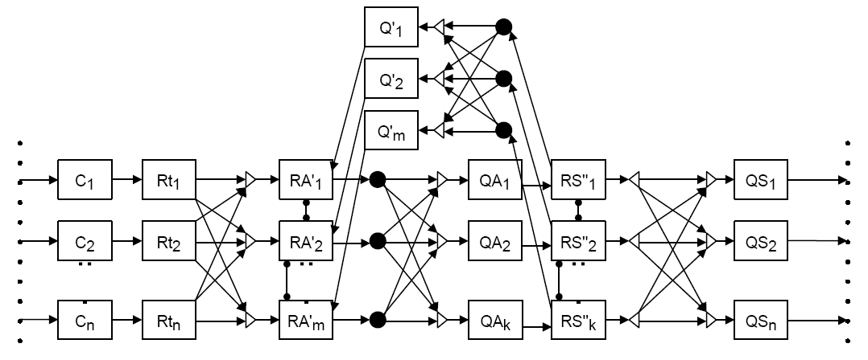
Motivation
We faced the task of re-engineering spaghetti diagrams of PnF dataflow architectures
Here is another one:
what does this mean and why does it work?
“parallel crash fault
tolerant sever”

Slide 6
Motivation
Familiar problems:
how can complex PnF architectures be explained in a simple way so that non-experts you, me, engineers can understand and appreciate expert-created designs and implementations?
remember how I told you how to incrementally explain a complicated UML diagram?
how can domain-specific design knowledge be organized in a domain-independent way so that a common methodology and tool set can be used to reengineer legacy PnF applications from different domains?
PnF architecture tools have been around for 20 years – hard to believe that standard tools LabVIEW, Weaves, Simulink are inadequate for this task

Slide 7
Surprise!
But they are!
They have refinement replace interface with implementation, but more is needed
interface
implement

Slide 8
Surprise!
Missing is the:
ability to define domain-specific optimizations that break modular boundaries to improve performance or gain properties that otherwise could not be achieved solely by refinement alone like a compiler!
ability to extend designs with new capabilities features!
Refinements, optimizations, extensions are all transformations
foundation of MDE – create complex models from simple ones by xforms
MDE provides a conceptually broader foundation and potentially more tool support for expressing domain-specific designs as compositions of xforms

Slide 9
Transformations are not Enough
Transformations don’t necessarily make things easier
This is where engineering and experience enters the picture
Want models of applications and domains to capture fundamental abstractions as boxes in our architectures
just as various domains of physics have their own laws
so too will various domains of software
Mappings of these boxes – refinements, optimizations, extensions – correspond to fundamental algorithms in the literature of that domain
Domain Analysis

Slide 10

Tutorial on Domain Analysis
From my first tutorial in 1994 on Software Product Lines
Domain analysis is a parlor game

Slide 11

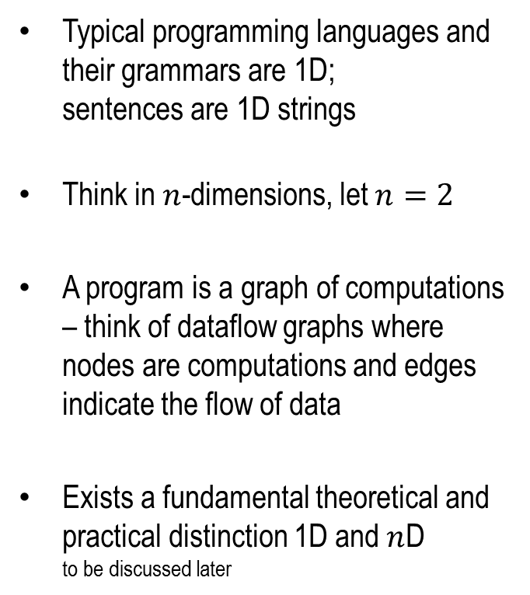



How To Think about Program Derivation
Typical programming languages and their grammars are 1D; sentences are 1D strings
Think in $n$-dimensions, let $n=2$
A program is a graph of computations – think of dataflow graphs where nodes are computations and edges indicate the flow of data
Exists a fundamental theoretical and practical distinction 1D and $n$D to be discussed later
$$β$$
$$γ$$
$$α$$
$$α^{−1}$$
$$β$$
$$γ$$
different colors mean different functionalities

Slide 12






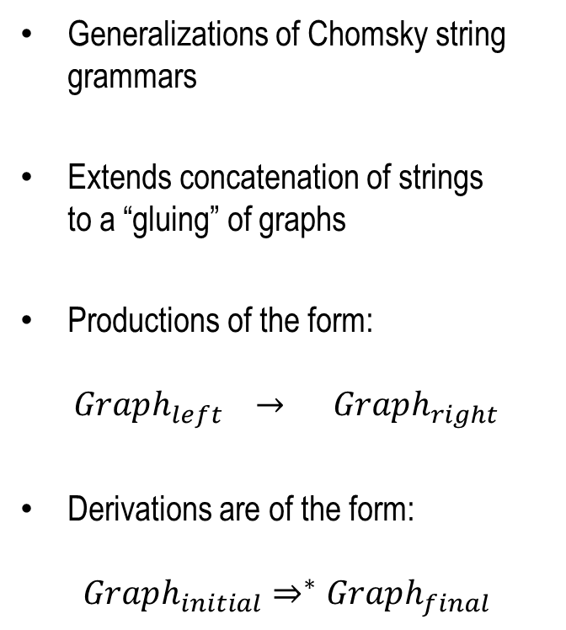









Grammars Graph Grammars
Generalizations of Chomsky string grammars
Extends concatenation of strings to a “gluing” of graphs
Productions of the form:
$$Graph_{left} → Graph_{right}$$
Derivations are of the form:
$$Graph_{initial}⇒^{∗}Graph_{final}$$
$$β$$
$$β$$
$$→$$
$$α$$
$$α^{−1}$$
$$β$$
$$γ$$
$$γ$$
$$→$$
$$α$$
$$α^{−1}$$
$$γ$$
$$α^{−1}$$
$$α$$
$$→$$

Slide 13




















DxT Basics (Part 1)
$$Graph_{initial}$$
$$β$$
$$γ$$
$$⇒$$
$$Graph_{final}$$
$$β$$
$$β$$
$$γ$$
$$α$$
$$α^{−1}$$
$$γ$$
$$α$$
$$α^{−1}$$
$$β$$
$$β$$
$$γ$$
$$⇒$$
$$⇒$$
That’s it!
That’s DxT (Part 1)
$$β$$
$$γ$$
$$α$$
$$α^{−1}$$
$$α$$
$$α^{−1}$$
$$β$$
$$γ$$

Slide 14
For Graph Grammar Enthusiasts…
DxT grammars follow the:
Unfortunately…
above is more general than we need
yet to find a non-obvious theorem that gives us any leverage
Algebraic (double-pushout)
hyper-graph grammar approach

Slide 15
Now Remember or Recall
Just in case I didn’t cover it in the first few weeks of class – standard terminology in MDE:
PIM – platform independent model high-level, abstract model
PSM – platform specific model low-level implementation model
MDE tools perform the PIM → PSM mapping

Slide 16
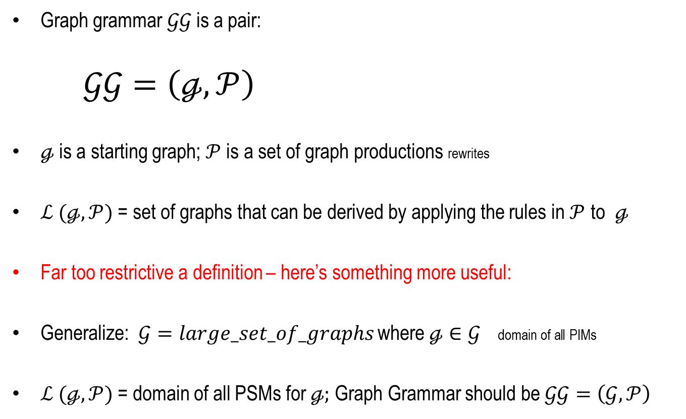


Essential Idea From Literature
graph $ℊ$
Graph grammar $𝒢𝒢$ is a pair:
$𝒢𝒢=\left(ℊ,𝒫\right)$
$ℊ$ is a starting graph;$𝒫$ is a set of graph productions rewrites
$ℒ (ℊ,𝒫)$ = set of graphs that can be derived by applying the rules in $𝒫$ to$ℊ$
Far too restrictive a definition – here’s something more useful:
Generalize:$𝒢=large_set_of_graphs$ where $ℊ∈𝒢$ domain of all PIMs
$ℒ (ℊ,𝒫)$ = domain of all PSMs for $ℊ;$Graph Grammar should be $𝒢𝒢=\left(𝒢,𝒫\right)$
$$ℒ (ℊ,𝒫)$$

Slide 17


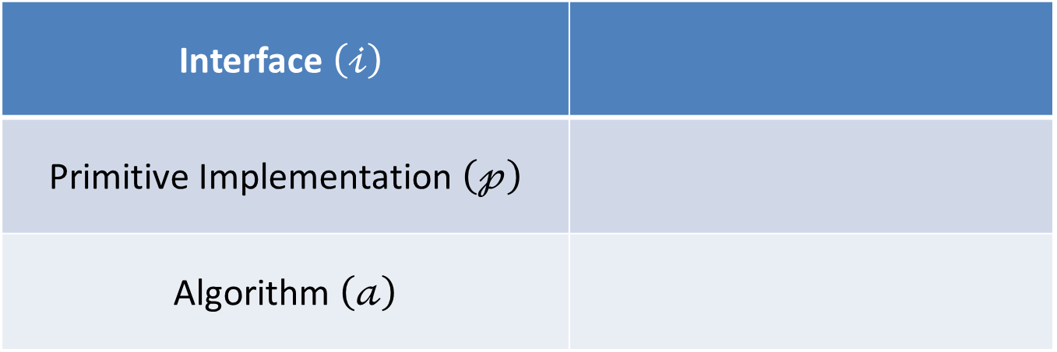





DxT MetaModel Terms
Interface $\left(𝒾\right)$
Primitive Implementation $\left(𝓅\right)$
Algorithm $\left(𝒶\right)$
$${in}_{1}$$
$$𝒾$$
$${out}_{1}$$
$${in}_{1}$$
$$𝓅$$
$${out}_{1}$$
$${in}_{1}$$
$$𝒶_{1}$$
$${out}_{1}$$
Big picture: DxT user draws an abstract graph whose nodes are interfaces
DxT rewrites the abstract graph into a concrete graph whose nodes are primitives
there can be huge number of abstract-to-concrete mappings
part of DxT is to determine which is “best” or “most efficient”

Slide 18








Refinement Rewrites
Replaces an interface with an implementation
Rewrites define domain specific theorems
Rewrites are not context free
interfaces have preconditions standard
RHS have additional preconditions unusual for classical refinements
$${in}_{1}$$
$$𝒾$$
$${out}_{1}$$
$${in}_{1}$$
$$𝒶_{1}$$
$${out}_{1}$$
$$;pre_{1}$$
$${in}_{1}$$
$$𝒶_{2}$$
$${out}_{1}$$
$$;pre_{2}$$
$${in}_{1}$$
$$𝓅$$
$${out}_{1}$$
$$;pre_{3}$$

Slide 19









Example: Sorting Streams
$${in}_{1}$$
$$sort$$
$${out}_{1}$$
$${in}_{1}$$
$$quick$$
$${out}_{1}$$
$${in}_{1}$$
$$merge$$
$${out}_{1}$$
$$sort$$
$${in}_{1}$$
$$hash$$
$$omerge$$
$${out}_{1}$$
$$sort$$
$${in}_{1}$$
$${out}_{1}$$
$$;stream already in desired order$$
key idea: do-nothing has stronger preconditions than its interface

Slide 20
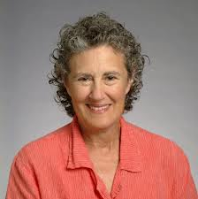
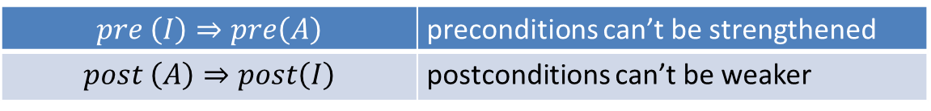
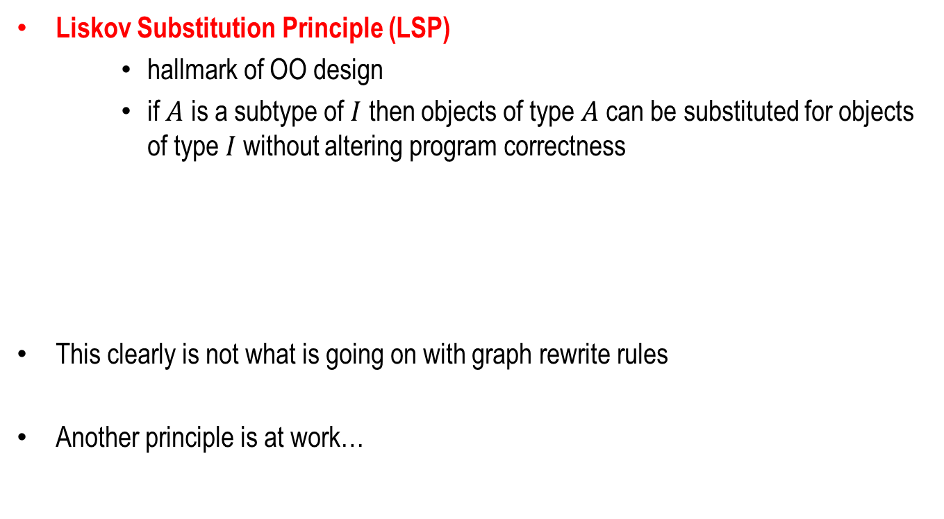
When to Apply Rewrites?
Liskov Substitution Principle (LSP)
hallmark of OO design
if $A$ is a subtype of $I$ then objects of type $A$can be substituted for objects of type $I$without altering program correctness
This clearly is not what is going on with graph rewrite rules
Another principle is at work…
$$pre \left(I\right)⇒pre\left(A\right)$$ | preconditions can’t be strengthened
$$post \left(A\right)⇒post\left(I\right)$$ | postconditions can’t be weaker

Slide 21

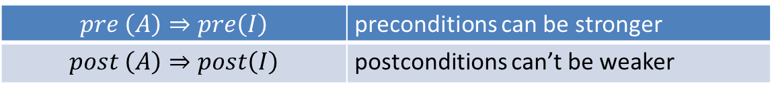
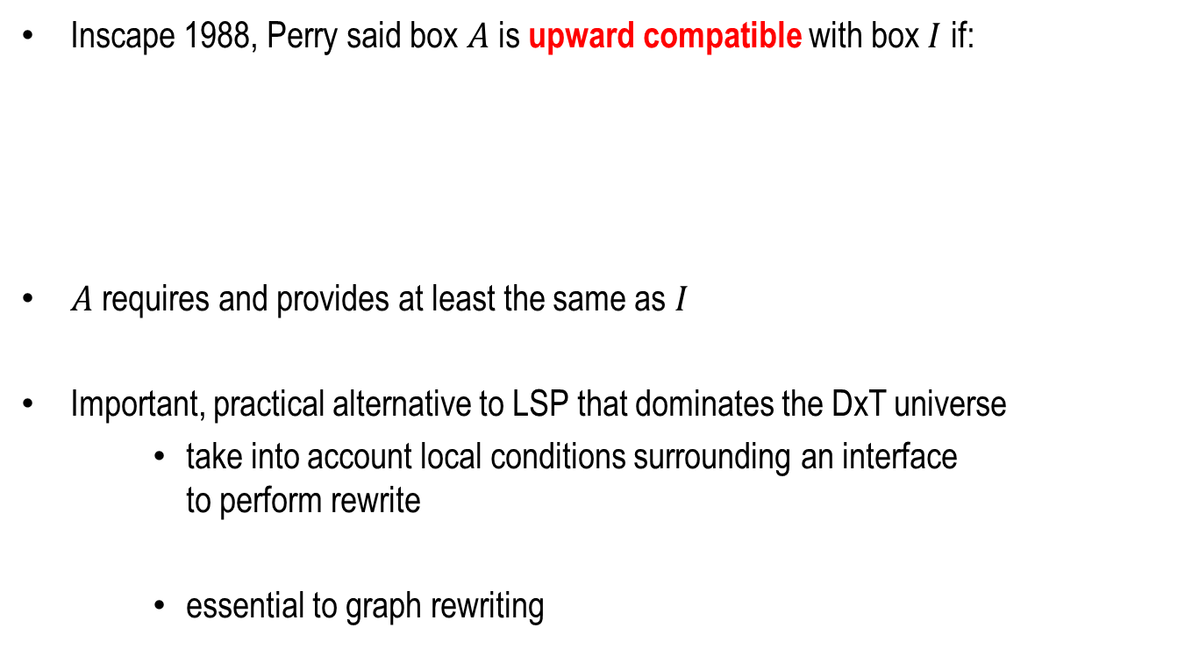
Perry Substitution Principle (PSP)
Inscape 1988, Perry said box $A$is upward compatible with box $I$ if:
$A$requires and provides at least the same as $I$
Important, practical alternative to LSP that dominates the DxT universe
take into account local conditions surrounding an interface to perform rewrite
essential to graph rewriting
$$pre \left(A\right)⇒pre\left(I\right)$$ | preconditions can be stronger
$$post \left(A\right)⇒post\left(I\right)$$ | postconditions can’t be weaker

Slide 22





Optimization Rewrites
Replaces a graph with another graph
or
Abstracts a graph to an interface which is then refined
Optimizations are essential for high-performance and practical dataflow designs
$${in}_{1}$$
$$𝒶_{1}$$
$${out}_{1}$$
$${in}_{1}$$
$$𝒶_{2}$$
$${out}_{1}$$
$${in}_{1}$$
$$𝒾$$
$${out}_{1}$$
$${in}_{1}$$
$$𝒶_{1}$$
$${out}_{1}$$
$${in}_{1}$$
$$𝒶_{2}$$
$${out}_{1}$$

Slide 23
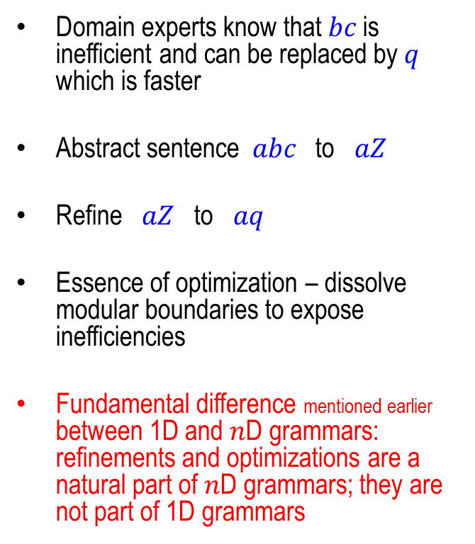




Optimizations Have No Counterpart in 1D Grammars
Sentence of this grammar is $abc$
Suppose composition $bc$ implements interface $Z$
Domain experts know that $bc$is inefficient and can be replaced by $q$ which is faster
Abstract sentence $abc$to $aZ$
Refine $aZ$ to $aq$
Essence of optimization – dissolve modular boundaries to expose inefficiencies
Fundamental difference mentioned earlier between 1D and $n$D grammars: refinements and optimizations are a natural part of $n$D grammars; they are not part of 1D grammars
$$A : a B c | … ;$$
$$B : b | … ;$$
$$Z : bc | q ;$$

Slide 24










Optimizations Across Modular Boundaries
$$β$$
$$γ$$
$$β$$
$$γ$$
$$α$$
$$α^{−1}$$
$$α$$
$$α^{−1}$$
$$β$$
$$γ$$
$$β$$
$$γ$$
$$α$$
$$α^{−1}$$
$$β$$
$$γ$$
That’s DxT (Part 1)

Slide 25
You May Have Seen This Before!
Very similar to optimization techniques in compilers for functional languages
Except:
using graphs not trees important engineering difference
grammars used to derive software designs that are correct-by-construction
domain experts should be the ultimate purveyors of this knowledge
not tool builders, not DxT users
tool builders
domain experts
users
today’s compilers

Slide 26
Back To Domain Analysis
You identify the fundamental operations/computations of a domain
define an interface for each of them
You search the literature and code bases for algorithms that implement your interfaces
for each interface there are multiple implementations
doing so you define a catalog of DxT refinements
You search the literature and code bases for optimizations in your domain
much harder to find because they are rarely published
by re-engineering legacy designs via DxT transformations you discover them
Takes time – but this is the price for sustainable software development

Slide 27



What Else?
Standard “trick” from functional programming language and static analysis playbooks:
Consider the following algorithm, the standard interpretation
Abstract Interpretation
$$𝒾$$
sort
filter
$$ℴ$$
[ 7 5 2 4 ]
[ 2 4 5 7 ]
[ 5 7 ]
[ 7 5 2 4 ]

Slide 28









Abstract Interpretation
Now we want to compute the performance of this algorithm – how do we do it?
Create a dataflow graph that is isomorphic (identical) in shape to the standard interpretation, but now we reinterpret the edges and components to estimate performance!
$$𝒾$$
$$ℴ$$
$$π_{𝒾 }$$
sort
filter
$$π_{ℴ}$$
$$π_{sort}$$
$$π_{filter}$$
$$\left[\begin{matrix}n \\ cost+n⋅log⁡(n)\end{matrix}\right]$$
$$\left[\begin{matrix}f⋅n \\ cost+n⋅\log\left(n\right)+n\end{matrix}\right]$$
# of tuples
cost
$$\left[\begin{matrix}n \\ cost\end{matrix}\right]$$
$$\left[\begin{matrix}n \\ cost+n⋅log⁡(n)\end{matrix}\right]$$
$$\left[\begin{matrix}n \\ cost\end{matrix}\right]$$

Slide 29








Abstract Interpretation
Now we want to compute the post conditions of this algorithm – how do we do it?
Create a dataflow graph that is isomorphic (identical) in shape to the standard interpretation, but now we reinterpret the edges and components to predict post conditions!
$$𝒾$$
$$ℴ$$
$$ρ_{𝒾 }$$
sort
filter
$$ρ_{ℴ}$$
$$ρ_{sort}$$
$$ρ_{filter}$$
$$\left[\begin{matrix}true \\ sort_key\end{matrix}\right]$$
$$\left[\begin{matrix}predicate \\ sort_key\end{matrix}\right]$$
tuple qualifier
sort order
$$\left[\begin{matrix}true \\ −\end{matrix}\right]$$
$$\left[\begin{matrix}true \\ sort_key\end{matrix}\right]$$
$$\left[\begin{matrix}true \\ −\end{matrix}\right]$$

Slide 30




Abstract Interpretation
Standard trick in functional programs
“Shape” of an algorithm that is shared by all interpretations of that shape
Abstract computation
Has different representations
Representation vectors ala AHEAD
α
$$α_{s}$$
$$α_{π}$$
$$α_{ρ}$$
$$α= \left[\begin{matrix} α_{s} & α_{π} & α_{ρ}\end{matrix} \right]$$

Slide 31
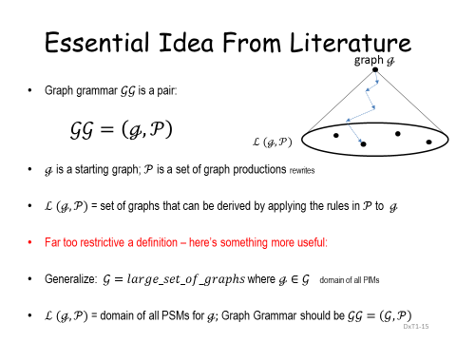

Automatic Programming and MDE
Recall Slide:
Given an abstract design $ℊ$or PIM, using domain-specific productions $𝒫$ we can:
generate space of all algorithms or PSMs, estimate performance of each, and choose cheapest
how we have generated efficient DLA algorithms

Slide 32
Testing
Most details are not captured in architecture diagrams
whether SORT box works correctly
typically boxes don’t have proofs of correctness – need to test
"Beware of bugs in the above code; I have only proved it correct, not tried it." – Donald Knuth
Module Test

Slide 33
Testing Refinements
We identify tests at every level of abstraction. The validity of these tests (properties) must hold after every refinement. So as details are revealed, we accumulate tests to verify the correctness of an implementation.
note there are other kinds of
integration tests
Integration or System Test

Slide 34
Gamma
now for a real example
parallelizing hash joins in database machines

Slide 35
This Part of Today’s Lecture
This not a database course
But we have used several times basic database concepts
I will be presenting domain-specific knowledge about hash-joins that
you likely don’t know
I think are easy enough to absorb and will expect you to know
because you’ll need them in your last programming assignment….
will be to get into teams
and build “Gamma”

Slide 36
Background on Databases
A relational database is a collection of tables
each table has of a set of rows called tuples
each table has a set of columns called attributes
think of a table as a class whose fields are attributes
think of a row as an object of this class
there are no methods
2 tables below, Client and Viewing
Client
clientNo | Fname | Lname | tele | prefType | maxRent
cr76 | John | Kay | 774-5632 | flat | 425
cr56 | Allen | Steward | 848-1825 | flat | 350
cr74 | Mike | Ritchie | 539-2178 | house | 750
cr62 | Mary | Tregear | 224-1967 | flat | 600
Viewing
clientNo | propertyNo | viewDate | comment
cr56 | PA14 | 24-May-04 | too small
cr76 | PG4 | 20-Apr-04 | too remote
cr56 | PG4 | 26-May-04
cr62 | PA14 | 14-May-04 | no dining room
cr56 | PG36 | 29-Apr-04

Slide 37
Relationships among Tables
Rows have identifiers called keys underlined below
Rows of different tables are related if they
(a) share columns and (b) have the same values for those columns
For example, client cr56 whose name is Allen Steward visited 3 properties PA14, PG4, PG36
Client
clientNo | Fname | Lname | tele | prefType | maxRent
cr76 | John | Kay | 774-5632 | flat | 425
cr56 | Allen | Steward | 848-1825 | flat | 350
cr74 | Mike | Ritchie | 539-2178 | house | 750
cr62 | Mary | Tregear | 224-1967 | flat | 600
Viewing
clientNo | propertyNo | viewDate | comment
cr56 | PA14 | 24-May-04 | too small
cr76 | PG4 | 20-Apr-04 | too remote
cr56 | PG4 | 26-May-04
cr62 | PA14 | 14-May-04 | no dining room
cr56 | PG36 | 29-Apr-04

Slide 38


Join ($⋈$) of Tables X and Y
$Join\left(X,Y\right)= X⋈Y =$joining rows of X with rows of Y that have the same value over common attributes called the join key – which oddly doesn’t have to be a key!
Client
clientNo | Fname | Lname | tele | prefType | maxRent
cr76 | John | Kay | 774-5632 | flat | 425
cr56 | Allen | Steward | 848-1825 | flat | 350
cr74 | Mike | Ritchie | 539-2178 | house | 750
cr62 | Mary | Tregear | 224-1967 | flat | 600
Viewing
clientNo | propertyNo | viewDate | comment
cr56 | PA14 | 24-May-04 | too small
cr76 | PG4 | 20-Apr-04 | too remote
cr56 | PG4 | 26-May-04
cr62 | PA14 | 14-May-04 | no dining room
cr56 | PG36 | 29-Apr-04
join
key
Join(Client, Viewing)
clientNo | fname | lname | tele | prefType | maxrent | propertyNo | viewdate | comment
cr76 | John | Kay | 774-5632 | flat | 425 | PG4 | 20-Apr-04 | too remote
cr56 | Allen | Steward | 848-1825 | flat | 350 | PG36 | 29-Apr-04
cr56 | Allen | Steward | 848-1825 | flat | 350 | PG4 | 26-May-04
cr56 | Allen | Steward | 848-1825 | flat | 350 | PA14 | 24-May-04 | too small
cr62 | Mary | Tregear | 224-1967 | flat | 600 | PA14 | 14-May-04 | no dining room

Slide 39
Gamma Database Machine
Gamma was maybe still is the most sophisticated relational database machine ever built in academics
University of Wisconsin late 1980’s early 1990s
Look at how hash joins were parallelized
fundamental result in parallelizing joins
representative of commercial database systems today
presented in a new way
derive Gamma hash join architecture from first principles

Slide 40
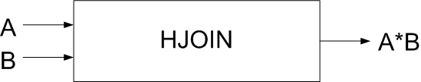
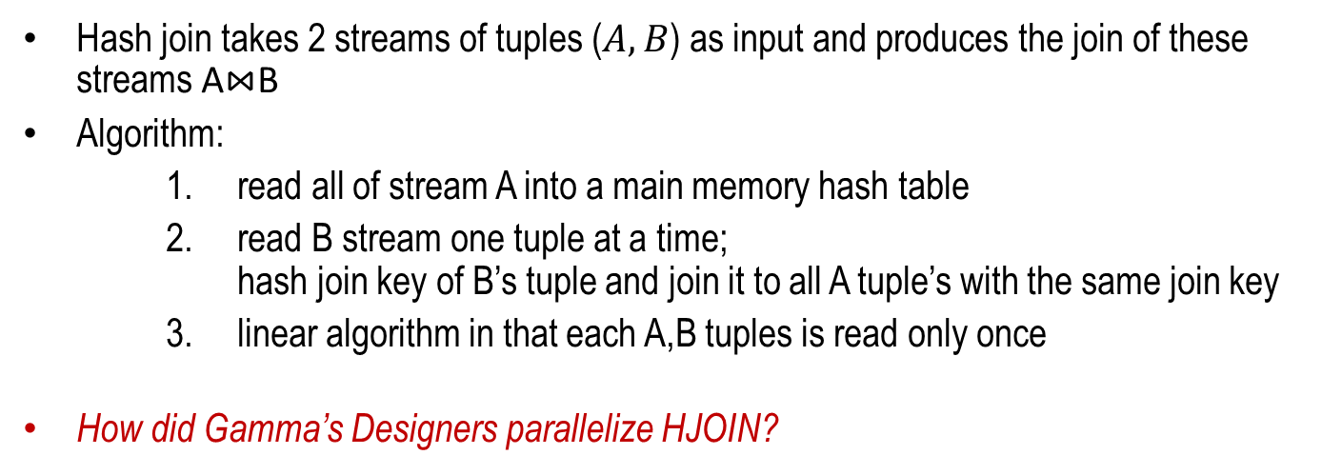

Sequential Hash Join Architecture
note: $A⋈B=A∗B$
x
y
x
z
x
y
y*y
x*x
x*x
Hash join takes 2 streams of tuples ($A,B$) as input and produces the join of these streams A⋈B
Algorithm:
read all of stream A into a main memory hash table
read B stream one tuple at a time; hash join key of B’s tuple and join it to all A tuple’s with the same join key
linear algorithm in that each A,B tuples is read only once
How did Gamma’s Designers parallelize HJOIN?

Slide 41
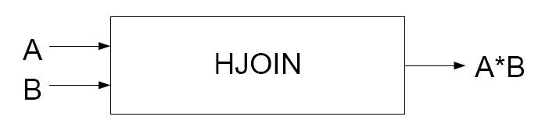
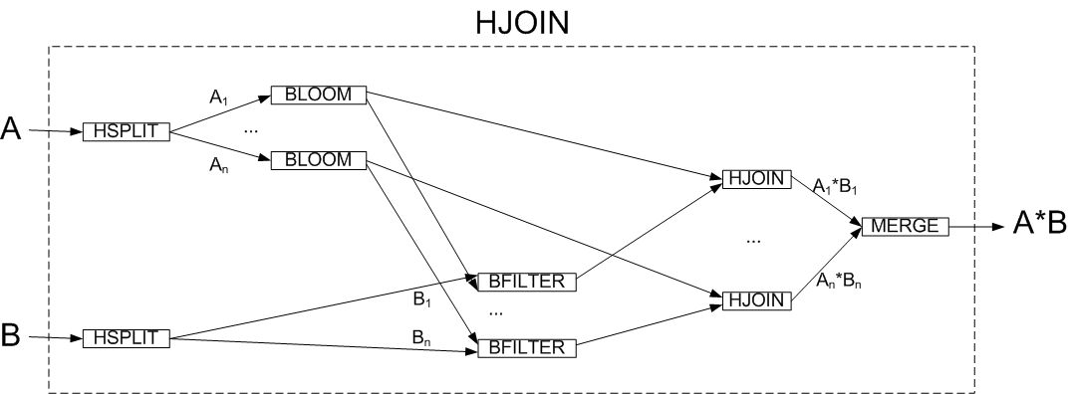
Next Slides Explain PIM-PSM Derivation

Slide 42
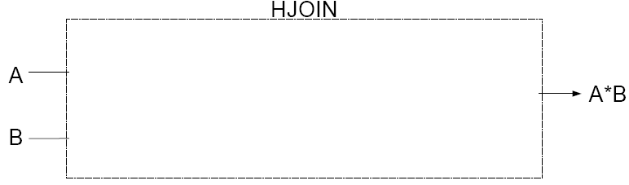
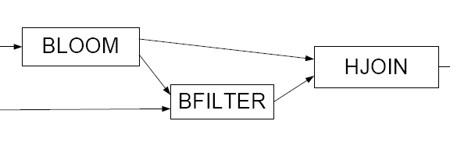
First Refinement
Because joins are among the most complex operations in databases, increase efficiency by reducing the size of its input streams
Used Bloom filters to eliminate B tuples that do not join with A tuples

Slide 43
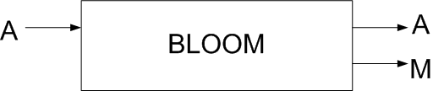
BLOOM Box
x
y
x
0
1
0
1
0
Bloom filtering is a common technique for disqualifying tuples from further processing
Algorithm:
clear bit map M
read each A tuple, hash its join key, and mark corresponding bit in M
output each tuple A
after all A tuples read, output M

Slide 44
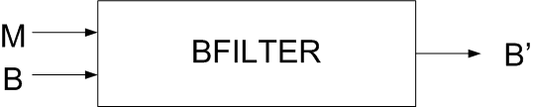
BFILTER Box
1
1
0
z
x
y
The filtering part of Bloom filters
eliminates B tuples that cannot join with A tuples
Algorithm:
read bit map M
read each tuple of B, hash its join key: if corresponding bit in M is set output tuple
else discard tuple as it will never join with A tuples

Slide 45
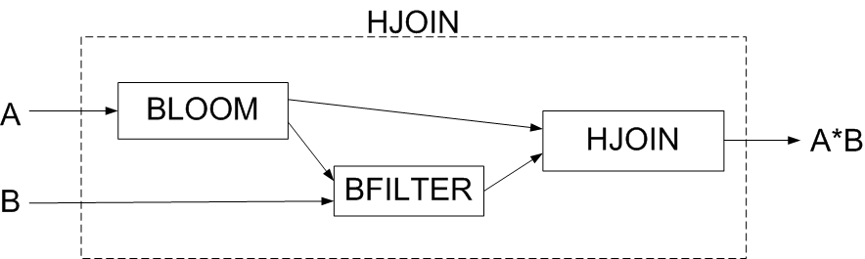
The First Refinement
x
y
x
1
1
0
y*y
x*x
x*x
z
x
y
Expose inner details of HJOIN box
Can prove correctness of this refinement

Slide 46
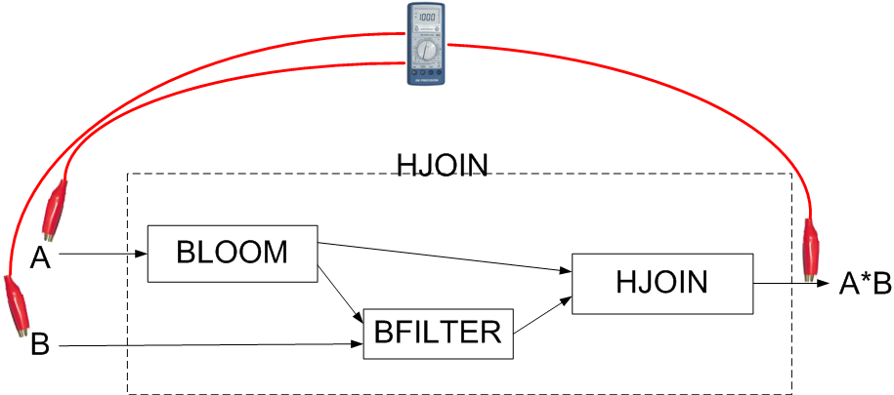
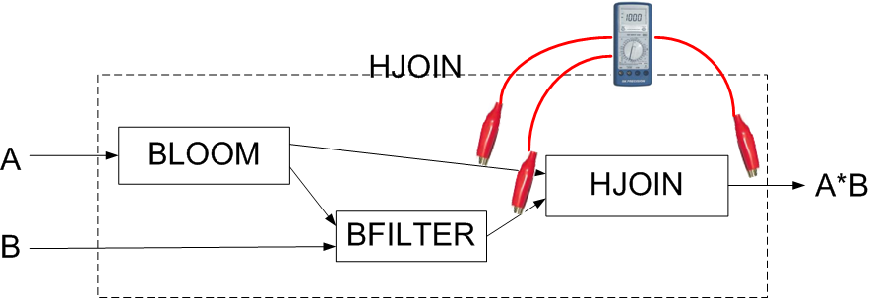
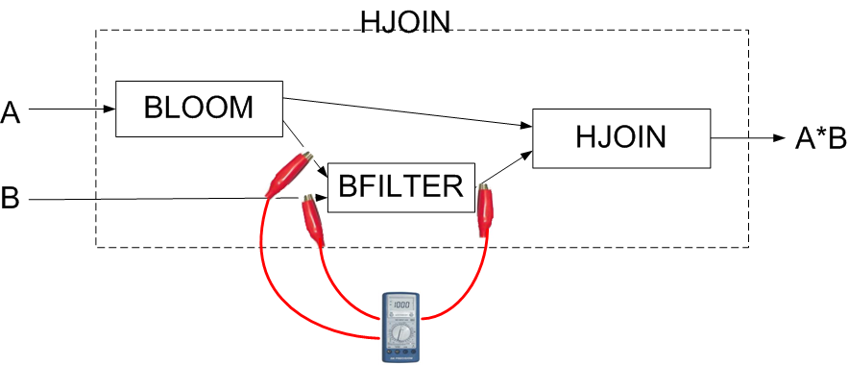
Testing
As we refine, we accumulate and apply tests at every level of abstraction

Slide 47
Parallelize Each Box above by map reduce

Slide 48
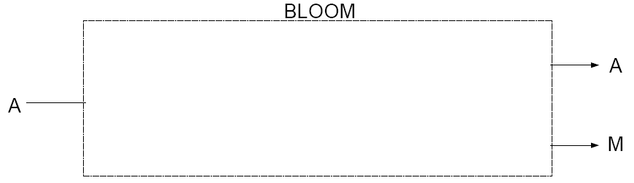
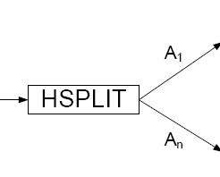
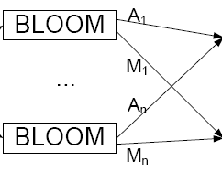


Parallelization of BLOOM Box
Algorithm:
HSPLIT stream A
compute Bloom filter for each substream
reconstitute stream A
form merge bit maps to produce single bit map M

Slide 49
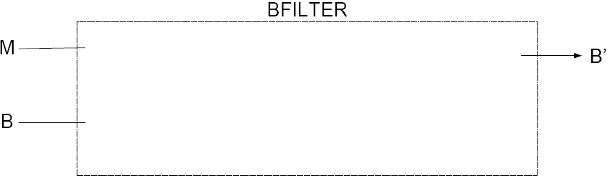
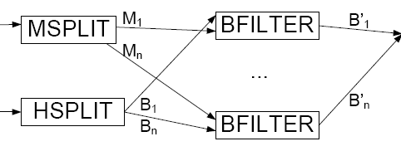



Parallelization of BFILTER Box
Algorithm:
split M into M₁…M_{n}
hash split stream B into B₁…B_{n}
bloom filter B_{i} substreams in parallel
reconstitute stream B’
always hash split
streams A and B
using the same hash
function! This gives
us properties on which
to optimize!

Slide 50
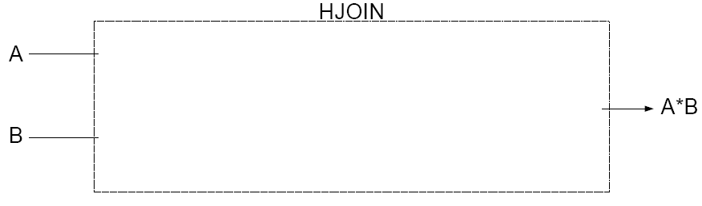
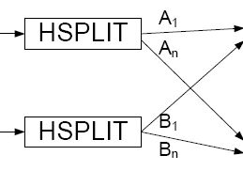
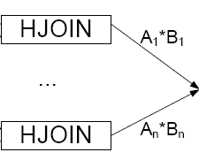
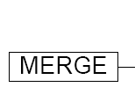
Parallelization of HJOIN Box
Algorithm:
split both streams using same hash function
A and B tuples can join only if they have the same hash key perform n joins rather than n² in parallel
reconstitute join

Slide 51
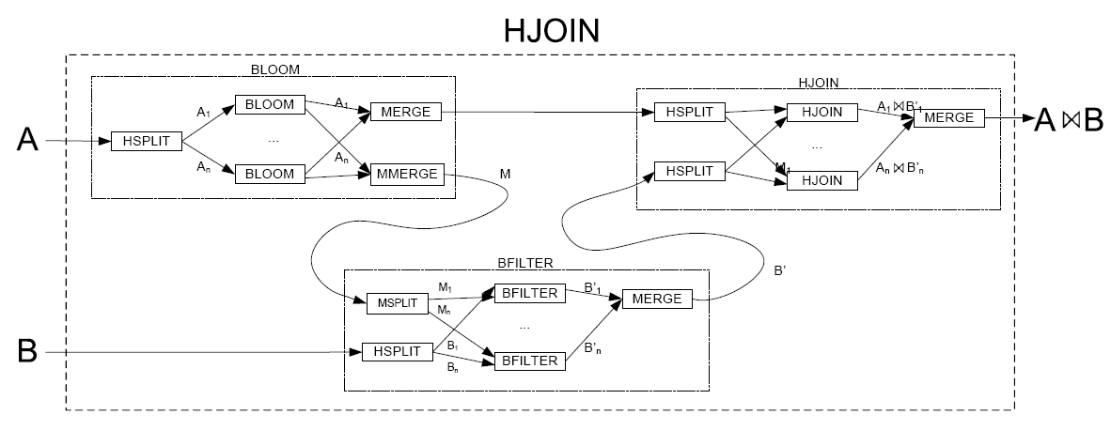
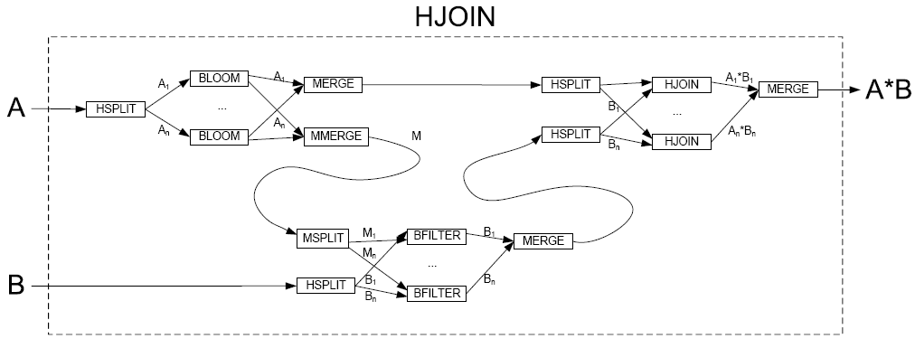
Architectural Optimization
A*B
Substitute parallel implementations for each box
Note 3 optimizations are possible
Here are the first two…

Slide 52
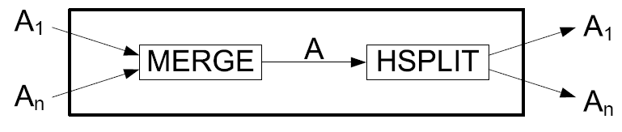
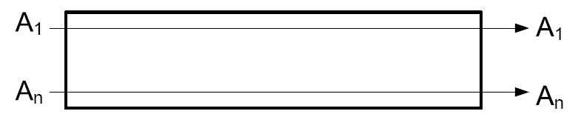
A Better View: ID Abstraction
Stream A is hash split into A₁…A_{n}, reconstituted, then hash split again
MERGE – HSPLIT combination is the identity map
Optimization – get rid of MERGE-HSPLIT
Same for stream B

Slide 53
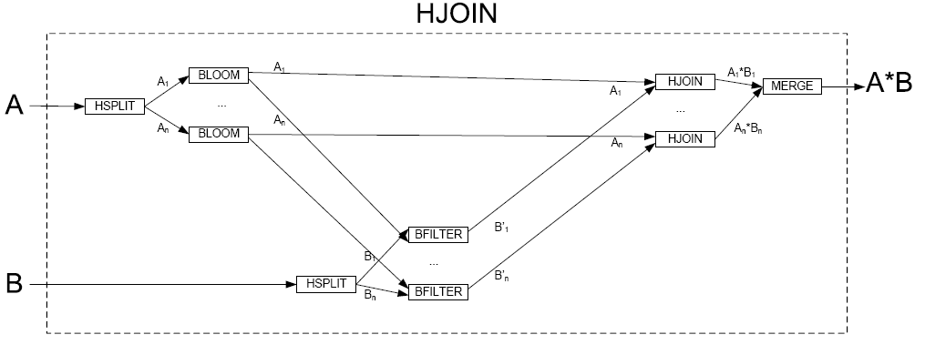
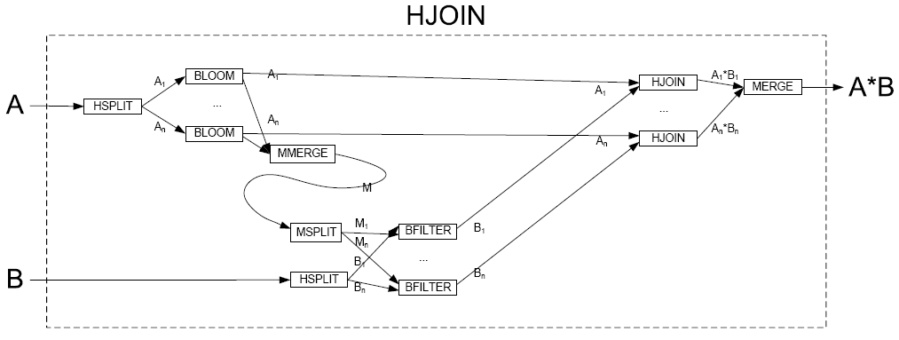
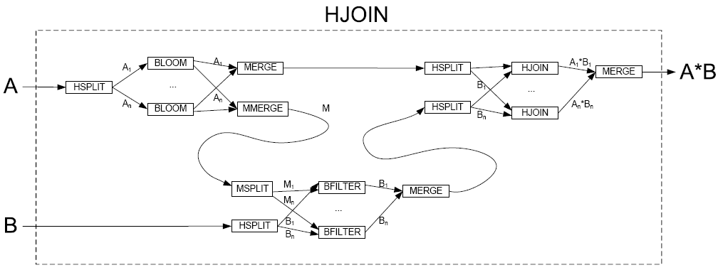
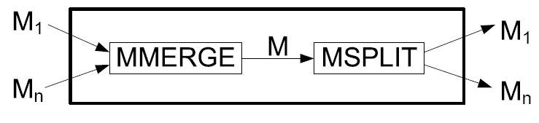
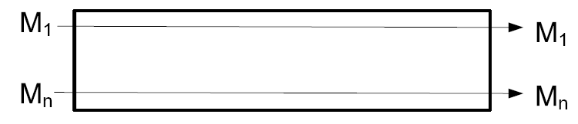
Architectural Optimization
Still one more optimization to perform… MID abstraction

Slide 54
How is this last Refinement Possible?
If you create bitmaps MMERGE and MSPLIT in the naive way, MMERGE and MSPLIT are not inverses
The simplest is this: M is a n×k bitmap. The join key of an A tuple is hashed twice: once to determine the row of M, the second to determine the column within the selected row. Thus, all tuples of substream A_{i} hash to row i of M.
MMERGE combines M₁…M_{n} into M by boolean disjunction.
For each i, MSPLIT extracts row i from M and zeros out the rest of M_{i}.

Slide 55
The (Almost) Final Design
Elegant
Easier to remember the derivation than the design itself (!)
Each step can be proven correct, so the final design is correct

Slide 56
Gamma Graph Grammar
HJOIN : hjoin | bloomfilteredhjoin(BLOOM, BFILTER, HJOIN) | parallelhjoin(HSPLIT, HJOIN, MERGE) ;
BLOOM : bloom | parallelbloom(HSPLIT, BLOOM, MERGE, MMERGE) ;
BFILTER : bfilter | parallelbfilter(HSPLIT, BFILTER, MERGE, MSPLIT) ;
MERGE : merge ;
HSPLIT : hsplit ;
MMERGE : mmerge ;
MSPLIT : msplit ; ID : id(MERGE,HSPLIT) | nothingid ;
MID : mid(MMERGE,MSPLIT)
| nothingmid ;
Note: each (abstraction, implementation) pair is a theorem to be proven. That is, we need to prove that the
implementation correctly implements its abstraction. We have done so…

Slide 57
Big Picture
Eventually collect more knowledge about domain-specific designs and integrate them into a domain-specific grammar
To have a tool that will help guide architects in design
Basic idea of KBSE Knowledge Base Software Engineering circa 1983
Difference now is:
we have experience in building systems transformationally – virtually nothing back then
MDE is now available – didn’t exist back then
have a better idea how to create correct by construction designs

Slide 58

Recap
Experts create and build non-obvious architectures that take time to understand
details are accessible to only domain experts and only after a considerable effort to appreciate
our experience confirms this, but offers hope…
by revealing domain knowledge incrementally in the context of MDE where details of architecture models are progressively revealed, non-experts can more easily appreciate, participate and contribute in their construction
Next lecture: how to build asynchronous recoverable crash-fault tolerant servers

