Slide 1
Opening the Door to Life's Abundance
— Foundational Altruism Practice Course · Gratitude —

Slide 2
Contents
Understanding Gratitude (30 min)
The Benefit Mindset (30 min)
Cultivating Gratitude — Gratitude Journal (15 min)
Web of Causality (40 min)
Summary & Practice Plan (10 min)

Slide 3
PART 01
Understanding Gratitude

Slide 4


Understanding Gratitude
Definition:
Be grateful for everything you have,
and appreciate all those who have contributed.
In Buddhism, gratitude is not limited to specific people or events. Buddhism teaches that all sentient beings are interdependent; no one can survive without family, society, all people, and nature. Therefore, we should face everything with a grateful heart.

Slide 5
In-Class Exercise: Self-Reflection (10 min)
Observe your behavior and inner state across various life situations — with and without gratitude. Fill in the table below and estimate the proportion of time gratitude is "online" vs. "offline" in each scenario.
Scenario | State Without Gratitude | Proportion | State With Gratitude | Proportion
Example: Group Practice | Dissatisfied with some classmates, complaining, thinking "None of them study on their own, their sharing goes off-topic, what a waste of my time!" | 30% | Thankful for all classmates; without them, I would have no companions to study with | 70%
Example: Eating | Picky, finding the food unappetizing, the portions too small, the queue too long... | 40% | Thinking of the many people whose labor made this possible, truly feeling the nourishment of the food, feeling deeply content and energized | 60%
Interacting with Family

Slide 6

Discussion & Sharing (15 min)
Across different life situations, how often is my gratitude "online"?
When I feel grateful toward the people, events, and things around me, what is my mental experience? What is my physical experience?

Slide 7
PART 02
The Benefit Mindset

Slide 8
Why Cultivate Gratitude (The Benefit Mindset)
According to leading gratitude researcher Robert Emmons (Emmons & Mishra, 2012), practicing gratitude brings eight distinct benefits, including:
Maximizing benefit: Gratitude enables us to derive the greatest benefit from positive experiences.
Self-worth and self-esteem: Gratitude enhances our self-worth and self-esteem, making us more confident and effective. It guards against self-pity, a state of feeling like a victim.
Coping with stress: Gratitude helps us cope with stress and adversity. After the initial shock, gratitude helps us assess what matters most in life.
Helping others: Grateful people are more likely to help others. They become more aware of acts of kindness and care, and feel compelled to give back. They are less likely to be materialistic and more likely to cherish what they have.

Slide 9
Why Cultivate Gratitude (The Benefit Mindset)
Better relationships: Gratitude strengthens our relationships. When we truly recognize the value of friends and family, we tend to treat them better. When we treat them well, they treat us well in return.
Less negative comparison: Expressing gratitude reduces our tendency to compare ourselves with others. We become grateful and content with what we have (friends, family, home, health), and less likely to feel distressed about what we lack.
Fewer negative emotions: When we express gratitude, we tend to experience fewer negative emotions. For instance, when we are grateful, we are less likely to feel guilt, greed, or anger.
Slowing adaptation: How long does the joy of a new possession last? Initially we feel happy, but that happiness doesn't last long. By appreciating the meaning and value of things and experiences, we can slow this adaptation and extend the experience of joy.

Slide 10
Why Cultivate Gratitude (The Benefit Mindset)
Modern psychological research has found that sustained gratitude practice can:
Significantly reduce anxiety and depression, and increase well-being
Enhance physical health and immune function; reduce inflammation; improve heart health.
Gratitude improves interpersonal relationships, increasing workplace collaboration efficiency by 55% and reducing household conflict by 37% through expressions of gratitude.
Achieve goals faster and better: students with high gratitude levels see a 42% increase in academic goal attainment, and workplace innovation proposals increase by 55%.
Improve sleep quality, shortening time to fall asleep by 19 minutes and increasing deep sleep duration by 17%.

Slide 11
Why Cultivate Gratitude (The Benefit Mindset)
From the Buddhist perspective, a grateful heart brings us these benefits:
Gratitude is the source of merit and blessings
It makes the mind gentle, pliant, and joyful
It generates affinity, brings joy to sentient beings, earns their acceptance, and establishes wholesome connections with them
It contributes to social harmony
It is the foundation of loving-kindness and compassion
Discussion & Sharing (15 min)
In light of your own life, for each benefit of gratitude, share real examples you have observed.
Do I need to cultivate gratitude? Why?

Slide 12
Seeing All Beings with Gratitude
Without gratitude, we often feel indifferent toward others, or even perceive them with hostility, feeling that the world is full of enemies plotting against us. When we view people with this mindset, we find no one pleasing, and others find us displeasing in return.
If we recognize that every day we are sustained by the contributions of others — not only the help and care of parents, relatives, and friends, but also the services of people across all walks of society, and even the birds, fish, and insects that together sustain the Earth's ecosystem — then we can view all beings with gratitude and find joy in everything we see. When we regard all beings with such a heart, we naturally radiate affinity, bringing joy to others and earning their acceptance. This harmony and joy is a supporting condition for happiness.

Slide 13
PART 03
Cultivating Gratitude —
Gratitude Journal & Web of Causality

Slide 14
1. Gratitude Journal
Seeing and appreciating the small beauties in life

Slide 15
In-Class Exercise: Gratitude Journal
Carefully observe the people, events, and things in your life worth feeling grateful for. Write them down on your phone or on paper — the more, the better. Then rate your "level of gratitude" for each item (1-5, with 5 meaning very grateful).
1. _____________________________
2. _____________________________
3. _____________________________
······
After writing, review your list, savor the gratitude arising in your heart, and rest in that feeling for 30 seconds.
In-Class Exercise: Set a timer for 3 minutes — see how many you can write!

Slide 16
Discussion & Sharing (10 min)
Share your gratitude journal
What insights arose during the exercise?
What effect does this simple exercise have? Do I need to keep doing it? Why?

Slide 17
Gratitude Requires Deliberate Practice
If we don't consciously attend to everything we have, we will unconsciously be drawn to negative things.
When we fixate on the negative, negative things keep surfacing; more importantly, excessive focus on negativity blocks out happiness.
Fill your heart with as much gratitude as possible — it will bring you the most beautiful "life experience" and the most "abundant" life.

Slide 18
2. Web of Causality
Every beautiful thing arises dependently, not independently — it is made possible by countless sentient beings and conditions working together.

Slide 19
Everyone has been kind to you; the entire world is serving you
We do not live in isolation in this world. We need our parents to raise us, teachers to instruct us, and even as adults, we still depend on the contributions of society at large. Otherwise, we would have to grow our own food, weave our own cloth, and make everything we need ourselves. Just considering our daily necessities — food, clothing, shelter, and transportation — how much help and effort from countless beings have we received! Therefore, every sentient being is someone to whom we owe gratitude, someone we should repay with a grateful heart.
Modern people tend to focus heavily on the sense of "self," but from a Buddhist perspective, this "self" is nothing more than an elaborate and complete illusion. Misled by this sense of self, people easily set themselves against the world, even viewing everyone as a potential enemy, leading to loneliness, withdrawal, and even depression. If we shift perspective and consider that everyone has been kind to us, that the entire world is serving us, then we will never feel estranged from anyone we meet.
Discussion & Sharing (10 min)
In my daily life, whose contributions do I tend to take for granted, rarely feeling grateful toward them?
In my life, whom do I regard as unrelated strangers? With what attitude and behavior do I face these "strangers"?

Slide 20
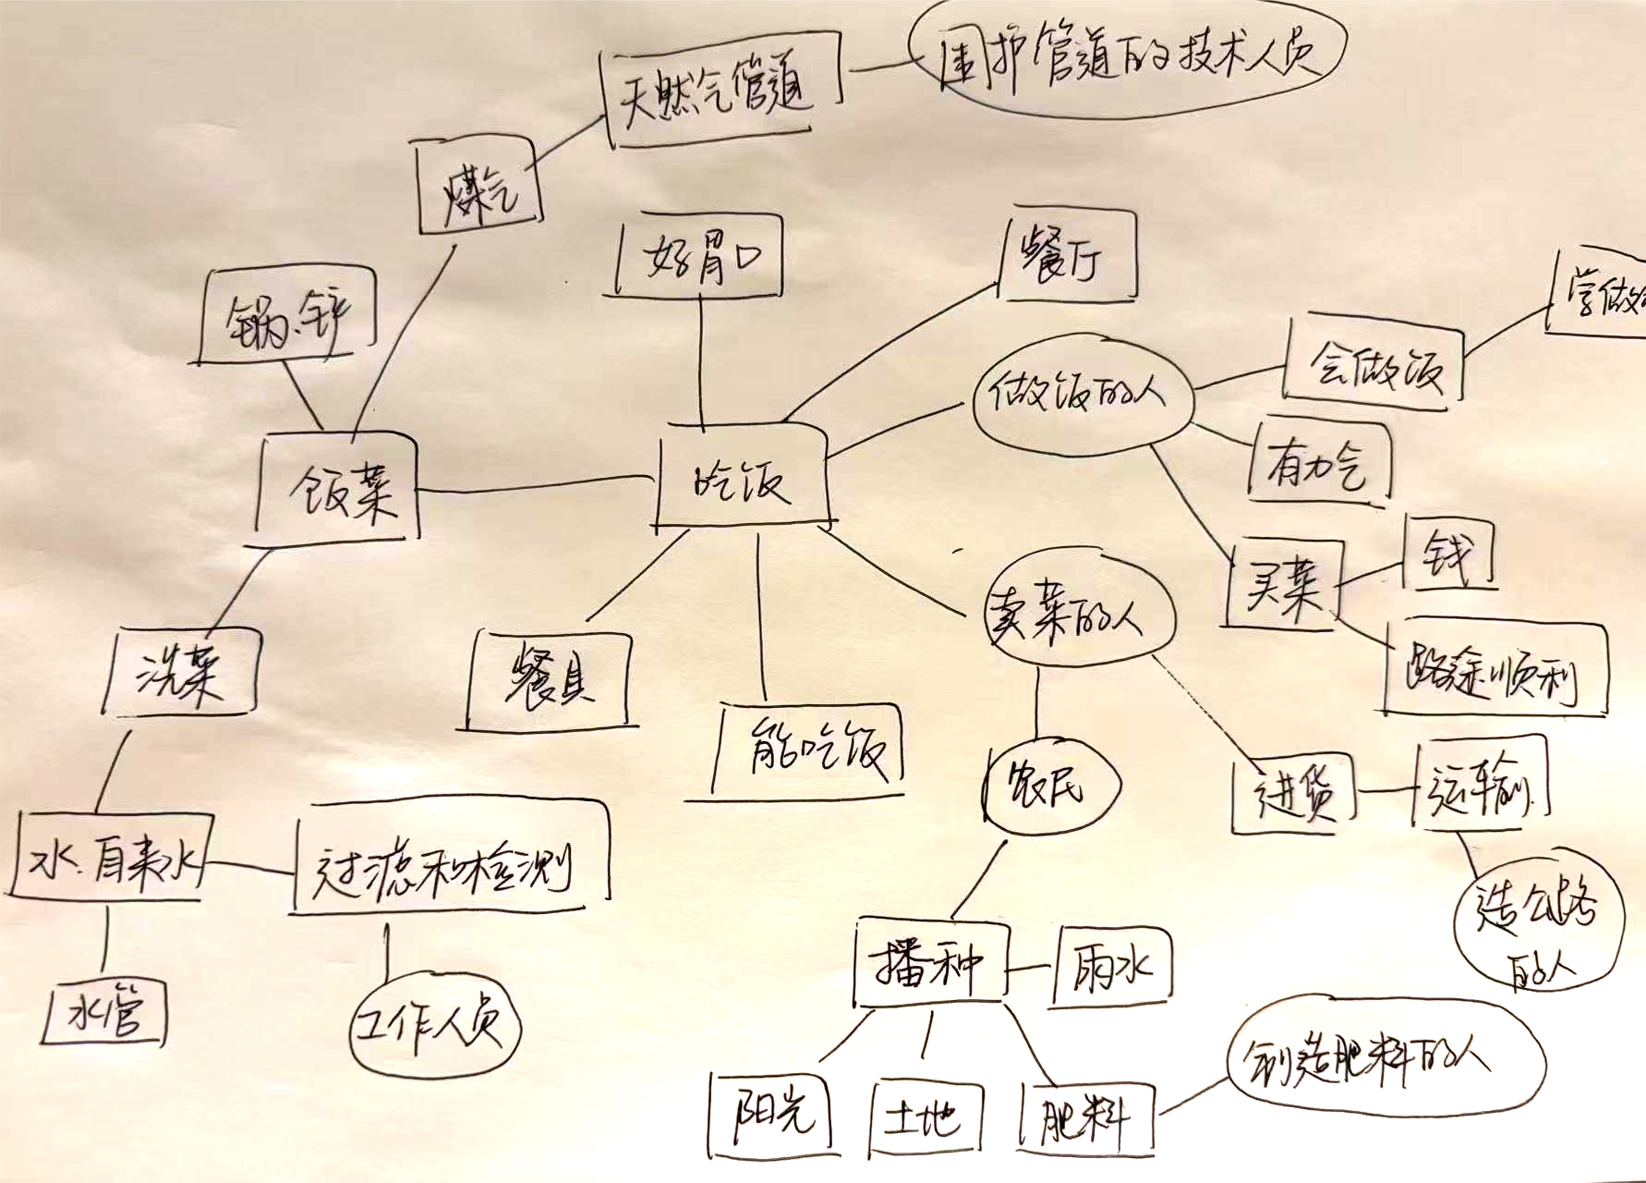
In-Class Exercise: Web of Causality (10 min)
The "atomized" lifestyle of modern society often gives people the illusion of isolation. In reality, all life is deeply interconnected and interdependent.
Choose something you are grateful for and write it at the center of a piece of paper.
List out each cause and condition (people, events, things) that made this possible, connecting them with lines — use boxes for events and things, circles for people.
Each person or thing also arises dependently rather than independently; list out the causes and conditions that made them possible in turn, forming a "web of causes and conditions."
Notes:
Once familiar with this exercise, any object — whether food, an item, a person, or an event — can be deeply examined through the lens of dependent origination.

Slide 21
Interactive Exercise (10 min)
In pairs, exchange your "web of causality" exercises and supplement each other's: What other causes and conditions can I think of? (5 min)
Share with each other what you added and your reflections (5 min)

Slide 22
Discussion & Sharing (10 min)
What thoughts and feelings arose during the exercise?
Share one chain of causes and conditions that particularly moved you
What causes and conditions have I never thought to feel grateful for?

Slide 23
Seeing and Feeling Grateful for Everything You Have
Living in this world, we are both independent individuals and part of a greater whole, sustained by the nourishment of all things and the protection of all beings. That we are here today is likewise made possible by countless causes and conditions, so we should feel grateful for all of it. The Buddhist teaching of "repaying the four great kindnesses" means remembering with gratitude the kindness of parents, teachers, the nation, and all sentient beings, and vowing to repay them. When gratitude arises in us, our heart becomes joyful and tender, and we naturally think of doing something for society and for all beings. This is the foundation for growing compassion.

Slide 24
PART 06
Summary & Practice Plan

Slide 25
Key Points Review
What is the essence of gratitude?
Being grateful for everything you have, and appreciating all those who have contributed.
What are the benefits of cultivating gratitude?
Happiness, joy, merit, harmony...
How to Cultivate Gratitude
[Gratitude Journal] Actively noticing the people, events, and things in life worth feeling grateful for
[Web of Causality] Establishing gratitude through the perspective of dependent origination

Slide 26
Purpose of the Practice
Self-Reflection
Build the habit of consciously facing present-moment people and events with gratitude across different life situations.
Gratitude Journal
Build the habit of noticing kindness and good things in life (no matter how small).
Web of Causality
Build a universal sense of gratitude and a broad sense of connectedness, feeling that we live within a vast web of causality, thereby weakening self-centeredness and the sense of isolation.

Slide 27
Practice Plan
 | Daily Formal Loving-Kindness Practice | Daily Gratitude Practice
Week 1 | Loving-kindness toward oneself — 15 min | Gratitude Journal
Week 2 | Loving-kindness toward oneself — 15 min | Web of Causality
1. Practice requirements: formal + daily life practice at least 5 days per week
2. Daily sharing: share your daily practice and reflections in the class group
3. After each weekly class discussion, 2-3 classmates share their practice reflections for the week

Slide 28
Recite Together
"Gratitude Prayer"

Slide 29
Gratitude Prayer
Grateful for nature's gifts, grateful for our parents' nurturing,
Grateful for our teachers' guidance, grateful for our country's nourishment,
Grateful for the support of all sentient beings, grateful for the protection of the Three Jewels.
May we be grateful for all that we have, and may our gratitude inspire us to give generously,
May this gratitude bring comfort to all beings, awaken hearts long closed, and dissolve all barriers between self and other,
May people open their hearts in gratitude and care for one another,
May the world be filled with warmth through gratitude, and may peace prevail everywhere.

