Slide 1

GymShare

Slide 2
Why GymShare?
Due to the Coronavirus Pandemic, many gyms are forced to close. Many States has opened up their gyms for business but NYC’s gyms are expected to close until the end of the year.
With the rising share apps like AirBnB and Turo, anyone can become a hotel owner or rental car owner, sharing their spare room/space, or their unused car.
With GymShare, anyone with a garage gym can host their gym and share it with many gymgoers who has lost the ability to attend a commercial gym.

Slide 3
Who would use GymShare
Many people has cleared out the stores of gym equipment and left many without the ability to workout efficiently.
There are people whose daily routine is working out before/after work and because of Coronavirus Pandemic, their daily routine has been interrupted and they are excited to get back in shape again after months of being dormant.

Slide 4
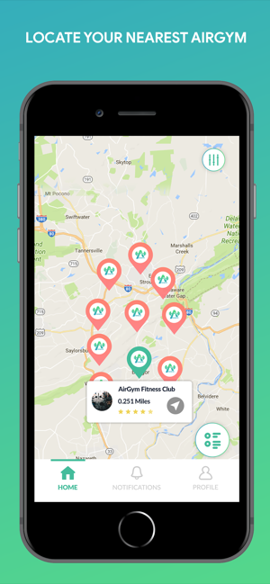
Similar Apps
There is only one App similar to mine, AirGym
AirGym was developed in 2017 by a entrepreneur who lived in a community of garage gym owners in Tennessee.

Slide 5
GymShare is currently still in Development, Future Updates Include…
Future updates will include a payment system, hosting your app on the world map with one click of a button.
The ability to rate gyms and leave a comment.
App appearance improvements.

Slide 6
Technology used in GymShare
Google’s Maps API
Google’s FireBase API

Slide 7
Problems encountered While Developing
Using Geocode to convert user’s address to Latitude and Longitude and add a marker on map using users Lat/Long.
Payment System

Slide 8
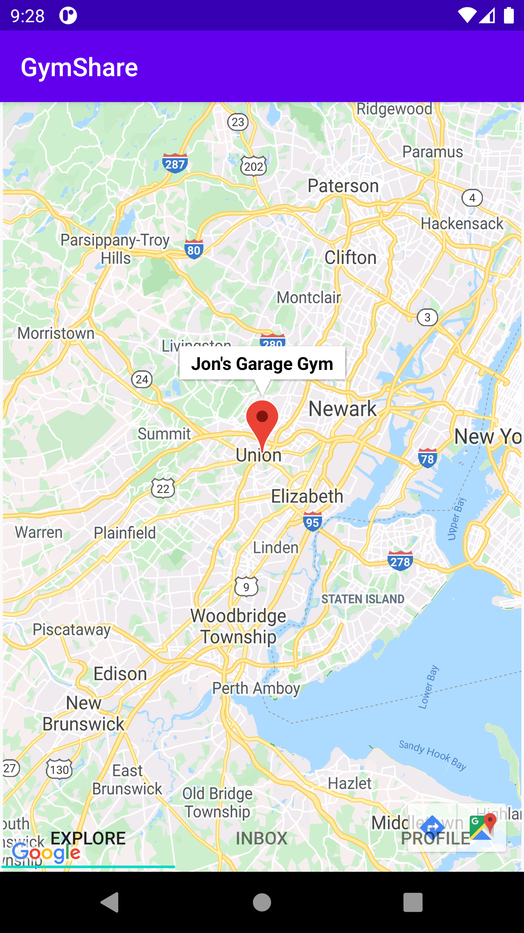
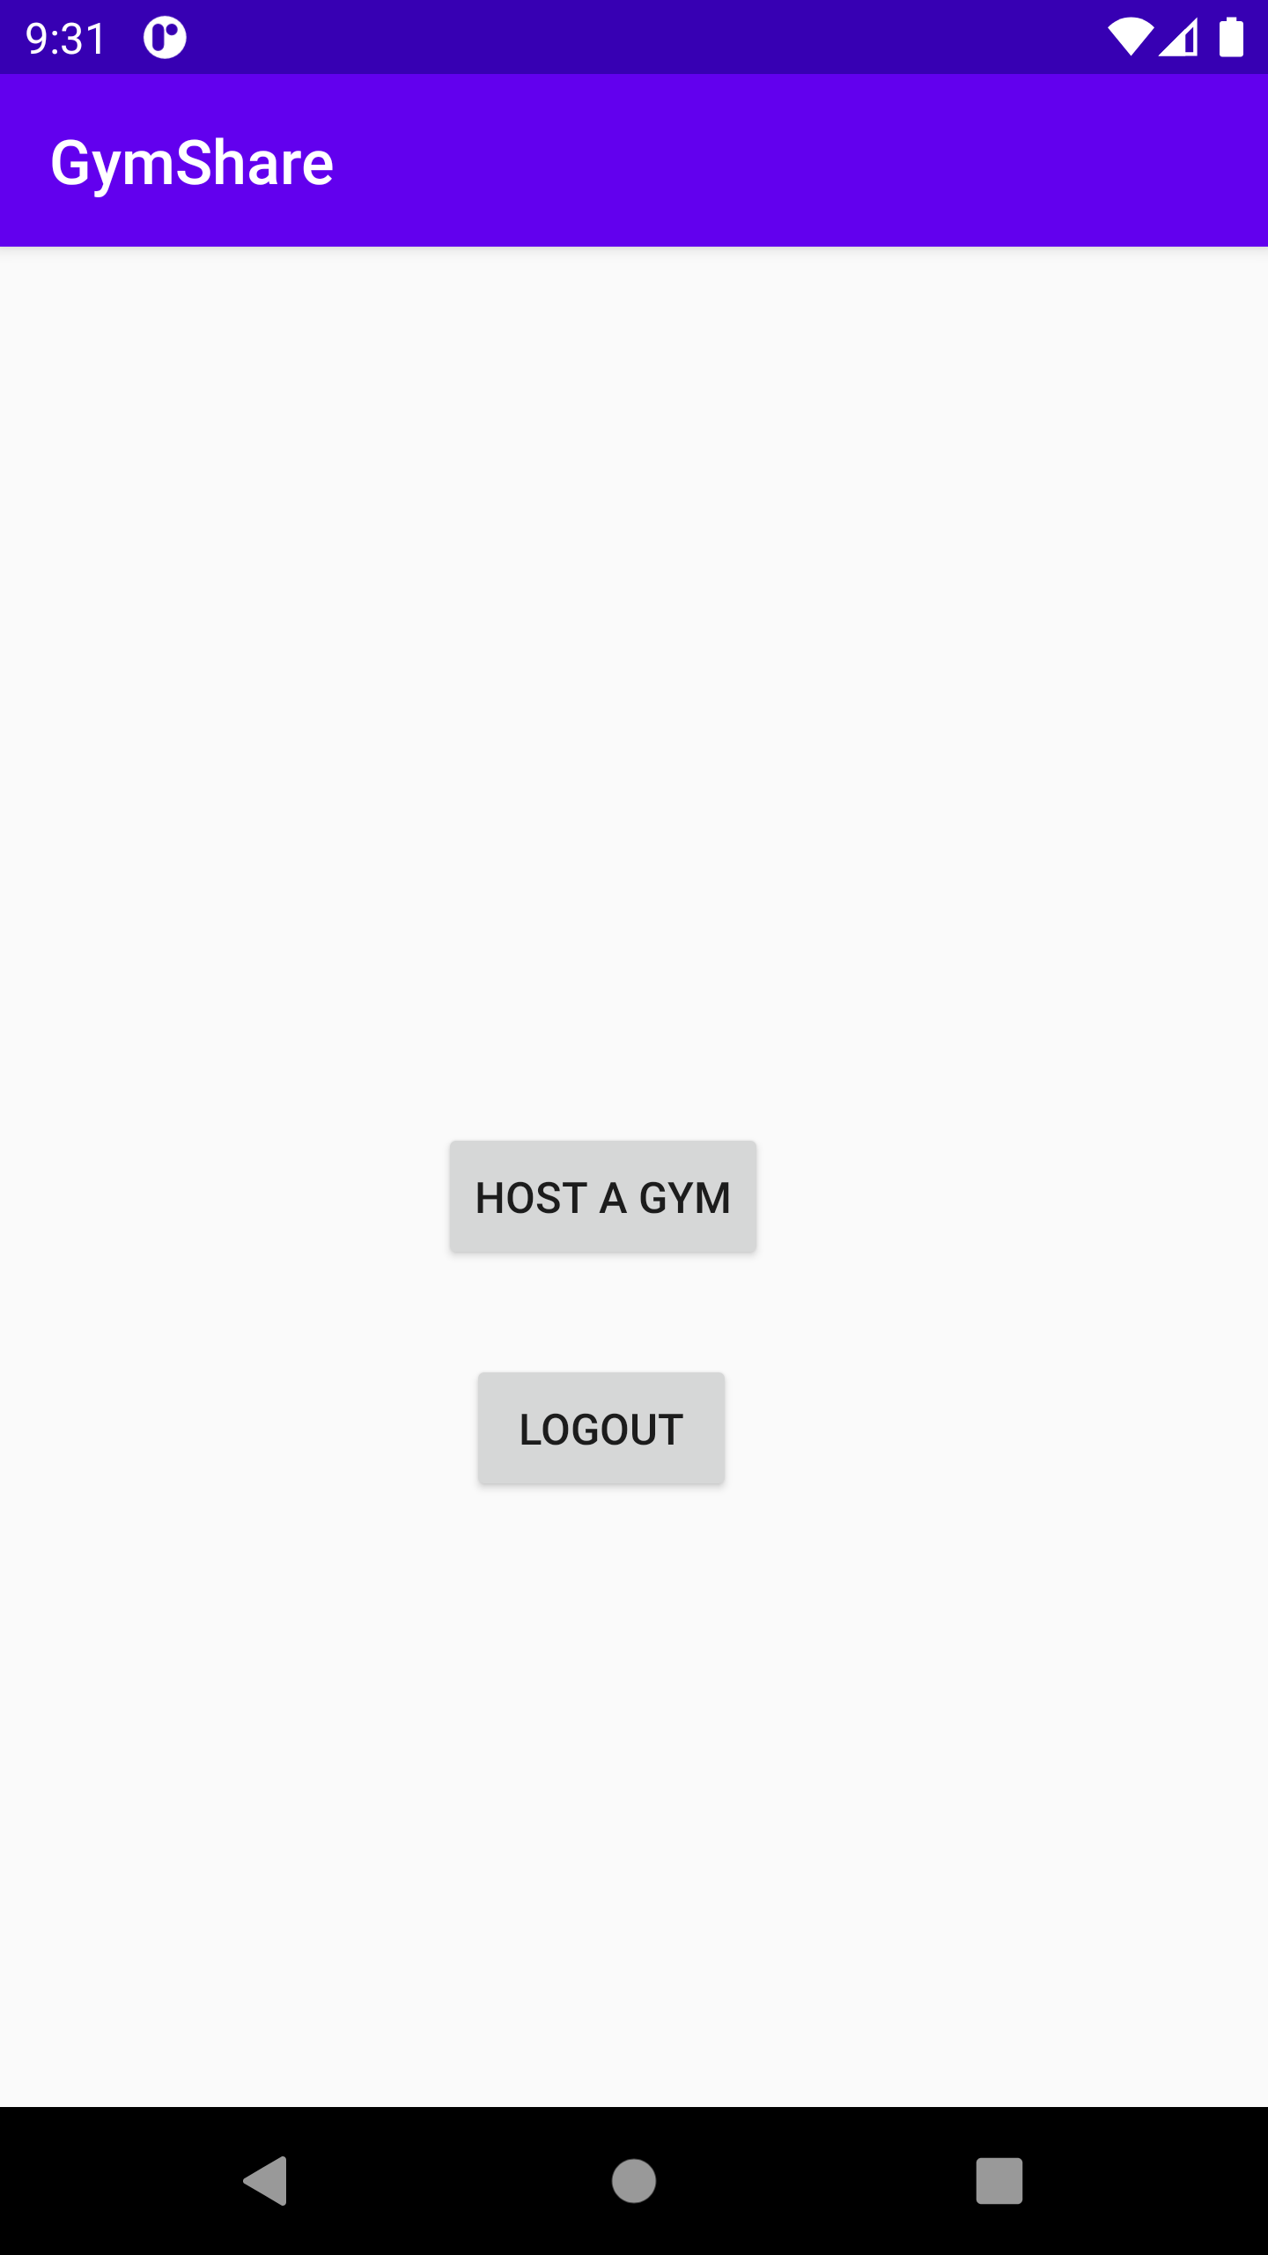
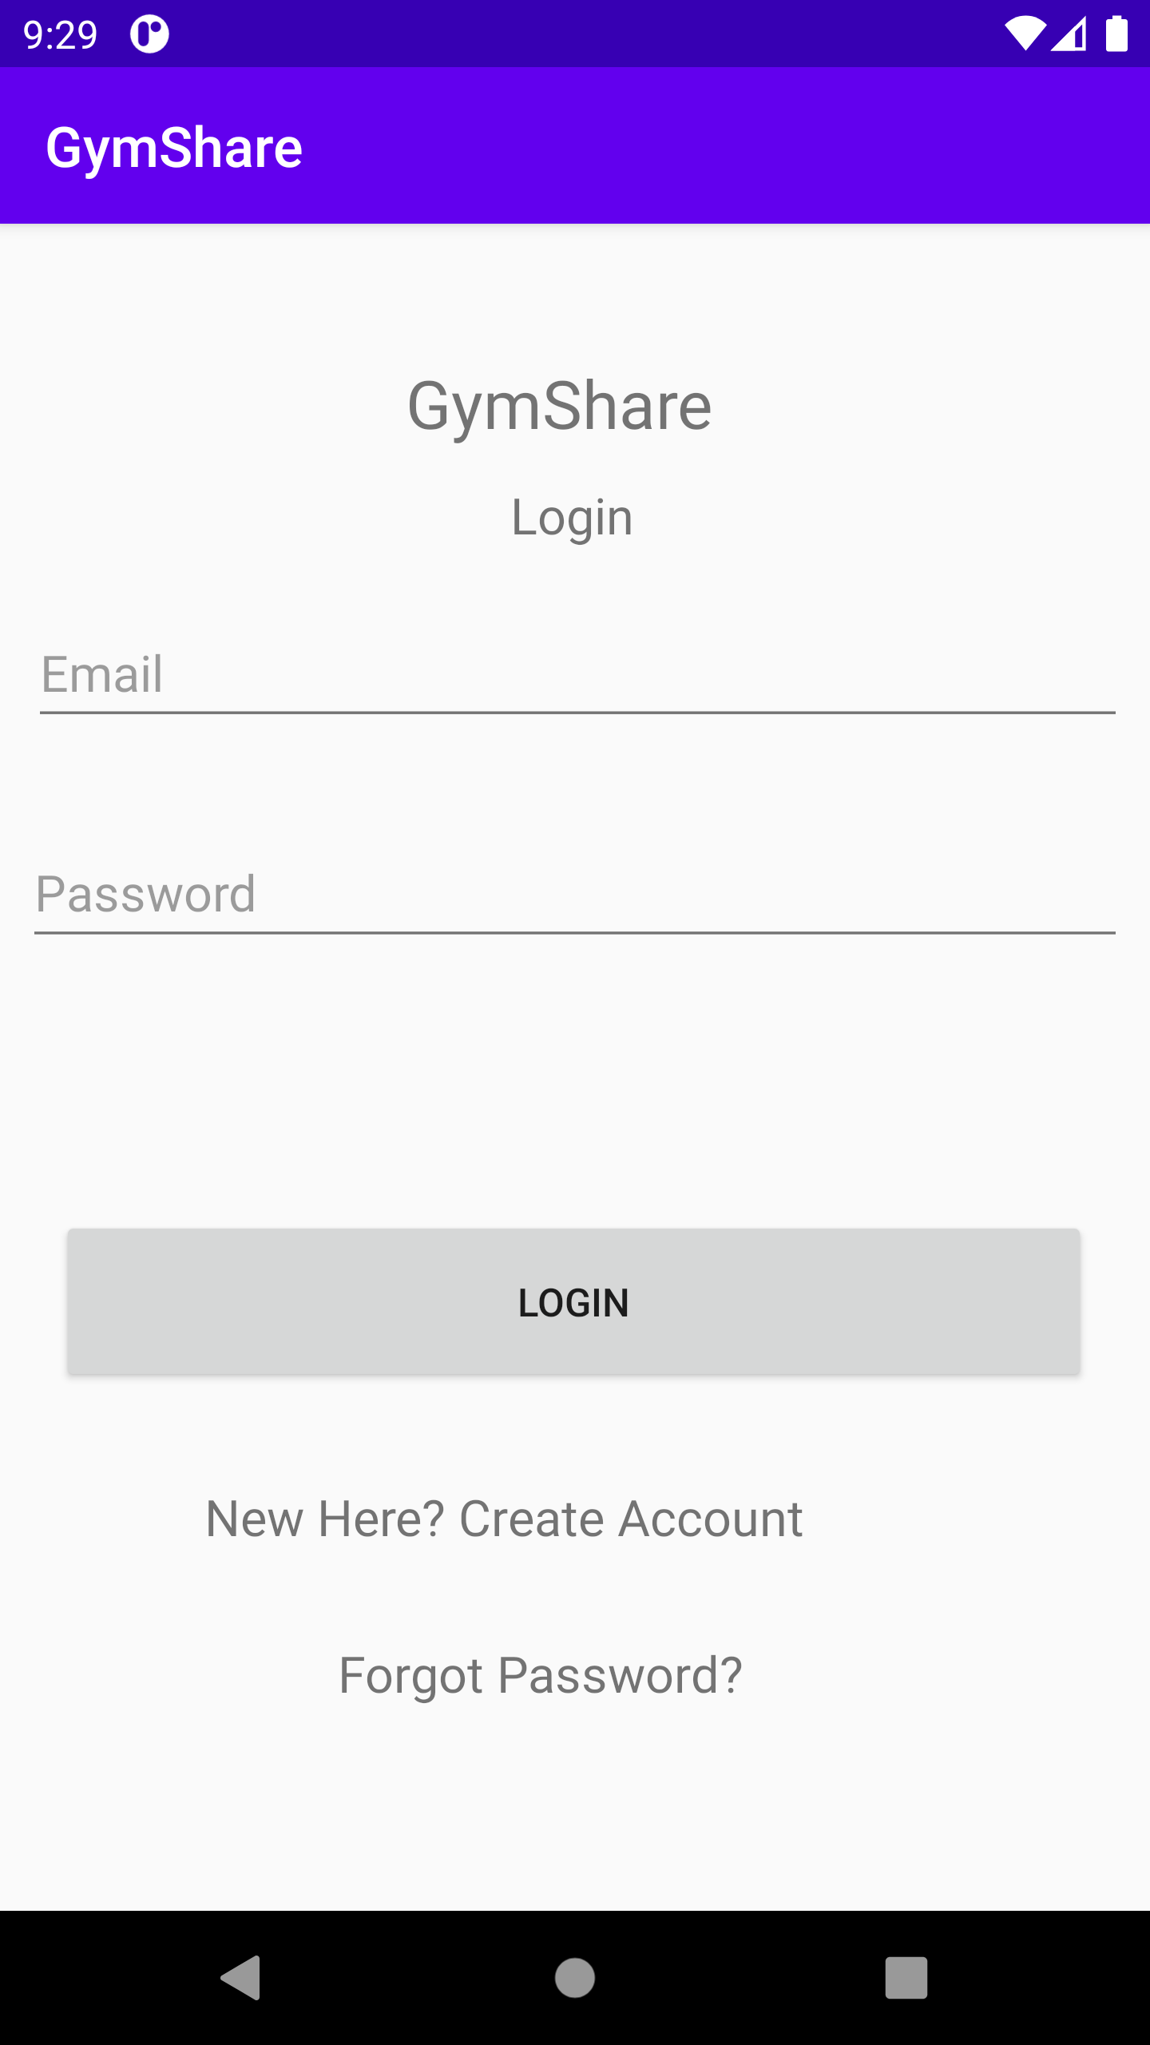
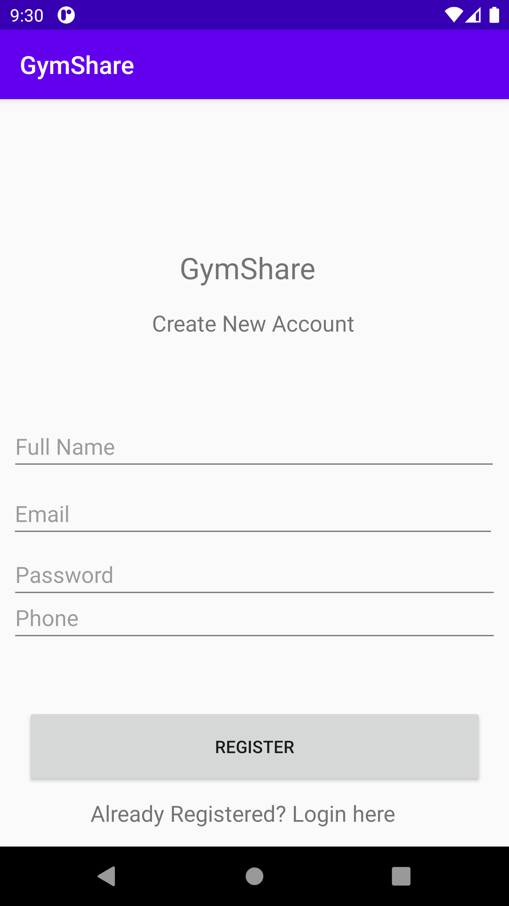
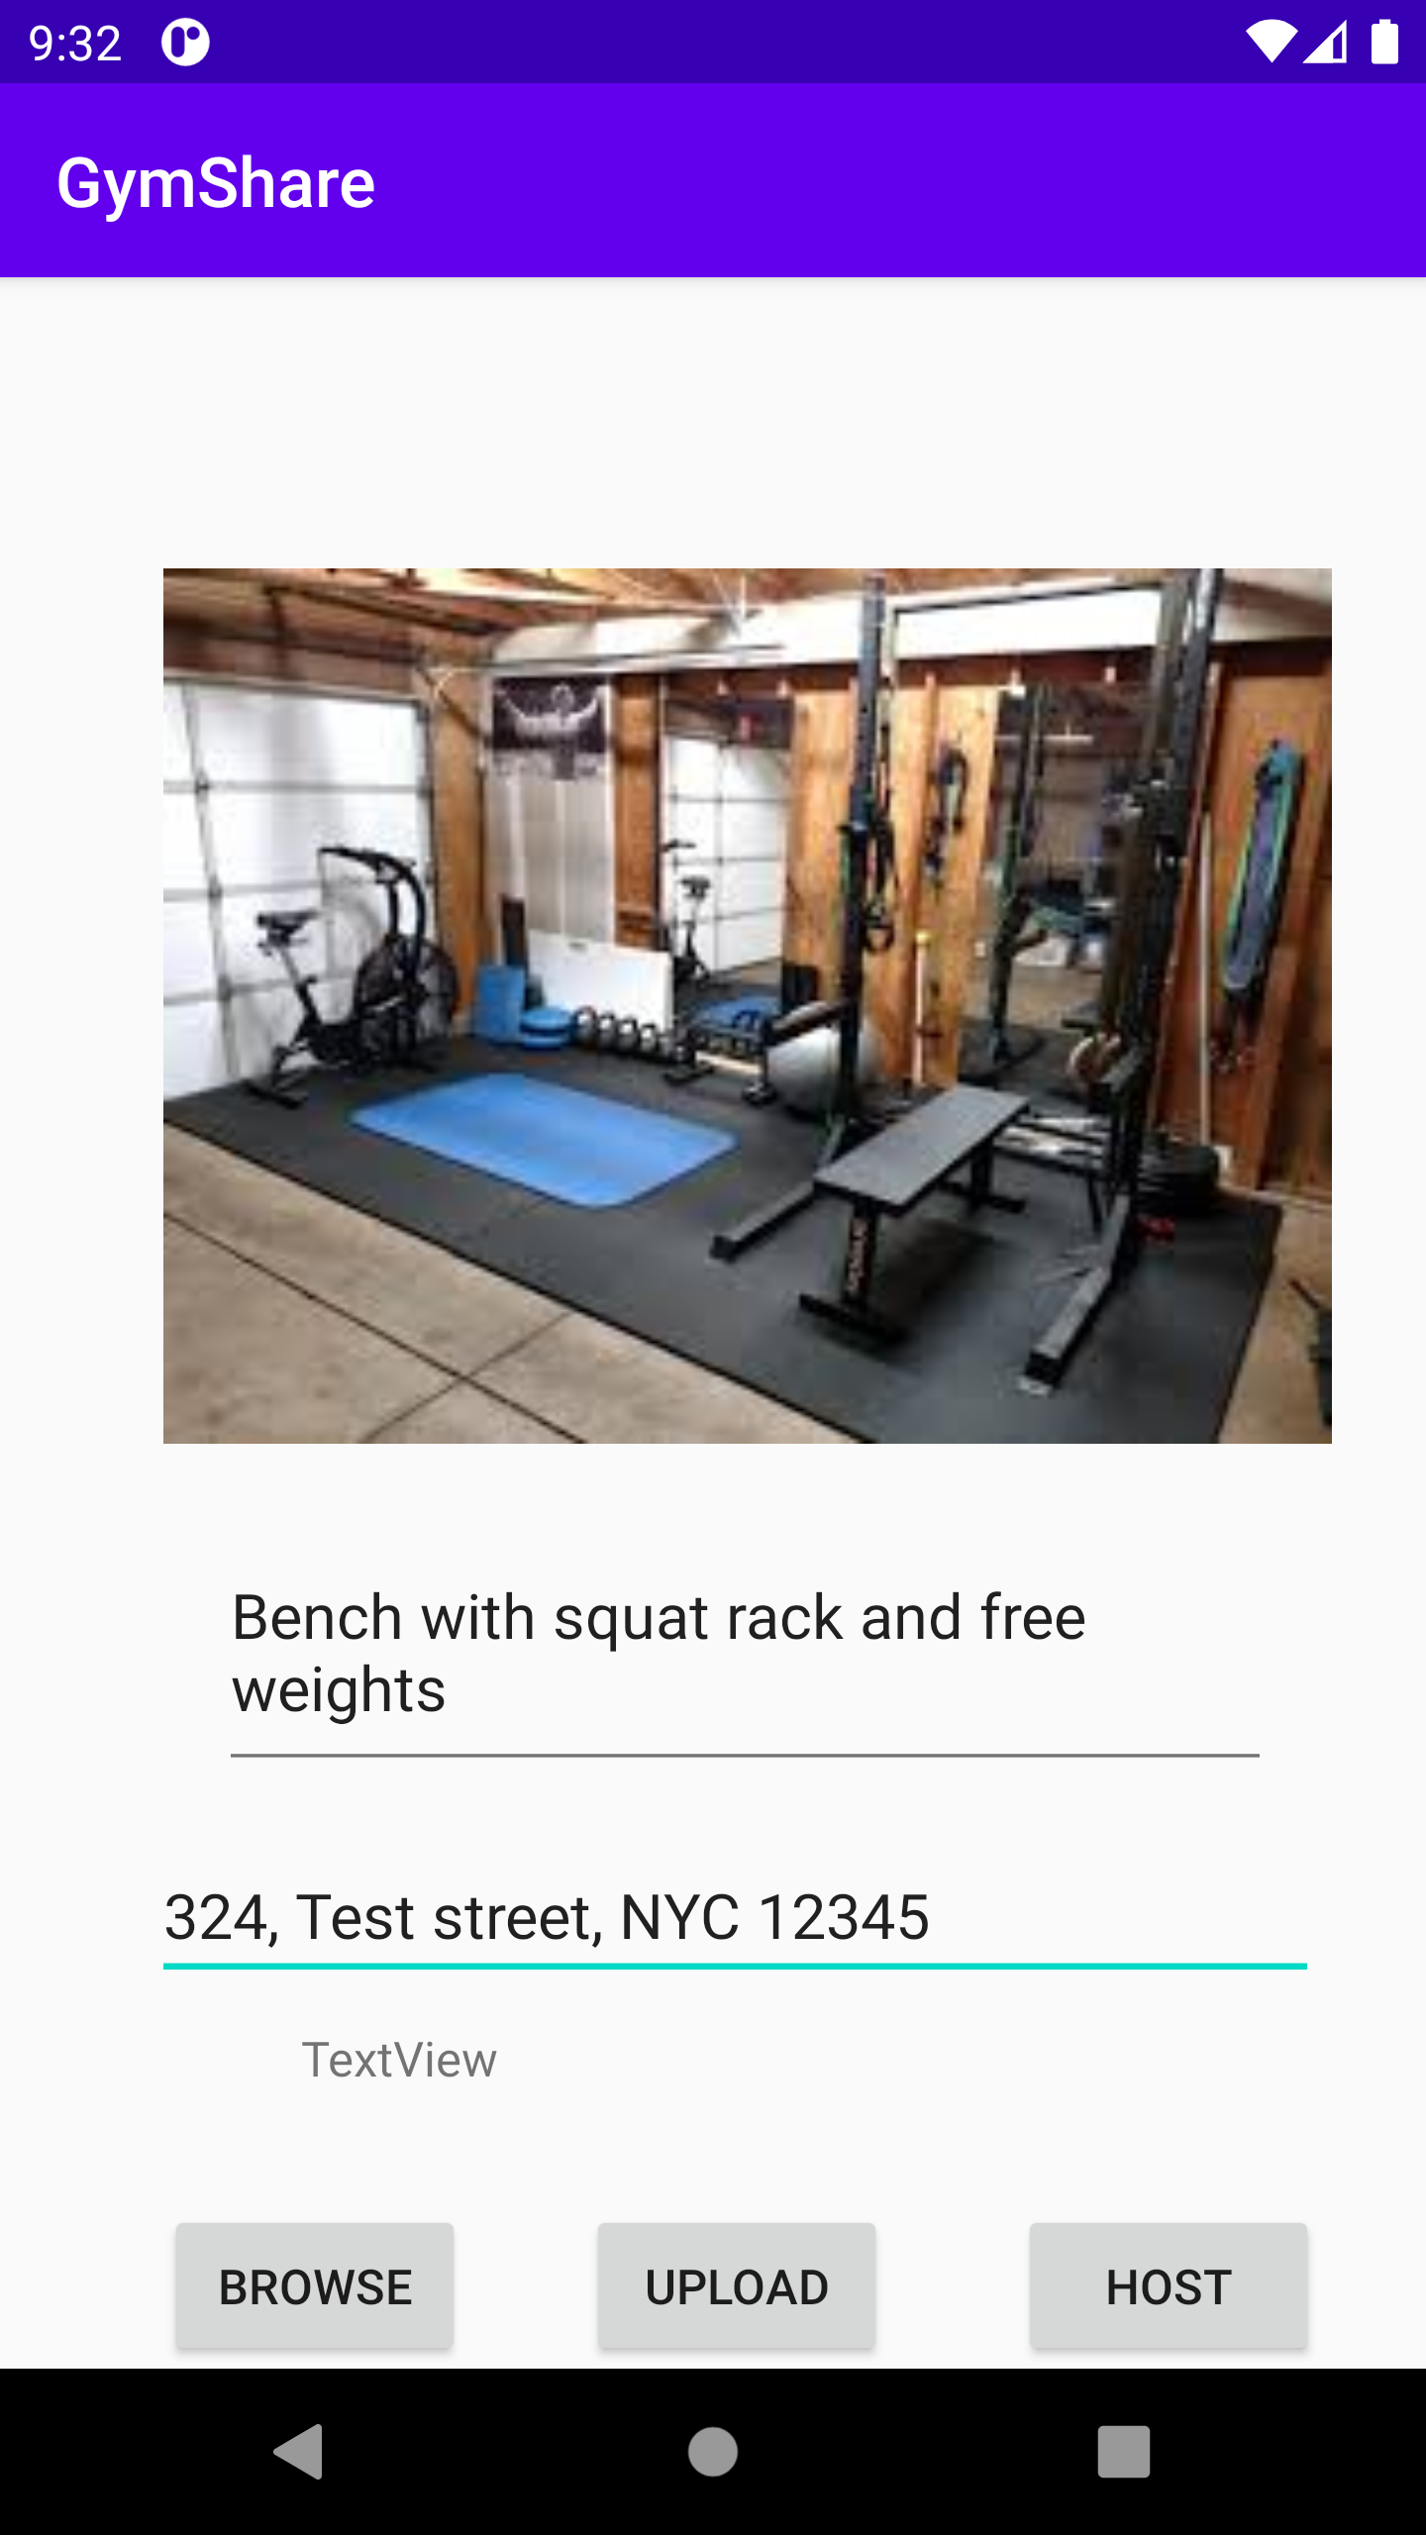
Pictures of GymShare

