Slide 1
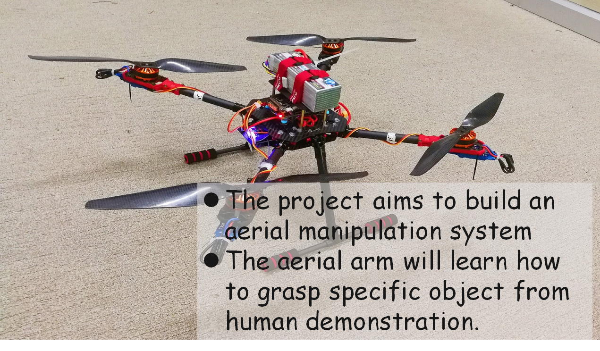
Recap: Research Questions
The project aims to build an aerial manipulation system(mount robotic arm under the drone)
The aerial arm will learn how to grasp specific object from human demonstration.

Slide 2
Research Question
We are trying to build intelligent Unmanned Aerial Manipulator, interacting and cooperating with users to accomplish general daily tasks.
Platform Design
Learning Framework offline+online
Efficient model learning from Joint- Action demonstration

Slide 3
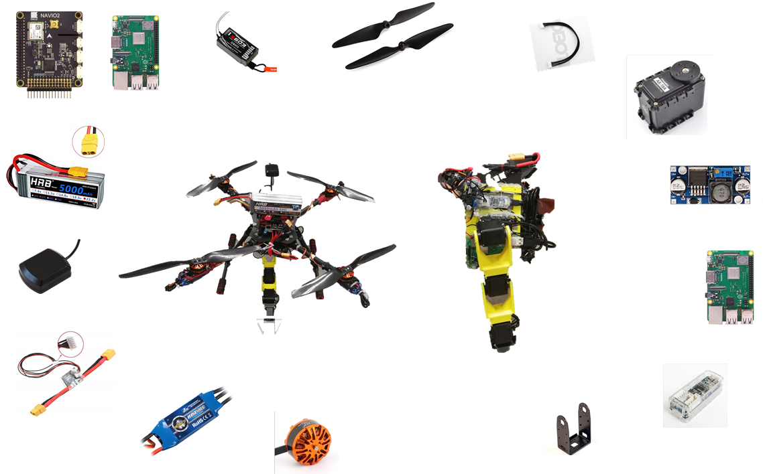

Slide 4
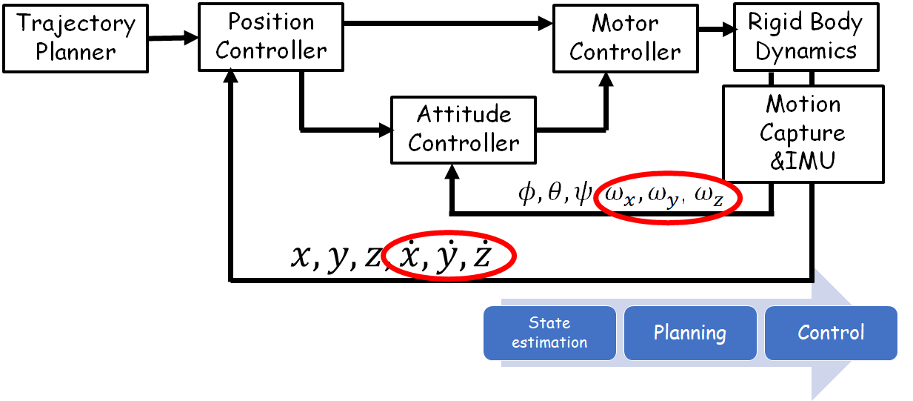

Slide 5
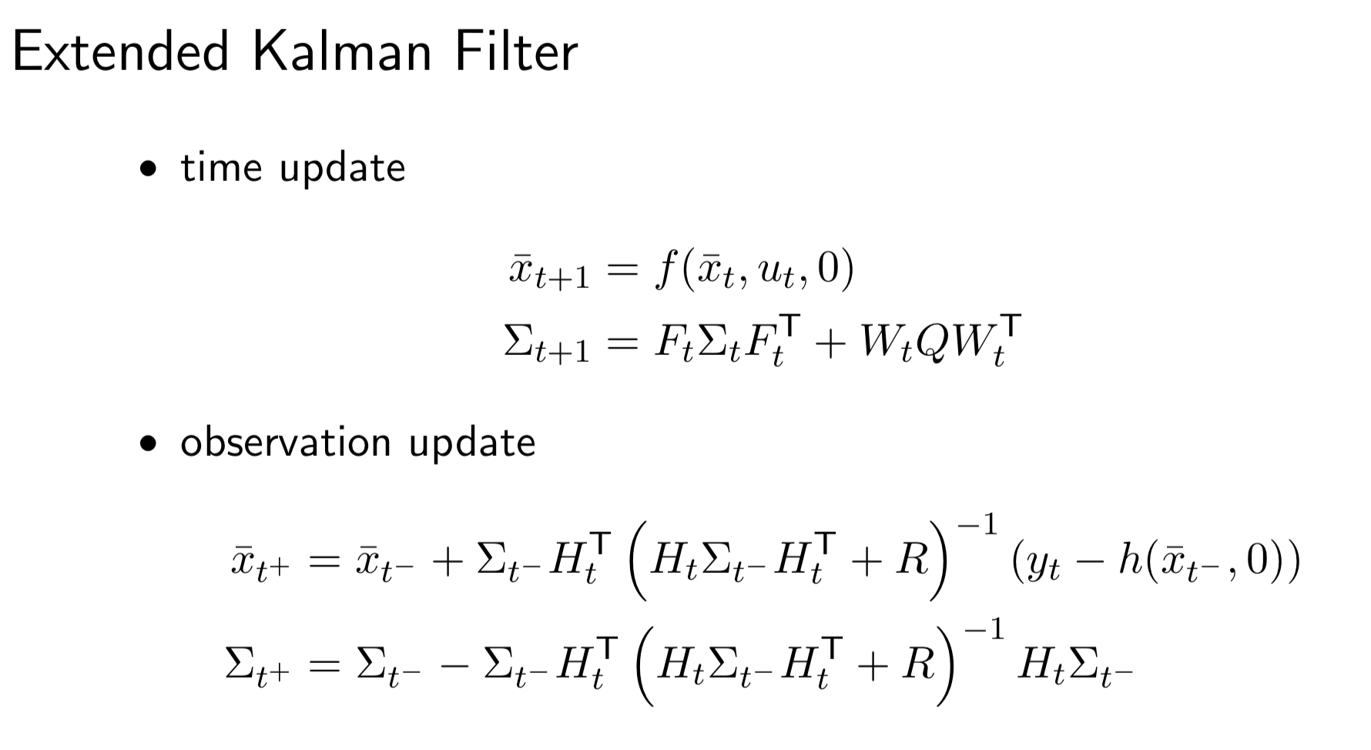
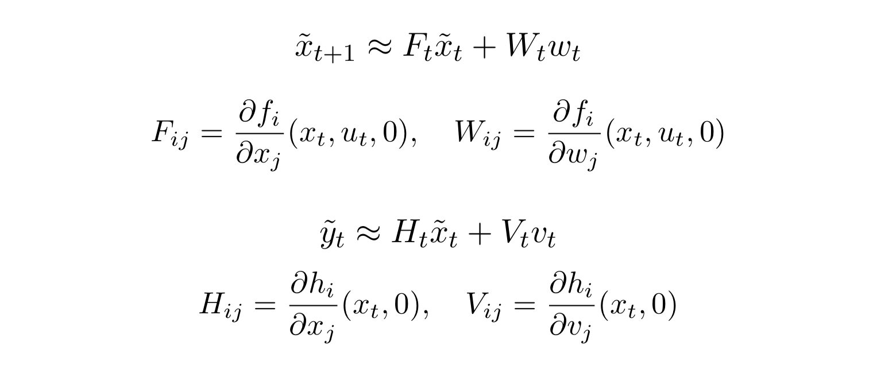
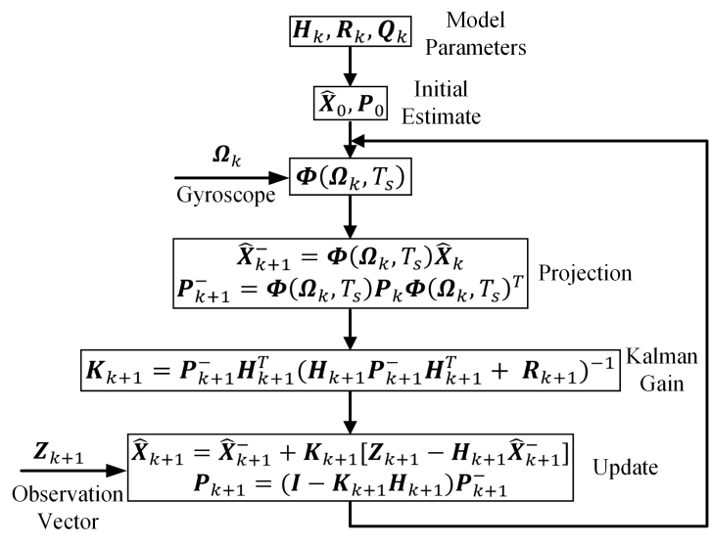
16 states Extended Kalman Filter is derived based on kinematic model for state estimation.

Slide 6
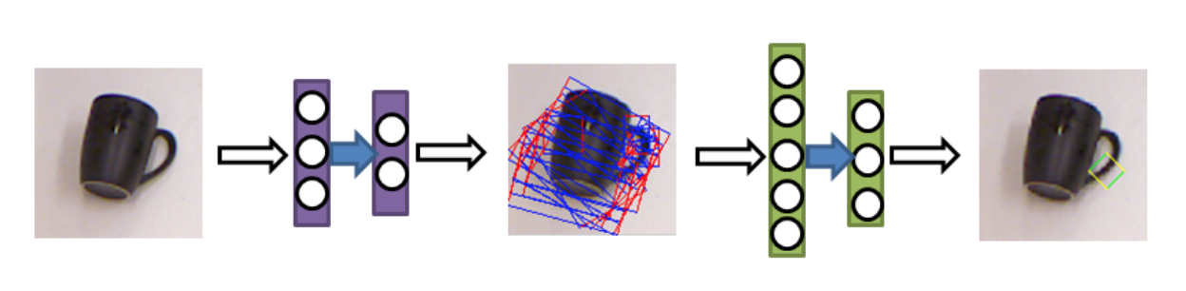
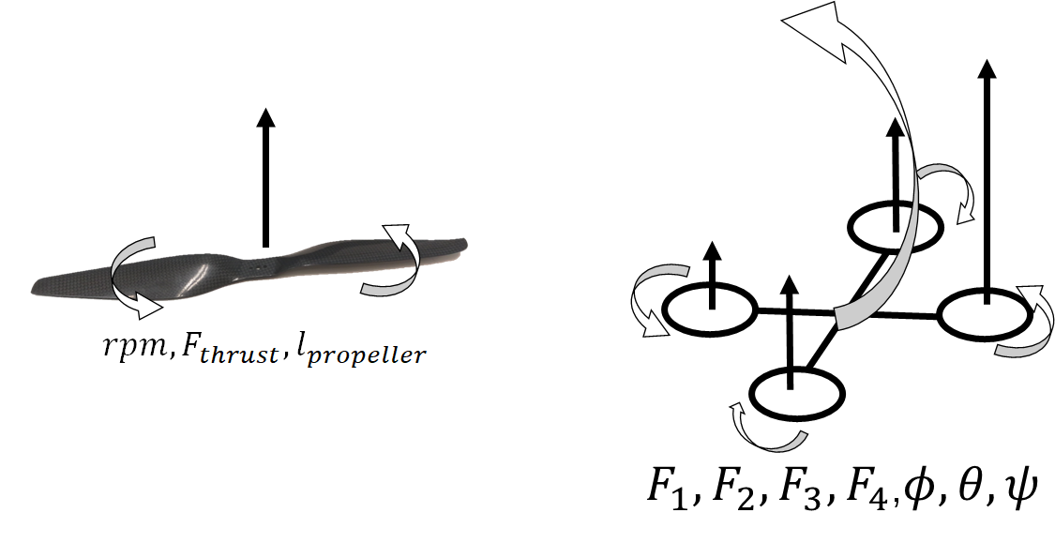
Finish debugging state estimation code.
Derive dynamic model of quadcopter
Software for control
Training offline model with force information
RL for IKsolver

Slide 7
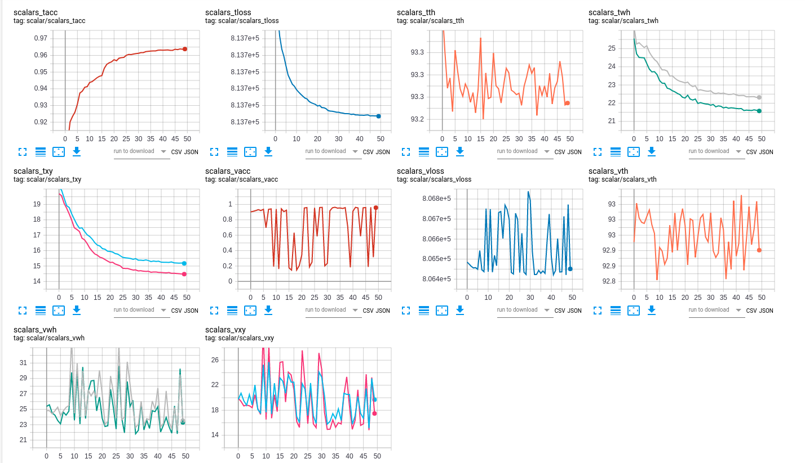

Slide 8
