Slide 1
Spark basic
Li Zhichao
Software Engineer@ Big Data Technologies
Spark 1.5.2

Slide 2
https://github.com/zhichao-li/fudan-tutorial tar -zxvf xxxspark.tgz zhichao.li@intel.com pip install pyspark -i https://pypi.tuna.tsinghua.edu.cn/simple

Slide 3
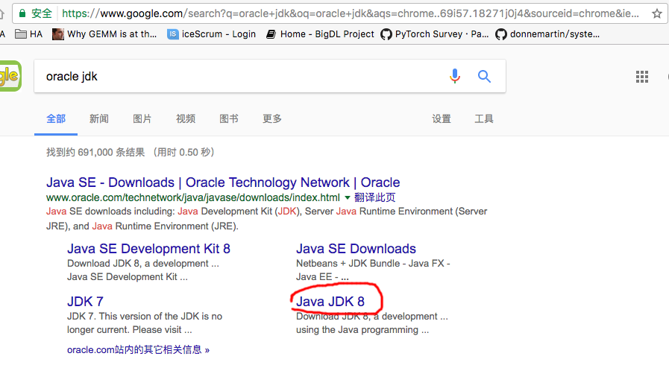

Slide 4
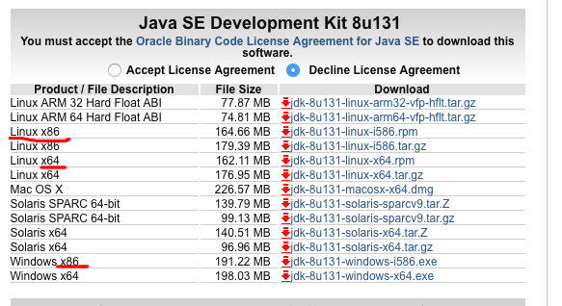

Slide 5
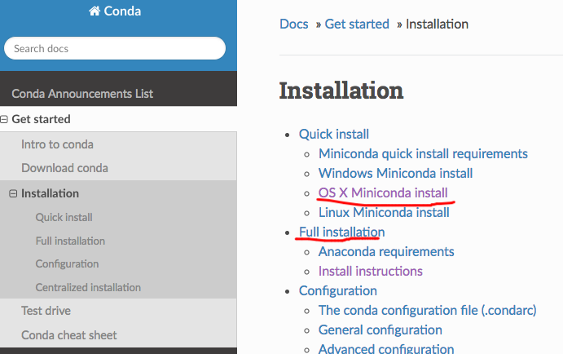
Conda
https://conda.io/docs/installation.html

Slide 6
Scala -> bytecode ---| Python wrapper | --》 JVM Java -> bytecode ---|

Slide 7
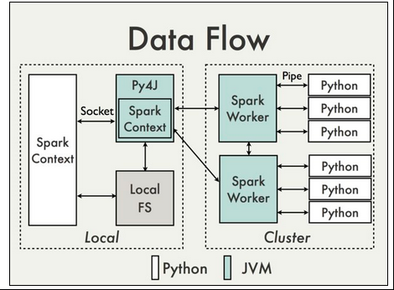

Slide 8
Go through spark
https://spark.apache.org/docs/latest/
https://spark.apache.org/docs/latest/cluster-overview.html
https://spark.apache.org/docs/latest/submitting-applications.html

Slide 9
bash ./Miniconda2-latest-MacOSX-x86_64.sh
pip install Faker
export JAVA_HOME= path to java
export PATH=path_to_java/bin:$PATH
export SPARK_HOME=path to spark-2.0.2-bin-hadoop2.7
export PYTHONPATH=$SPARK_HOME/python/lib/pyspark.zip:$SPARK_HOME/python/lib/py4j-0.10.3-src.zip
jupyter notebook

Slide 10
export JAVA_HOME=/Library/java/JavaVirtualMachines/jdk1.8.0_131.jdk/Contents/Home
export PATH=$JAVA_HOME/bin:$PATH
which java
/Library/java/JavaVirtualMachines/jdk1.8.0_131.jdk/Contents/Home/bin/java
java -version
java version "1.8.0_131"
Java(TM) SE Runtime Environment (build 1.8.0_131-b11)
Java HotSpot(TM) 64-Bit Server VM (build 25.131-b11, mixed mode)

Slide 11
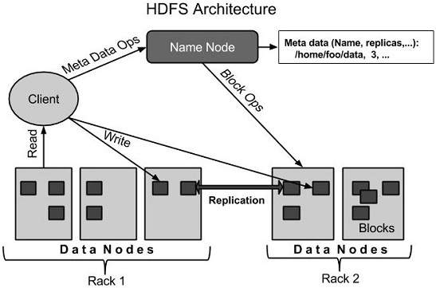
HDFS

Slide 12
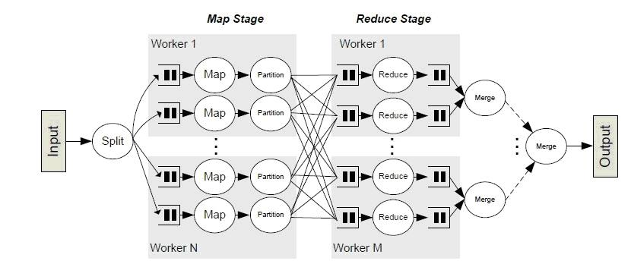
shuffle

Slide 13
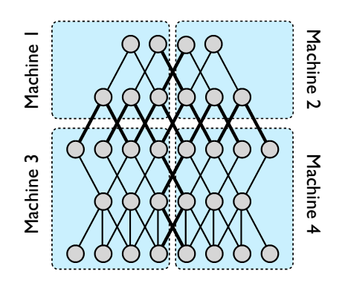
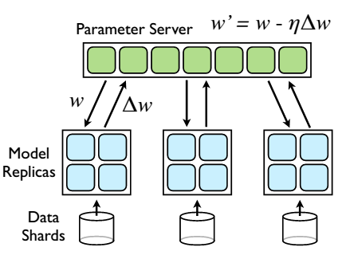
Pattern
Model Parallelism
Data Parallelism
Source: Dean J, Corrado G, Monga R, et al. Large scale distributed deep networks[C]//Advances in neural information processing systems. 2012: 1223-1231.

Slide 14
Communication Model
Task
Task
Driver
Task
Task
Task
Task
All to one
Parameter Server
11
10
35
Task
35
14
4
7
2
35
Task
Task
35
35
35
5
1
35
6
2
5
1
6
Task
All reduce (tree aggregation)
All reduce

Slide 15
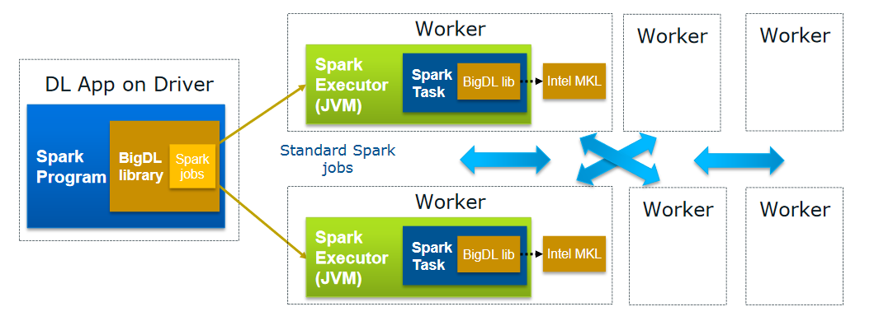
BigDL Features
Distributed Deep learning applications on Apache Spark*
No changes to the existing Hadoop/Spark clusters needed

Slide 16
SQLContext HiveContext SparkSession
https://spark.apache.org/docs/latest/sql-programming-guide.html
https://github.com/apache/spark/blob/master/python/pyspark/sql/context.py
https://databricks.com/blog/2015/02/17/introducing-dataframes-in-spark-for-large-scale-data-science.html

Slide 17
What’s Spark SQL*?
http://spark.apache.org/
*Other names and brands may be claimed as the property of others.

Slide 18
Entry points
class HiveContext(sc: SparkContext) extends SQLContext(sc)
bin/spark-shell
bin/spark-sql

Slide 19
Demo with SQL
Michael, 29
Andy, 30
Justin, 19
1. Combine case class with data
2. CREATE TABLE IF NOT EXISTS people (name STRING, age STRING)
LOAD DATA LOCAL INPATH ‘people.txt'
INTO TABLE people;

Slide 20
Demo with SQL
val sqlContext = new org.apache.spark.sql.SQLContext(sc)
import sqlContext.implicits._
case class Person(name: String, age: Int)
val people = sc.textFile("examples/src/main/resources/people.txt")
.map(_.split(","))
.map(p => Person(p(0), p(1).trim.toInt)) //RDD[People] ->DataFrameHolder
.toDF()
people.registerTempTable("people")
// people.saveAsTable("people")

Slide 21
Demo with SQL
val teenagers = sqlContext.sql("SELECT name, age FROM people WHERE age >= 13 AND age <= 19")
teenagers.map(t => "Name: " + t(0)).collect().foreach(println)
teenagers.map(t => "Name: " + t.getAs[String]("name")).collect().foreach(println)

Slide 22
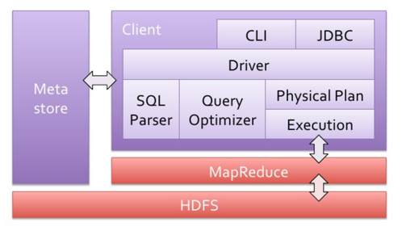
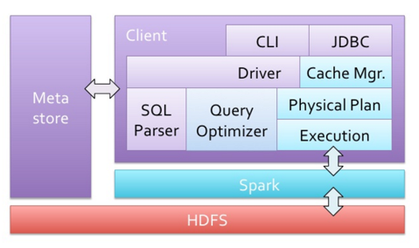
Demo with Hive*
Hive Architecture
Spark* Architecture
*Other names and brands may be claimed as the property of others.

Slide 23
Demo with Hive*
CREATE TABLE IF NOT EXISTS people (name STRING, age STRING)
ROW FORMAT DELIMITED FIELDS TERMINATED BY ','
LINES TERMINATED BY '\n'
STORED AS textfile;
LOAD DATA LOCAL INPATH 'examples/src/main/resources/people.txt'
INTO TABLE people;
queries_in_hql.scala
*Other names and brands may be claimed as the property of others.

Slide 24
Other features: Dataframe
val teenagers = sqlContext.sql("SELECT name, age FROM people WHERE age >= 13 AND age <= 19")
VS
val teenagers =people.where('age >= 13).where('age <= 19).select('name)
val teenagers =people.where(people(age) >= 13).where(people(age) <= 19).select(people(name))
dsl.scala

Slide 25
Other features: Parquet
A columnar format
http://parquet.io/
A | B | C
A1 | B1 | C1
A2 | B2 | C2
A3 | B3 | C3
A1 | B1 | C1
A2 | B2 | C2
A3 | B3 | C3
Row format
A1 | A2 | A3
B1 | B2 | B3
C1 | C2 | C3
Columnar format

Slide 26

Other features: Parquet
Spark SQL* supports read/write of parquet files, automatically preserving the schema of the original data parquet.scala
DataFrames:
val people: RDD[Person] = ...
people.toDF().write.format("parquet").save(“people.parquet")
people.write.parquet("people.parquet") //convenient method
val peopleDF = sqlContext.read.parquet("people.parquet")
SQL:
CREATE TABLE people USING parquet
OPTIONS (path "people.parquet")
*Other names and brands may be claimed as the property of others.

Slide 27

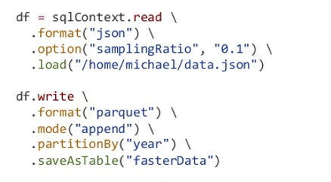
Other features: more option for input & output
https://databricks.com/blog/2015/01/09/spark-sql-data-sources-api-unified-data-access-for-the-spark-platform.html
Built-in： Json*, Parquet*, Amazon* S3, HDFS* ..
External: CSV*, Hbase*, AVRO*, Cassandra*..
*Other names and brands may be claimed as the property of others.

Slide 28
Example for Third-party data source
Github*:
https://github.com/databricks/spark-csv
Maven*:
com.databricks:spark-csv_2.10:1.2.0
Code:
val peopleCsvDF = sqlContext.read .format("com.databricks.spark.csv")
.load("people.csv")
.toDF("name", "age")
spark-packages.org
*Other names and brands may be claimed as the property of others.
Notes:
spark-packages.org managed by databricks. Contains links to externally-managed github projects.

Slide 29
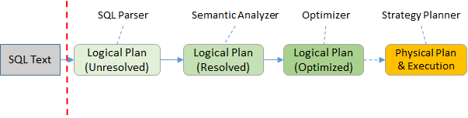
How does Spark SQL* work?
*Other names and brands may be claimed as the property of others.
Notes:
https://software.intel.com/en-us/blogs/2015/05/01/restudy-schemardd-in-sparksql

Slide 30
How does Spark SQL* work?
spark-sql> explain extended SELECT name
FROM (
SELECT *
FROM people ) p
WHERE p.age > 20;
== Parsed Logical Plan ==
'Project [unresolvedalias('name)]
'Filter ('p.age > 20)
'Subquery p
'Project [unresolvedalias(*)]
'UnresolvedRelation [people], None
== Analyzed Logical Plan ==
name: string
Project [name#17]
Filter (cast(age#18 as double) > cast(20 as double))
Subquery p
Project [name#17,age#18]
MetastoreRelation default, people, None
*Other names and brands may be claimed as the property of others.
Notes:
通过explain extended 可以打印出sql语句具体的分析情况。

Slide 31
How does Spark SQL* work?
== Parsed Logical Plan ==
'Project [unresolvedalias('name)]
'Filter ('p.age > 20)
'Subquery p
'Project [unresolvedalias(*)]
'UnresolvedRelation [people], None
== Analyzed Logical Plan ==
name: string
Project [name#17]
Filter (cast(age#18 as double) > cast(20 as double))
Subquery p
Project [name#17,age#18]
MetastoreRelation default, people, None
Project name
Project name#17
Filter (p.age > 20)
Filter (cast(age#18 as double) > cast(20 as double))
Project *
Project [name#17,age#18]
People
People
*Other names and brands may be claimed as the property of others.

Slide 32

How does Spark SQL* work?
== Optimized Logical Plan ==
Project [name#17]
Filter (cast(age#18 as double) > 20.0)
MetastoreRelation default, people, None
== Analyzed Logical Plan ==
name: string
Project [name#17]
Filter (cast(age#18 as double) > cast(20 as double))
Subquery p
Project [name#17,age#18]
MetastoreRelation default, people, None
Project name#17
Project [name#17,age#18]
Filter (cast(age#18 as double) > 20.0)
Filter Push-Down
People
Project name#17
Filter (cast(age#18 as double) > cast(20 as double))
Project name#17
Filter (cast(age#18 as double) > 20.0)
Project [name#17,age#18]
People
People
*Other names and brands may be claimed as the property of others.

Slide 33
How does Spark SQL* work?
== Optimized Logical Plan ==
Project [name#17]
Filter (cast(age#18 as double) > 20.0)
MetastoreRelation default, people, None
== Physical Plan ==
Project [name#17]
Filter (cast(age#18 as double) > 20.0)
HiveTableScan [name#17,age#18], (MetastoreRelation default, people, None)
*Other names and brands may be claimed as the property of others.

Slide 34
How does Spark SQL* work?
*Other names and brands may be claimed as the property of others.
Notes:
https://software.intel.com/en-us/blogs/2015/05/01/restudy-schemardd-in-sparksql

Slide 35

How Spark SQL* works? Strategy
spark-sql> explain extended select * from people p1 join people p2 where p1.age = p2.age;
== Optimized Logical Plan ==
Project [name#1,age#2,name#3,age#4]
Join Inner, Some((age#2 = age#4))
MetastoreRelation default, people, Some(p1)
MetastoreRelation default, people, Some(p2)
== Physical Plan ==
TungstenProject [name#67,age#68,name#69,age#70]
BroadcastHashJoin [age#68], [age#70], BuildRight
ConvertToUnsafe
HiveTableScan [name#67,age#68], (MetastoreRelation default, people, Some(p1))
ConvertToUnsafe
HiveTableScan [name#69,age#70], (MetastoreRelation default, people, Some(p2))
*Other names and brands may be claimed as the property of others.
Notes:
Reference: https://software.intel.com/en-us/blogs/2015/05/01/restudy-schemardd-in-sparksql
Reduce join VS Map join

Slide 36
How does Spark SQL* work?
bin/spark-sql --conf spark.sql.autoBroadcastJoinThreshold=-1
spark-sql> explain extended select * from people p1 join people p2 where p1.age = p2.age;
== Optimized Logical Plan ==
Project [name#1,age#2,name#3,age#4]
Join Inner, Some((age#2 = age#4))
MetastoreRelation default, people, Some(p1)
MetastoreRelation default, people, Some(p2)
== Physical Plan ==
TungstenProject [name#1,age#2,name#3,age#4]
SortMergeJoin [age#2], [age#4]
TungstenSort [age#2 ASC], false, 0
TungstenExchange hashpartitioning(age#2)
ConvertToUnsafe
HiveTableScan [name#1,age#2], (MetastoreRelation default, people, Some(p1))
TungstenSort [age#4 ASC], false, 0
TungstenExchange hashpartitioning(age#4)
ConvertToUnsafe
HiveTableScan [name#3,age#4], (MetastoreRelation default, people, Some(p2))
*Other names and brands may be claimed as the property of others.
Notes:
Reference: https://software.intel.com/en-us/blogs/2015/05/01/restudy-schemardd-in-sparksql
这个参数是什么意思呢？ 表示小于这个阀值的，都会去做broadcast join

Slide 37
Join strategy
Map side join: BroadcastJoin
Reduce side join: ShuffledHashJoin, SortMergeJoin
http://www.slideshare.net/databricks/strata-sj-everyday-im-shuffling-tips-for-writing-better-spark-programs

Slide 38

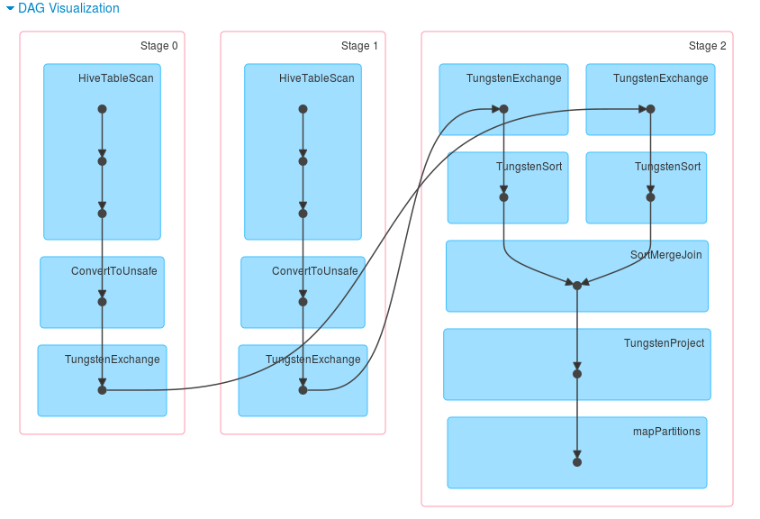
SortMergeJoin

Slide 39
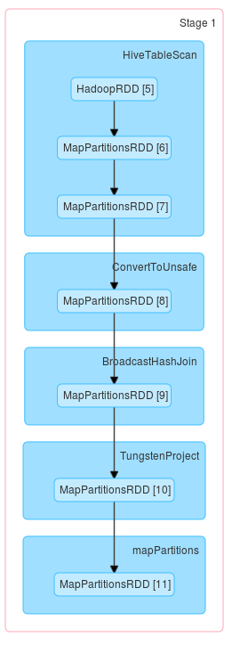
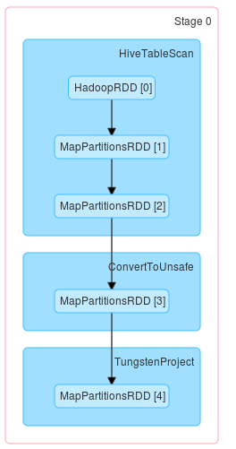
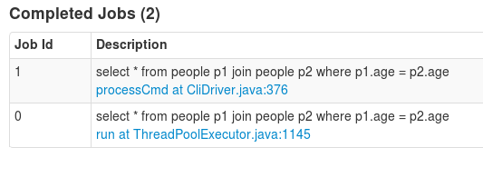
BroadcastHashJoin
…
BT1_p1
BT1_p1
BT1_p1
Small_table1
Small_table1
http://www.slideshare.net/databricks/strata-sj-everyday-im-shuffling-tips-for-writing-better-spark-programs

Slide 40
How does Spark SQL* work?
More option:
spark.sql.autoBroadcastJoinThreshold : maximum size in bytes for a table that will be broadcastjoin
spark.sql.shuffle.partitions: the number of partitions to use when shuffling data for joins or aggregations.
http://spark.apache.org/docs/latest/sql-programming-guide.html#performance-tuning
*Other names and brands may be claimed as the property of others.

Slide 41
Good references
http://spark.apache.org/
https://software.intel.com/en-us/blogs/2015/05/01/restudy-schemardd-in-sparksql
https://en.wikipedia.org/wiki/Sort-merge_joinks
http://www.slideshare.net/databricks/strata-sj-everyday-im-shuffling-tips-for-writing-better-spark-programs
http://sqlity.net/en/1480/a-join-a-day-the-sort-merge-join/
https://databricks.com/blog/2015/04/28/project-tungsten-bringing-spark-closer-to-bare-metal.html
http://www.slideshare.net/cfregly/advanced-apache-spark-meetup-data-sources-api-cassandra-spark-connector-spark-151-zeppelin-060

Slide 42
Notice and Disclaimers:
No license (express or implied, by estoppel or otherwise) to any intellectual property rights is granted by this document.
Intel does not control or audit third-party benchmark data or the web sites referenced in this document. You should visit the referenced web site and confirm whether referenced data are accurate.
Intel and the Intel logo are trademarks of Intel Corporation in the U.S. and/or other countries.
*Other names and brands may be claimed as the property of others.
Copyright ©2016 Intel Corporation.

