Slide 1
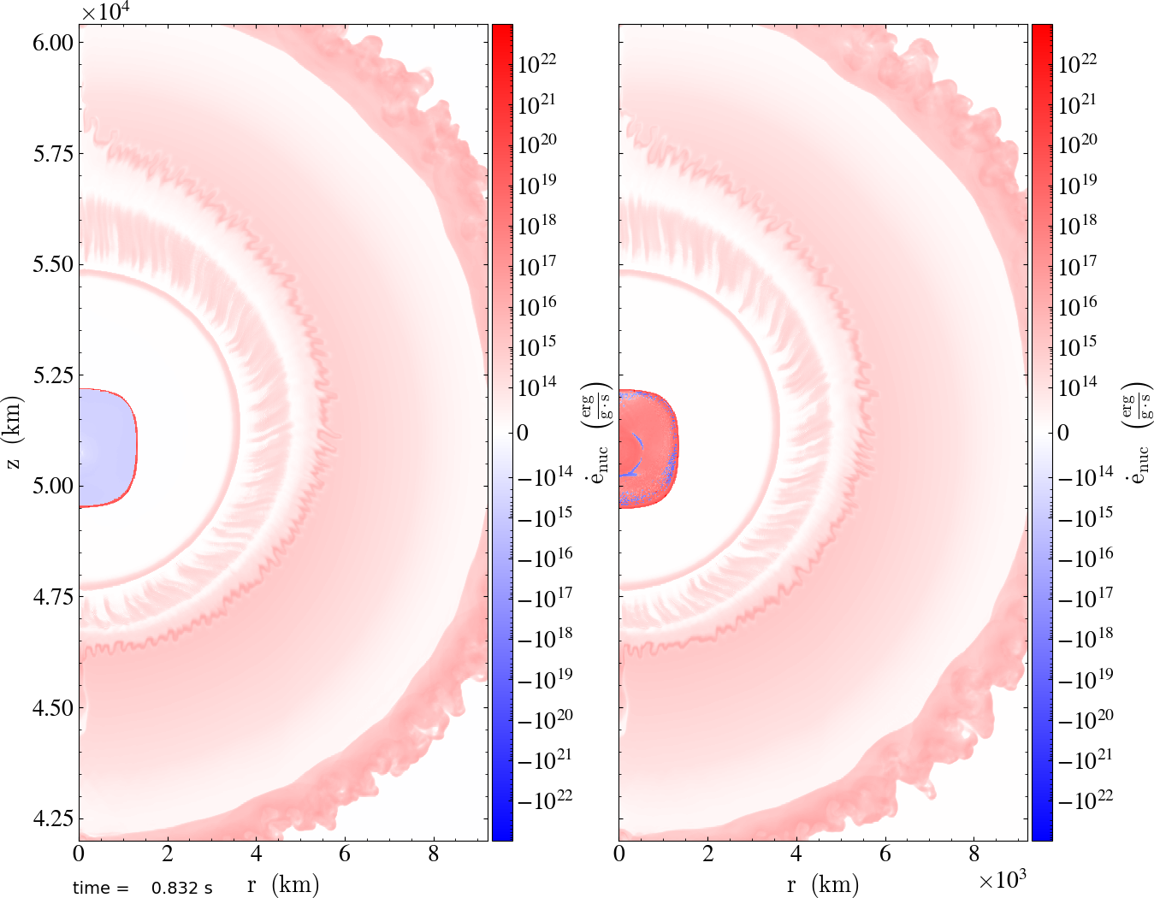
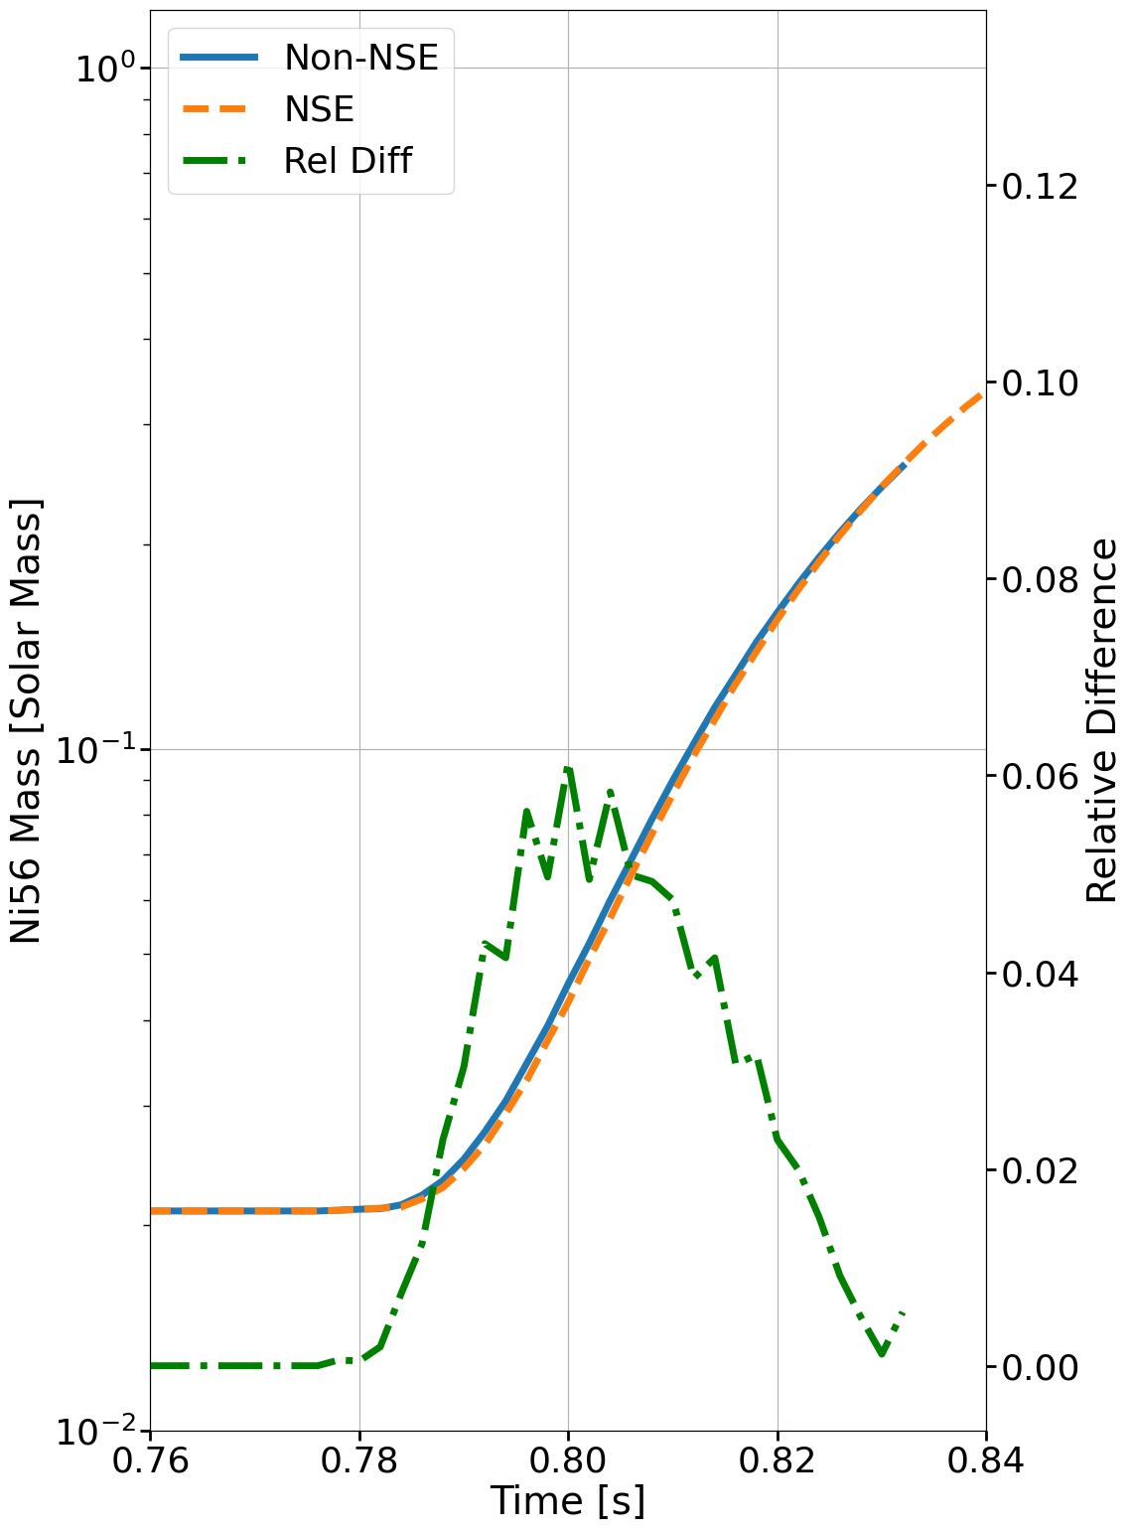
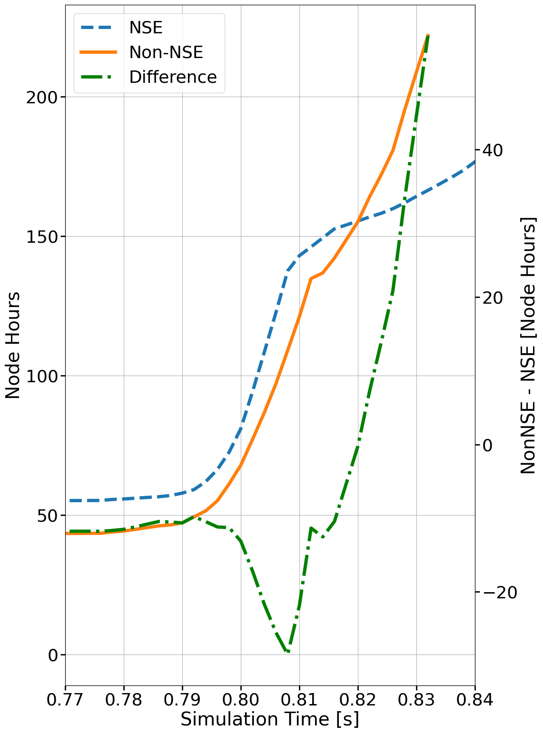





Adaptive Nuclear Statistical Equilibrium for Type Ia SN Simulation
Zhi Chen¹, Ryan Brady¹, Khanak Bhargava¹, Eric T. Johnson¹, Alexander Smith Clark¹, and Mike Zingale¹
¹Department of Physics and Astronomy, Stony Brook University, Stony Brook, NY 11794-3800, USA
INTRODUCTION
NSE EVOLUTION SCHEMATIC DIAGRAM
CONVERGENCE
Due to the stiff nature of solving reaction equations for simulating thermonuclear explosions, i.e. Type Ia SN and X-ray bursts, these simulations require careful coupling of hydrodynamics and reactions to avoid being limited by the nuclear reaction timescale instead of hydrodynamic timescale. But as temperature reaches beyond ~ 6 billion Kelvin, numerical integration becomes even more challenging when the timescale of the composition to reach statistical equilibrium is much shorter than the sound crossing time. Inspired by earlier work [1, 2] in the community at adaptively evaluating the nuclear statistical equilibrium (NSE) conditions, we have implemented an adaptive NSE method in our simplified spectral-deferred-corrections (SDC) [3] coupling of hydrodynamics and reactions. This can seamlessly transition from integrating a network to imposing the equilibrium during the reaction update of a simulation.
In this work, we demonstrate the recent effort of implementing an adaptive NSE algorithm in Castro/Microphysics code. We will show case its viability using a 2D sub-chandrasekhar double-detonation progenitor model for type Ia SN.
Enters Burner
Field |  | rate |  | rate |  | rate
 | 3.58e+19 | 1.948 | 9.27e+18 | 2.033 | 2.27e+18 | 2.042 | 5.50e+17
 | 1.80e+28 | 1.036 | 4.37e+27 | 2.002 | 1.09e+27 | 1.988 | 2.75e+26
 | 1.80e+28 | 2.046 | 4.37e+27 | 2.002 | 1.09e+27 | 1.988 | 2.75e+26
 | 5.41e+37 | 1.955 | 1.39e+37 | 2.021 | 3.44e+36 | 1.999 | 8.60e+35
 | 5.33e+37 | 1.955 | 1.38e+37 | 2.022 | 3.39e+36 | 1.999 | 8.50e+35
 | 5.86e+20 | 2.000 | 1.46e+20 | 2.131 | 3.34e+19 | 2.278 | 6.90e+18
 | 2.83e+18 | 1.859 | 7.79e+17 | 2.014 | 1.93e+17 | 2.227 | 4.12e+16
 | 1.22e+18 | 2.041 | 2.98e+17 | 2.214 | 6.41e+16 | 2.242 | 1.36e+16
 | 1.43e+19 | 1.903 | 3.82e+18 | 1.999 | 9.55e+17 | 2.076 | 2.27e+17
 | 3.88e+20 | 2.038 | 9.44e+19 | 2.086 | 2.22e+19 | 2.228 | 4.74e+18
User-setting param,
4 GK by default.
Burn Failure:
Is it because we entered NSE?
YES
NSE Check
Mass fractions do not differ significantly from NSE composition
Min Temp Check
Check all pairs of forward and reverse rates, then group reactants and products together if forward and reverse rates are in equilibrium and faster compared to sound-crossing time.
YES
NO
Mass Abundance Check
Burn via Integration
YES
Successful
Burn
NSE Grouping
NO
Check final grouping configuration to determine whether we’re in NSE or not.
YES
YES
Table 1: This shows the convergence rates using the L1 Norm for NSE convergence test problem along with simplified-SDC coupling. This shows that NSE burn is 2nd order accurate.
Is in NSE?
NSE Burn via RK2
NUCLEAR STATISTICAL EQUILIBRIUM
TEST PROBLEM
Nuclear Statistical Equilibrium: An equilibrium state of the system where the forward and reverse strong reactions are in chemical equilibrium. By imposing chemical equilibrium, one can derive the equation, Eq. 1, of determining the composition in NSE subject to two constraints, conservation of mass (Eq. 2) and charge (Eq. 3) given
(T, , ). So, we can do an algebraic solve (we use Hybrid-Powell Method) to avoid the expensive integration!
Background: We use run 2-D Type Ia SN simulations of a sub-Chandrasekhar mass white dwarf with an accreted He layer and a C/O core [4]. This is a double detonation model where the detonation wave caused by He burning sends out a compression wave that eventually propagates inward and ignites the core causing a second C detonation. During the second detonation, integrating the network becomes extremely difficult as T reaches beyond 6 GK, suggesting NSE taken place. To test the NSE evolution mode, is to make sure we get approximately the same solution with NSE evolution disabled, and faster at the same time.
Eq. 1: NSE Composition Equation with two unknowns: and
Eq. 2: Conservation of baryon #
Eq. 3 : Conservation of charge.
REFERENCES
[1] Kushnir, D., & Katz, B. (2020). DOI: 10.1093/mnras/staa594
[2] Lippuner, J., & Roberts, L. (2018). DOI: 10.3847/1538-4365/aa94cb
[3] Zingale, M., Katz, M. P., Nonaka, A., & Rasmussen, M. (2022). DOI: 10.3847/1538-4357/ac8478
[4] Zingale, M., Chen, Z., Rasmussen, M., Polin, A., Katz, M. P., Clark, A., S., & Johnson, E. (2024). DOI: 10.3847/1538-4357/ad3441
CODE
Castro
Microphysics
Pynucastro
| https://github.com/AMReX-Astro/Castro
| https://github.com/AMReX-Astro/Microphysics
| https://github.com/pynucastro/pynucastro
Fig 1: Slice plots showing the specific nuclear energy generation rate for the sub-Chandrasekhar Type-Ia SN model. Left: NSE evolution enabled. Right: With NSE evolution disabled. We successfully detects NSE within the second detonation. The energy update is not fully correct, due to missing terms in the energy update, which ended up suppressing the energy output. This issue has been fixed recently.
Fig 2: Ni56 Mass evolution plot in solar mass unit. Axis on the right shows the relative difference. At ~0.78 s, C detonation happens and we see a sharp increase in Ni56. We see that NSE evolution mode agrees well with NSE disabled.
Fig 3: Node hours taken to run simulations. Before C detonation, NSE run is slower due to the NSE detection algorithm overhead. After C detonation, NSE run is slower initially, but ended up being faster after using the Jacobian-swap trick. Jacobian-swap refers to switching between numerical and analytic Jacobian during a burning-retry after integration fails. While one type of Jacobian struggles with integration, we find the other type usually solves the system instantly.
New Contributions
Are Welcome!
The work at Stony Brook was supported by DOE/Office of Nuclear Physics grant DE-FG02-87ER40317.
This research was supported by the Exascale Computing Project (17-SC-20-SC), a collaborative effort of the U.S. Department of Energy Office of Science and the National Nuclear Security Administration.

Slide 2
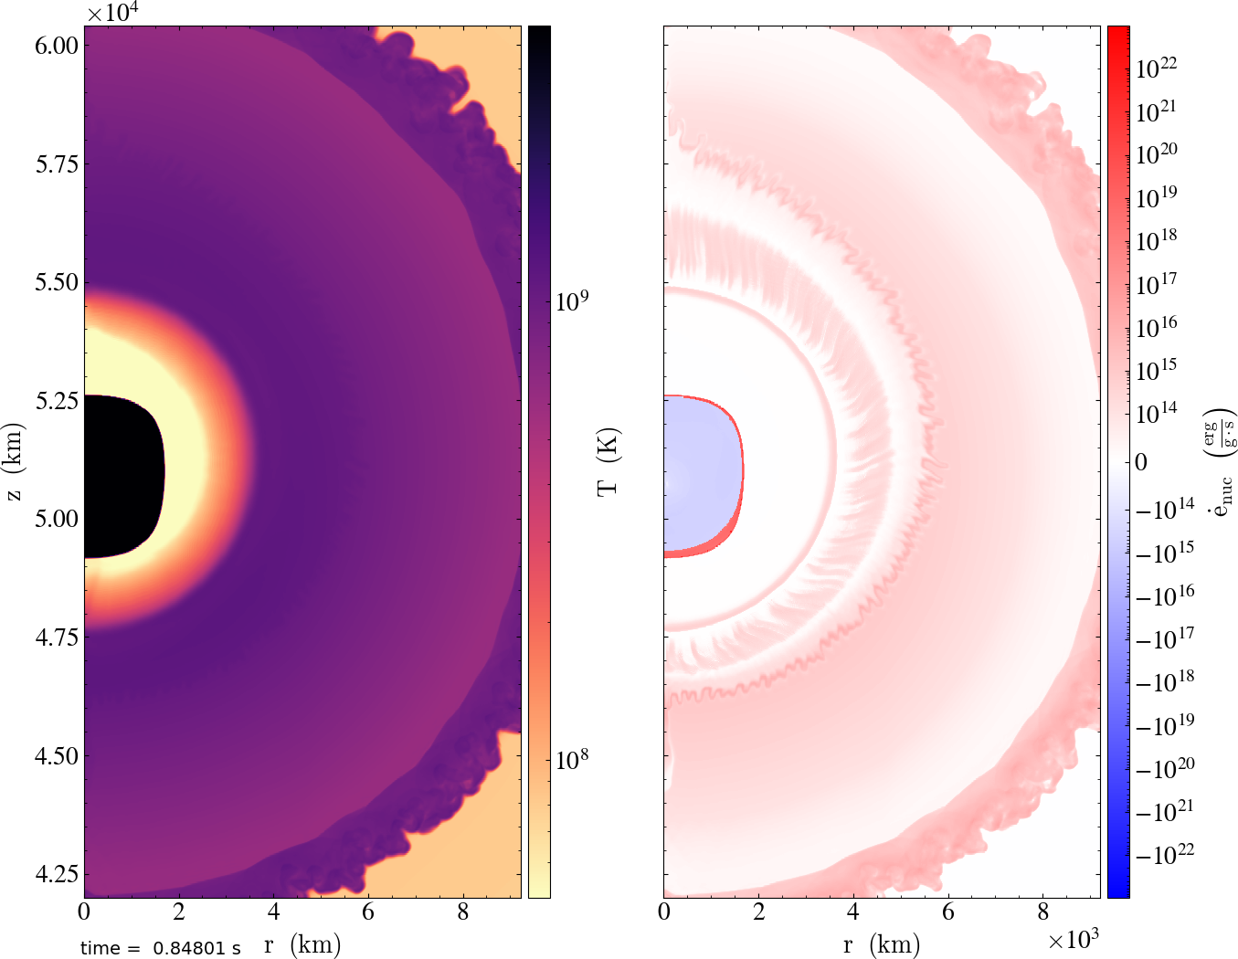

Adaptive Nuclear Statistical Equilibrium for Type Ia SN Simulation
Zhi Chen¹, Ryan Brady¹, Khanak Bhargava¹, Eric T. Johnson¹, Alexander Smith Clark¹, and Mike Zingale¹
¹Department of Physics and Astronomy, Stony Brook University, Stony Brook, NY 11794-3800, USA
NSE EVOLUTION SCHEMATIC DIAGRAM
Motivation / Problem:
Challenging numerical integration of the reaction network when the system reaches nuclear statistical equilibrium (NSE) at high temperatures ( > ~6 GK).
Solution:
  Composition in NSE has an analytic equation subject to two constraint equations.
  Replace numerical integration with root-finding.
Steps:
1. NSE detection Algorithm
2. Reaction Update (composition and energy)
Advantage:
1. Self-consistent NSE criteria
2. Multi-Dimensional Simulation compatibility
3. Seamless transition from integrating the network to imposing NSE due to our simplified spectral-deferred-correction (SDC) coupling hydrodynamics and reaction.
Enters Burner
Burn Failure:
Is it because we entered NSE?
YES
NSE Check
Min Temp Check
YES
Mass Abundance Check
NO
Burn via Integration
YES
Successful
Burn
NSE Grouping
NO
YES
Is in NSE?
YES
NSE Burn via RK2
CODE
Castro
Microphysics
Pynucastro
| https://github.com/AMReX-Astro/Castro
| https://github.com/AMReX-Astro/Microphysics
| https://github.com/pynucastro/pynucastro
This is me!
New Contributions
Are Welcome!
The work at Stony Brook was supported by DOE/Office of Nuclear Physics grant DE-FG02-87ER40317.
This research was supported by the Exascale Computing Project (17-SC-20-SC), a collaborative effort of the U.S. Department of Energy Office of Science and the National Nuclear Security Administration.

Slide 3
Adaptive Nuclear Statistical Equilibrium for Type Ia SN Simulation
Zhi Chen¹, Ryan Brady¹, Khanak Bhargava¹, Eric T. Johnson¹, Alexander Smith Clark¹, and Mike Zingale¹
¹Department of Physics and Astronomy, Stony Brook University, Stony Brook, NY 11794-3800, USA
NSE EVOLUTION SCHEMATIC DIAGRAM
Enters Burner
NSE Check
By the end of a integration step
YES
Min Temp Check
YES
Mass Abundance Check
NO
Burn via Integration
YES
Successful
Burn
NSE Grouping
NO
YES
Is in NSE?
YES
NSE Burn via RK2
CODE
Castro
Microphysics
Pynucastro
| https://github.com/AMReX-Astro/Castro
| https://github.com/AMReX-Astro/Microphysics
| https://github.com/pynucastro/pynucastro
This is me!
New Contributions
Are Welcome!
The work at Stony Brook was supported by DOE/Office of Nuclear Physics grant DE-FG02-87ER40317.
This research was supported by the Exascale Computing Project (17-SC-20-SC), a collaborative effort of the U.S. Department of Energy Office of Science and the National Nuclear Security Administration.

