Slide 1
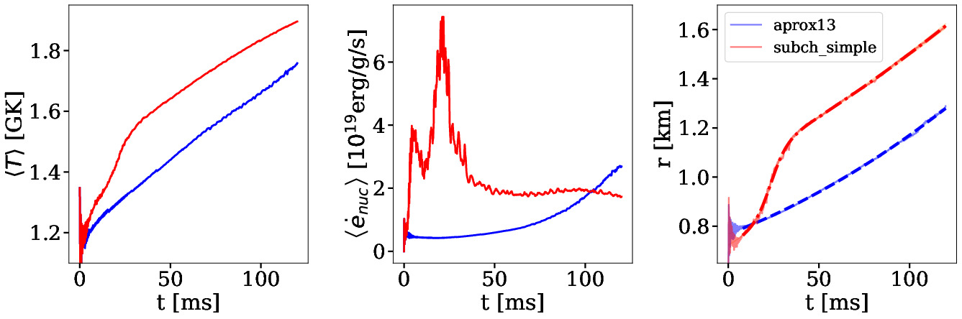


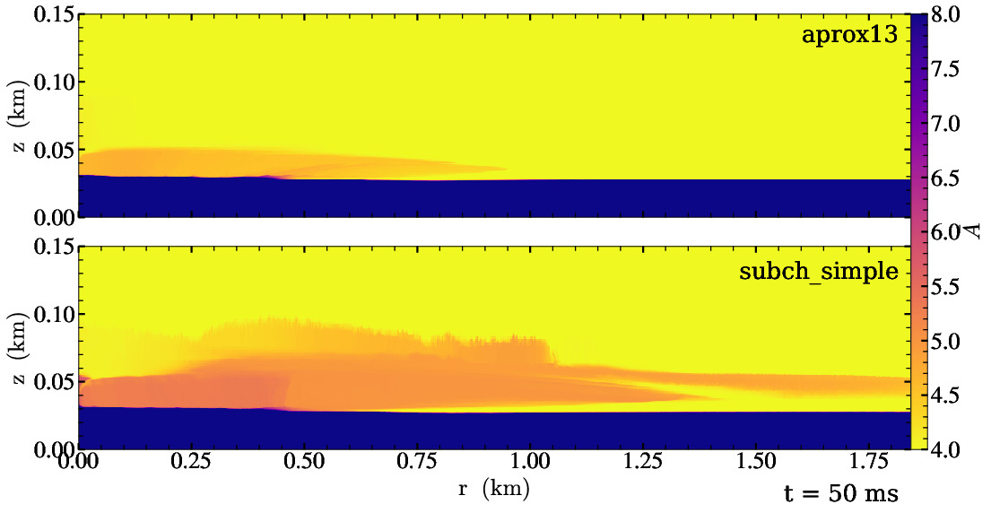
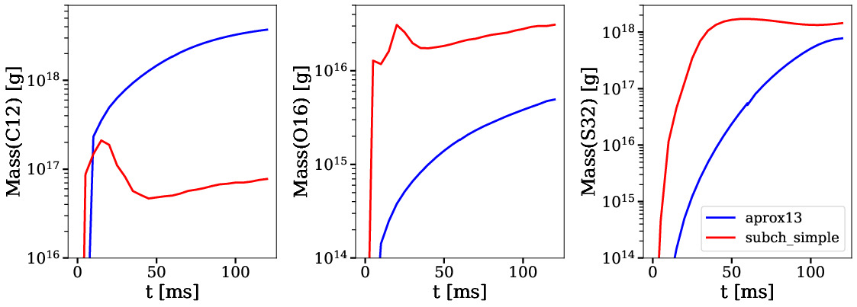
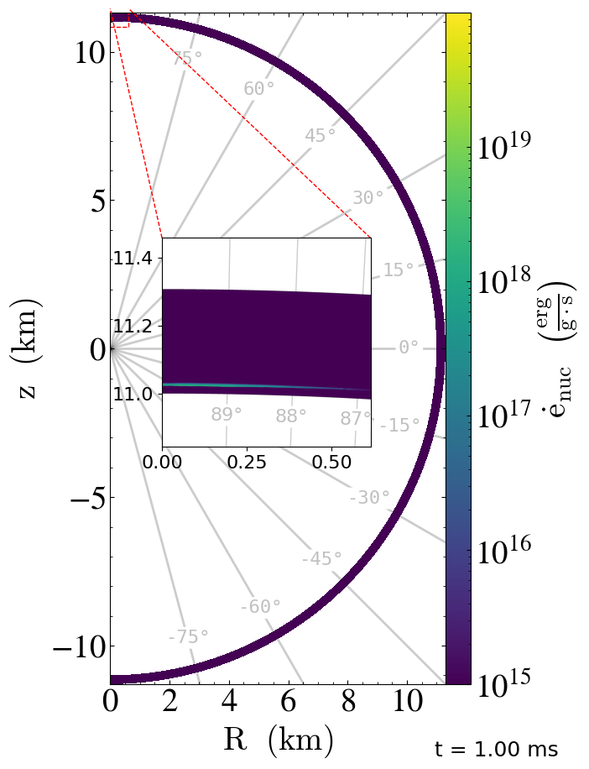
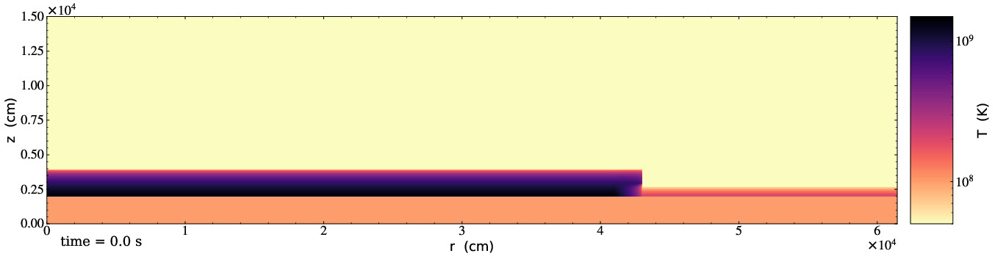
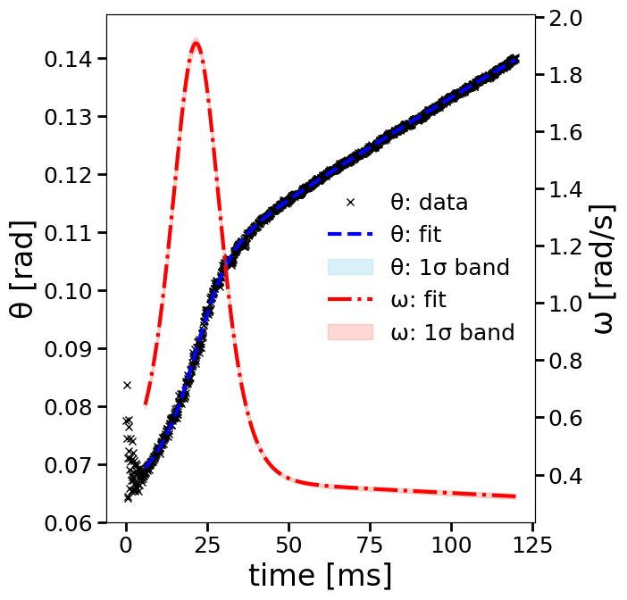
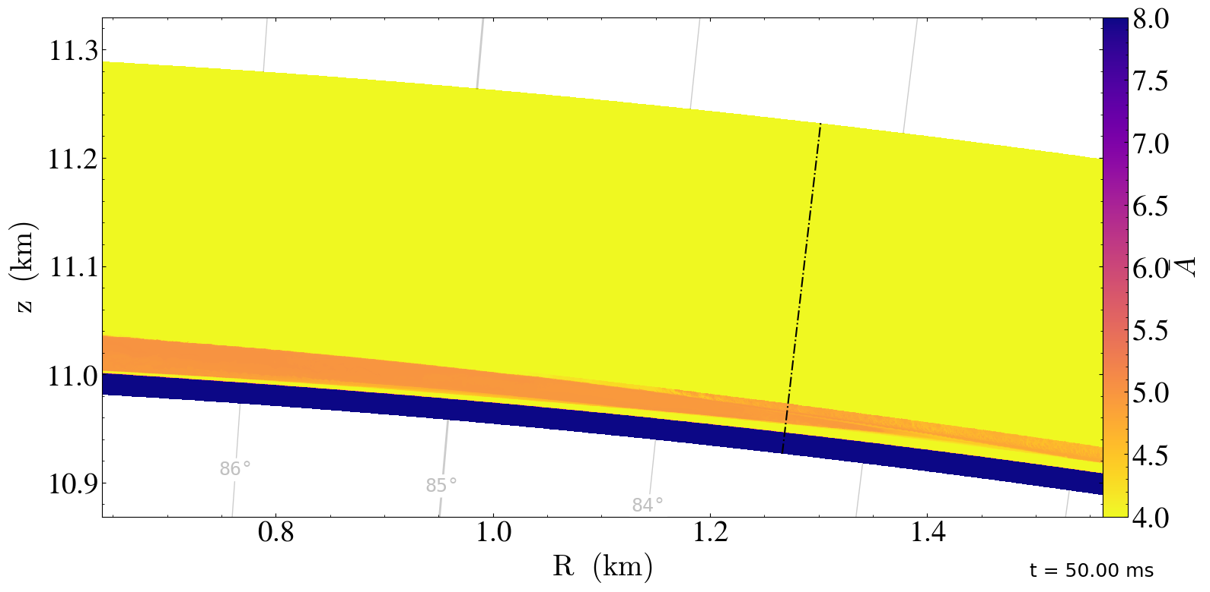



Simulating X-ray Burst Flame Propagation: From Parallel Plane to Full Star
Zhi Chen¹ and Mike Zingale¹
¹Department of Physics and Astronomy, Stony Brook University, Stony Brook, NY 11794-3800, USA
INTRODUCTION
PARALLEL PLANE SIMULATION RESULTS
An X-ray burst (XRB) is a thermonuclear runaway caused by the ignition of the accreted fuel on the surface of a neutron star. The burst oscillation behavior observed during the rise-time of the burst and difference between the accretion and burst timescales both suggest that nuclear ignition is likely to begin in a localized region (hotspot), and spread to the rest of the neutron star. The goal is to use numerical simulations to study the XRB flame dynamics:
Study the effect of nuclear reactions on ⁴He flame propagation in a localized region on the rotating pole with 2D R-Z geometry.
Study the effect of variation in rotational forces on ⁴He flame as it spreads across the full star with 2D R-θ geometry.
Plane Parallel Local Simulation:
9216 × 1536 zones or 20 cm resolution in finest grid
R = [0, 1.843 × 10⁵ cm] and Z = [0, 3.072 × 10⁴ cm]
~ 3,000 GPU node hours to finish at t = 120 ms.
Shows results between two networks: aprox13 and subch_simple, they differ as subch_simple includes:
INITIAL MODEL
Corotating frame with consideration of rotating pseudo forces.
Assumed a 1.4 M⊙ NS with R = 11 km and Ω = 1000 Hz.
Pure Helium-4 accretion layer for pure Helium XRB.
Initial model is in hydrostatic equilibrium.
Isothermal base with T = T* and pure ⁵⁶Ni composition for 0 < z < H* to represent the underlying neutron star.
A transition phase with prescribed temperature and composition profiles that blend the base and atmosphere for H* < z < H* + 3δatm.
Isentropic atmosphere with pure ⁴He composition for z > H* + 3δatm to represent the accretion layer.
A temperature perturbation on the left part of the domain to drive a rightward propagating flame, a spreading hotspot for our geometry.
Fig: Top Panels: Time evolution of the density weighted T (left), nuclear energy generation rate (mid), and flame position (right). Bot Panels: Time evolution of total mass of ¹²C, ¹⁶O, and ³²S.
Fig: Slice plot showing average atomic weight at t = 50 ms.
SPHERICAL POLAR SIMULATION RESULTS
Spherical Polar Local simulation:
R = [11 km, 11.3072 km], θ = [0, 10º]
1536 × 9360 zones or 20 cm res
~ 2,000 node hours to reach 120 ms.
A test run to demonstrate that the spherical-polar geometry is well behaved.
Full – Star simulation:
R = [11 km, 11.3072 km], θ = [0, π]
1536 × 172,800 zones or 20 x 20 cm resolution
Will need ~100,000 node hours to finish.
Ongoing simulation!
Fig: Zoom-in of the initial temperature profile. A temperature perturbation of 1.2 GK is set on the left edge of the domain to start the burning.
CODE
Castro
Microphysics
Pynucastro
| https://github.com/AMReX-Astro/Castro
| https://github.com/AMReX-Astro/Microphysics
| https://github.com/pynucastro/pynucastro
New Contributions
Are Welcome!
Fig: Slice plot showing average atomic weight at t = 50 ms. Black Dashed line indicates the flame front position, determined by the leading edge of the energy generation rate. Burning ash is more uniform compared to the plane-parallel run.
Fig: Time evolution of the flame front position with fitted curve shown in Blue. Derived fitted angular velocity shown in Red.
Fig: Full Star slice plot with zoom-in shown in the center, showing nuclear energy generation rate.
The work at Stony Brook was supported by DOE/Office of Nuclear Physics grant DE-FG02-87ER40317.
This research was supported by the Exascale Computing Project (17-SC-20-SC), a collaborative effort of the U.S. Department of Energy Office of Science and the National Nuclear Security Administration.
This project was supported by the Inovative and Novel Computational Impact on Theory and Experiment (INCITE) Program and under OLCF project name: AST106.

