Slide 1
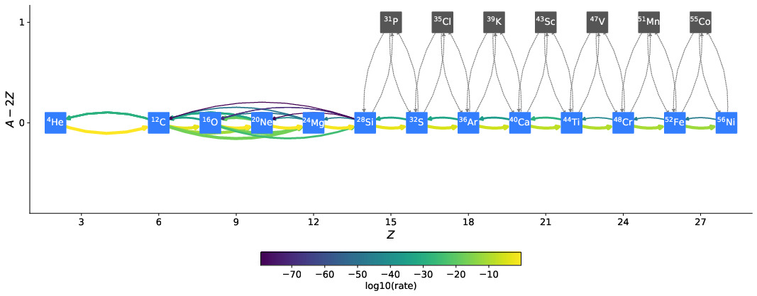
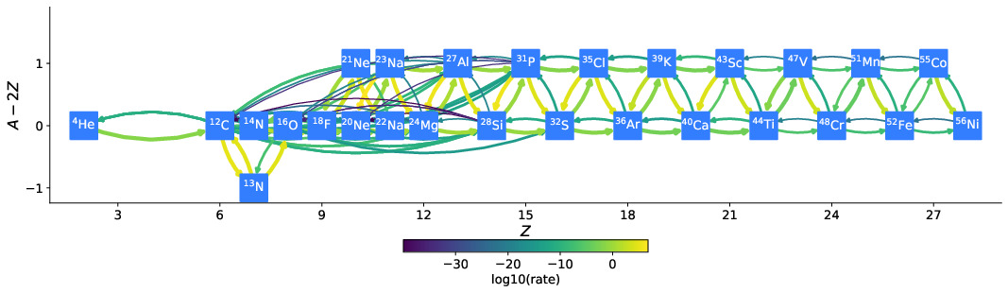
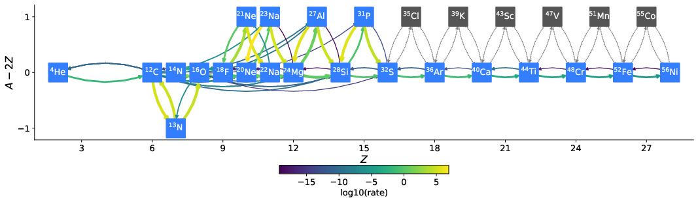
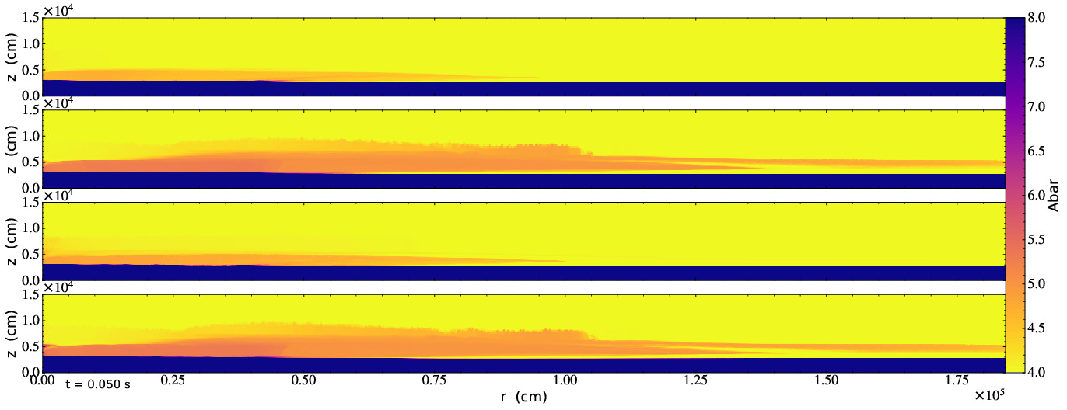
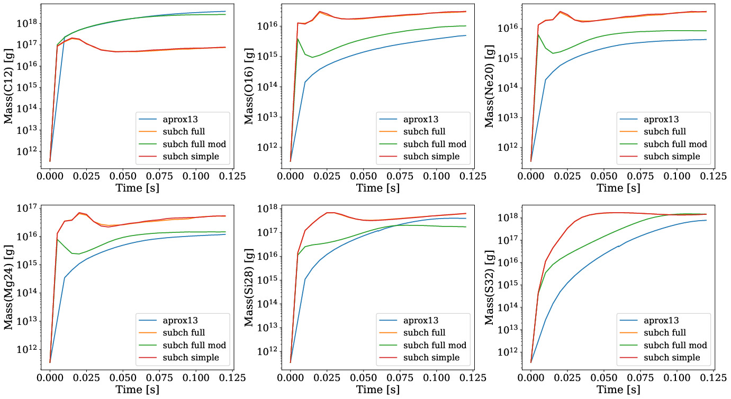
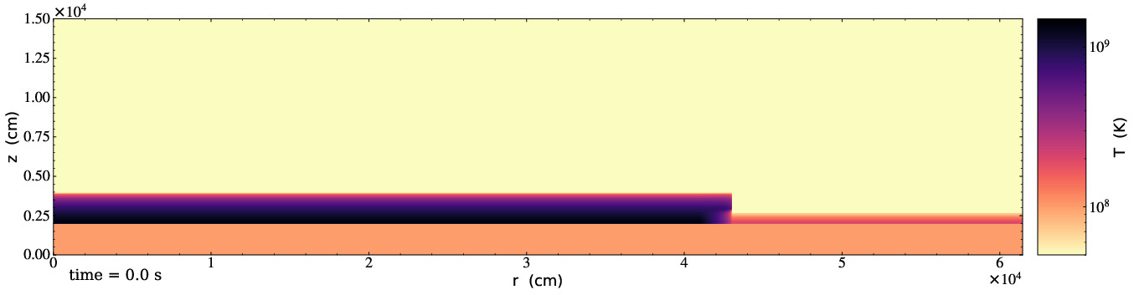
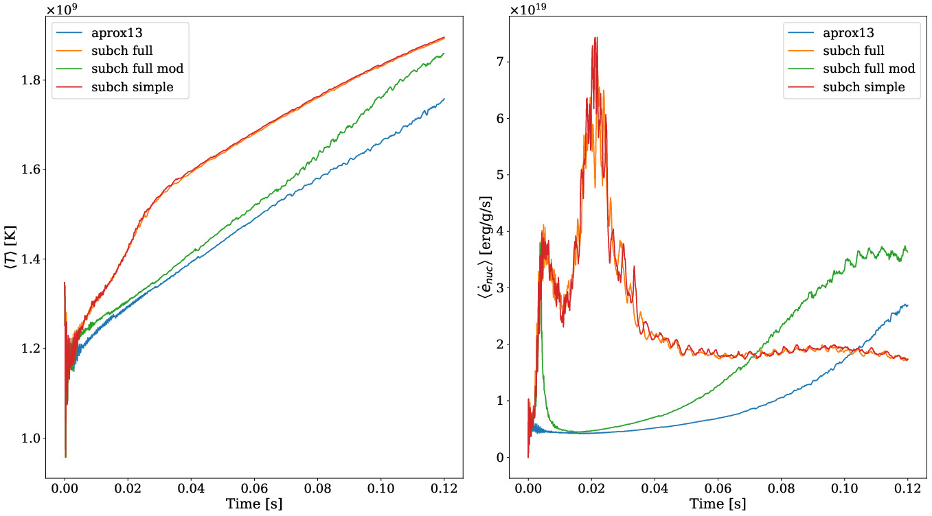
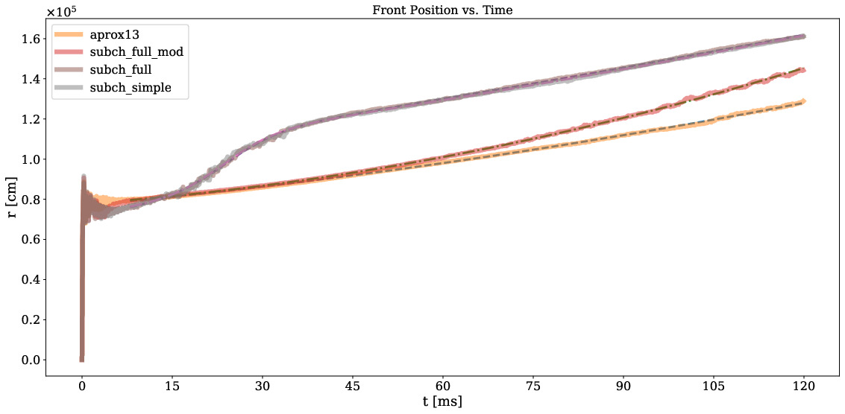



Sensitivity of He Flames in X-ray Bursts to Nuclear Physics
Zhi Chen¹, Mike Zingale¹, and Kiran Eidan²
¹Department of Physics and Astronomy, Stony Brook University, Stony Brook, NY 11794-3800, USA
²Department of Astronomy, University of California, Berkeley, Berkeley, CA 94720-3411, USA
INTRODUCTION
NUCLEAR REACTION NETWORKS
An X-ray burst (XRB) is a thermonuclear runaway caused by the ignition of the accreted fuel on the surface of a neutron star. XRBs found with a mixture of hydrogen and helium fuel layers show bursts with ∼ 5 sec rise time, while a pure helium layer is typically more explosive and shows bursts with shorter rise times (∼ 1 sec). The burst oscillation behavior observed during the rise-time of the burst and difference between the accretion and burst timescales both suggest that nuclear ignition is likely to begin in a localized region (hotspot), and spread to the rest of the neutron star.
Continuing our previous works [1, 2], we employ a 2D model to study the sensitivity of Helium flames in X-ray burst.
aprox13:
(α, p)(p, γ) approximation.
13 isotopes, 31 rates.
subch_full:
No (α, p)(p, γ) approximation.
Additional rates, such as ¹²C(¹²C, p)²³Na to give complete representation on carbon and oxygen burning.
Additional rates, ¹⁴N(α, γ)¹⁸F(α, p)²¹Ne and ¹²C(p, γ)¹³N(α, p)¹⁶O, discussed in Shen & Bildsten 2009 and Weinberg 2006 [3], [4].
28 isotopes, 107 rates.
subch_full_mod:
Identical to subch full but ¹²C(p, γ)¹³N(α, p)¹⁶O rates are disabled.
27 isotopes, 103 rates.
INITIAL MODEL
2D r-z cylindrical coordinate system assuming azimuthal-symmetry.
Corotating frame with consideration of Coriolis force.
Pure Helium-4 accretion layer
Employed a hydrostatic initial model to represent the neutron star’s initial thermodynamic conditions.
Overall 2D Hydrostatic Profile:
Isothermal base with T = T* and pure ⁵⁶Ni composition for 0 < z < H* to represent the underlying neutron star.
A transition phase with prescribed temperature and composition profiles that blend the base and atmosphere for H* < z < H* + 3δatm.
Isentropic atmosphere with pure ⁴He composition for z > H* + 3δatm to represent the accretion layer.
A temperature perturbation on the left part of the domain to drive a rightward propagating flame, a spreading hotspot for our geometry.
subch_simple:
(α, p)(p, γ) approximation for heavy isotopes.
The reverse rates of all ¹²C + ¹²C, ¹⁶O + ¹⁶O, and ¹⁶O + ¹²C are removed.
Forward and reverse rates of ¹²C + ²⁰Ne , ²³Na(α, γ)²⁷Al, and ²⁷Al(α, γ)³¹P removed.
22 isotopes, 57 rates.
SIMULATION RESULTS
Fig: Initial temperature profile showing 1/3 of the full simulation domain.
Fig: Slice plots of the flame propagation comparing average atomic weight, Abar, for aprox13 (top panel), subch full (second panel from top), subch full mod (third panel), and subch simple (last panel) at 50ms.
REFERENCES
Fig: The evolution of the total mass for ¹²C, ¹⁶O, ²⁰Ne, ²⁴Mg, ²⁸Si, and ³²S.
[1] Eiden, K., Zingale, M., Harpole, A., Willcox, D., Cavecchi, Y., & Katz, M. P. (2020). DOI: 10.3847/1538-4357/ab80bc.
[2] Harpole, A., Ford, N. M., Eiden, K., Zingale, M., Willcox, D. E., Cavecchi, Y., & Katz, M. P. (2021). doi:10.3847/1538-4357/abee87
[3] K. J. Shen and L. Bild, DOI: 10.1088/0004-637x/699/2/1365.
[4] N. N. Weinberg, L. Bildsten, and H. Schatz, DOI: 10.1086/499426.
Name | v23 [km/s] | v100 [km/s] | t10 [s]
aprox13 | 3.369 ± 0.016 | 5.234 ± 0.027 | 0.7647
subch_full | 20.732 ± 0.284 | 5.411 ± 0.105 | 0.9917
subch_full_mod | 3.468 ± 0.017 | 7.975 ± 0.029 | 0.4873
subch_simple | 21.095 ± 0.332 | 5.521 ± 0.120 | 0.8483
CODE
Castro
Microphysics
Pynucastro
| https://github.com/AMReX-Astro/Castro
| https://github.com/AMReX-Astro/Microphysics
| https://github.com/pynucastro/pynucastro
New Contributions
Are Welcome!
Fig: Left: The weighted temperature time profile.
Right: The weighted nuclear energy generation rate time profile.
Fig: The flame front position as a function time.
Solid Lines: Data. Dashed lines: fit
Table: Instantaneous flame propagation speeds at t = 23 ms and t = 100 ms calculated using the fitting function. t10 is the expected time for the flame to reach r = 10 km using the fitting function.
The work at Stony Brook was supported by DOE/Office of Nuclear Physics grant DE-FG02-87ER40317.
This research was supported by the Exascale Computing Project (17-SC-20-SC), a collaborative effort of the U.S. Department of Energy Office of Science and the National Nuclear Security Administration.

