Slide 1


0.3 km
1.4M⊙
Z
R
11 km

Slide 2

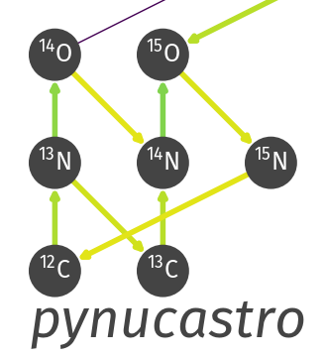
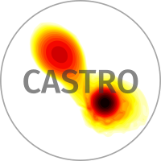

Creates the network.
Outputs C++ code for RHS/Jacobian.
Reaction network solver.
Adaptive Mesh Refinement
Parallelization
Main Code
Hydro + Reaction Coupling

