Slide 1
Building and Comparing Reranking Modules Based on Context Relevance
Shane Masuda Zhicheng Zhang

Slide 2
Motivation
Our aim is to find a better ranking algorithm and module.
We want to combine the Lucene ranking and Ranklib evaluation and training module as the summary of the quarter, in this case, we will modify the lucene ranking algorithms and use the Ranklib to get the NDCG@10 and MAP scores.
Before we start our modification for the lucene ranking algorithm, we firstly want to combine multiple basic algorithms as the new linear algorithm to rank , as we have 4 basic ranking modules (default, bm25, dfr and lm), we want to construct a linear equation with all 4 modules’ scores, and let the Ranklib decides the parameters and test the performance.
It’s performance and the basic performance will be the baseline for our result.
Then, we modify the basic algorithm as the new ranking algorithm and compare it with the original one and part 1’s module. And then, do the same Ranklib work for the new ranking algorithm.

Slide 3
Part 1
In the Ranklib data set, we can give each query several features (in homework 2 we use 46 features ). In the first test, we process the data set in lucene, respectively with the default, bm25, dfr and lm. Then, we get 4 different lists of score, we use the different rankings as the features and put it into another txt file as the training set for Ranklib.
This step, we use the combine programme to get the Ranklib data set, after input the data set in Ranklib, we use the MAP (Mean Average Precision) as the first standard and the NDCG (Normalized Discounted Cumulative Gain) as the second standard. Then, we can get the trained modules based on the four features.

Slide 4
Part 1
Compare the performance of 4 scoring functions: DEFAULT, BM25, DFR, and LM
Document set: Trec Disks 4-5
Query set: Title Queries 300-450

Slide 5
The Method
For each algorithm, and each query, return all relevant documents in descending order of scores
For each query, cross compare the documents returned by each algorithm and only keep documents that were returned by all four
Construct a feature vector for each algorithm consisting of the scores for the documents that remain under each query
Use the learn-to-rank algorithms in RankLib to rank the features in terms of NDCG@10 and MAP and get the trained modules.

Slide 6
Learn-To-Rank Algorithms Used
MART
RankNet
AdaRank
Coordinate Ascent
LambdaMART

Slide 7
The contrast
We use the BM25 score as the contrast.
In the tables, we use the NDCG@10 and MAP of BM25 as the baseline to compare with the NDCG@10 and MAP of the 4 feature combination module.

Slide 8

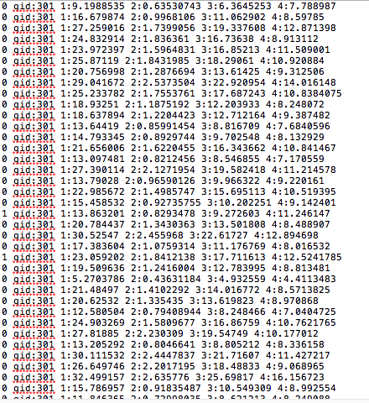
The Data set
The original Data set.
The Ranklib Data set after combination.

Slide 9
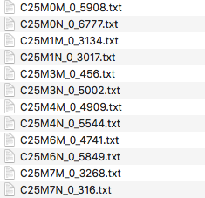
The result modules
After the processing of Ranklib, we get the modules of the four combination. We focus on the MAP and NDCG@10. After 10 times test, we get 5 different modules, and the MAP and NDCG@10 score of the combination.

Slide 10
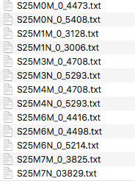
Constract

Slide 11
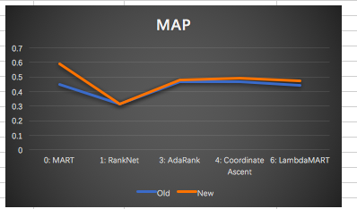
The results of contrast
MAP

Slide 12
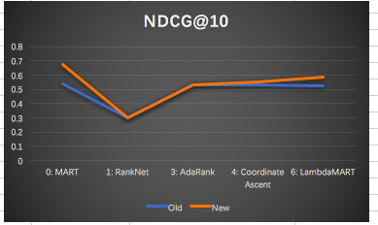
The results of contrast
NDCG@10

Slide 13
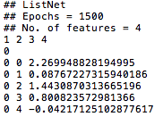
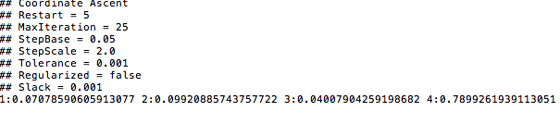
The Trained Modules (partial)

Slide 14
Summary
If we use the 4 basic modules as the whole part to build a linear equation, indeed, there are some improvements, however, the improvements is not very sharp.
Compared with the processing time, the improvement is very small. Because we need process 4 times than before.
In this case, we want to modify the the algorithms in lucene to get more specific features thus, we use the paper in the professor’s slides.
Based on that, we start the part 2, we would not focus on the basic algorithms. Our job is to modify the ranking algorithm to optimize the performance.

Slide 15
Before the Part 2
We checked those references:
Zhao and Huang. Enhanced Context-sensitive Proximity Model for Probabilistic Information Retrieval. SIGIR 2014.
Tao, Zhai, An exploration of proximity measures in information retrieval. SIGIR 07.
In those paper, the authors have given us the method of how to improve the module, our job is implementing them and use the Ranklib to verify them.
And use the Ranklib to get the factors, scores, and modules.

Slide 16
Part 2
Want to compare BM25 to the improved version described in An Enhanced Context-sensitive Proximity Model for Probabilistic Information Retrieval
Same data, same queries (except we removed queries with only 1 term)

Slide 17
Original BM25
Bag of words retrieval function that ranks documents based on the query terms that appear within them
Does not consider the inter-relationship between query terms within a document

Slide 18
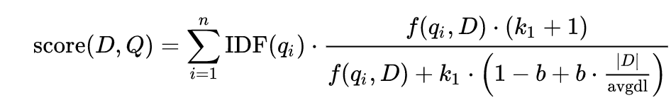
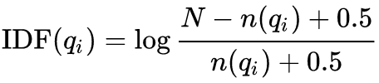
Vanilla BM25

Slide 19
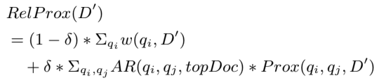
BM25++, or BM26 for short

Slide 20



Slide 21
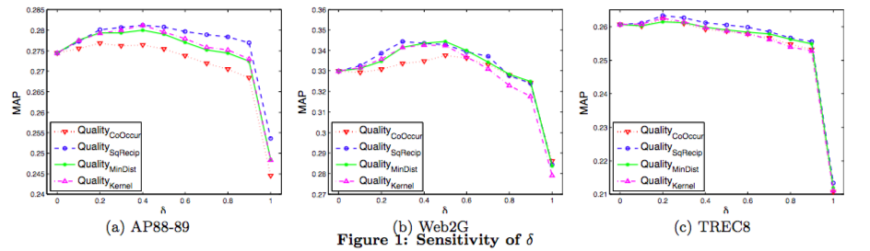
The Sensitivity of δ
As the paper said, when δ equals to 0.3 or 0.4, the performance should be better.
In this case, we set the δ equals to 0.4.

Slide 22
The Process
Same

Slide 23
Learn-To-Rank Algorithms Used
MART
RankNet
AdaRank
Coordinate Ascent
LambdaMART
ListNet

Slide 24
The contrast
We use the BM25 score and the combination score as the contrast.
In the tables, we use the NDCG@10 and MAP of BM25 as the baseline to compare with the NDCG@10 and MAP of the 4 feature combination module.
Different from the contrast before, this time, we compare the bm26 with the combination module for the proving.

Slide 25

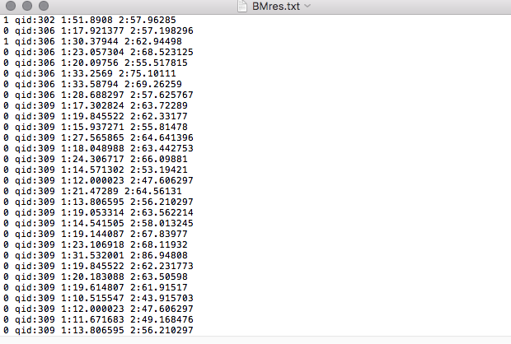
The Data set
The original Data set.
The Ranklib Data set after combination.

Slide 26
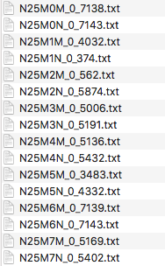
The result modules
After the processing of Ranklib, we get the modules of the four combination. We focus on the MAP and NDCG@10. After 12 times test, we get 6 different modules, and the MAP and NDCG@10 score of the combination.

Slide 27
Constract

Slide 28
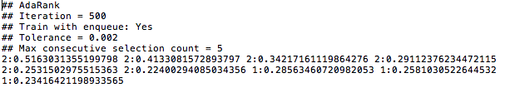
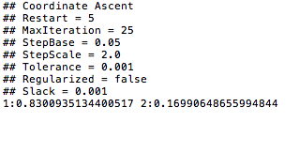
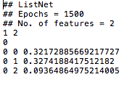
The Trained Modules (partial)

Slide 29
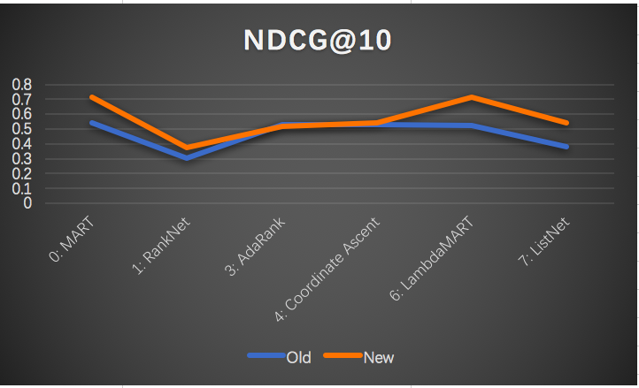
The results of contrast

Slide 30
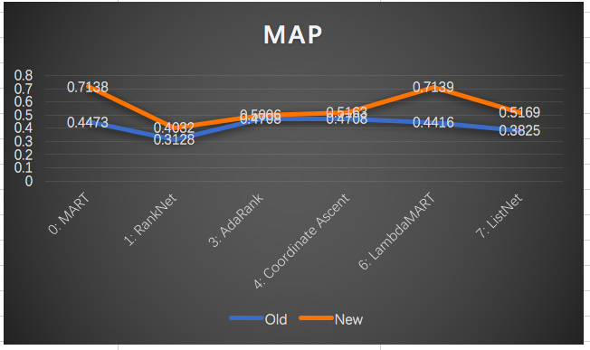
The results of contrast

Slide 31
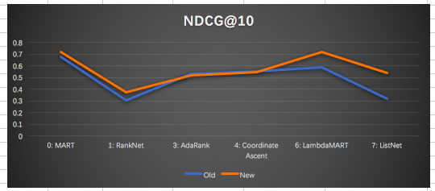

The results of contrast

Slide 32
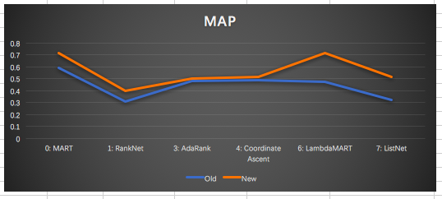

The results of contrast

Slide 33
Summary
Based on the graph, we can say the improvement of bm25 is obvious, and also, the single improvement is better than the combination.
Compared with the processing time, the new method costs same time but can improve 20%.
After we change δ as the paper said, we also use the retraining module to get a new δ based on it, but as the time limitation, we don’t test the new δ in modules.
And also, through the whole project, we review the whole process of search, ranking, training and reranking. But also, there are some things we can do better.

Slide 34
THANK YOU

Slide 35
