Slide 1
Orthographic Star Coordinates
Zhiming, Ding
2016.01.10
SEIEE Building #3-528

Slide 2
Outline
Brief Introduction on Orthographic Star Coordinates (OSC)
Improvements on Current Method and Algorithms
Demo

Slide 3
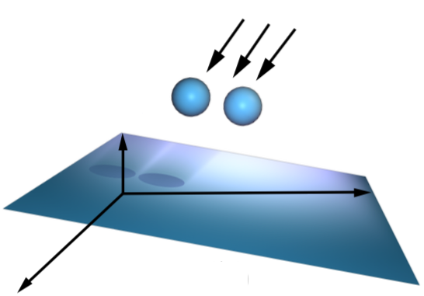
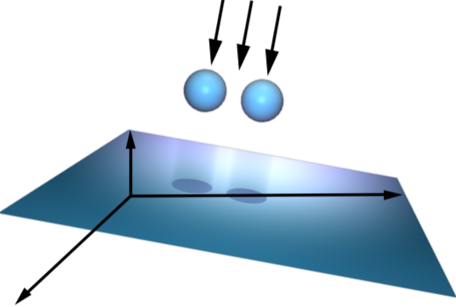
About OSC
Star Coordinate is a method to display high dimension data into low dimension space.
Orthographic Star Coordinate is an improvement of Star Coordinate with orthogonal transformation.
No Distortion!
Star Coordinate
Orthographic Star Coordinate

Slide 4
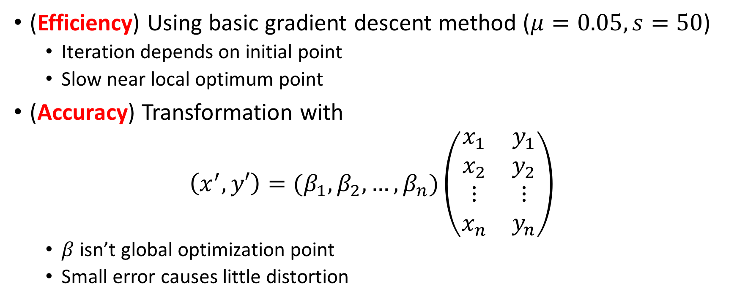
Disadvantages on OSC
(Efficiency) Using basic gradient descent method ($μ=0.05, s=50$)
Iteration depends on initial point
Slow near local optimum point
(Accuracy) Transformation with
$\left(x^{′},y′\right)=(β_{1},β_{2},…,β_{n})\left(\begin{matrix}x_{1} & y_{1} \\ x_{2} & y_{2} \\ \begin{matrix}⋮ \\ x_{n}\end{matrix} & \begin{matrix}⋮ \\ y_{n}\end{matrix}\end{matrix}\right)$
$β$ isn’t global optimization point
Small error causes little distortion

Slide 5
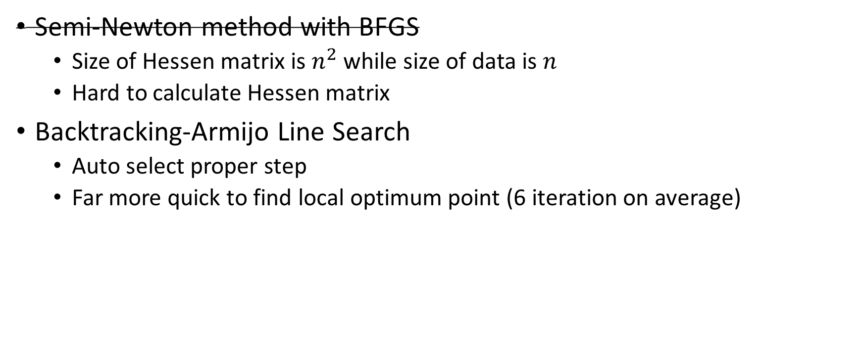
Efficiency
Semi-Newton method with BFGS
Size of Hessen matrix is $n^{2}$ while size of data is $n$
Hard to calculate Hessen matrix
Backtracking-Armijo Line Search
Auto select proper step
Far more quick to find local optimum point (6 iteration on average)
Second-order optimization not worked.

Slide 6
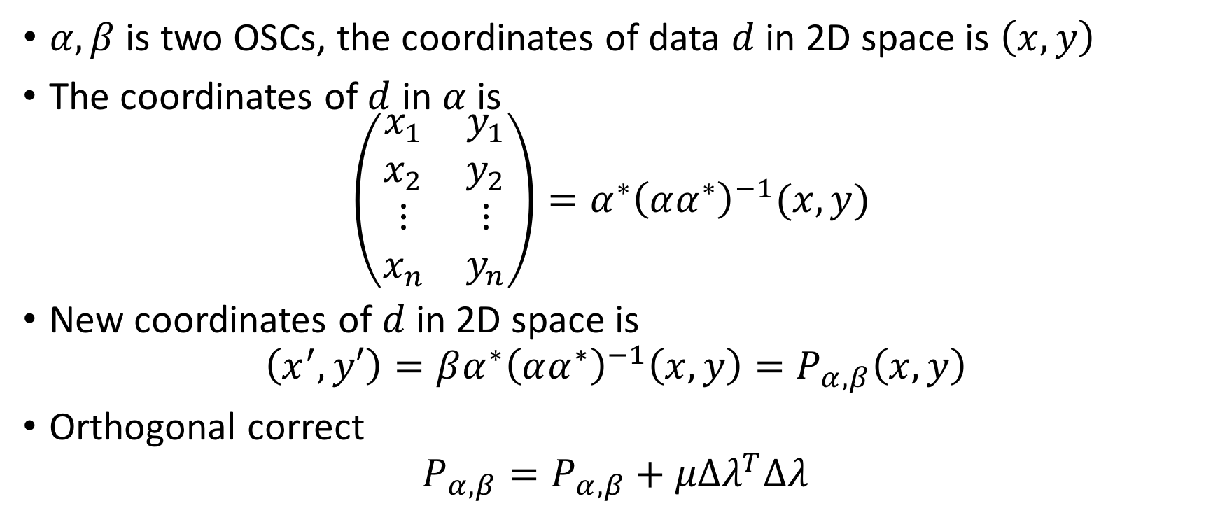

Accuracy
$α,β$ is two OSCs, the coordinates of data $d$ in 2D space is $\left(x,y\right)$
The coordinates of $d$ in $α$ is
$$\left(\begin{matrix}x_{1} & y_{1} \\ x_{2} & y_{2} \\ \begin{matrix}⋮ \\ x_{n}\end{matrix} & \begin{matrix}⋮ \\ y_{n}\end{matrix}\end{matrix}\right)=α^{∗}{\left(αα^{∗}\right)}^{−1}(x,y)$$
New coordinates of $d$ in 2D space is
$$\left(x^{′},y′\right)=βα^{∗}{\left(αα^{∗}\right)}^{−1}\left(x,y\right)=P_{α,β}\left(x,y\right)$$
Orthogonal correct
$$P_{α,β}=P_{α,β}+μΔλ^{T}Δλ$$
Notice $α$ is row full rank

Slide 7
Demo
Programming Language
Python 2.7
Library dependency
numpy
matplotlib
Workload
500+ lines code

Slide 8
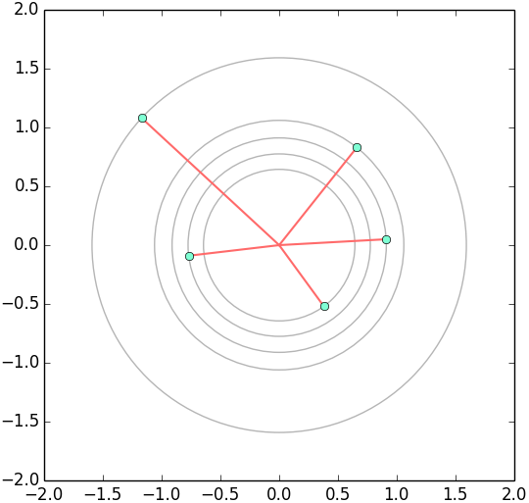
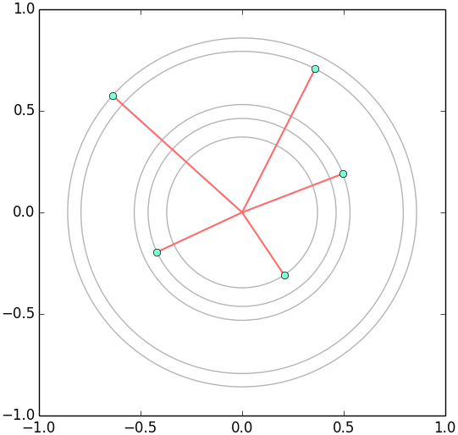
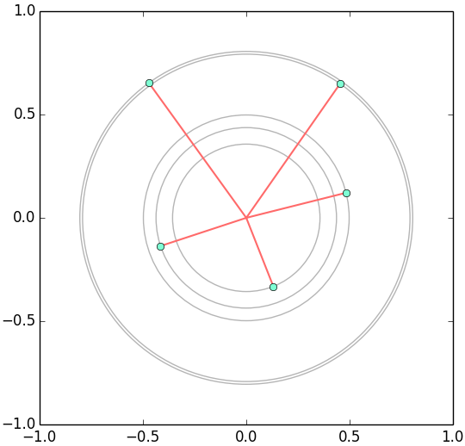
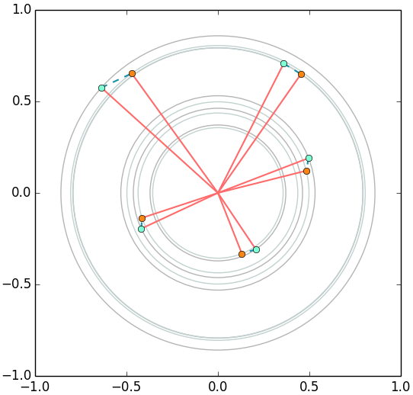
Demo
Recondition and Energy minimization Algorithms
Non-OSC
Recondition
Energy minimization
Comparison between RE and EM

Slide 9
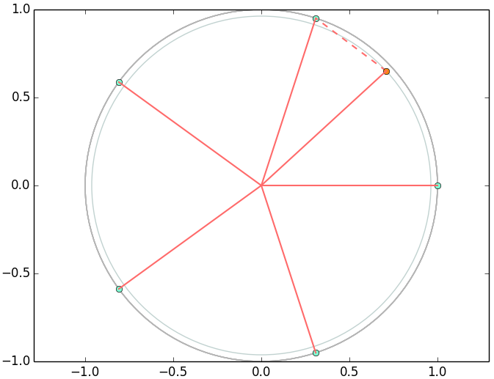
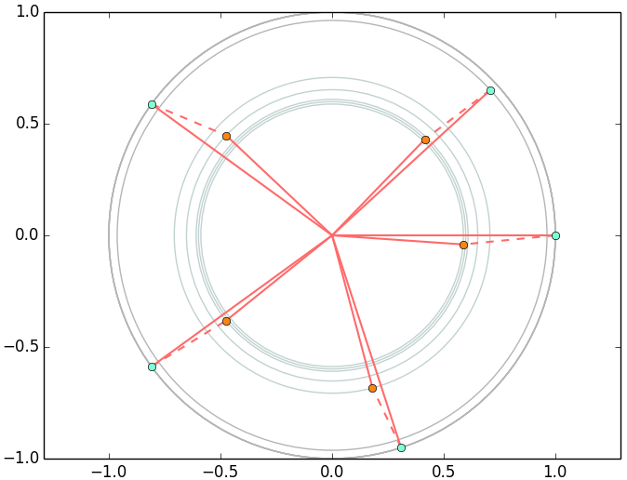
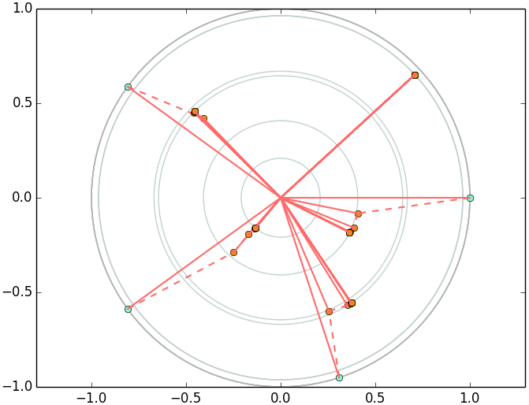
Demo
Interaction with OSC
Move A to B then do OSC with B fixing.
A
B
Initial
Recondition
Energy minimization

Slide 10
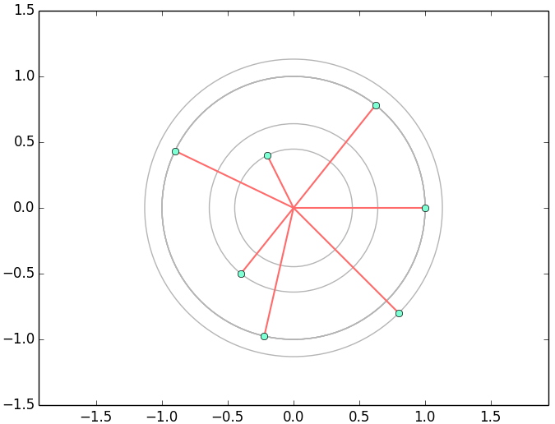
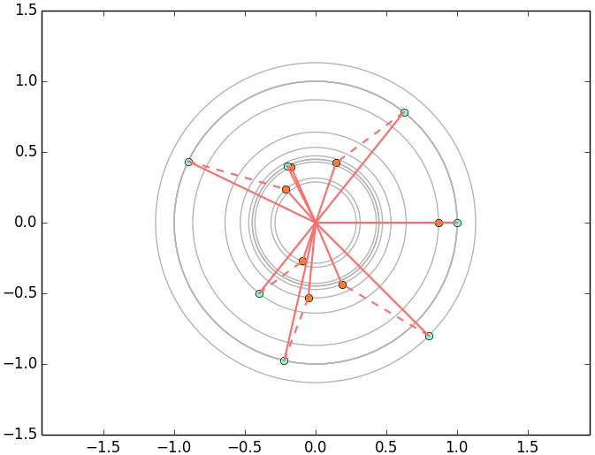
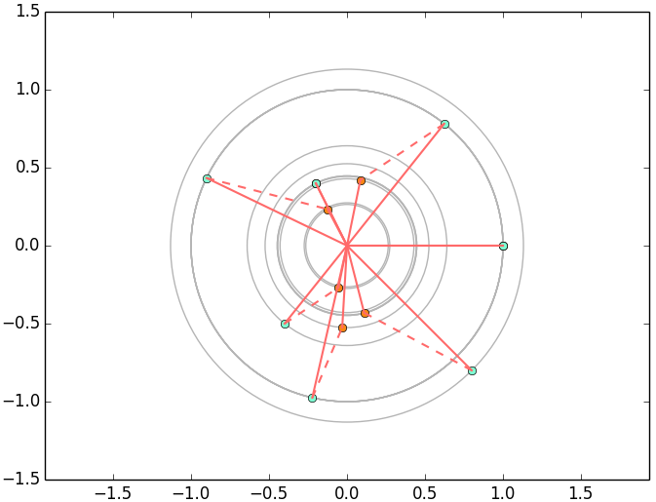
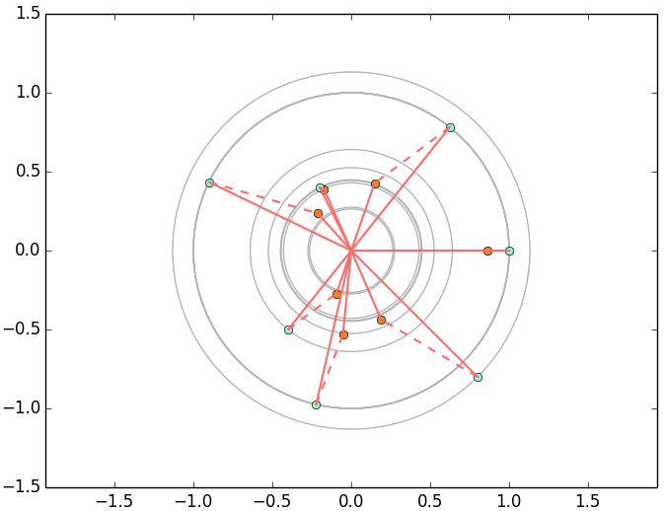
Demo
Conditional Interaction (n=7) with EM algorithms
A
A
Initial
B
Radial Movement
B
A
A
B
Fixed condition
B
Directional Movement

Slide 11
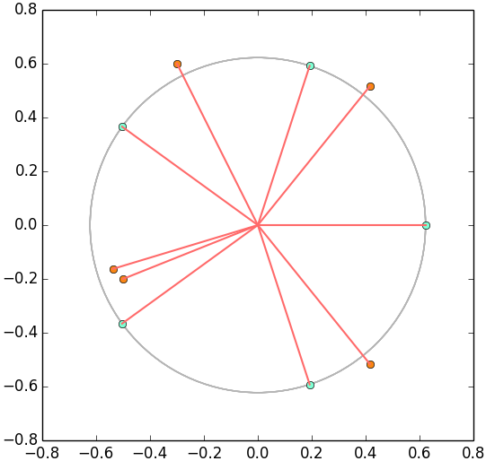
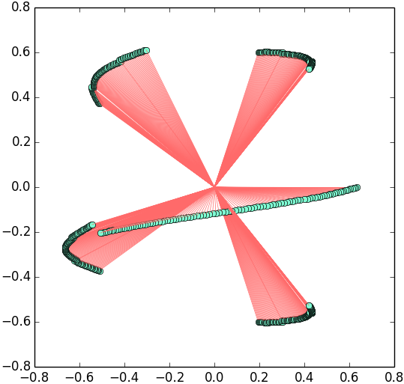
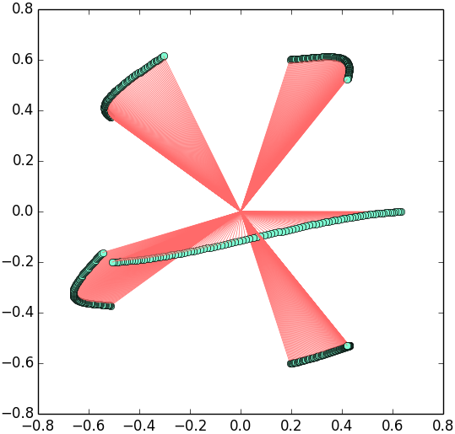
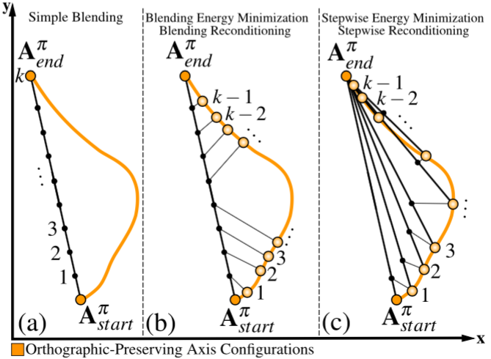
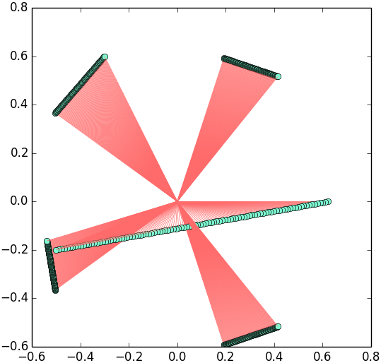
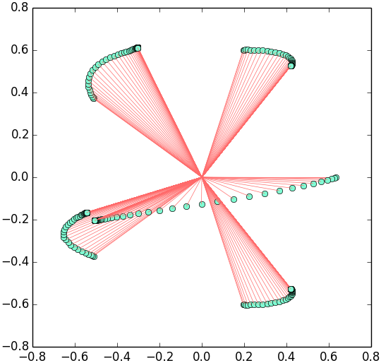
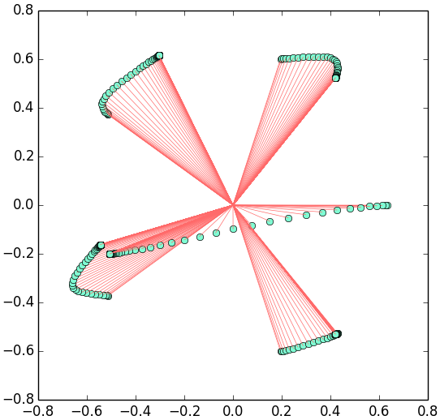
Demo
Morphing between OSC (Orthographic-Preserving)
Initial Axes
Blending EM
Blending RE
Simple Blending
Stepwise EM
Stepwise RE

Slide 12
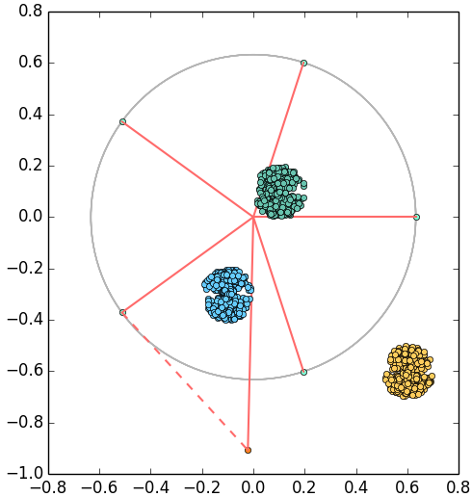
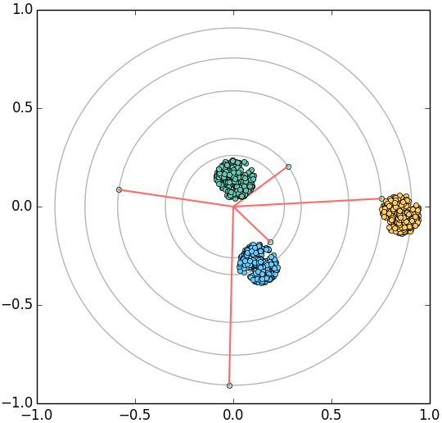
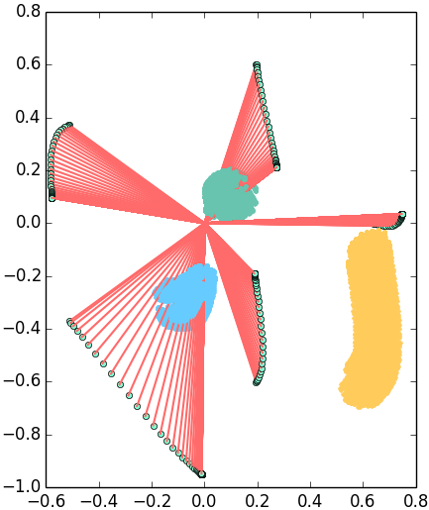
Demo
Data Tour
Interaction
Energy minimization
Morphing

Slide 13
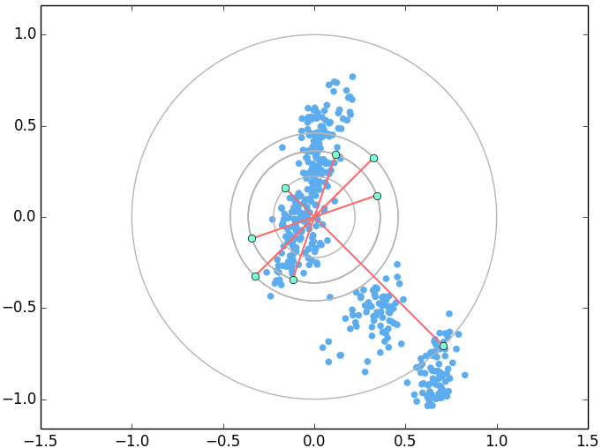
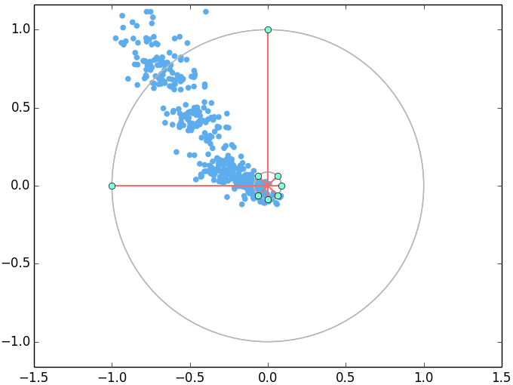
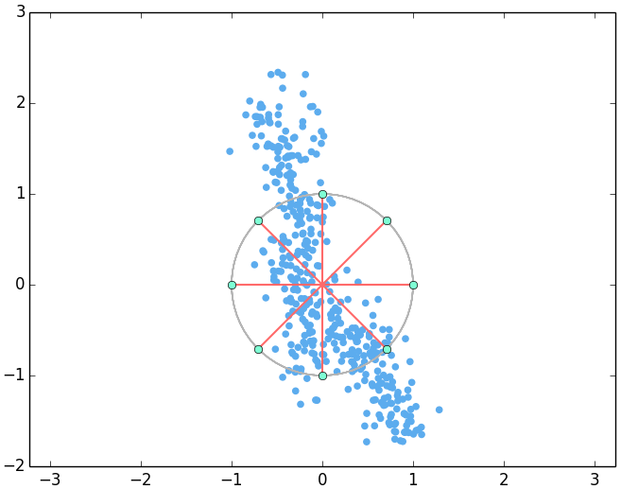
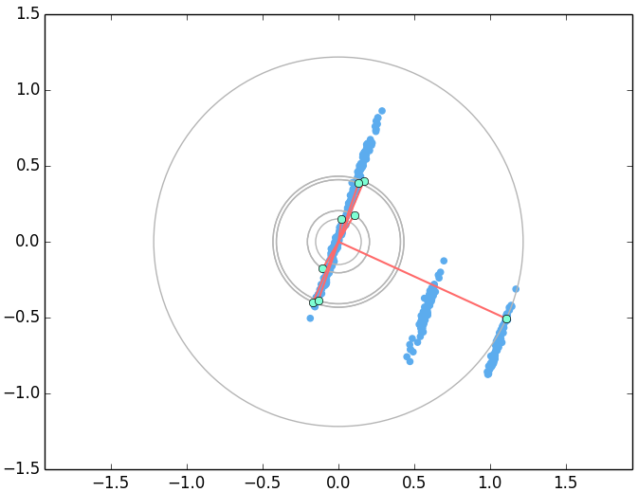
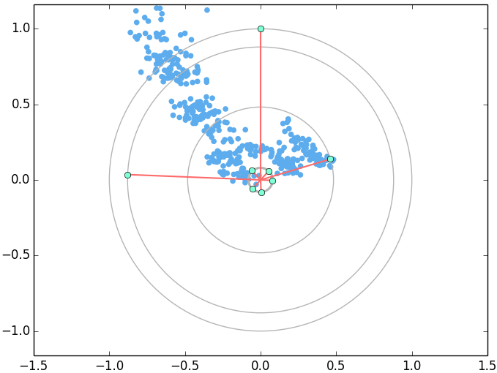
Demo
Applications on ‘cars.csv’ dataset (nDims=7, records=407)

Slide 14
The End
Thanks.

