Slide 1
Annotation Tools - Overview

Slide 2
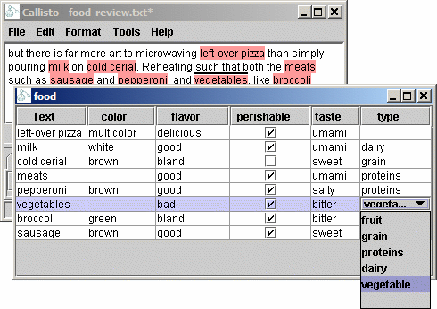
Callisto (callisto.mitre.org)‏
Has specialised plugins for different annotation tasks:
  NE tagging, relations (ACE), timex, cross-doc coref,...
Attributes:
  boolean
  list of values
  free text/values
  defined in XML
Right-click action menu
Tear-off annot. viewers
Annotation hiding supported, per task, persistent

Slide 3
WordFreak (wordfreak.sf.net)‏
Has different plugins for different tagging tasks
Some typical ones are for MUC, ACE, POS tagging
  http://wordfreak.sourceforge.net/screenshots.html
  When an annotation has a possible set of values (e.g. POS), they are displayed as buttons to click
  When having several annotation types, then they appear as buttons and their features again as a set of related buttons (see ACE one)‏
  Also has nice navigation banner, like CD player with Prev., Next, Add, Delete, etc.

Slide 4
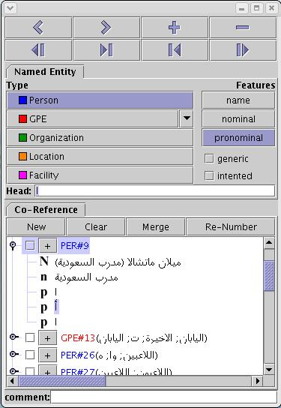
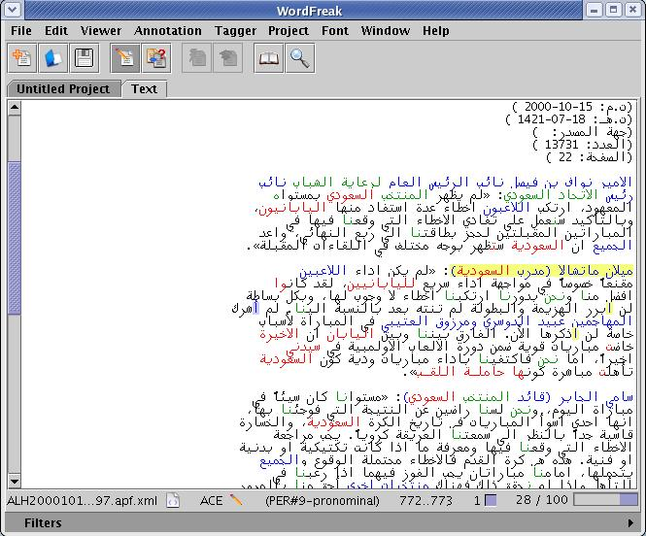
ACE annotation GUI

Slide 5
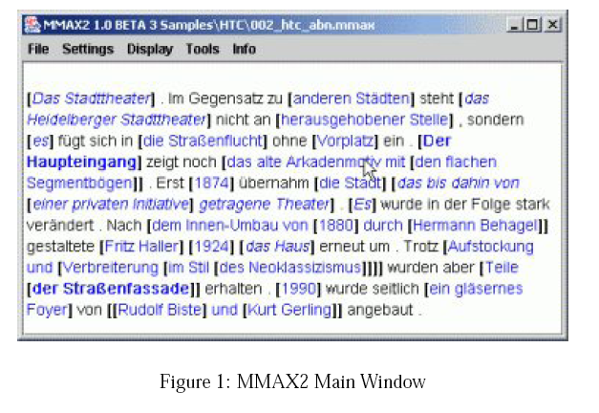
http://mmax2.sourceforge.net/
Handles(brackets) mark annotation boundaries
Clicking on handles highlights the relevant part and shows their attributes
Right click shows a list of actions, such as deletion of markables

Slide 6
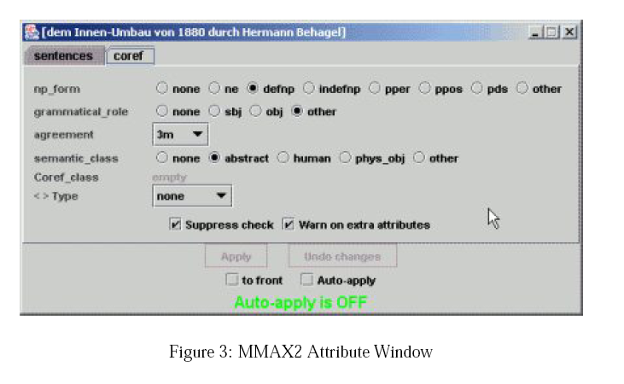
Showing attributes in MMAX2
Attributes with several possible values are shown as radio buttons/check boxes
When there are more values – drop-down menu
Colours of annotation types are modifiable and are stored in a configuration file for later use
Creating new Annotations
  Select then with mouse by holding and dragging
  A popup appears with items “Create X” for each annotation type X defined in the annotation schema
  All default values of attributes (defined in schema) will be set and can be edited in the attribute window as above
MMAX2 also supports relation marking, which we should study when developing relation support in GATE

Slide 7
What about Annotator GUI?
Our annotation schemas also define sets of possible values and defaults
All other tools require the user to select an annotation schema and, if such is selected, only annotations of the defined types are supported. “Free” annotation only if no schema is chosen
  I think this is useful to be implemented too, with no New annotation type allowed, if schema is defined. As GATE supports many schemas, we need to introduce the notion of selecting a schema for annotation somehow (e.g. new Schema button, next to New in the right annotation set pane

Slide 8
What about Annotator GUI? (2)‏
Having a schema, the pop-up that appears can be customised with possible features and values shown
Will be useful if ESC dismisses the pop-up that appears on highlighting, currently only mouse can
For me, the annotation table at the bottom is good and useful for finding annotations. The annot. set viewer on the right can be simplified to show annot. types and their possible features as check-boxes/lists, as alternative to pop-up
Lists if more than 10 possible values exist, for less – check boxes? Or users define one or the other in the XML that defines which annotation types are visible (status?)
Coref. annotation – allow people to select more than 1 annot by using Shift + mouse, then add all together to a new/existing chain. Will speed up greatly

Slide 9
What about annotation with ontologies
Let's try these ideas in the case of annotations with schemas, then evaluate them with Harvard and think how to widen to ontology-based annotation?

