Slide 1
GLEAM’s Document Service

Slide 2
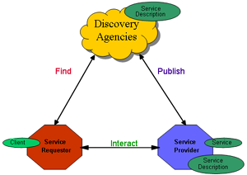
Service oriented architectures
loosely coupled systems
functionality exposed as (software) services for use by other applications
through published (and discoverable) interfaces
Usually assumes stateless interaction
Most distributed systems may be considered SOA

Slide 3
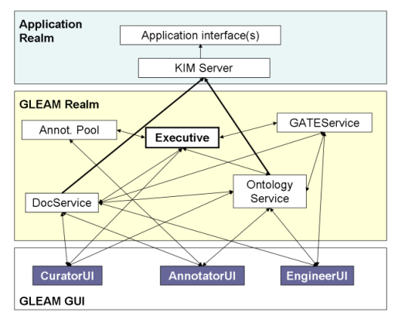
GLEAM modules

Slide 4
Document Service is…
One of the GLEAM services
Designed for document storage/modification/searching
Provides remote annotating facility
Available as web service

Slide 5
Doc service functions
Browse storage contents
Create and delete documents & corpora
Add/remove documents to/from corpora
Concurrent modification of document annotations (AnnotationSet is a minimal level of discretion)
Search documents according to particular criteria

Slide 6
Doc Service interface
// Browse store contents
String[] listDocs()
String[] listCorpora()
String[] listDocs(String corpusID)
// Create & delete
String createCorpus(String corpusName)
String createDoc(String docXmlContent)
String createDoc(String corpusID, String docXmlContent)
boolean deleteCorpus(String corpusID)
boolean deleteDoc(String docID)
// organize
boolean addDocumentToCorpus(String corpusID, String documentID)
boolean removeDocumentFromCorpus(String corpusID, String documentID)
// view & modify
String getDocXML(String docID)
String getText(String docID)
String[] getAnnotationSet(String docID, String annSetName, boolean readOnly)
boolean modifyAnnotationSet(String xmlContent, String taskID)
boolean releaseLock(String taskID)
// search
Match[] search(String corpusID, String query, int start, int length)

Slide 7
Information interchange
Simple data types
  String & String[]
  primitive boolean
XML
Every operation is standalone and independent transaction
XML parser can be reused by client apps

Slide 8
Doc Service in loosely coupled environment
Doc Service is a different approach (not RMI)
Not an another GATE Data Store
Independent clients
Stateless service (no sessions)
Smart clients

Slide 9
Doc Service current implementation
Web application under Apache Tomcat
Includes Apache AXIS (is an implementation of SOAP)
Uses GATE Serial DataStore as underlying document storage
Custom locking mechanism has been implemented for concurrent modifications
Single WAR file deployment
http://grindleford:8080/docservice

Slide 10
Support for the Doc Service clients
Auto-generated client stubs provided
Client API (gleam.docservice.client.*)
Not bounded to the GATE or GLEAM internal classes

Slide 11
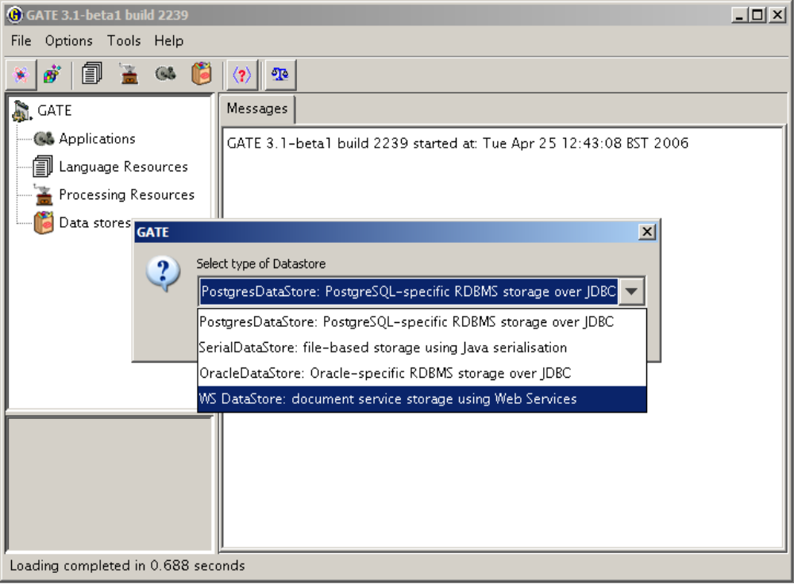
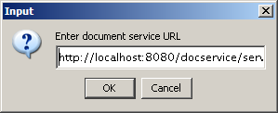
Integration with GATE GUI

Slide 12
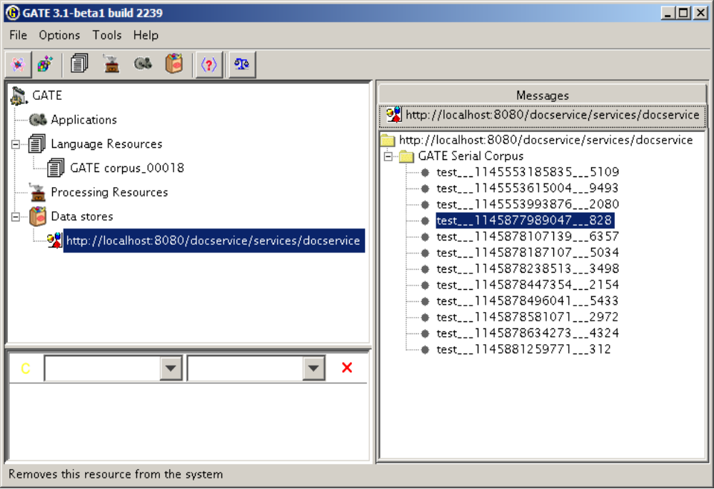
Integration with GATE GUI

Slide 13
Problem with cross-annotation references
Client 1
Server
Client 2
AnnSet 1
document
AnnSet 2
Ann1 : ID1
Ann1 : ID1
AnnSet 1
Ann2 : ID2
Ann2 : ID2
AnnSet 2
Feature = “ID1”
Feature = “ID1”
If Ann1 in both sets are new annotations with the same ID and have a references from other annotations – we have a problem of merging.

Slide 14
Current work state (summary)
General functionality implemented (except searching)
Local & remote Doc Service UNIT tests
GATE demo is under development
Scripts for
  Regeneration of client stubs
  Service redeployment
  Generating javadoc as part of deployment

Slide 15
TODO:
Implement search functionality
Implement correct restoration after system crash (locks in DB)
Improve existing mechanism for handling dead locks
Finish integration with GATE GUI
Deploy DocService interface instead of particular implementation

Slide 16
Thanks!

