Slide 1
GLEAM vs KIM Cluster
http://gate.ac.uk/ http://nlp.shef.ac.uk/
GATE Services
Julien Nioche
Sheffield, 23 January 2005

Slide 2
KIM overview
  KIM is a solution for semantic annotation developed by Ontotext.
  It is based on :
    Lucene (Storage and Indexing)
    GATE (IE)
    SESAME / OWLIM (Ontologies - KB)
  Comes with an API / web client / IExplorer plugin
  Communications based on RMI
  KIM Cluster : extensive scaling by combining Annotators (e.g. GATE instances)

Slide 3
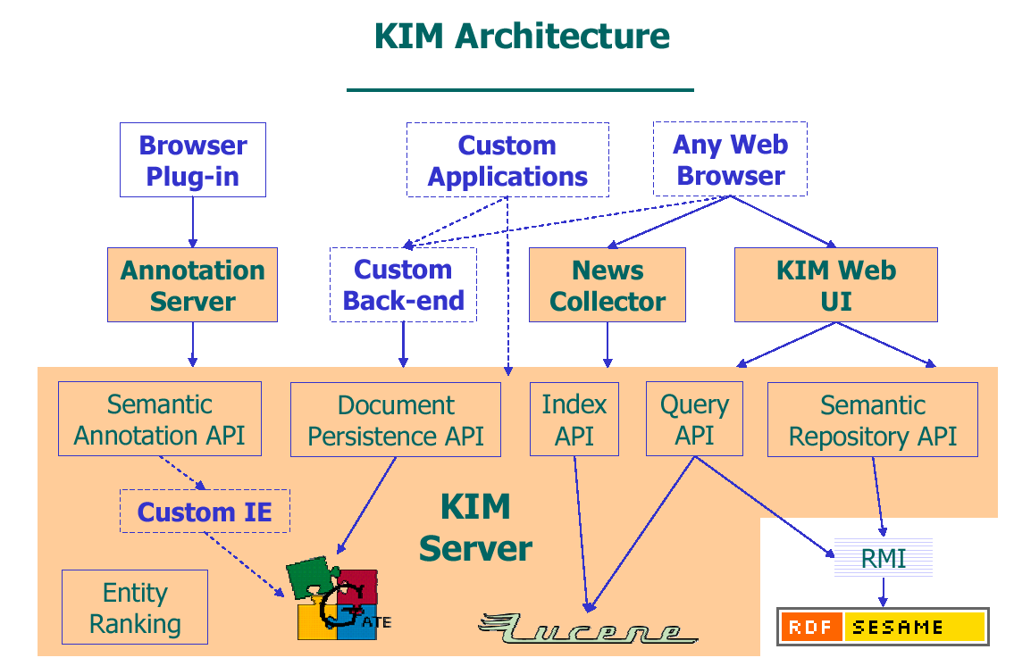

Slide 4
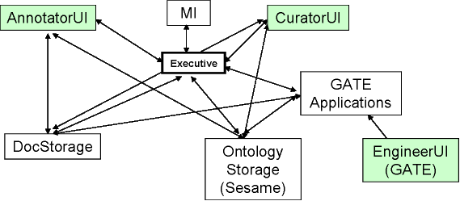
GLEAM architecture

Slide 5
GLEAM vs KIM
Main diffs :
- manual annotation in GLEAM
  and of course MI
ML (possible in KIM inside a GATE app)
  How to learn? Outside KIM. Learning is not distributed.
KIM Document storage : store + index
  Looks vaguely similar to the DocService of GLEAM
  But limited : document is text + references to entities in KB (GATE features are stored and accessible via the doc API)

Slide 6
KIMAnnotations
KIMAnnotationImpl: id=940; type=Person; features={gender=female, inst=http://www.ontotext.com/kim/2005/04/wkb#Woman.KIM%20Download_R.36141, matches=[897, 886, 896, 891, 876, 883, 895, 890, 880, 875, 884, 889, 879, 894, 881, 885, 878, 892, 921], rule1=PersonFull, rule=PersonFinal, class=http://proton.semanticweb.org/2005/04/protonu#Woman, matches_processed=, originalName=KIM Web UI}; start=NodeImpl: id=112; offset=821; end=NodeImpl: id=390; offset=831
KIMAnnotationImpl: id=935; type=Organization; features={orgType=null, inst=http://www.ontotext.com/kim/2005/04/wkb#Institute.DERI%20Ireland_R.36146, rule1=GazOrganization, class=http://proton.semanticweb.org/2005/04/protonu#Institute, matches_processed=, rule2=OrgCountryFinal, originalName=DERI Ireland}; start=NodeImpl: id=118; offset=962; end=NodeImpl: id=121; offset=974
KIMAnnotationImpl: id=928; type=Person; features={gender=female, inst=http://www.ontotext.com/kim/2005/04/wkb#Woman.KIM%20Download_R.36141, matches=[897, 886, 896, 891, 876, 883, 895, 890, 880, 875, 884, 889, 879, 894, 881, 885, 878, 892, 921], rule=Unknown, kind=PN, NMRule=Unknown, class=http://proton.semanticweb.org/2005/04/protont#Person, matches_processed=, originalName=Plug-in}; start=NodeImpl: id=393; offset=836; end=NodeImpl: id=394; offset=843
KIMAnnotationImpl: id=929; type=Person; features={gender=female, inst=http://www.ontotext.com/kim/2005/04/wkb#Woman.KIM%20Download_R.36141, matches=[897, 886, 896, 891, 876, 883, 895, 890, 880, 875, 884, 889, 879, 894, 881, 885, 878, 892, 921], rule1=GazPersonFirst, rule=PersonFinal, class=http://proton.semanticweb.org/2005/04/protonu#Woman, matches_processed=, originalName=KIM}; start=NodeImpl: id=122; offset=1002; end=NodeImpl: id=123; offset=1005
KIMAnnotationImpl: id=927; type=Person; features={gender=female, inst=http://www.ontotext.com/kim/2005/04/wkb#Woman.KIM%20Download_R.36141, matches=[897, 886, 896, 891, 876, 883, 895, 890, 880, 875, 884, 889, 879, 894, 881, 885, 878, 892, 921], rule1=PersonFull, rule=PersonFinal, class=http://proton.semanticweb.org/2005/04/protonu#Woman, matches_processed=, originalName=KIM Server}; start=NodeImpl: id=110; offset=752; end=NodeImpl: id=366; offset=762

Slide 7
Issues
Will GLEAM be used only to annotate w.r.t. an Ontology only? Or do we aim at staying generic?
Reuse things for GATE and share with other projects
Search a la Kim (KB + docs) difficult to do in GLEAM

