Slide 1
ETC Challenge Problem
ETC Model
Requirements
Towards a Checkmate model
OEP vs Checkmate model
Simulation results
Parametric verification
Results

Slide 2
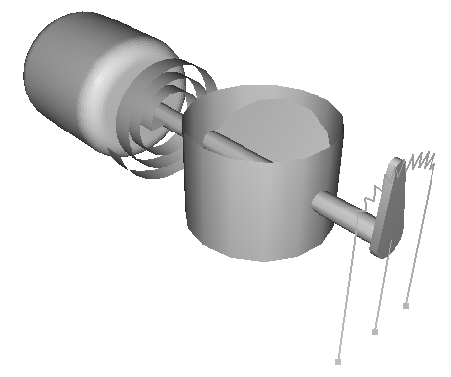
ETC Hardware
Components
D.C. motor
Return spring
Throttle body & Plate
Potentiometer (TPS)

Slide 3
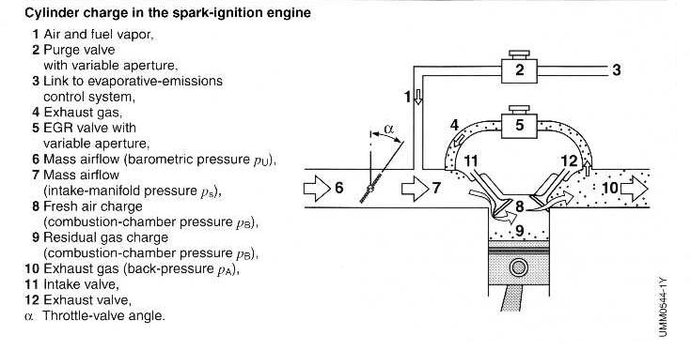
ETC Hardware

Slide 4
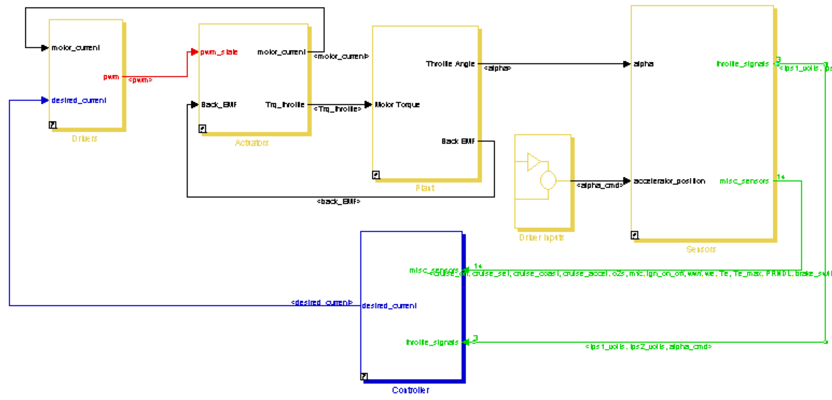
Simulink/Stateflow
Top Level Simulation
Current Feedback
Driver
Electric Sys
Mech. Sys
Sensors
Misc. Inputs
Back EMF
Controller
Notes:
A detailed model of the system. Now there are continuous and discrete time signals, and the continuous actuation has been replaced by a PWM. The output of the controller is changed from a voltage to a desired current. The driver adjusts the
PWM duty-cycle based on the current feedback from the armature.
Black lines are continuous signals
Red signal is the fastest discrete signal (pwm signal)
Green signal is the 2nd fastest discrete signal (sensor signals)
Blue signal is the 3rd fastest discrete signal (desired current signal)
The electrical system is driven by a PWM signal. The electrical and mechanical parts of the motor are linked by torque and back EMF.

Slide 5
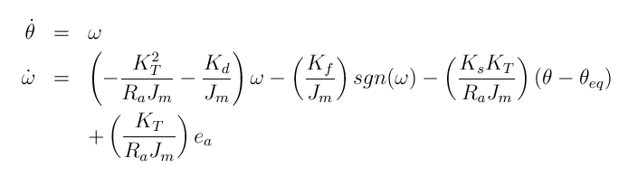
Hardware Model: Plant
Input: throttle torque: ea
2nd Order nonlinear System
Coulomb friction adds non-linearity
Viscous Damping
Coulomb Friction
Return Spring
Voltage Input
Output : throttle angle θ, back EMF Kt ω

Slide 6
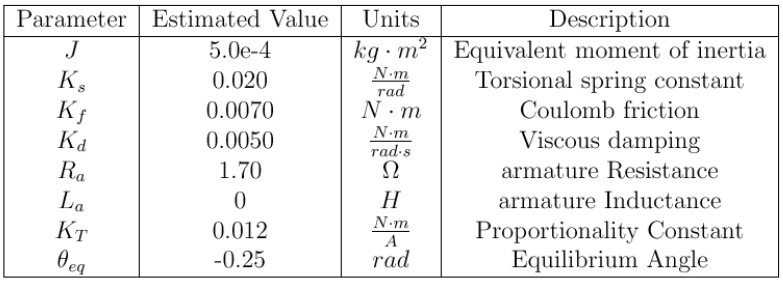
Hardware Parameters
Parameters estimated from system step response and electrical measurements of motor
Hardware Model: Actuator

Slide 7
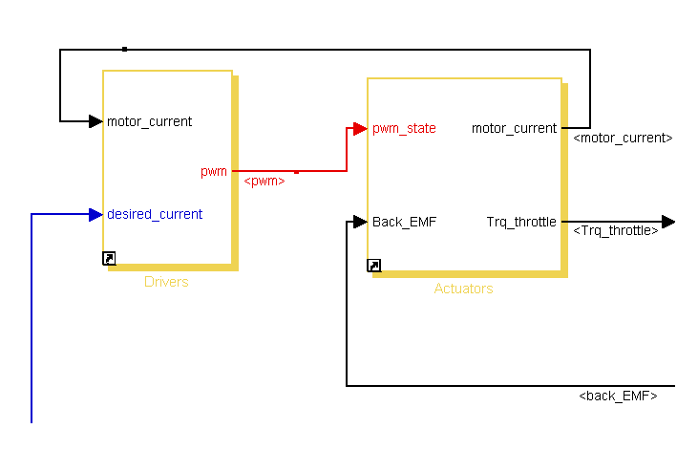
Hardware Model: Actuator

Slide 8
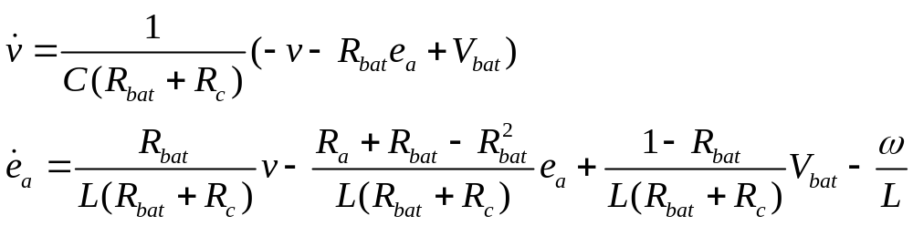
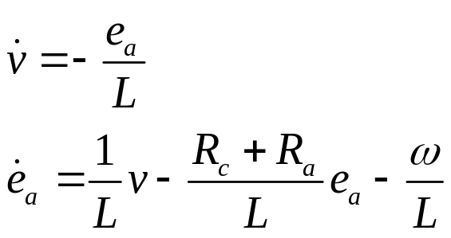
Hardware Model: Actuator
input: Back emf ω , pwm
switches between motor on (pwm=1) and off (pwm=0)
on:
off:
output: motor current ea

Slide 9
Hardware Parameters
Parameters of the simulink model for the acuator
Ra 1.7 Ohm resistance of motor windings
Rc 1.5 Ohm resistance of RC filter
Rbat 0.5 Ohm internal resistance of battery
L 1.5e-3 Henry motor winding inductance
C 1.5e-3 Farad capacitance of RC filter

Slide 10
Pulse Width Modulation
Input: motor current dc (=ea), desired motor current mc
Delay introduced by PWM
  outputs 1 if dc>mc at begin of PWM cycle
  outputs 0 if dc≤ mc
dc>mc
dc≤ mc
pwm=1
pwm=0
Time
pwm cycle
(hypothetical input)

Slide 11
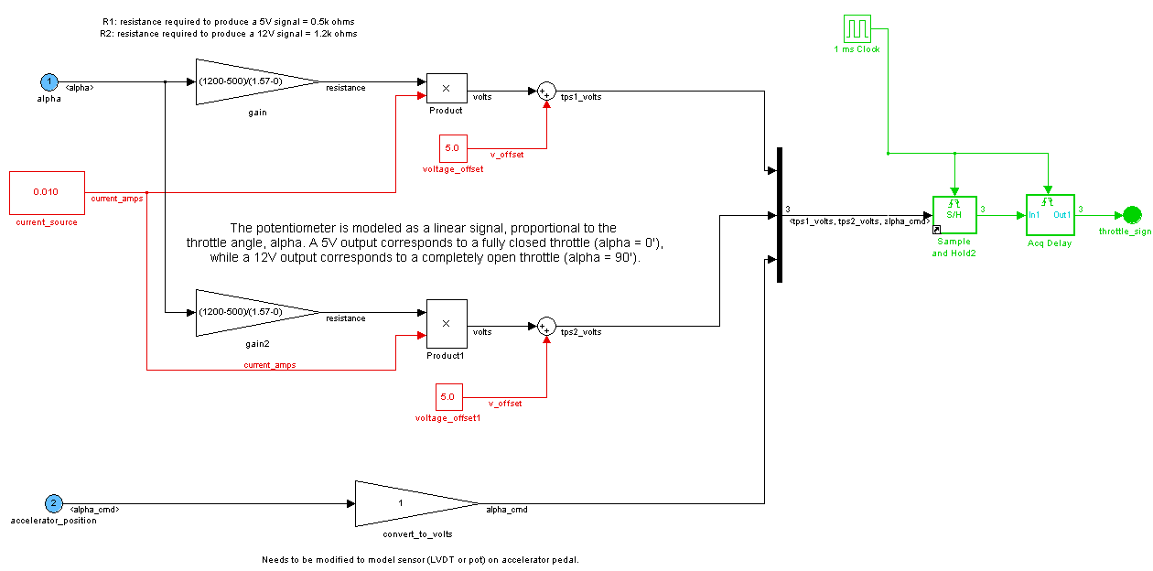
Hardware Model:Sensors (I)

Slide 12
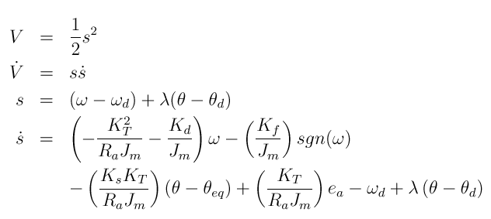
Human Control Mode
A sliding mode controller tries to reach the desired throttle angle
The Lyapunov function and sliding surface

Slide 13
Reminder

Slide 14
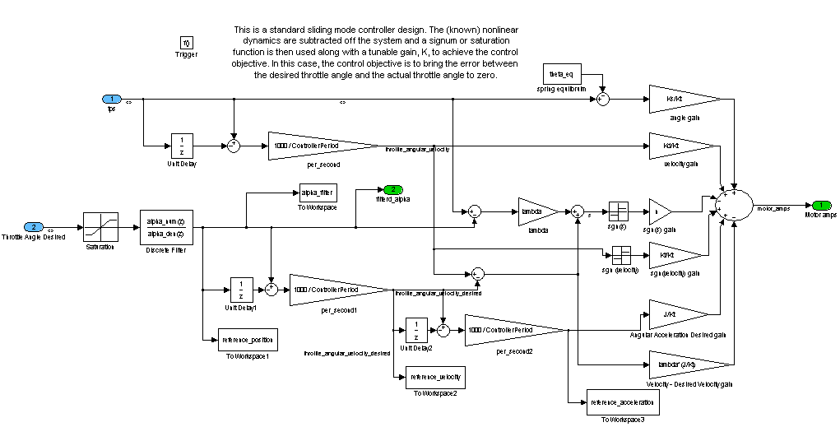
Human Control Mode
A sliding mode controller which tries to reach the desired throttle angle.

Slide 15
Outline
How to get formal requirements?
How to get a model suitable for verification?
How does the verification model compare to
the OEP model?
First results
More results

Slide 16
Performance Requirements
1 to 4 only in
human/cruise control mode
Rise time smaller than 100ms
Fall time smaller than 60ms
Settling time ( ±5%) smaller than 40ms
Steady state error smaller than 2%
Angle always in [0,90º]
Problem: Transforming these requirements
into formal specifications.
Solution: (part of) Discussion with phase 2
participant c.q. UCB

Slide 17
Performance Requirements
x:=0
A
α<10
x’=0
Rise Time, defined as the time required to rise from 10% of fully open to 90% for the throttle plate angle response to a step change in pedal position of the steady state value. The rise time for step changes from closed to is 100ms.
α>=10
B
x<=100
x’=1
x>=100
α<90
violate
rise
time
α>=90
x:=0
α>=90
x:=0
∀G not(violate rise time)
C
x<=40
x’=1
x>=40
α<95
Settle Time is defined as the minimum time after which the throttle plate angle remains within +5% of steady-state value. ETC shall guarantee that the settle time is less than 40ms after the throttle plate angle reaches 90% of the steady-state value
x>=40
α>=95
violate
settle
time
D
95≤α≤105
x’=0
α<95 v α>105
∀G not(violate settle time)
input α, internal clock x

Slide 18
The ETC model simplified
The aim is to prove properties that deal with
the angle α when the sliding-mode controller is used
OEP model can be simplified
Contains control logic for switching modes
Models internal communication
Contains place holders
Contains implementation details with limited effect on α

Slide 19
The ETC model simplified
Omitting the PWM
Reducing chattering
Removing delays (about 2 ms)
Replaced a 5th order filter by a 2nd order filter
Replacing numeric derivatives by exact ones
How does this effect the behavior?

Slide 20
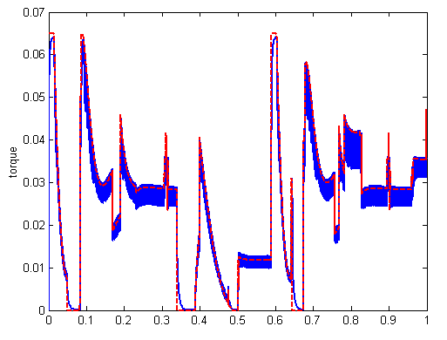
The ETC model simplified
Omitting actuator and PWM
output of pwm/actuator
output of gain and saturation block

Slide 21
The ETC model simplified
Reducing chattering in sliding mode
sliding
surface
sliding
surface
Behaves close to surface approximately as a given equivalent controller
Introducing a boundary layer
with ε =0.05. Within this layer we apply the equivalent controller

Slide 22
The ETC model simplified
Reducing chattering in sliding mode
1
1
s
-ε
ε
s
-1
-1
OEP model uses a sign-function to represent the modes
Within the boundary layer with ε =0.05 we apply the function s/ε

Slide 23
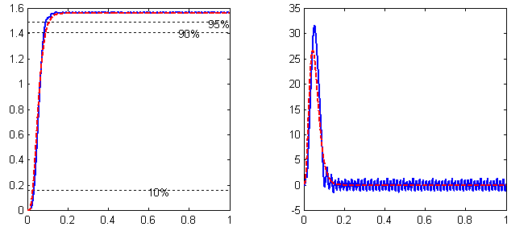
The ETC model simplified
Reducing chattering in sliding mode
Removing communication delays (about 2ms)
alpha
omega
OEP model
without chattering, delay and pwm

Slide 24
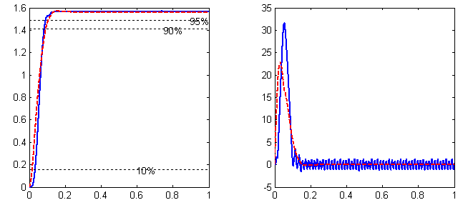
The ETC model simplified
A 5th order filter is part of the controller
alpha
omega
If we reduce it to a 2nd order filter we get slightly different behavior
OEP model
as before but with 2nd order filter

Slide 25
OEP vs Checkmate model
checkmate model separates discrete part
from continuous part
switching in behavior triggered by hitting
thresholds
⇒
sliding-mode controller and coulomb friction
modeled by modes
continuous behavior and controller modeled by the
same switching continuous function

Slide 26
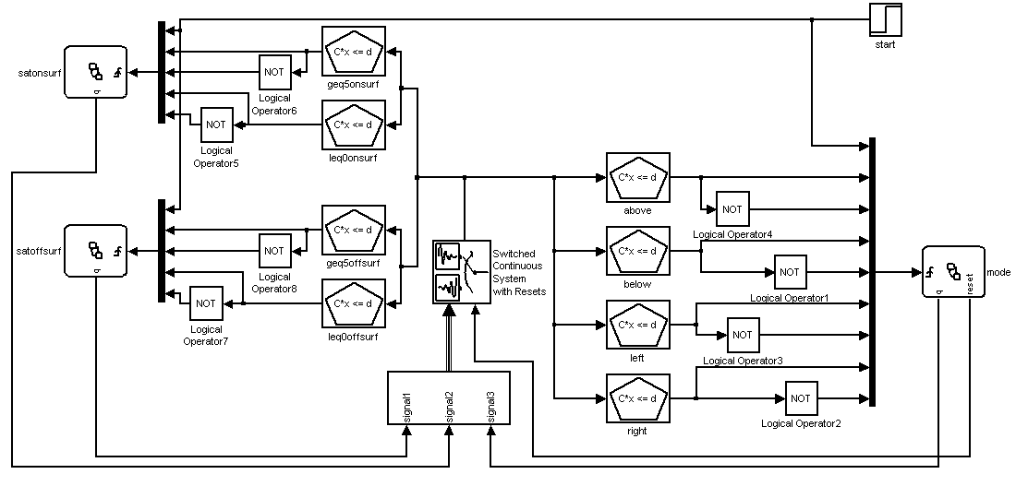
Checkmate model
switched continuous system
discrete input

Slide 27
Checkmate model
Saturation of output current

Slide 28
Checkmate model
Sliding mode switching and coulomb friction

Slide 29
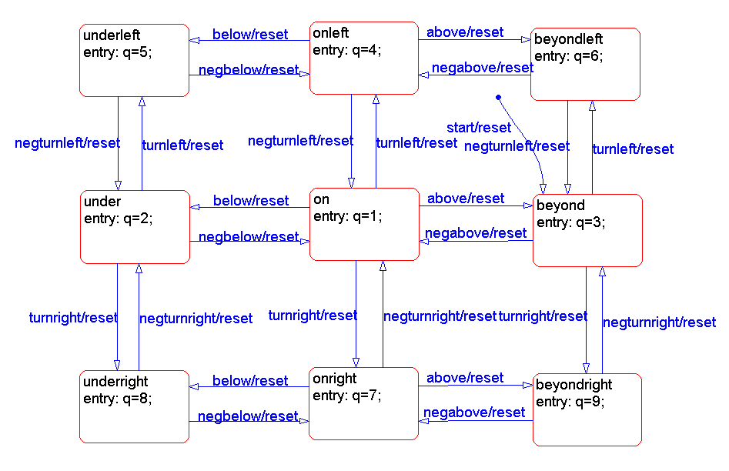
Checkmate model
Sliding mode switching and coulomb friction

Slide 30
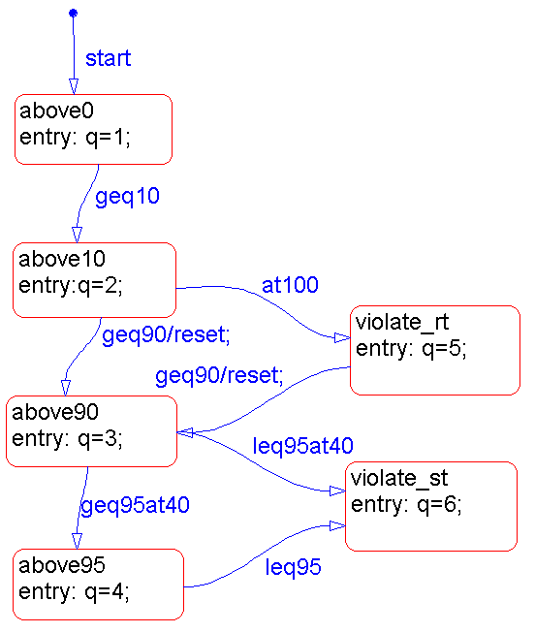
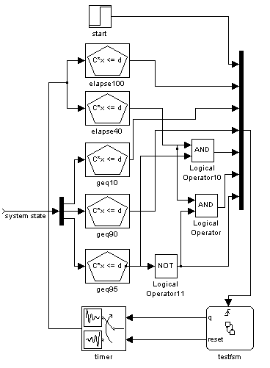
Requirements

Slide 31
Requirements
switching conditions
angle
timer

Slide 32
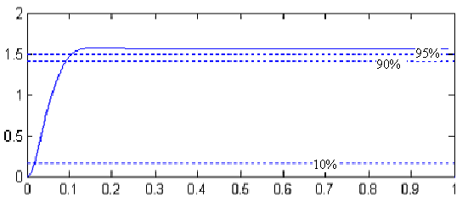
Requirements
Some Requirements can be proven by simulation (e.g. Rise time)

Slide 33
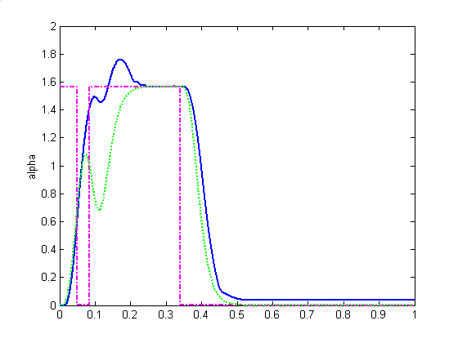
Requirements
Some Requirements can be proven by simulation (e.g. Rise time)
Other can be proven not to hold, by simulation
overshoot
angle
input
filtered input

Slide 34
Requirements
Some Requirements can be proven by simulation (e.g. Rise time)
Other can be proven not to hold, by simulation
steady state tracking error
angle
input
filtered input

Slide 35
Verification
What can verification add, if simulation gives the answer, already?
Verification allows to deal with uncertain initial conditions on the state.
Parametric verification allows to deal with uncertain parameters
For example: Does the rise time requirement hold if spring constant or coulomb friction range over an interval?

Slide 36
Parametric Verification
Propagate vertices for each vertex of the parameter range

Slide 37
Parametric Verification
Propagate vertices for each vertex of the parameter range
Determine enclosing polyhedron

Slide 38
Parametric Verification
Propagate vertices for each vertex of the parameter range
Determine enclosing polyhedron
Enlarge polyhedron by optimization over the initial set, the time interval and the parameter range

Slide 39
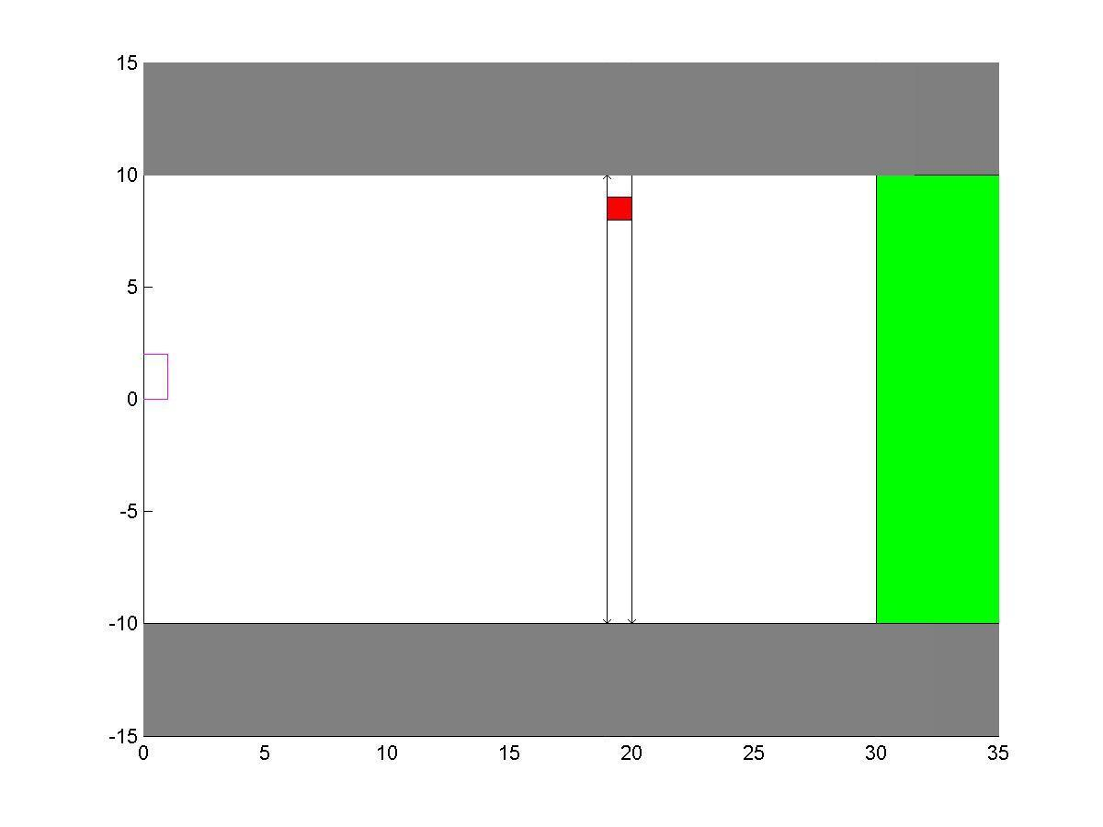
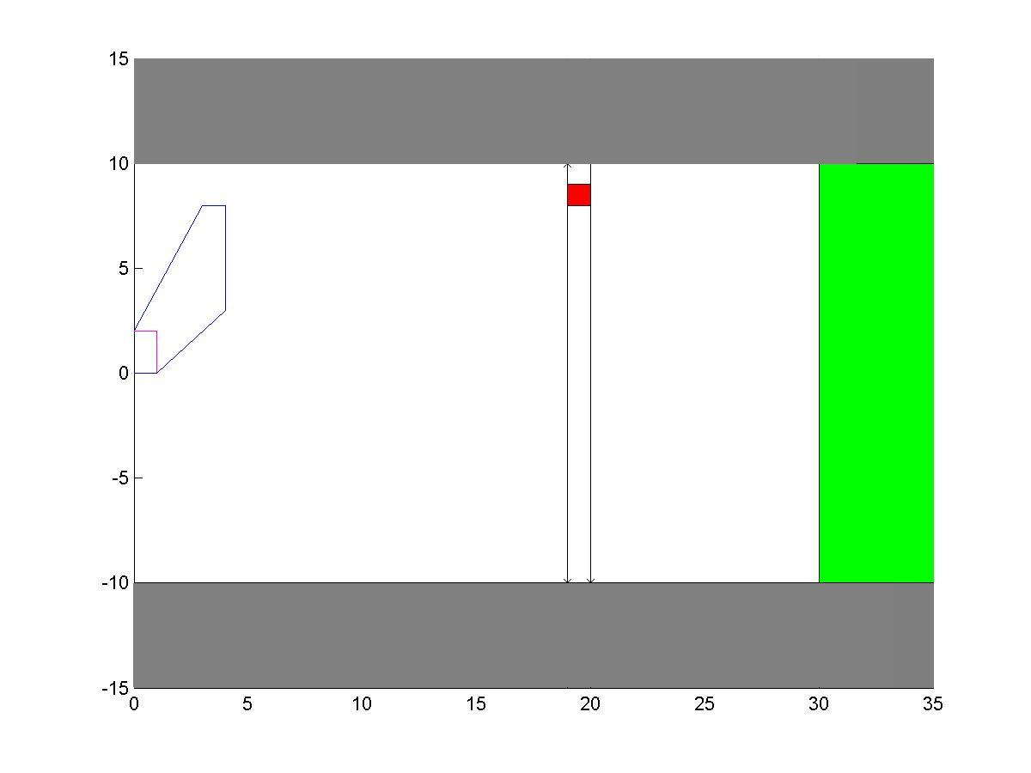
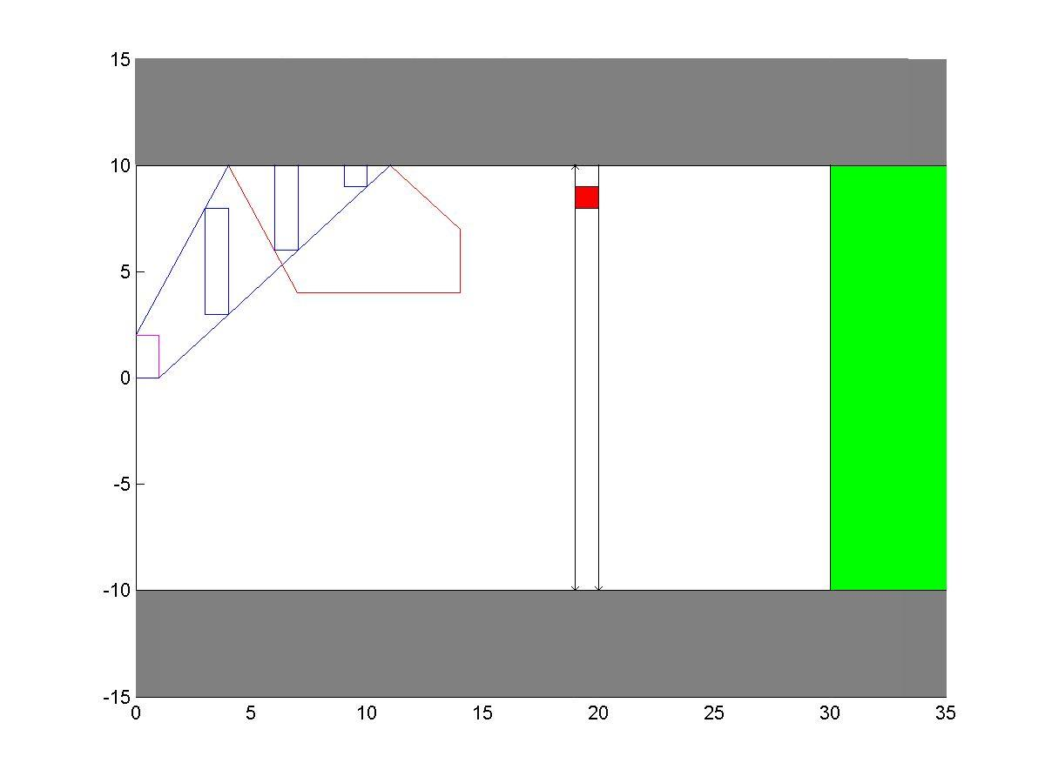

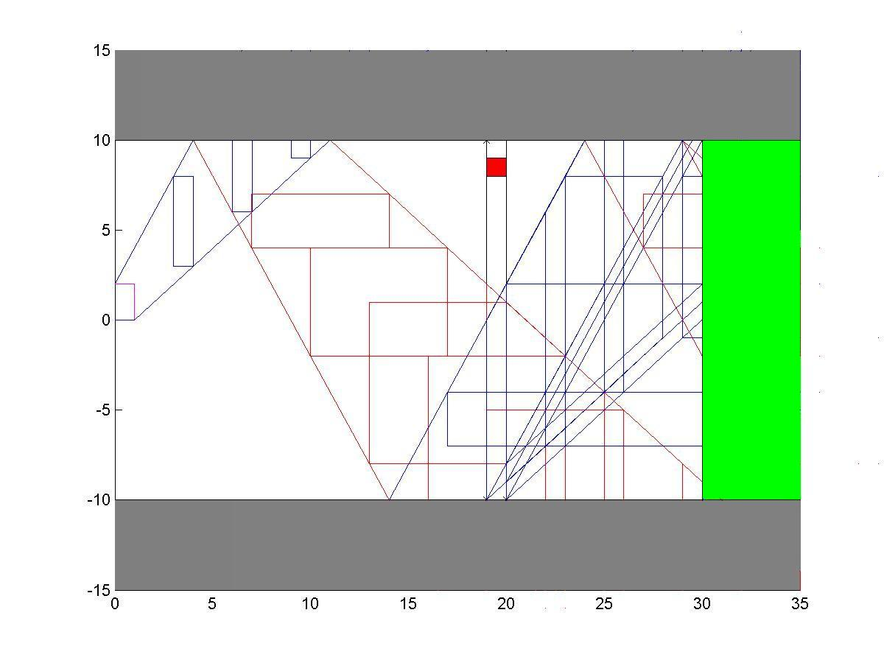
Parametric Verification
First experiments (multi-rate automata)

Slide 40
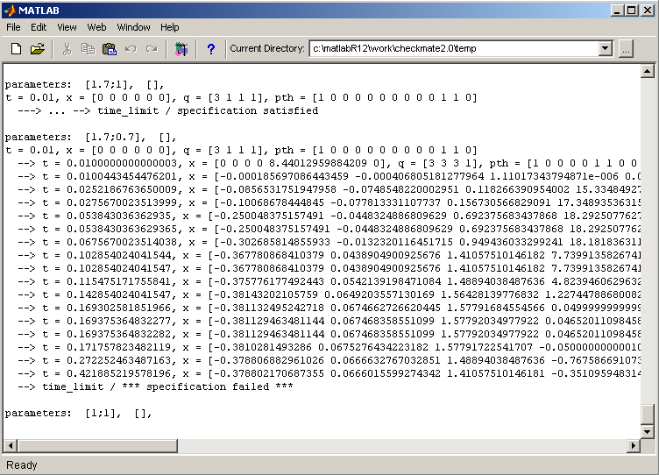
Parametric Verification
First ETC results with Checkmate validation tool
error trace
angle below 95%

