Slide 1
Chinese Spelling Correction
Review update @ December 14, 2021

Slide 2
Relevant papers and code
Earlier papers (not presented today due to poor performance)
2014 - 2015 (rules, conditional random field or hidden markov models)
Chinese Spelling error detection and correction based on language model, pronunciation, and shape, ACL 2014 - language models and rules
Introduction to sighan 2015 bake-off for chinese speeling check, SIGHAN workshop 2015 - language models and rules
Hanspeller++: A united framework for chinese spelling correction, SIGHAN workshop 2015
Most relevant papers (performance & authoring lab)
2018 - the year in which BERT is developed
A Hybrid Approach to Automatic Corpus Generation for Chinese Spelling Check, EMNLP 2018, Tencent AI Lab
2019
Confusionset-guided Pointer Networks for Chinese Spelling Check, ACL 2019, Tencent Cloud AI - seq2seq with attention
A SPELLING CORRECTION MODEL FOR END-TO-END SPEECH RECOGNITION - seq2seq with attention
FASPell: A Fast, Adaptable, Simple, Powerful Chinese Spell Checker Based On DAE-Decoder Paradigm, ACL 2019, Intelligent Platform Dvision, iQIYI - seq2seq & BERT
2020
Spelling Error Correction with Soft-Masked BERT, ACL 2020, Bytedance AI lab) - BERT
SpellGCN: Incorporating Phonological and Visual Similarities into Language Models for Chinese Spelling Check, ACL 2020, Ant Financial Services Group - BERT & GCN

Slide 3
We'll focus on recent works.

Slide 4
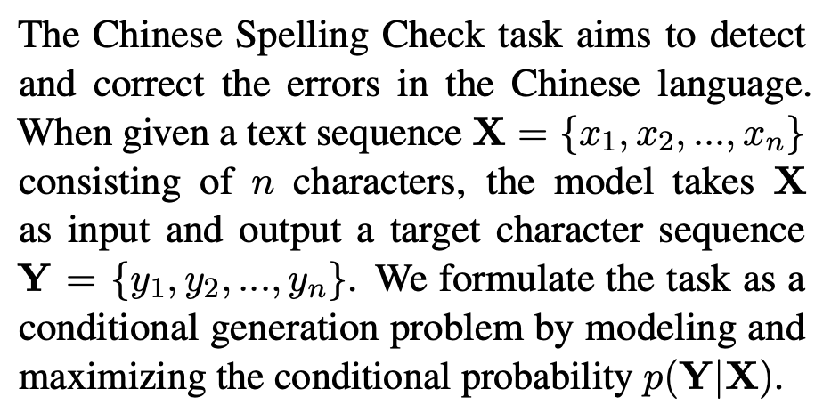
Intro: Spelling correction as a seq-to-seq problem
This allows us to use techniques previously developed for machine translation!

Slide 5
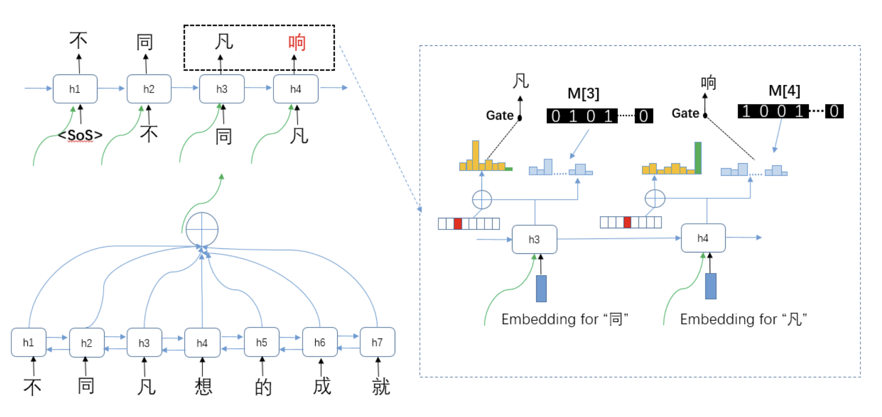
seq2seq/Confusionset-guided Pointer Networks
Confusionset-guided Pointer Networks for Chinese Spelling Check, ACL 2019, Tencent Cloud AI
Architecture: A standard seq2seq network with attention,
Intuition*: A simple application of seq2seq with attention to Chinese spelling correction. For correct words, the output is trained to copy the word; for errors, the output to trained to choose a character from the confusion set (see “Gate” in the picture below), rather than the whole vocabulary, hence search space is reduced and is more likely to generate the correct correction.
gating mechanism
decoder
confusion set mask has the same length
as the vocab, with positions corresponding
to the confusion characters of the current
character marked at 1
attention
encoder

Slide 6
BERT/Vanilla fine-tuned BERT
This is not a paper, but this is a very strong baseline in the following two papers. Following papers also claim to be better than fine-tuned BERT.
What is fine-tuned BERT? Just means training a pre-trained BERT to output the correct sentence given an incorrect sentence (which includes copying the correct characters), as in seq2seq.

Slide 7
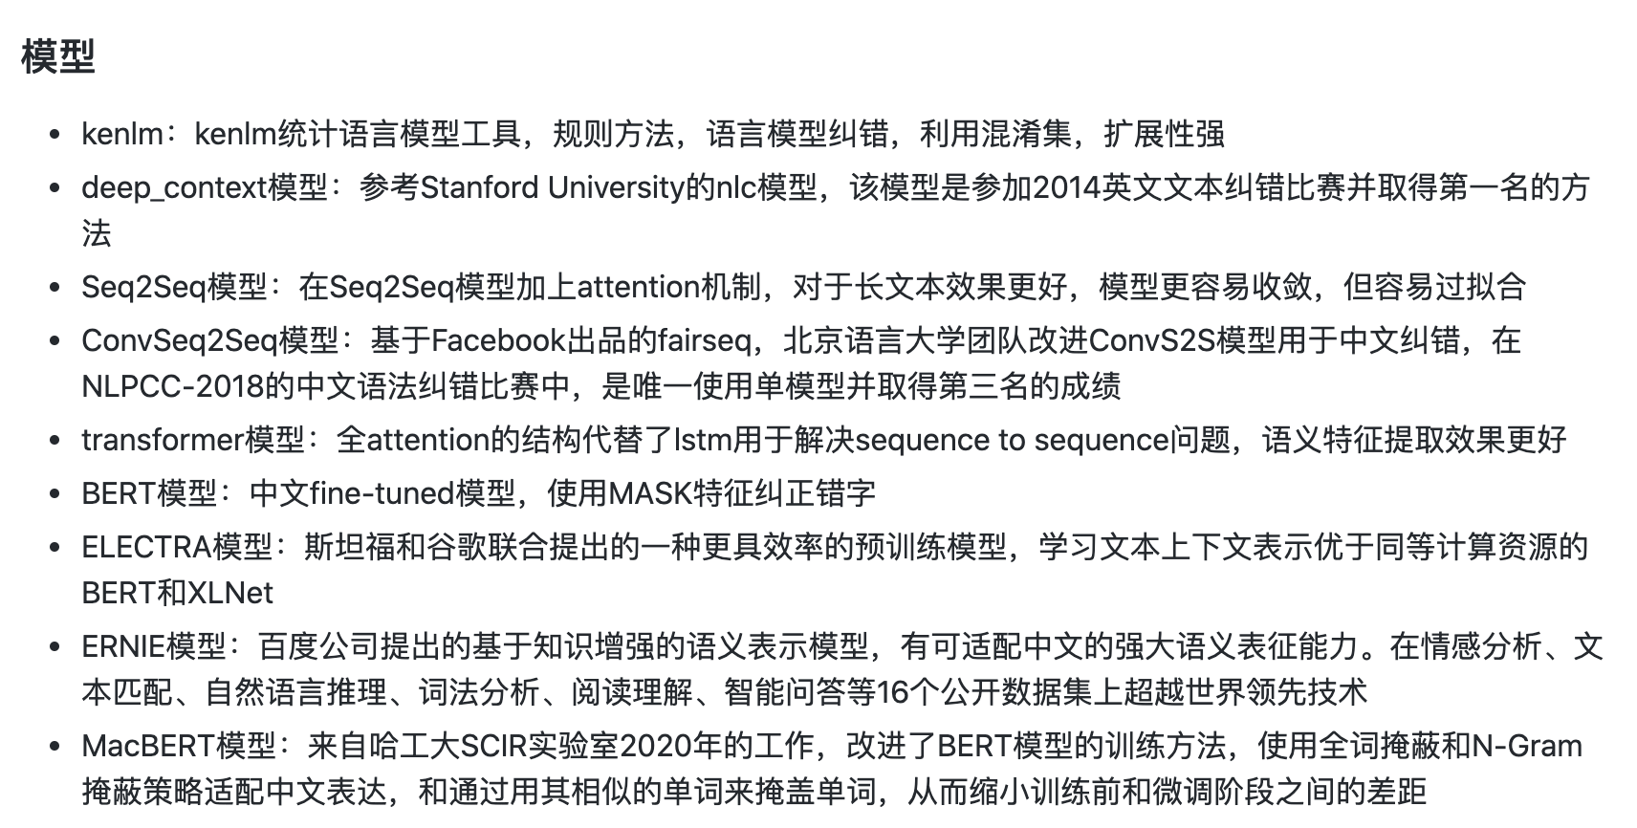
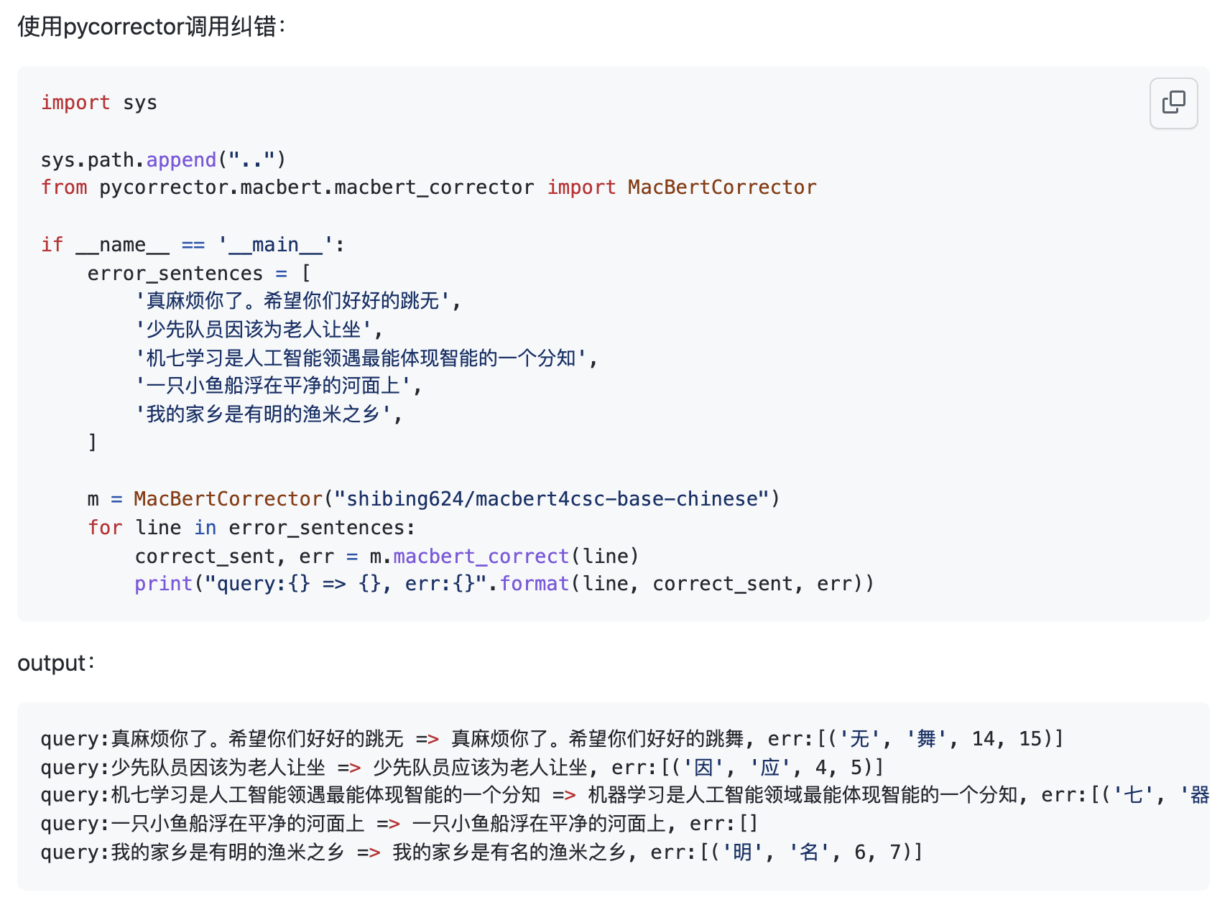
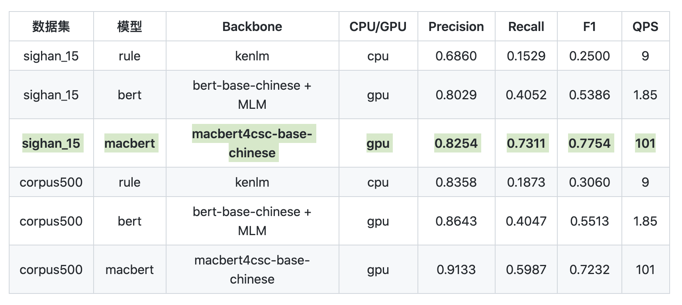
Software: pycorrector
https://github.com/shibing624/pycorrector
Included algorithms
本项目重点解决其中的谐音、混淆音、形似字错误、中文拼音
全拼、语法错误带来的纠错任务。
API
Benchmark
Notes:
包含了BERT为基础的中文纠错模型

Slide 8
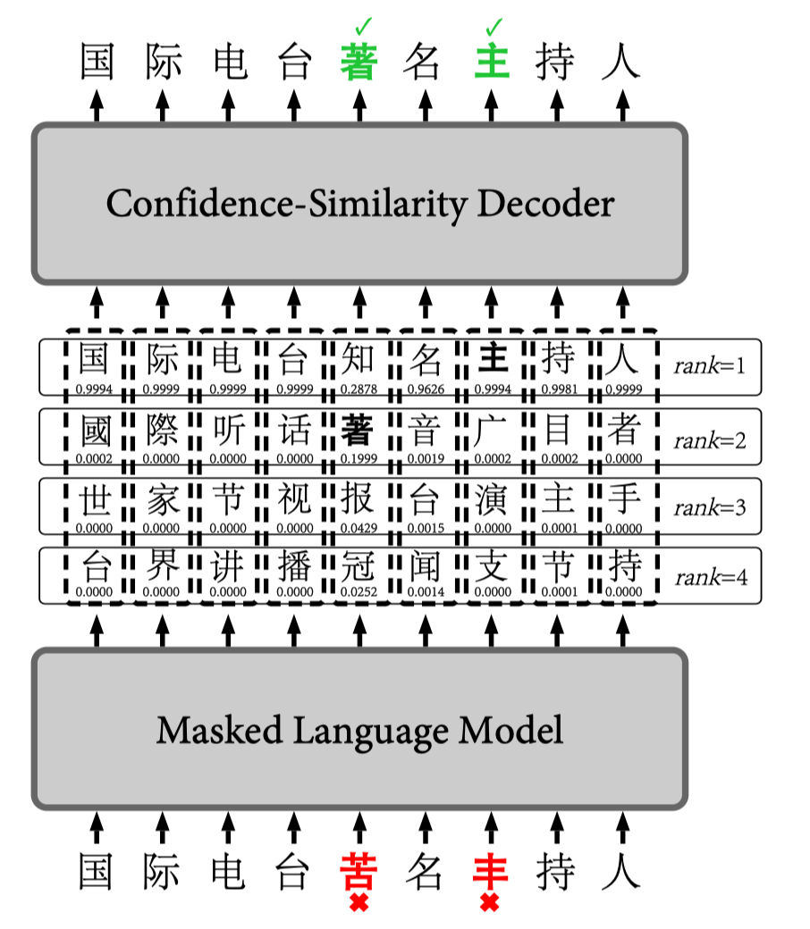
BERT/Faspell
FASPell: A Fast, Adaptable, Simple, Powerful Chinese Spell Checker Based On DAE-Decoder Paradigm, ACL 2019, Intelligent Platform Dvision, iQIYI
2 primary contributions:
(1) finetune BERT because errors introduced by random masks maybe very different from actual errors in spell checking data - fix distribution shift issue
(2) utilize character and phonological similarity (obtained from extra datasets) to filter candidates - incorporate expert knowledge about the errorenous characters

Slide 9
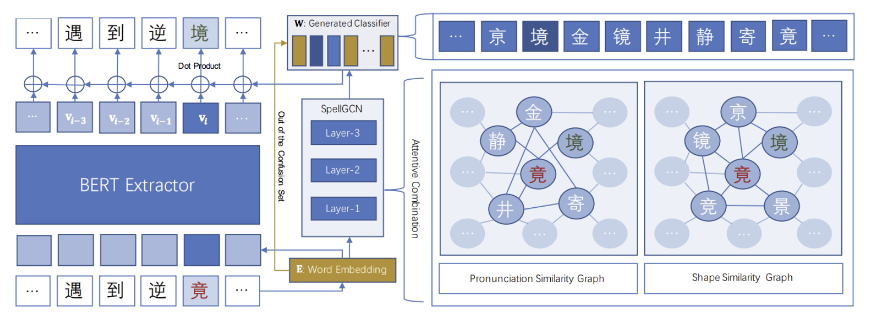
BERT/SpellGCN
SpellGCN: Incorporating Phonological and Visual Similarities into Language Models for Chinese Spelling Check, ACL 2020, Ant Financial Services Group @ Alibaba
Architecture: BERT on the left, SpellGCN on the right. SpellGCN's parameters are partly determined by some outside knowledge. Embedding is passed separately into two networks, but merged at the end.
Intuition: (1)前后信息与(2)错字本身*都可以为纠正提供信息，所以纠正不仅仅是使用前后信息进行文本填空（与soft-masked BERT对比）

Slide 10
Notice how Faspell and SpellGCN both utilize expert knowledge from visual and phonological similarity. Their primary difference seems to be that Faspell first generates the candidates and then applies expert knowledge in selection, while SpellGCN applies extra knowledge directly when generating the candidates.

Slide 11
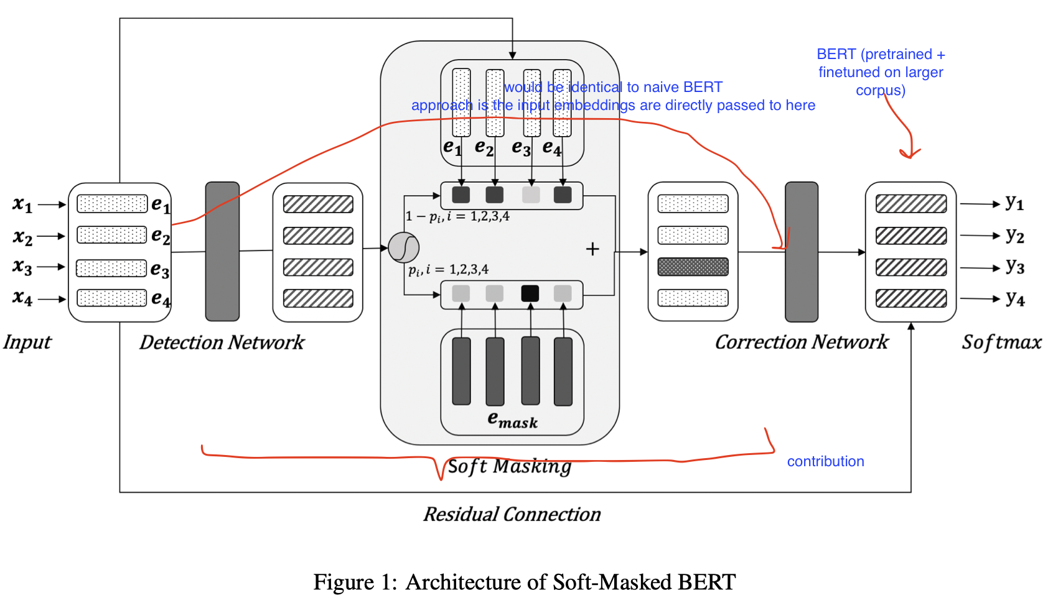
BERT/Soft-masked BERT
Spelling Error Correction with Soft-Masked BERT, ACL 2020, Bytedance AI lab
Architecture: BERT on the right, error correction network (bi-directional GRU) on the left
Intuition*: Error correction capability of using vanilla fine-tuned BERT is not high enough, but once an error is detected, the model has a better chance to make a right correction. Therefore, error detection is done with a separate network. Masking the error also forces the model to learn the right context (but the error itself is omitted).
For this reason, I'd expect soft-masked BERT to be less performant than Faspell, but the soft-masked BERT paper shows otherwise...
Currently, there seems to be no comparison between soft-masked BERT and SpellGCN, since they are concurrent work...

Slide 12
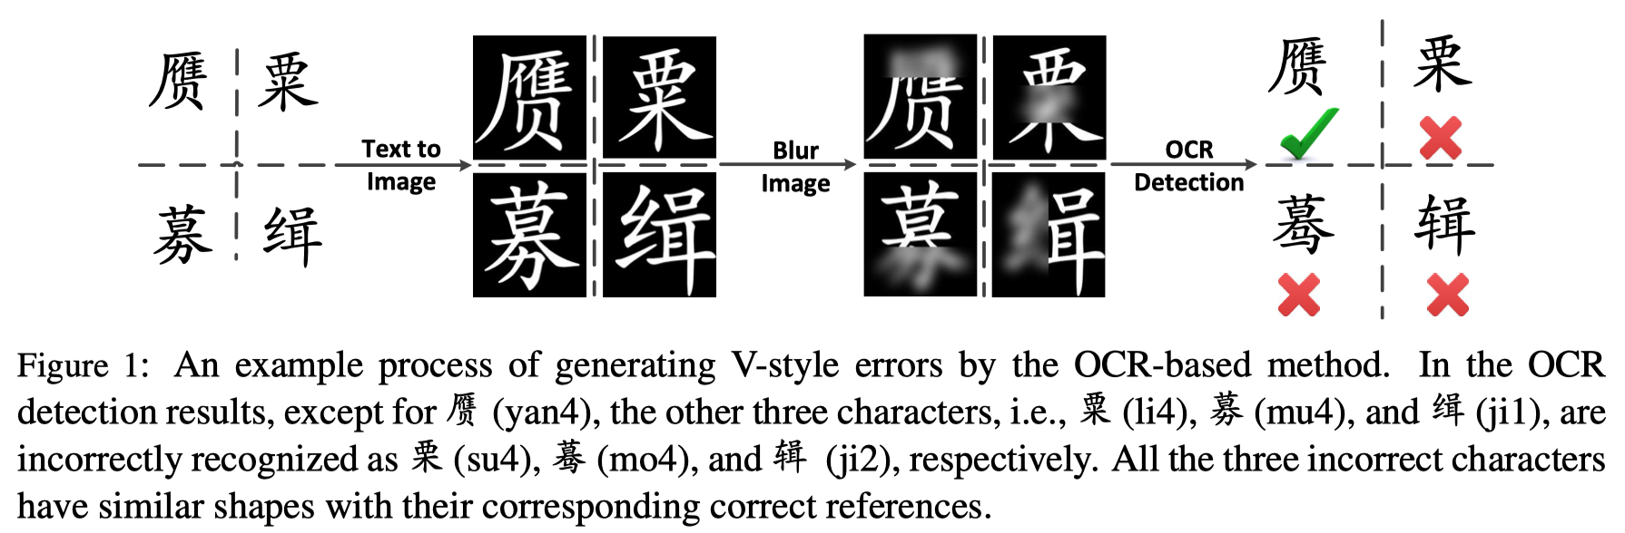
data/A Hybrid Approach to Automatic Corpus Generation for Chinese Spelling Check
A Hybrid Approach to Automatic Corpus Generation for Chinese Spelling Check, EMNLP 2018, Tencent AI Lab
Idea: Generate extra training data that fits a particular purpose (e.g., OCR, voice recognition). For example, if we generating extra data for OCR, we want to generate errors that are likely to appear in the OCR seeting.
extra training data!!!

Slide 13
Relevant blogs for reference
https://www.icode9.com/content-4-898309.html

