Slide 1
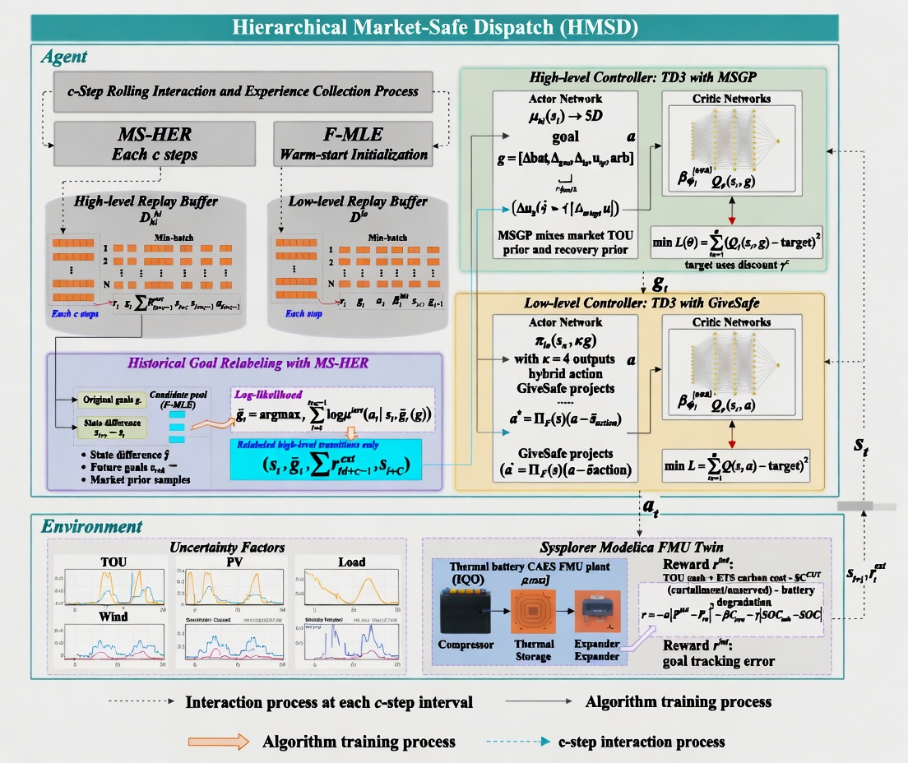
c-Step Interaction and Experience Collection Process
MS-HER
Each c steps
F-MLE
Warm-start Initializatin

