Slide 1
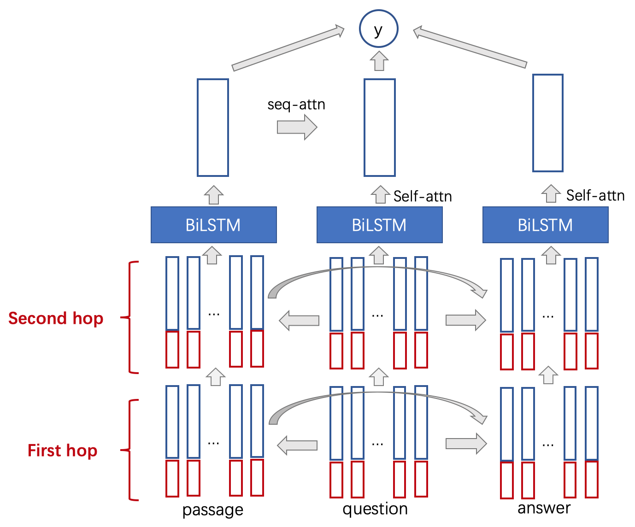
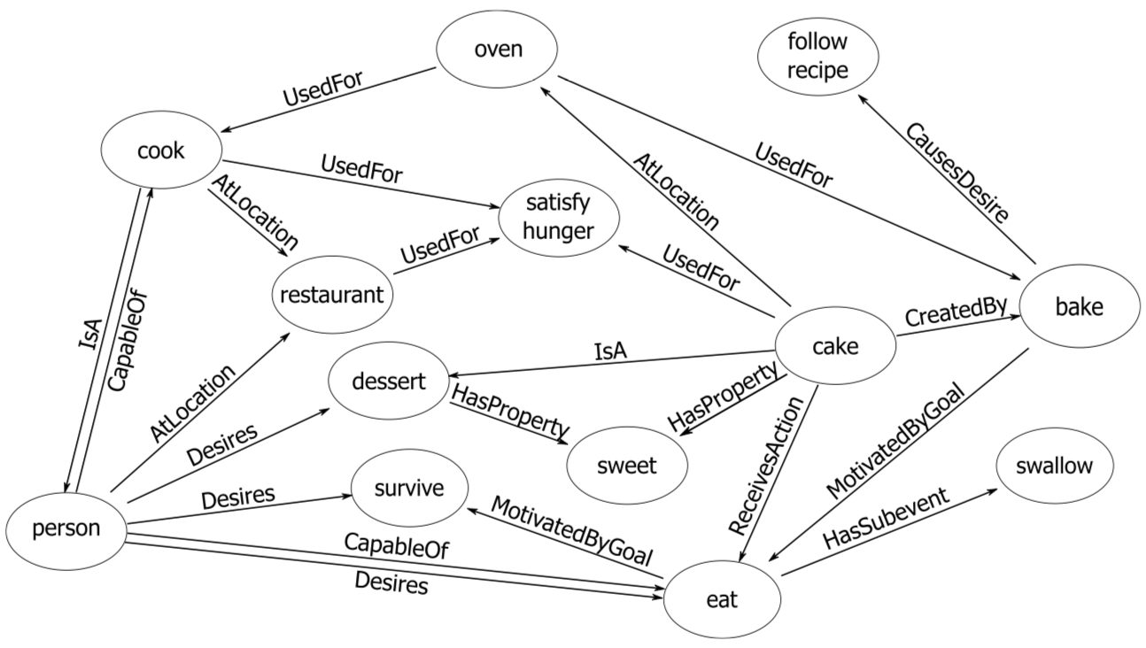
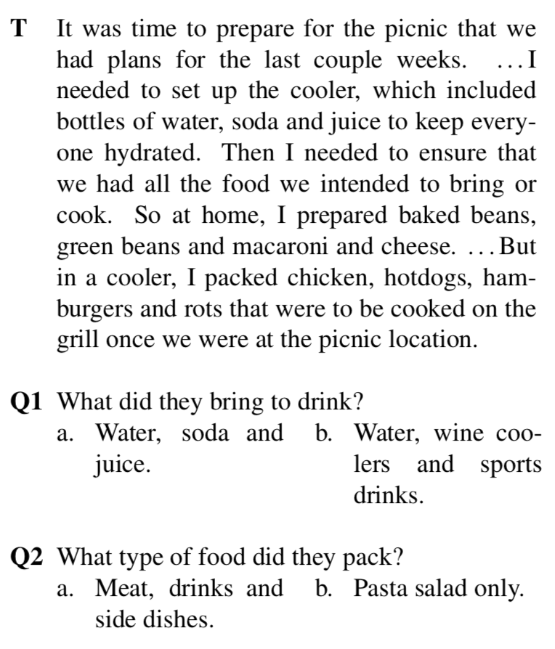
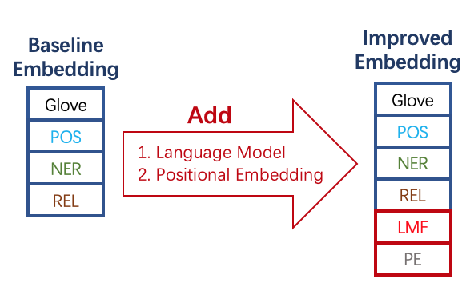
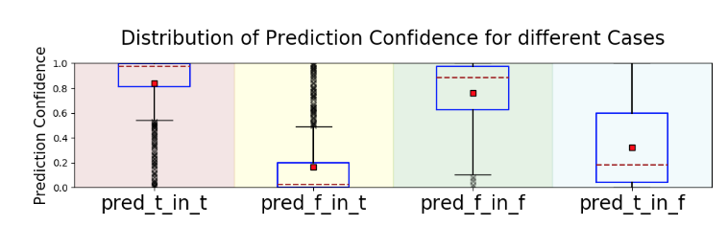
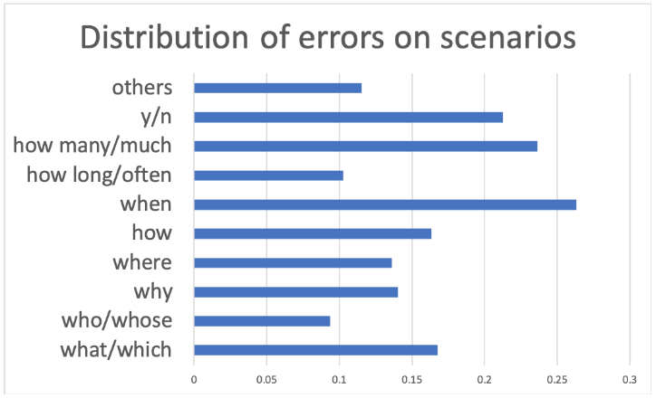
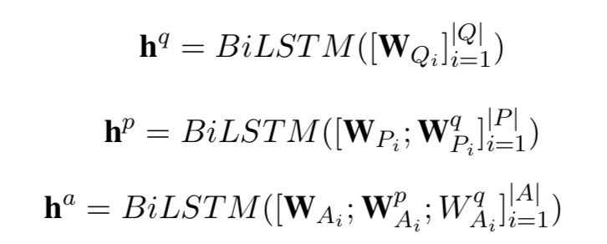

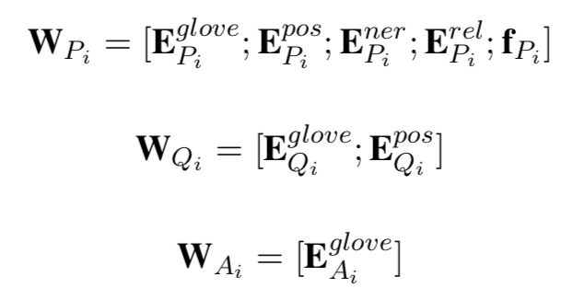
Incorporating Script Knowledge and Reasoning for Machine Comprehension
Zhihao Zhou* Xue Lei† Jiaxu Zou†
*Language Technologies Institute, Carnegie Mellon University
†Department of Electrical and Computer Engineering, Carnegie Mellon University
Abstract
Our project is based on SemEval-2018 Task 11: Machine Comprehension using Commonsense Knowledge. We use Three-way Attentive Networks (TriAN) as the baseline to model interactions among the passages, questions and answers. Building on TriAN, we propose to 1. integrate pre-trained language models to capture script knowledge 2. add multi-hop attention to enable multi-hop reasoning. 3. add positional embedding to help model reason through event ordering.
Then the question and answer vectors are summarized to a single vector using self attention. The passage vectors are summarized to a single vector using bilinear attention to the question vectors. Outputs are computed from the sigmoid of the sum of two bilinear interactions.
TriAN model also incorporates features including: part-of-speech tags (POS), name-entity-recognition (NER), relation embeddings extracted from ConceptNet (REL), algorithmic term frequencies from Wikipedia.
Task Description
Machine comprehension:
Given a narrative text and several questions, choose the correct answer.
Script knowledge:
Commonsense knowledge on sequences of events describing stereotypical everyday human activities.
MCScript:
A dataset to evaluatethe contribution of script knowledge to machine comprehension.
Error Analysis:
Main issues:
Fail to build temporal sequence
Lack of Commonsense Knowledge
Answer is irrelevant to question
Ambiguous Reference
Abuse of Commonsense Knowledge
Results:
LM sample generation:
I went into my bedroom and flipped the light switch ==> . I took the ladder to the light switch. I then cut open the light bulb and turned on the light bulb. I then got a little light bulb…
I think it is time to do the laundry. ==> I make sure to clean the floor. I will find a nice flat sheet. I put the comforter in the back of the bed. I then put the clothes in the washing machine. I put them in the dryer machine…
I was going to visit some friends in Florida . ==> I had to go to the airport. I got out my car and started looking in the car. I went to the store and found a seat. The next day I decided to go to the airport. I got out and walked in a parking lot…
Accuracy:
Baseline Model:
The Three-way Attentive Networks models attentions among passages, questions and answers on both word-level and sentence-level. The model first calculate simple context vectors for passage and answer by attending to each other and to the question as well. The attention function is Dot-Product after linear projection. These simple context vectors are appended to word embeddings before fed to Bi-LSTMs.
Proposed methods
Integrate pre-trained language models to capture script knowledge
  It could be helpful for the model to learn script knowledge from LM objective (multi-task learning)
Add multi-hop attention to enable multi-hop reasoning
  Once the model knows which words to attend to, it could be helpful to then think about what to attend to next
  E.g., to answer “what happened after A”, the model should first attend to “A” and then to the things after A.
Add positional embedding to help model reason through event ordering
  Dot-product attention on word vectors does not consider word orderings.
  Multi-hop reasoning often requires temporal information
TriAN (no handcrafted) | TriAN+LM (no handcrafted) | TriAN+PE+Multi-hop | TriAN+LM+PE+ Multi-hop
82.42% | 84.05% | TBD | TBD

