Slide 1
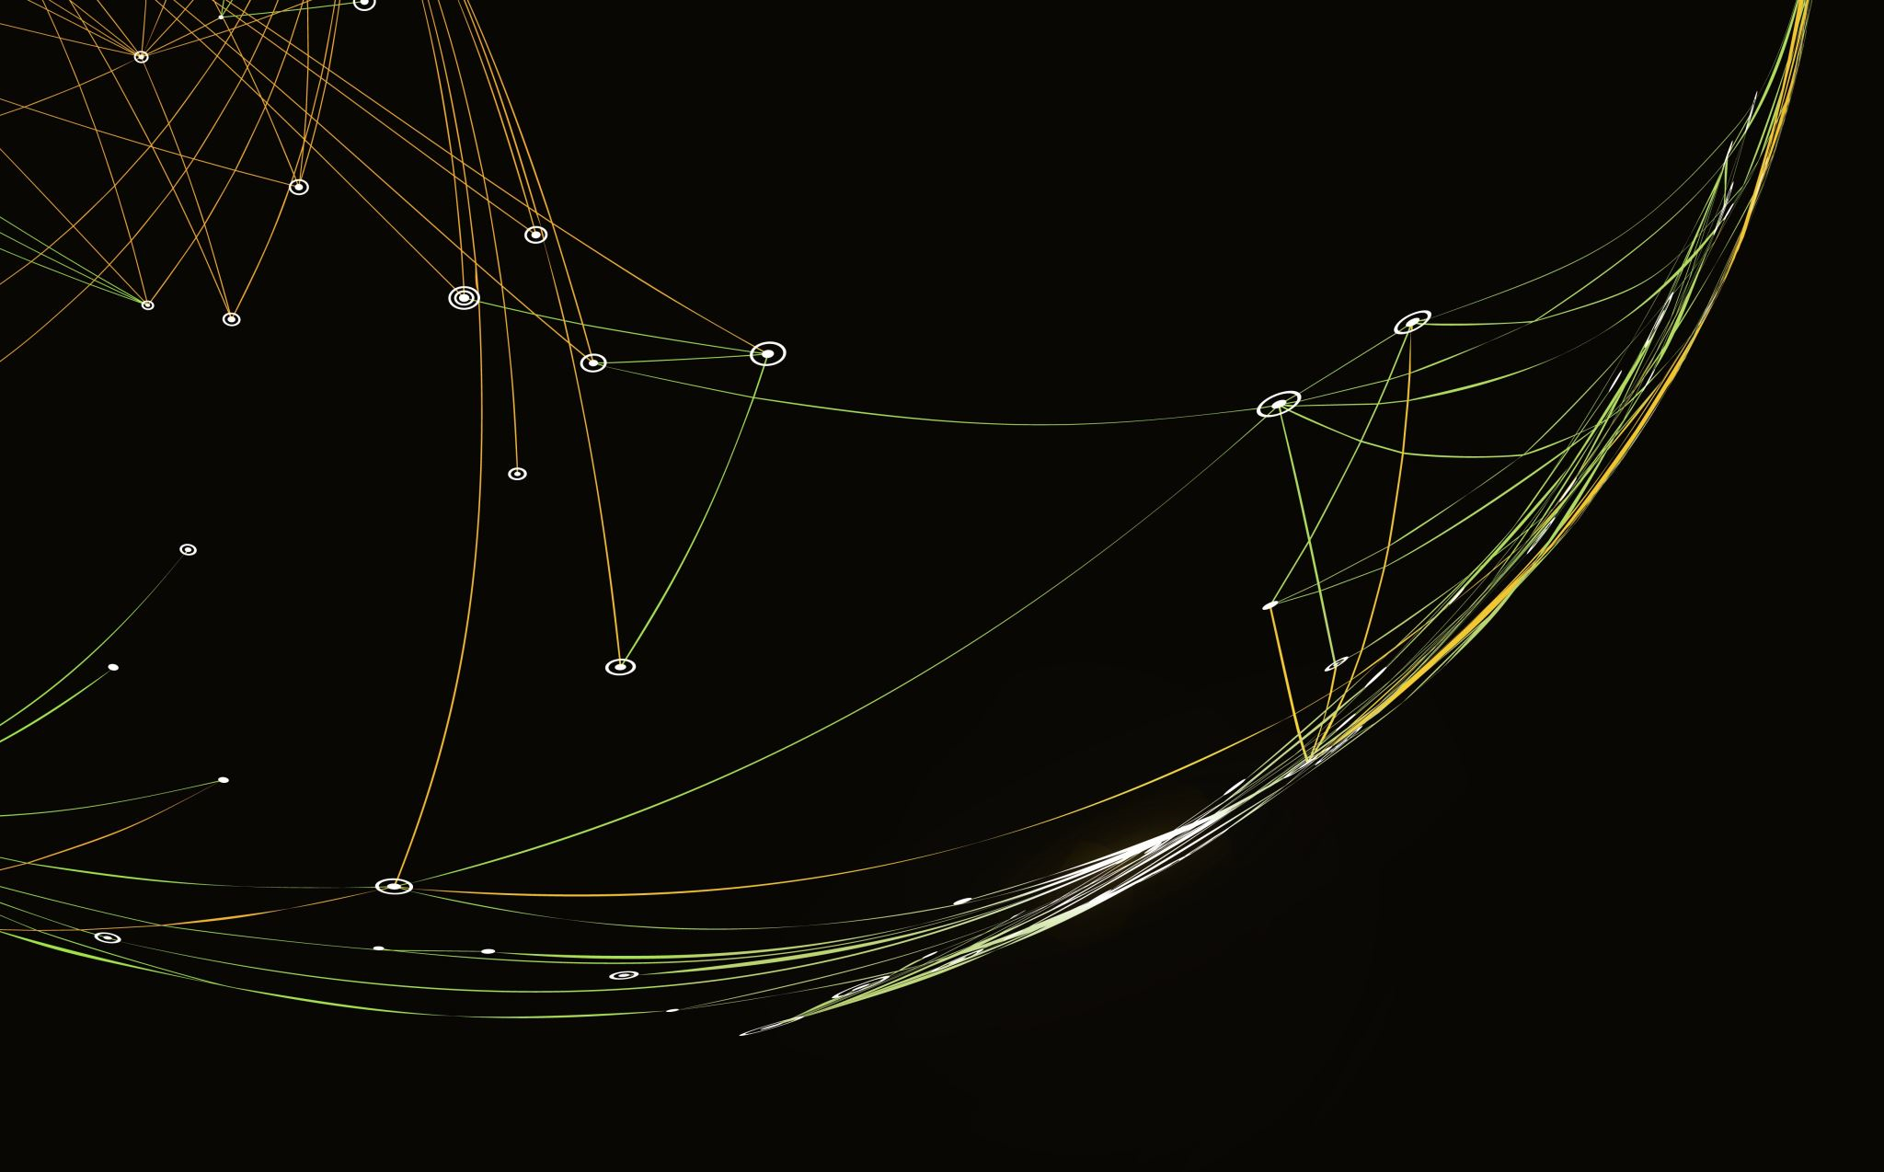
Group6 – Skynet Hex
Yanze Xin, Mohan Ren, Zhihao Fang, Jiachen Fan

Slide 2
Overview
Main Methods
Unique Techniques
Hyper-parameter selection
Performance & Evaluation
Quantitative Metrices
In Future
References

Slide 3
Main Methods
State Value Model
Deep CNN function approximator to evaluate state (V-Learning)
Reinforcement learning pre-trained by self-play (TD(0))
Policy Model
Deep CNN policy predictor
Pre-trained by game data from an existing AI agent
Input: 11x11, output: 122
Monte Carlo Tree Search
Expand and Simulate while playing
Apply policy model to expand searching tree
Select best move:
argmax( C * average reward from MCTS + (1 - C) * score from value model )
Notes:
This time we adopted MTCL Tree Search Algorithm as our base framework. While playing the game, we will input the current board state as the root node and construct the Game Tree as much as possible within a fixed period of time. In the phase of expansion, instead of choosing all possible moves, we will only select top 10 best moves as the children of the leaf node by applying the policy function, so that we can prevent to reach on those nodes which are less likely to lead to victory. After finishing construct the game tree, we will choose the move which maximize this function as our best move and update the root node for our search tree.

Slide 4
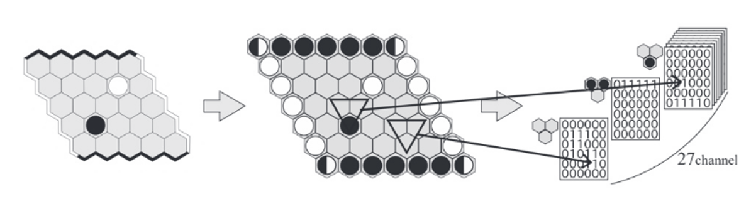


Unique Techniques
Fabulous Board Encoding
- Inspired by DeepEZO Hex
Easier to learn the cell adjacency
Transfer rhomboid board to rectangular board
This example: $\left(5, 5\right) →(6, 6, 27)$
$$\left(11, 11\right) →(12, 12, 27)$$
Notes:
We considered each inverted triangle with three places as a training unit. We also expanded the board by adding four boundaries so that the shape is 13 x 13. Also, as each inverted triangle has 27 patterns, which is the 3 cube, we can have 27 channels for it. Finally, we encoded our board as an input with shape 12x12x27, which makes it easier to learn the cell adjacency because the goal of the hex is to connect two opposite, and the cell adjacency is quite important.

Slide 5
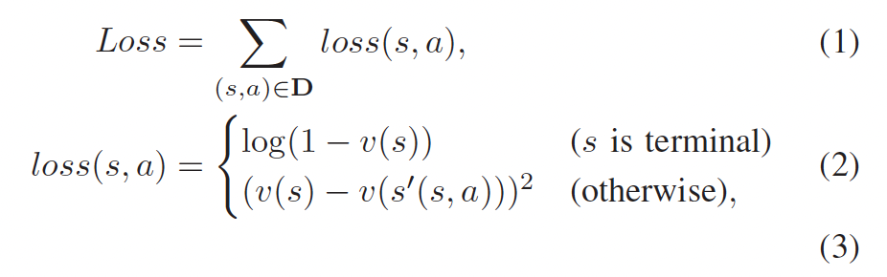
Unique Techniques
Exploitation and Exploration
Addition of small random number to evaluation value
Random moves during starting of each game
Loss of Value Model

Slide 6
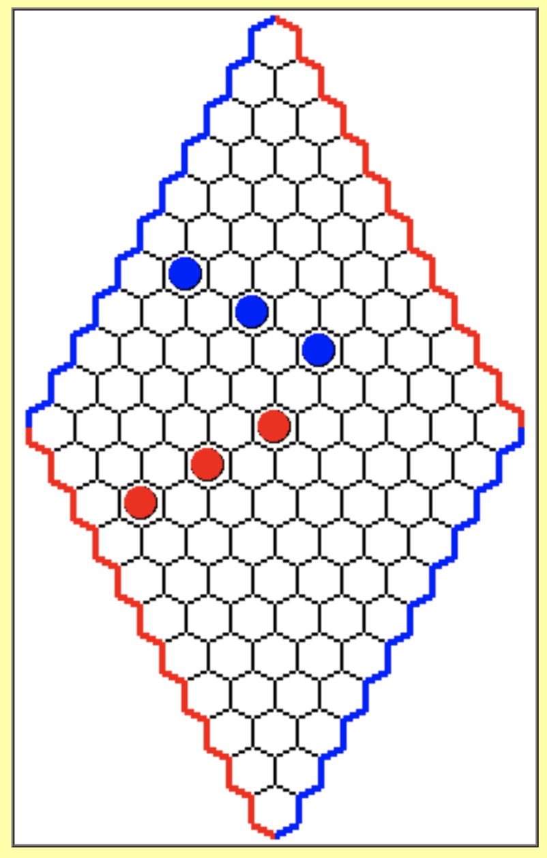
Unique Techniques
Opening Strategy
1. Swap Logic
2. Applied in the first three steps (virtual connection)
Notes:
Due to the defects of neural network , the first few steps often can not find a good point, so we set up some artificial strategies
If we are backhand, we can choose some special points (those that are very good for the situation) to swap
For the first 3 steps, we will choose virtual connection method in order to get a good start.

Slide 7
Hyper-parameter Selection
Architecture of CNN in Value Model
Layer Type | Image size | Channel | Kernel Size
Input | 12 x 12 | 27 | -
Conv 1 | 10 x 10 | 128 | 3 x 3
Conv 2 | 8 x 8 | 128 | 3 x 3
Conv 3 | 6 x 6 | 128 | 3 x 3
Conv 4 | 4 x 4 | 128 | 3 x 3
Conv 5 | 2 x 2 | 128 | 3 x 3
Conv 6 | 1 x 1 | 128 | 2 x 2
Full Connection | - | 128 | -
Output | - | 1 | -
From EZO-CNN

Slide 8
Hyper-parameter Selection
Architecture of CNN in Policy Model
Layer Type | Image size | Channel | Kernel Size
Input | 12 x 12 | 27 | -
Conv 1 | 10 x 10 | 128 | 3 x 3
Conv 2 | 8 x 8 | 128 | 3 x 3
Conv 3 | 6 x 6 | 128 | 3 x 3
Conv 4 | 4 x 4 | 128 | 3 x 3
Conv 5 | 2 x 2 | 128 | 3 x 3
Conv 6 | 1 x 1 | 128 | 2 x 2
Full Connection | - | 168 | -
Output | - | 122 | -
A little change…
Notes:
This is the architecture of our CNN model used in policy learning. The only difference is that we changed the dimension of the output to 122. The first 121 number is the possibility to move in our board, and the last 1 number is the possibility to swap when there is a chance to swap at the beginning.

Slide 9
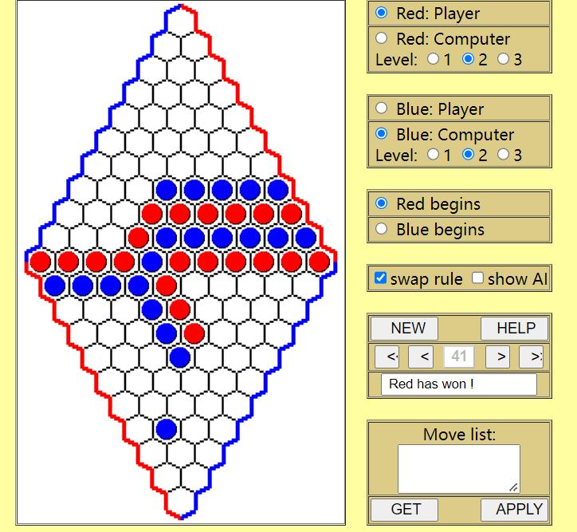
Performance & Evaluation
Level 2 Hex Agent
https://www.lutanho.net/play/hex.html
Notes:
To evaluate our model performance, we use it to play Hex games against different level of agents, each agent plays 20 games, and then calculate winning percentage. When competed with level 1 agent, we won 90 percent of the games. But unfortunately, level 2 and level 3 agents are strategy-based, and our model seems not suitable for competing this kind of model. when playing with level 2 agent, the winning percentage was down to 35 percent. And we only got 5 percent winning percentage when playing with level 3 agent. However, we forecast our model can perform well with Neural Network – based model.

Slide 10
Quantitative Metrices
Value Model
Game batch: 64
Trained epochs: 14,000
Training time: ~2 weeks (Google Colab A100 GPU & Laptop)
Policy Model
Training data size: >1.4 million game moves
Evaluation accuracy: 73.4%
MCTS
Simulation time budget: 10s (maximum 30 turns per player)
Simulation number: ~1,000 each turn

Slide 11
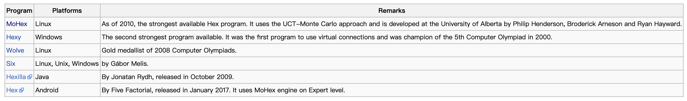
In the future…
Our Dream is Big…
Notes:
These are some really good agents we found in Hexwiki. As tomorrow is the deadline of this project, we cannot make a significant progress on it anymore. But since we put a lot of effort on this project and found that is an interesting game, we will continue to improve our models and believe that in the future, we can defeat these powerful agents!

Slide 12
References
K. Tadaka, H. Lizuka and M. Yamamoto, “Reinforcement Learning for Creating Evaluation Function using Convolutional Neural Network in Hex” – EZO CNN
S. Huang, B. Arneson, “MOHEX 2.0: a pattern-based MCTS Hex Player” – MoHex 2.0
Tautenhahn, L. (no date) Hex. Available at: https://www.lutanho.net/play/hex.html.
https://www.hexwiki.net/index.php/Computer_Hex
Notes:
1: value model
2：MCTS
3：existing AI agent, Policy model
4. Ranking on the hex agent

