Slide 1
Intro// mohammed
USP, phases // adrian
Design // faye and jelly
Database and server // fang
Calculations // Ahmed
Ethics // Bonnie
How to split up the group// Mohammed
Making basic version?

Slide 2
Poster
(Fi Track)

Slide 3
--- Index ---
--- Introducing Our Idea ---------------------------------------------------------------
--- How It Is Similar, How It Is Unique ----------------------------------------------
--- Mock Up Webpages, How it will look ------------------------------------------
--- Database and Server Considerations -------------------------------------------
--- The Tools We Will Use --------------------------------------------------------------
--- Stages of Implementation ---------------------------------------------------------
--- Ethical Considerations --------------------------------------------------------------
--- Team Ethic, How Work Will Be Distributed ------------------------------------

Slide 4
Introducing Fi-Track
What is it?
Web application that will track finances mainly for students.
Students as an audience, will have the app helping them more with managing loans and spending.
One example of a financial tracker we will tend to use the structure of is yolt. (maybe reword)
Yolt is a mobile financial tracker app that gets info from peoples banks and tracks their expenditure

Slide 5
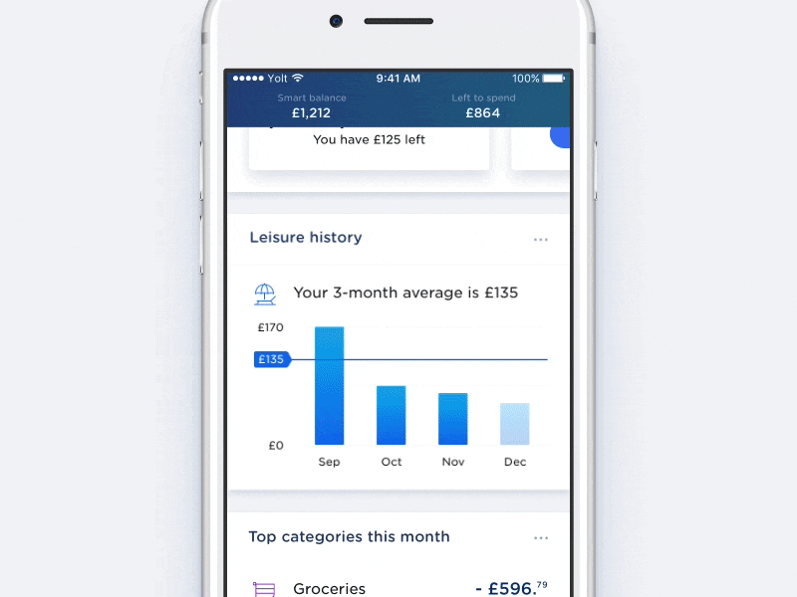
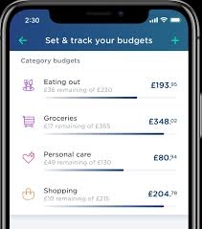
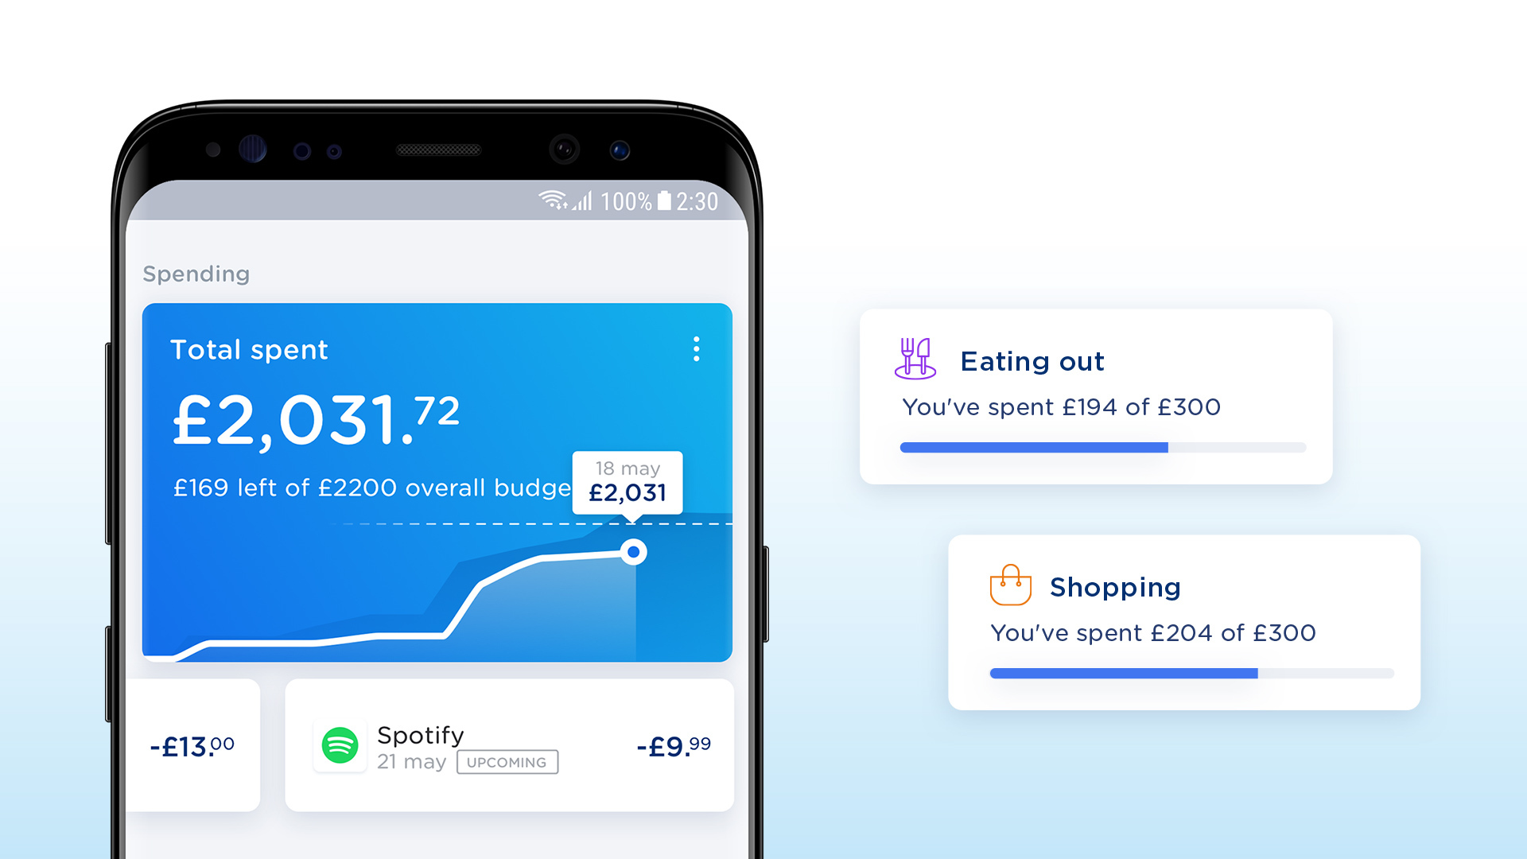
YOLT

Slide 6
What does Fi-Track do?
The app will be able to get the users transactions through a database and allocate each spending to its sector.
Each sector of spending eg. Groceries, investments, take-out.. Will be given an advised spending limit every week/ month, the app will warn the user if their consumption for the sector exceeds the advised limit.
The user will be able to choose if they want the advised spending limit
(is this what our app does tho? Idk about students making investments)

Slide 7
Different from the rest
Unlike current apps in the budgeting space, ours will be centered around student users. This translates to a much more convenient set up, as well more use out of the software overall.
Instead of entering 'income', the user would be asked for the size of their maintanance loan, savings or support from family - expecting these, the app would offer shortcuts (such as an option to tick 'I got the min loan amount', for example).
Instead of entering 'bills', the user would be asked for their accomodation cost – expecting this, we could construct a database of university accomodation costs (using the public data found online), enabling the user to simply search for theirs instead of entering a long number and a series of payment dates.

Slide 8
Being an app that supports money management of students, with access to their spending habbits and the internet, it would make sense for it to also notify the user of student deals that they aren't taking advantage of.
This information would be delivered via an automated chatbot, which is our distinctive approach to being 'user-friendly'.
The bot would have a lot to say, we find that the best choices are made when we have the best information at hand. Basic weekly feedback on statistics can put finances in perspective and later versions of the app could even recognise patterns within spending (a sudden increase, for example).
Other than that, the user should be given links to sources/ articles for more general advice (on decreasing living costs, for example) as well as clarification on how to navigate/ get the most use out of the application.

Slide 9
Webpage Design
(mock ups)
Design:
https://jamboard.google.com/d/1jBBT2z5DOiKSNVgVwaehvxrOsrKYQqXaYZU_rj9Ccpw/edit?usp=sharing

Slide 10
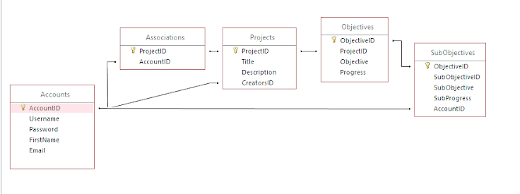
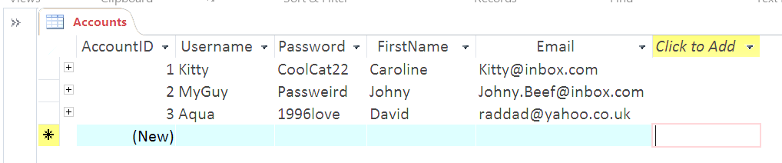
- Database designs (relational diagram), server?
Too technical?
{
Emails, Passwords, Names, Incomes, Expenses, History, Bank Details, Set Goals, Phone Numbers (authentication), Security questions and answers,
}
Example from different project:

Slide 11
Tools for the web
We have been collaborating while apart up until now and we will probably continue in this fashion throughout our Web App project – but many professional developers are used to such workflows. They make use of the same tools that are readily available to all of us:
A lot of group planning has taken place over Whatsapp which has proved to be useful for smaller memos or decisions (like setting a date for a real-time meeting) whereas professionals may usually do this over e-mail, but a popular alternative we could consider is known as Slack. The many features, beyond it's chatroom functionality, may actually envelop other tools I will name but this extensiveness may also be too much for what we plan on doing.
Zoom and Bb Collaborate have been used interchangeably to replace face-to-face interactions. Being able to share screens and send documents will be essential throughout the development lifecycle, especially during the conception and design stages that will come before any actual code is produced and require the whole team's input.
Developers do eventually spend a lot of time on source files (whether that's during implementation or testing stages) and sometimes in teams much bigger than ours, which is where Git version control comes in. GitLab will help coordinate our work by permitting everyone online access to every file, its history of changes and the complementing comments (from each of us) after every new merge request. It provides a secure environment for issues to be addressed quickly, therefore maintaining quality/ productivity.

Slide 12
To make something that could potentially be accessed via the WWW, we will need to make use of several languages. These were chosen due to their commonplace on the web and because we would all be somewhat familiar with them, due to them being taught within the COMP10120.
HTML is the standard markup language for anything displayed by a web browser. It structures content on a web page using a series of elements/ tags, contributing to functionality and usability of a site.
CSS is a style sheet language used for describing the presentation of a document written in a markup language. This involves the design, layout and variations in display for different devices.
JavaScript is a programming language used mostly for client-side functionality, turning static web pages into dynamic web applications by adding interactive elements that engage a user.
PHP is a scripting language used for server-side functionality. This includes managing dynamic content, databases and session tracking to name some examples. By employing a Web Framework we could instead use Python or Java which may simplify development.
MySQL is an open-source relational database management system. Most of our ideas will likely involve a databse of some level of complexity and this will make managing it much more streamlined.

Slide 13
Some additional instruments can be mentioned.
We will all likely be using Sublime for text-edditing/ coding and Google Chrome for testing the application.
W3 schools provides a HTML validity checker that would help with maintaining correctness in our code and we will surely make use of infomration on sites like Stack Exchange for help with actual debugging or feature implementation.
There exist many frameworks which can legitimise our web app to function or look like a typical site that we would usually use (Bootstrap being the most popular HTML-CSS-JS library that adds plenty of style)
If we are to have 'multiplayer' features/ multiple people interacting with the site, we may need to make use of Apache to create/ host a virtual server the way Stewart does in his tutorial videos.
Most extension stuff is dependent on the path that development will take so, cannot be confirmed at this stage...

Slide 14
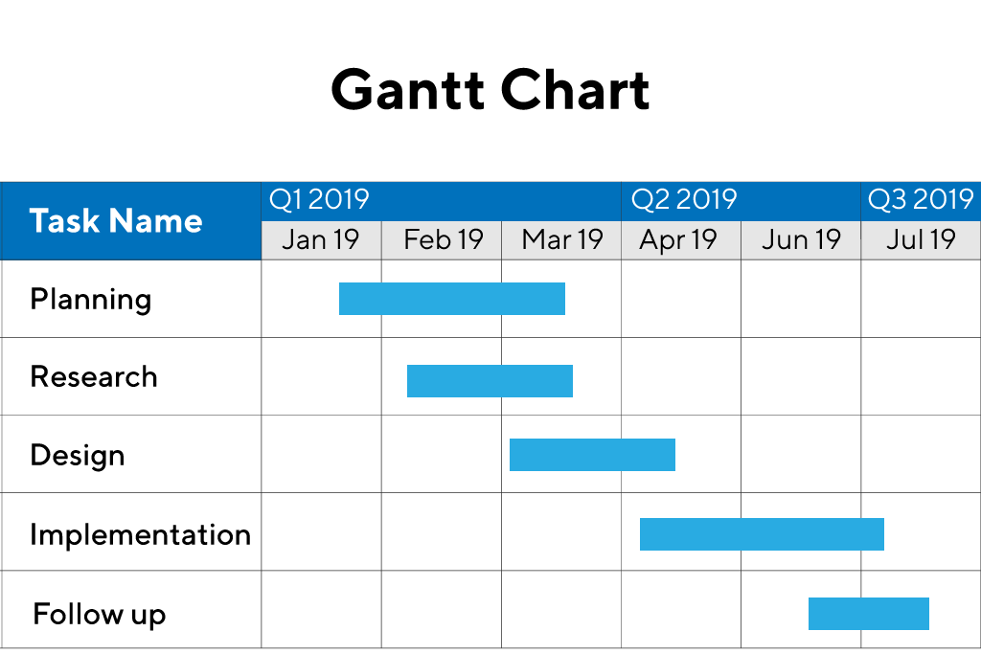
- Phases of design ~ basic to more advanced features
Approx 2 months to complete
(gant chart)

Slide 15
PHASE 1 (x weeks)
Takes users weekly/ monthly/ yearly incomes - one added, then total displayed, then additional sources of income added the same way, then total updated
Takes users weekly/ monthly/ yearly bills - one added, then total displayed, then additional bills added the same way, then total updated
During both, the reference for where this money is coming from/ going to is taken (e.g. water bill) and recorded within database along with number that was added/ subtracted from the total (e.g. ref:”waterbill”, pounds:-20)
Calculates daily/ weekly/ monthly budget based on these initial inputs (income minus expenditure), checks both in same scale (yearly minus yearly), then budget displayed
Lets user set daily/weekly/ monthly savings goal so a certain amount of money is unspent if stick to budget, checks number < budget, then budget updated
Lets user add non-recurring expense, this updated how much of the budget is left (budget minus expense), recorded in database (e.g. date: 02/12/20, ref: Sainsburys, pounds: 4.50)

Slide 16
Back-end Calculations
Calculations
Over Expenditure
Available Funds after expenditure
Total Expense of each category ( Living , Accommodation , etc. )
Updating the Expenditure
Excess average % expenditure
Statistical Data
Statistical Data will be used by the software for Graphical Display.
Percentage of Expenditure on each category.
Percentage of Funds Available
Fi-track will carry out all the calculation using PHP language because PHP code is not visible on the page source, and all the PHP code is executed on the server side . All the calculation will be updated on the database.
User will set the budget, during the set up of Fi-Track, for different expenses. During the coarse of the month Actual Expenses can be updated and the software will use the data to alarm the user in case of over expenditure.
Calculations will be used to track the pattern of expenditure.

Slide 17
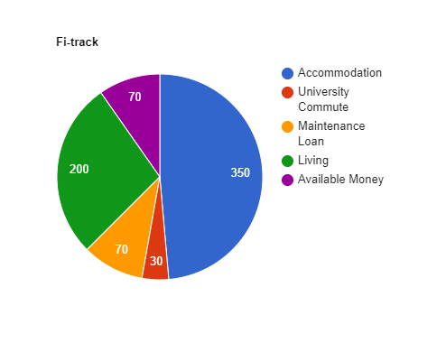
Graphical Display
Language
Pie Charts can be made using Html, CSS and Google Visualization services.

Slide 18
PHASE X (x weeks)
Account system, possibly security tweaks
Login, register, link account to their income expense info
PHASE X (x weeks)
Statistics and patterns displayed visually/ in helpful way, possibly providing tips
Possibly trying to make the front end generally more appealing/ easy to use
Chat bot helping with finance and technical problems/ using interface

Slide 19
PHASE X (x weeks)
Back-end calculation extension for business/ student specific things (taxes and long term projection/ maintenance loan and accommodation cost factoring, etc.)
Extra features (currency conversion and calendar view and exporting data and searching through) too much for one phase?
PHASE X (x weeks)
Incorporating outside apps/ accounts like Google/ Apple Pay that use NFC
Connecting Bank account, getting and using data
Or possibly make web app accessible by phone browser to add expenses that way

Slide 20
Tax Advice Sites and Ethics
Tax Advice Sites
https://www.gov.uk/tax-help
https://www.gov.uk/government/organisations/hm-revenue-customs/contact
Code of Ethics
Privacy and Security
Legal Issue
Intellectual Property

Slide 21
- Team rules, how we will fairly split this project to meet plan
Team Rules:
Attend meetings if possible/ Make effort
Make sure you know what you’re doing/ Make effort to find out otherwise
Complete your portion of the task as planned before the deadline
Make team aware if the task is beyond your abilities or undoable under current plan
Respect other team members and their contribution or criticism
Work with intent of doing your best work
Be accommodating of other team members’ schedules or other responsibilities
Big decisions should be made with the whole team’s awareness and/ or agreement
Follow ethical guidelines and rules against academic malpractice
Wear a mask when doing your shopping

