Slide 1
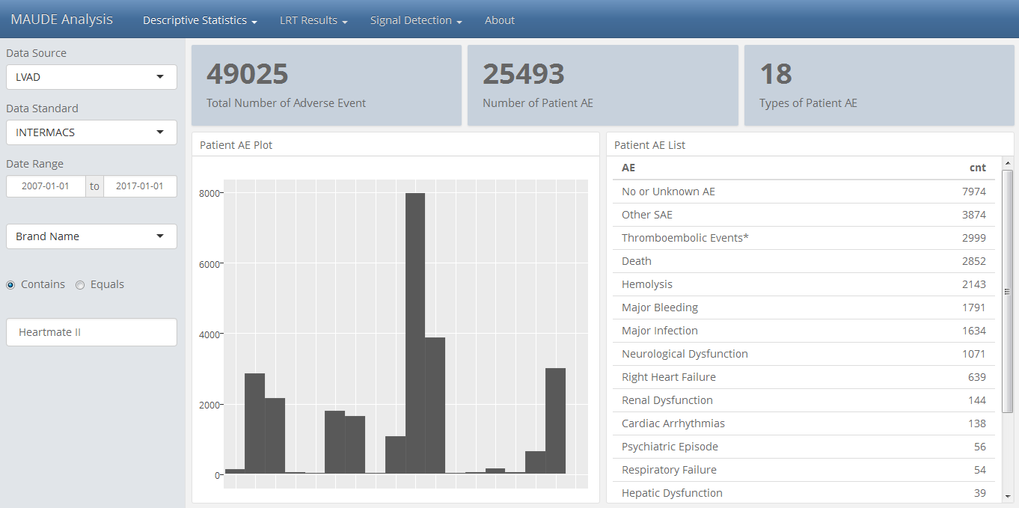
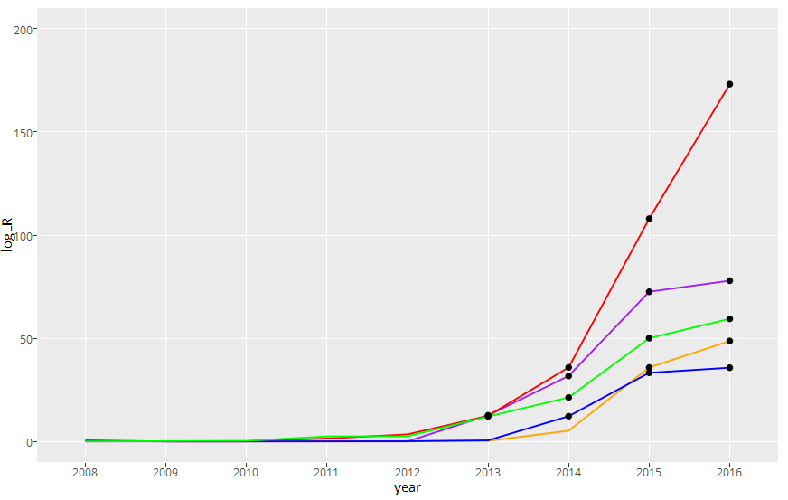
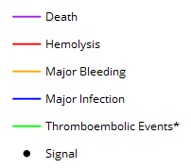
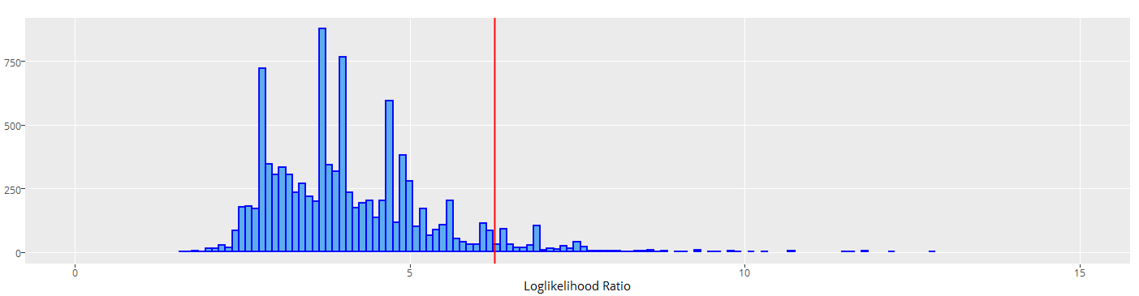
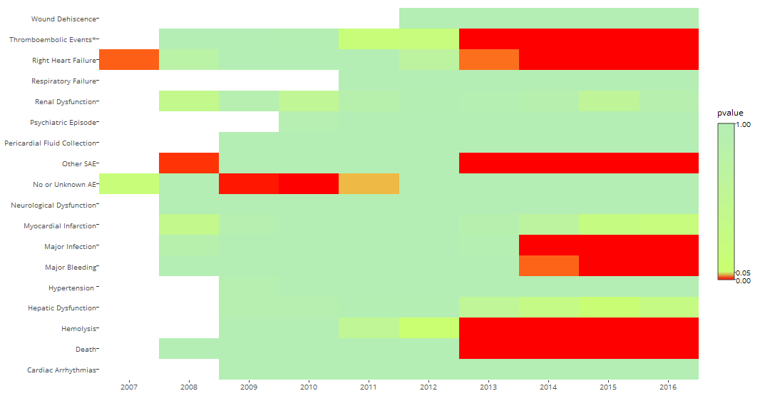
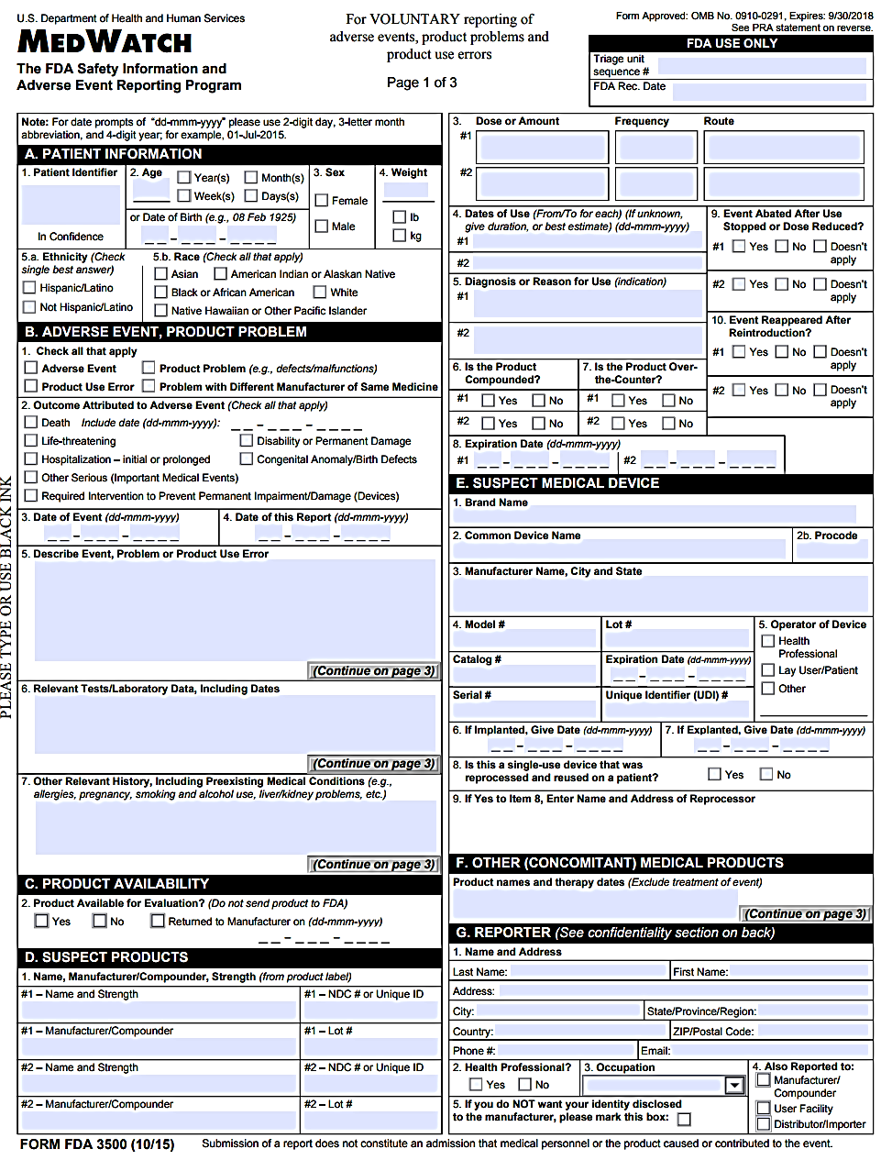
Likelihood Ratio Test Based Approach for Device Safety Signal Detection
Zhihao Yao, Mary Jung, Rebecca Ward, Lan Huang, Zhiheng Xu, Isaac Chang, and Ram Tiwari
FDA/CDRH/OSB
INTRODUCTION
METHODS
RESULTS
RESULTS (continued)
Timely post-market safety evaluation is critical to public health. In order to effectively perform safety signal monitoring, it is urgent to provide the proper analytical tools for investigating large datasets from different studies, sites, and sources.
Various data mining techniques have been used to detect possible safety signals by examining associations between approved medical products and adverse events (AEs). However, several of the existing data mining methods, such as the use of proportional reporting ratios (henceforth the RR method), do not control for family-wise Type-I error when examining multiple device-AE combinations and can result in false signals.
Thus, we present a likelihood ratio test (LRT) based method [1] for safety signal detection with a focus on identifying AE signals associated with HeartMate II, which is a left ventricular assist device (LVAD). Strengths of using a LRT based method are it retains good power and sensitivity for identifying signals as well as controls for family-wise Type-I error and false discovery rates. The LRT method has already been implemented in OpenFDA to detect drug-AE signals using FDA Adverse Event Reporting System (FAERS) data (see https://openfda.shinyapps.io/LRTest/).
Data Cleaning
For comparison purposes, patient AEs were categorized using well-established definitions set forth by the Interagency Registry for Mechanically Assisted Circulatory Support (INTERMACS). Since there was insufficient information in the MDR data to differentiate “Venous Thromboembolism” and “Arterial Non-CNS Thromboembolism,” a combined AE term called “Thromboembolic Events” was created. Only MDR patient AEs (i.e., MDR AEs that mapped onto all INTERMACS AE terms, excluding “Device Malfunction”) that were not associated with a device issue were analyzed.
INTERMACS AE Terms:
In regards to device brand names, different variations of HeartMate II and its components (e.g., HeartMate II LVAD, HeartMate 2, and HM II) were identified and combined. HeartMate components that did not specify a “II” were included only from reports submitted in 2008 (when the device first received FDA approval) or later.
LRT Tool Development
The LRT method was programmed using R and was displayed using Shiny by RStudio, which is a R package that enables results to be presented in an interactive web application format. The following were used for application development:
Front end: R markdown flexdashboard
Back end: R Shiny, JavaScript
R libraries: rmarkdown, tidyr, DT, sqldf, ggplot2, plotly, wordcloud
R markdown offers an easy way to combine narrative text and code to produce formatted output using multiple languages, such as JavaScript and SQL.
Flexdashboard can quickly generate a dynamic interface with html widgets and R shiny, which provides multiple user-friendly features.
Statistical Analysis
A step-down approach was employed to differentiate the strongest signal from secondary signals with overall error control. Potential patient AE signals were identified using the LRT (p-value<0.05) and RR methods for comparison (Reporting Ratio (RR)>1).
Figure 2. Application Interface Created by R Shiny:
Heartmate II in LVAD Class
Figure 4. Cumulative Year Totals - Patient AE Signals, 2008-2016
Y-axis: LLR values for select AEs by year
X-axis: Years (k), from 2008 to 2016
Signals: AEs with p-values<α/(2^k) to control for overall α of 0.05
Figure 3. Monte Carlo Simulation Plot for the Empirical Distribution of maxLLR (all data for HeartMate II), 10,000 repeats
Figure 5. Heatmap Trend Analysis of AEs, 2007 -2016
Cardiac Arrhythmias Device Malfunction Hepatic Dysfunction Hemolysis Hypertension Major Bleeding Major Infection Myocardial Infarction Neurological Dysfunction | Renal Dysfunction Respiratory Failure Right Heart Failure Pericardial Fluid Collection Psychiatric Episode Wound Dehiscence Arterial Non-CNS Thromboembolism* Venous Thromboembolism* Other SAE
Critical Value for α = 0.05
p-value = P(LLR_{i} > C_{0.05})
Table 1. AE Signals using the LRT and RR Methods
AE | ntrt | nidot | ndotj | ndotdot | RR | logLR | pvalue
Hemolysis | 2161 | 2726 | 24195 | 49224 | 1.67 | 226.73 | 0.000
Other SAE | 3696 | 5706 | 24195 | 49224 | 1.38 | 147.47 | 0.000
Thromboembolic Events* | 3040 | 4771 | 24195 | 49224 | 1.34 | 105.24 | 0.000
Death | 2766 | 4373 | 24195 | 49224 | 1.32 | 89.71 | 0.000
Major Bleeding | 1799 | 2737 | 24195 | 49224 | 1.36 | 73.64 | 0.000
Major Infection | 1650 | 2552 | 24195 | 49224 | 1.34 | 60.13 | 0.000
Right Heart Failure | 638 | 881 | 24195 | 49224 | 1.49 | 43.16 | 0.000
Myocardial Infarction | 22 | 24 | 24195 | 49224 | 1.87 | 3.51 | 0.069
Hepatic Dysfunction | 39 | 53 | 24195 | 49224 | 1.50 | 2.79 | 0.141
Renal Dysfunction | 148 | 251 | 24195 | 49224 | 1.20 | 2.32 | 0.247
Neurological Dysfunction | 1061 | 2074 | 24195 | 49224 | 1.04 | 0.87 | 0.845
Hypertension | 27 | 53 | 24195 | 49224 | 1.04 | 0.02 | 1.000
No or Unknown AE | 6883 | 22255 | 24195 | 49224 | 0.48 | 0.00 | 1.000
Cardiac Arrhythmias | 130 | 359 | 24195 | 49224 | 0.74 | 0.00 | 1.000
Psychiatric Episode | 47 | 154 | 24195 | 49224 | 0.62 | 0.00 | 1.000
Respiratory Failure | 51 | 141 | 24195 | 49224 | 0.74 | 0.00 | 1.000
Pericardial Fluid Collection | 33 | 104 | 24195 | 49224 | 0.65 | 0.00 | 1.000
Wound Dehiscence | 4 | 10 | 24195 | 49224 | 0.81 | 0.00 | 1.000
DATA SOURCE
CONCLUSIONS & DISCUSSION
In order to investigate potential AEs from HeartMate II, 2007-2016 post-market data obtained from Medical Device Reporting (MDR) were examined. Medical device reports are submitted by mandatory (i.e., manufacturers, device user facilities, and importers) and voluntary reporters (i.e., healthcare professionals, patients, caregivers, and consumers) and contain information on suspected device-related deaths, major injuries, and malfunctions.
Figure 1. MedWatch Voluntary Reporting Form
Given that hemolysis is a major complication of mechanical circulatory support devices, it is not a surprise that hemolysis was the first signal identified using LRT [2]. Thromboembolic events were also identified as a signal supporting previous findings that led to a FDA safety communication about pump thrombosis in 2015 [3].
Based on INTERMACS data, bleeding, infection, and cardiac arrhythmia were the top AEs having the highest rates (events/100 patient months) when examining VADs [4]. Bleeding and infection were also identified as signals using LRT although cardiac arrhythmia was not.
In comparison to the RR method, LRT offers an important advantage in its ability to control for false positives. LRT can be effective for signal detection and monitoring over time.
Table 2. AE Signals Identified in the “Other SAE” Category
AE in Other SAE | ntrt | nidot | ndotj | ndotdot | RR | logLR | pvalue
Enzyme Elevation, Cardiac | 315 | 328 | 3696 | 5694 | 1.524 | 22.809 | 0.000
Hematuria | 416 | 484 | 3696 | 5694 | 1.365 | 16.512 | 0.000
Dyspnea | 334 | 399 | 3696 | 5694 | 1.318 | 10.767 | 0.000
Indication
Event information:
Date of event
Date of report
Patient problem code
Device problem code
Patient information:
Age
Sex
Weight
Ethnicity and Race
Device information:
Brand name
Manufacturer
Model
Site
Country
Based on the LRT method, 7 patient AE signals were identified, while 12 were identified using the RR method (Table 1). In the “Other SAE” category, there were 106 different patient AEs. When these individual patient AEs were examined separately, the LRT method identified 3 patient AE signals (Cardiac Enzyme Elevation, Hematuria, and Dyspnea), while 56 patient AE signals were identified using the RR method (Table 2). Compared to the LRT method, the RR method appears to detect a greater number of false positives.
REFERENCES
[1] Huang L, Zalkikar J, Tiwari R. A likelihood ratio test based method for signal detection with application to FDA’s drug safety data. JASA. 2011; 106(496): 1230-41.
[2] Katz JN, Jensen BC, Chang PP, Myers SL, Pagani FD, Kirklin JK. A multicenter analysis of clinical hemolysis in patients supported with durable, long-term left ventricular assist device therapy. J Heart Lung Transplant. 2015;34(5): 701-9.
[3] Serious adverse events with implantable left ventricular assist devices (LVADs): FDA safety communication, 2015.
[4] Kirklin JK, Naftel DC, Pagani FD, Kormos RL, Stevenson LW, Blume ED, et al. Seventh INTERMACS annual report: 15,000 patients and counting. J Heart Lung Transplant. 2015; 34(12): 1495-1504.

