Slide 1
STPE.05
单击此处添加内容
STPE.04
单击此处添加内容
STPE.03
单击此处添加内容
STPE.02
单击此处添加内容
STPE.01
单击此处添加内容

Slide 2





单击此处输入你的智能图形项正文
单击此处输入你的智能图形项正文
单击此处输入你的智能图形项正文
添加标题
单击此处输入你的智能图形项正文
单击此处输入你的智能图形项正文

Slide 3
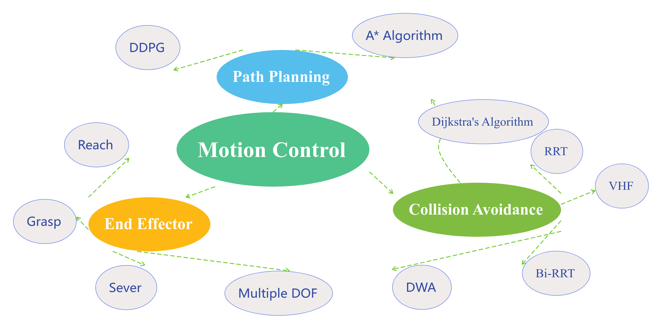
Fruit Perception
R-CNN Series
Perception Modalities
R-CNN
Fast R-CNN
Faster R-CNN
Mask R-CNN
R-CNN Variation
3D Stereo vision
RGB-D camera
Binocular camera
TOF Camera
Near Infrared(NIR)
LiDAR
RS (UAV,/Satellite)
IoT Sensors
YOLO Family
Segmentation
YOLOv3
YOLOv4
YOLOv5
Improved YOLO
DeepLabV3
UNet
FCN
SegNet

Slide 4
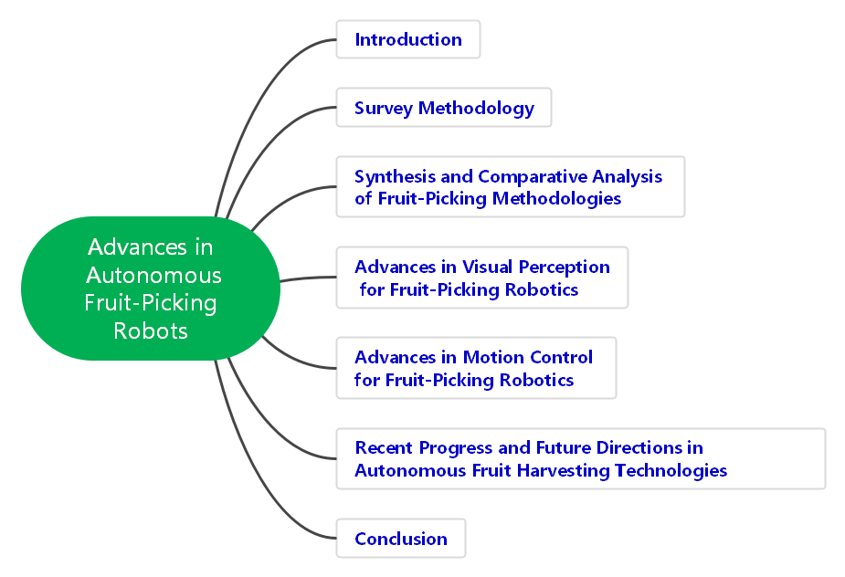
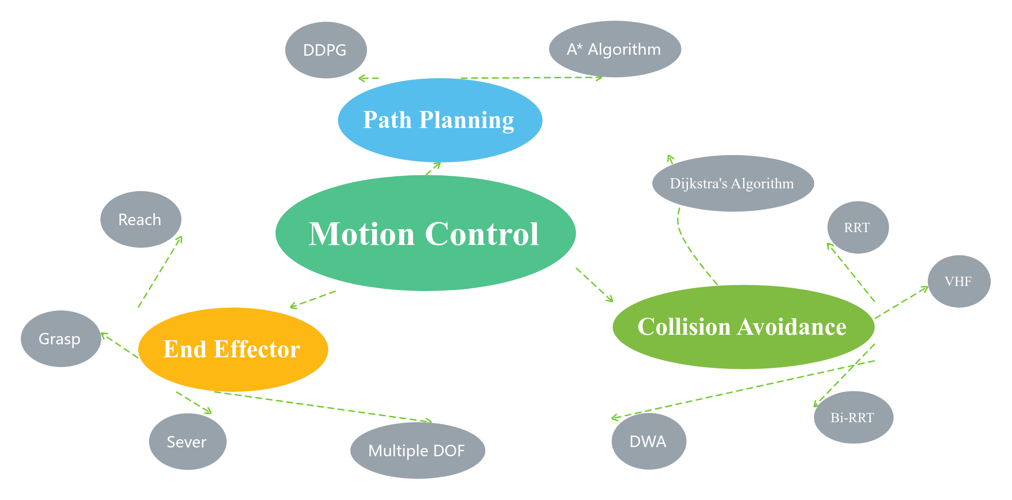
Visual Perception
RCNN Series
MultiSensor Fusion
R-CNN
Fast RCNN
Faster RCNN
Mask RCNN
RCNN Variation
3D Stereo vision
RGB-D camera
Binocular camera
YOLO Family
Segmentation
YOLOv3
YOLOv4
YOLOv5
Improved YOLO
DeepLabV3
UNet

Slide 5
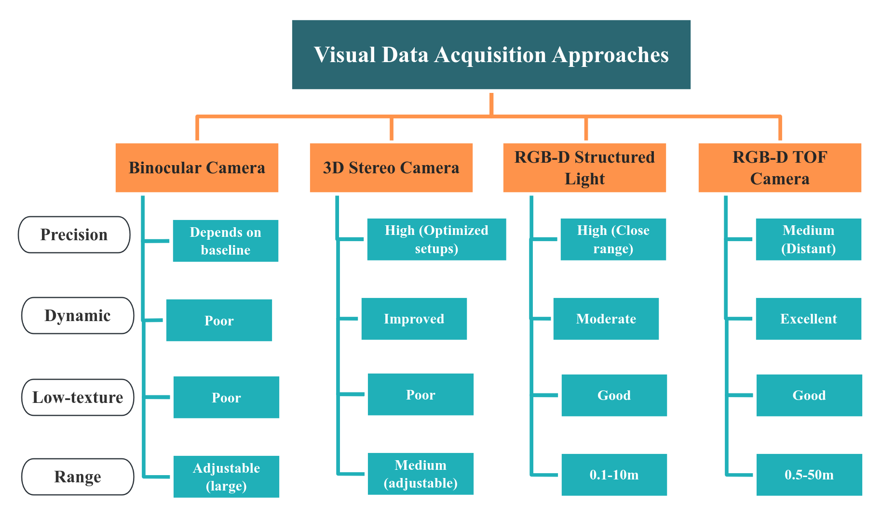

Slide 6
2014
2015
2015
2017
2018~
R-CNN
Fast R-NN
Faster R-CNN
Mask R-CNN
R-CNN Variant
Selective Search
Detection
CNN for detection
Selective Search
Detection
Feature reuse
RPN
Detection
RPN for proposals
RPN
Detection + Segmentation
RolAlign, mask prediction
Cascade R-CNN (2018)
Hybrid Task Cascade(2019)
DetectoRS(2020)

Slide 9
Improves object detection performance in terms of accuracy and computational efficiency, considering different application scenarios.
Struggles with mAP in detecting small objects.
Best balance between speed
and accuracy, more efficiency
YOLOv8
YOLOv9
YOLOv10
YOLOv11
YOLOv1
YOLOv2
YOLOv4
YOLOv5
2016
2018
2020
2022
2024
YOLOv3
YOLOv6
YOLOv7
Improved mAP when detecting small objects,
remained speed-accuracy trade-off
v6 uses RepVGG as backbone for special industrial application;
v7 struggles in scenarios with highly variable object sizes and complex backgrounds

Slide 10
Recods identified through database
searching
Web of Science (n=2358)
Scopus (n=2030)
ScienceDirect (n=536)
Recods identified through other
sources
Google Scholar (n=76)
Connected papers (n=24)
Identification
Total records identified
(n=5024)
Duplicated excluded
(n=1594 )
Screening
Recods screened by title and abstract
(n=3430 )
Irrelevant recods excluded
(n=3018 )
Eligibility
Recods excluded (n=275 )
No clear motivation (n= 137)
Focus out of scope (n= 138)
Full text assessed for eligibility
(n= 412)
Inclusion
Recods included
(n=137 )

Slide 11
Pick-point Detection
Stems
Peduncles
Branches
Precision
Scalability Deployment
Morphological Characteristics
Reliability
Rapidity
Picking Time
Yield Estimation
Real-time Counting
Color
Contour
Ripeness
Geometry

