Slide 1
Bias-Aware Approximate MAC Design
for Energy-Efficient DNN Inference
Jiabo Zhang · Yuxuan Wang
EEC 289Q — Deep Learning Hardware | Spring 2026 | UC Davis
Baseline Reproduction
→
Deficiency Identified
→
Contribution A Bias Fix
→
Contribution B Non-uniform K
→
RTL + FPGA Demo
1 / 11

Slide 2
Motivation: MAC Dominates DNN Inference Energy
Energy per Operation (45 nm, 1 GHz)
Truncated Multiplier Idea
INT8 multiply
0.2 pJ
Drop the lowest K bits of each integer product before accumulation. Hardware savings: Partial-product matrix shrinks by K(2n–K)/(2n²) ≈ 25% for K=4 The problem: Truncation always rounds toward –∞ Error ∈ [0, 2^K) → one-sided bias Over N MACs, bias grows like N ⚠
INT8 add
0.03 pJ
FP16 multiply
1.1 pJ
FP32 multiply
3.7 pJ
FP8 multiply
~0.35 pJ
Source: Horowitz, ISSCC 2014
A modern LLM runs 10¹² MACs per token.
Reducing per-MAC energy by even 20% saves terajoules at data-center scale.
2 / 11

Slide 3
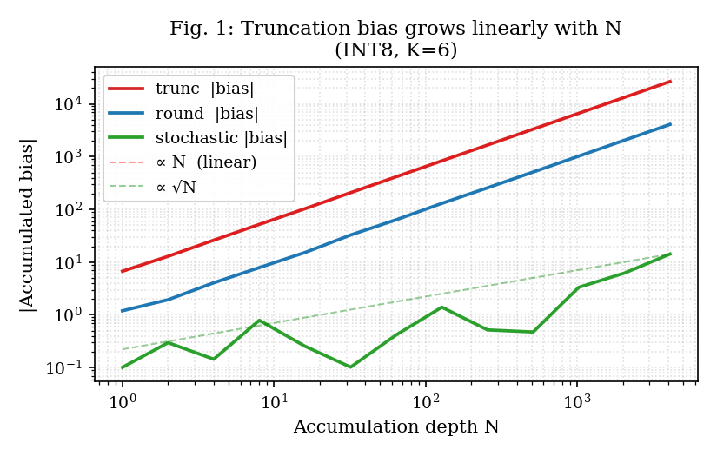
The Bias Accumulation Problem
Truncation error is one-sided → grows linearly with accumulation depth N
Key numbers (INT8, K=6, N=4096)
trunc bias
26,617
round bias
−14
stochastic bias
14
trunc grows ∝ N; round/stoch grow ∝ √N
Theorem 1 (Formal Proof)
E[Σ εᵢ] = N · 2^(K−1) [trunc, linear in N]
E[Σ δᵢ] = 0 for any N [round, zero bias]
Var[Σ] = N · (2^K)² / 12 [same for both]
round mode = free stochastic rounding (no RNG needed)
3 / 11

Slide 4
Contribution A: Error-Compensated Multiplier
Add correction constant 2^(K−1) before masking — same hardware cost as truncation
trunc
round
stochastic
product & ~mask
(product + 2^(K−1)) & ~mask
(product + rand[0,2^K)) & ~mask
Error ∈ [0, 2^K) Mean ≈ 2^(K−1) > 0 Linear bias growth
Error ∈ [−2^(K−1), 2^(K−1)) Mean = 0 (zero bias!) Constant add, folded into PPT
True zero-mean (√N growth) Needs K-bit LFSR per MAC → Gupta et al., ICML 2015
HW cost:
HW cost:
HW cost:
Baseline
≈ trunc
+LFSR RNG
4 / 11

Slide 5
RTL Implementation & Verification
Synthesizable Verilog · ModelSim · Quartus Prime Lite · EP4CE10 FPGA
RTL Modules (9 .v)
Verification
mac_unit.v
Parameterized approx MAC (K, mode)
ModelSim: 6 testbenches, all PASS
aca_adder.v
ACA approximate adder (W)
200 vectors each (golden from Python)
mac_array.v
16-MAC dot-product array
350 pytest tests, all PASS
lfsr.v
K-bit LFSR for stochastic rounding
mlp_top.v
2-layer MLP (simulation)
mlp_top_demo.v
Board wrapper + LED display
uart_tx/framer.v
UART 115200 baud output
Quartus Synthesis (EP4CE10)
drum_multiplier.v
DRUM-k unbiased multiplier (P1.1)
Logic Elements
1,769 / 10,320 (17%)
Timing
50 MHz closed ✓
round vs trunc ΔLE
+46 LE (2.6%)
stochastic ΔLE
+48 LE (needs LFSR)
5 / 11

Slide 6
FPGA On-Chip Validation — K=6 trunc causes MISCLASSIFICATION
EP4CE10 · 野火征途 Pro · UART output · 2026-06-01
Demo Setup
On-Chip Results
• Toy 2-layer MLP
Config
Note
Board argmax
Correct?
weights quantized to INT8
K=0 trunc
exact baseline
1
✓
correct class = 1
K=2 trunc
1
✓
• 5 bitstreams programmed
K=4 trunc
1
✓
via JTAG (USB-Blaster)
K=4 round
bias fix
1
✓
• UART @ 115200 baud
K=6 trunc
aggressive trunc
3
✗
streams 10 × int32 logits
back to PC
K=6 trunc: argmax 1 → 3 (WRONG) Matches Python sim bias +29.9 ✓ RTL faithfully implements bias accumulation
• read_uart.py decodes
argmax on PC
6 / 11

Slide 7
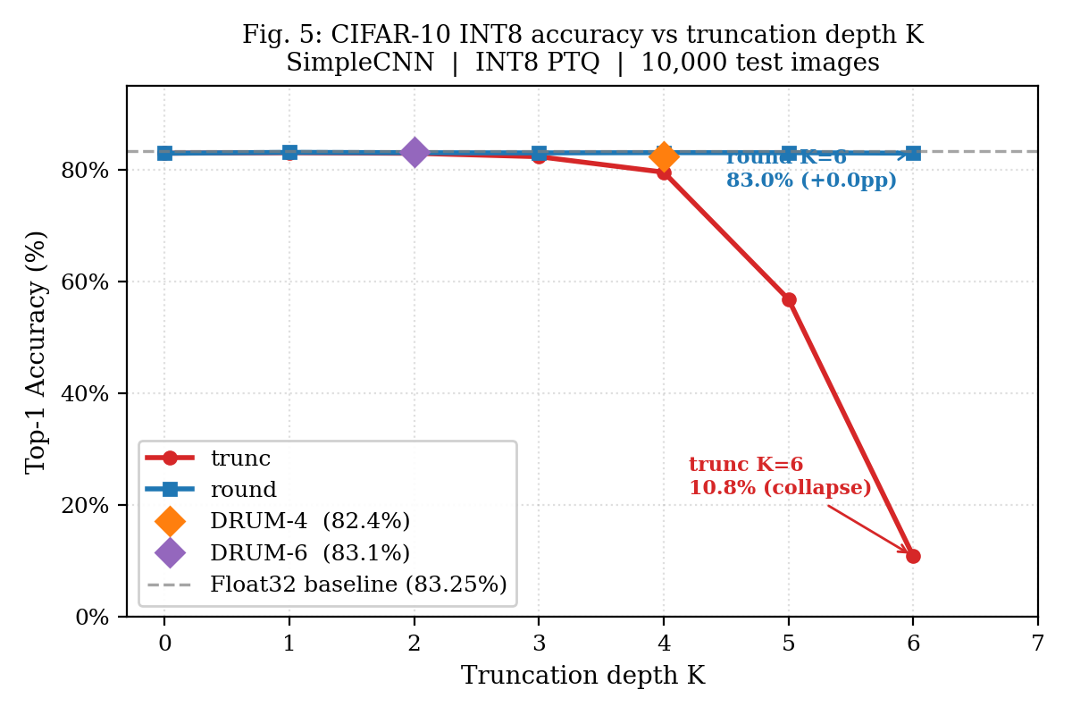
CIFAR-10 Validation — round mode is FREE accuracy preservation
SimpleCNN · INT8 PTQ · 10,000 test images · K = 0 … 6
Key Results
Float32 baseline
83.25%
INT8 exact (K=0)
82.94%
round K=6
83.0%
round K=4
83.0%
round K=2
83.0%
trunc K=4
79.5%
trunc K=5
56.8%
trunc K=6
10.8%
DRUM-4
82.4%
round mode: +72.1 pp over trunc at K=6 Zero additional hardware cost
7 / 11

Slide 8
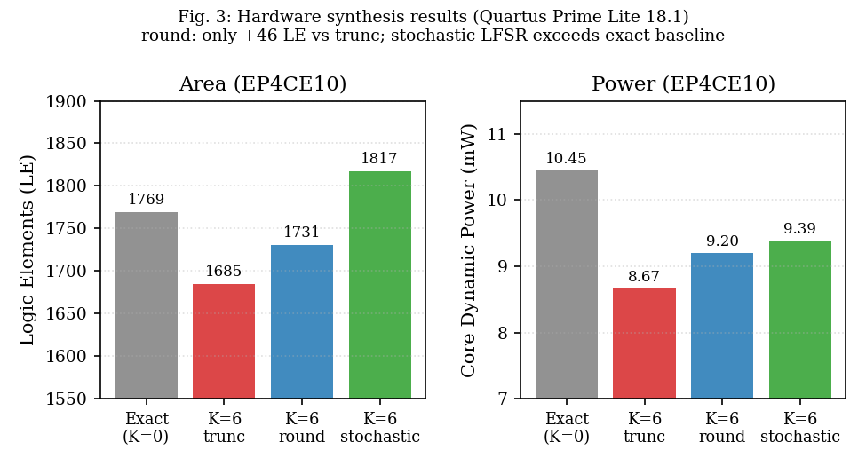
Hardware PPA Analysis
Quartus Prime Lite 18.1 · EP4CE10F17C8 · 50 MHz constraint
Takeaways
round vs trunc
+46 LE (+2.6%) ≈ identical area
stochastic
+48 LE (+LFSR) Exceeds exact baseline!
DRUM-4 (ppa_drum_k4)
Quartus run pending Expected: –LEs for mult but +LZC+shift overhead
→ round mode is the practical optimum: zero-mean bias + near-zero HW cost
8 / 11

Slide 9
Contribution B: Sensitivity-Driven Non-Uniform K Allocation
Greedy layer-wise K budget allocation · cf. ALWANN (ICCAD 2019), HAWQ (ICCV 2019)
The Uniform-K Problem
Greedy Allocation Algorithm
Demo MLP layer breakdown: Layer 1: 784×64 = 50,176 MACs (95.8%) Layer 2: 64×10 = 640 MACs ( 1.2%) With uniform K, the tiny layer 2 gets the same truncation depth as the dominant layer 1. → Energy wasted on insensitive layers. → Sensitive layers truncated too deep.
score_i = MAC_count[i] / (sensitivity[i] × (K[i]+1)) Assign next K unit to argmax(score): High MACs → more savings High sensitivity → smaller K Prevents one layer dominating budget
Result
Same energy budget: Non-uniform K allocation reduces logit NRMSE vs uniform K Layer 2 keeps K=0 (exact), Layer 1 absorbs more truncation.
9 / 11

Slide 10
Future Work → ISCAS 2027 / IEEE Embedded Systems Letters
Three concrete directions toward a publishable extension
① ASIC Synthesis (NanGate45 + OpenROAD)
Replace FPGA proxy with 45 nm ASIC numbers. Precise area / power comparison: trunc vs round vs DRUM. DRUM area advantage vs round control-logic overhead → definitive HW verdict.
② ResNet-20 / MobileNet-v2 on CIFAR-10 + ImageNet
Extend Contribution B (non-uniform K) to real trained architectures. Energy–accuracy Pareto front at task level (top-1 accuracy vs pJ/inference). Baseline: ALWANN on same networks.
③ Transformer Attention Bias Validation
Q·K^T at seq_len=512: each attention score accumulates d_head=64 MACs. Theorem 1 corollary: trunc K=4 → 512 LSB bias, exceeding INT8 range. Experiment: GPT-2 small, compare perplexity under trunc vs round.
10 / 11

Slide 11
Conclusion
Truncation bias is the dominant accuracy loss in approximate MAC inference.
Error always in [0, 2^K) → one-sided → coherent accumulation ∝ N. Formal proof: E[bias_N] = N · 2^(K-1) for trunc, 0 for round.
round mode = free fix: same hardware cost, zero bias.
+46 LE (+2.6%) on EP4CE10. CIFAR-10: 83.0% at K=6 vs 10.8% (trunc). 72.1 pp accuracy gap at zero hardware cost — confirmed on real FPGA.
Non-uniform K allocation further improves energy–accuracy trade-off.
Sensitivity-driven greedy allocation; same energy, lower logit NRMSE. cf. ALWANN / HAWQ — simpler, no Hessian, directly exploits MAC counts.
Jiabo Zhang · Yuxuan Wang | EEC 289Q Deep Learning Hardware | Spring 2026, UC Davis | bojzhang@ucdavis.edu
11 / 11

