Slide 1
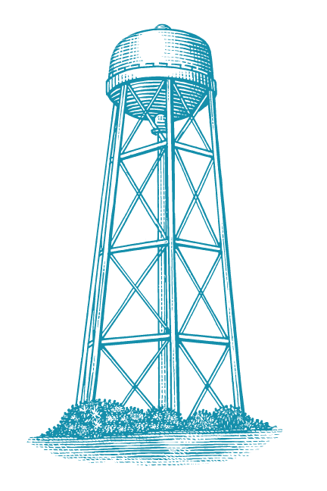

Exploring Approximate MAC Designs for Energy-Efficient DNN Inference
Wang Yuxuan Zhang Jiabo

Slide 2
Motivation&Introduction
DNN inference is dominated by multiply-accumulate (MAC) operations.
Approximate MAC designs can reduce hardware cost by truncating low-significance product bits.
We aim to build a fair evaluation framework to measure both energy savings and accuracy loss.

Slide 3
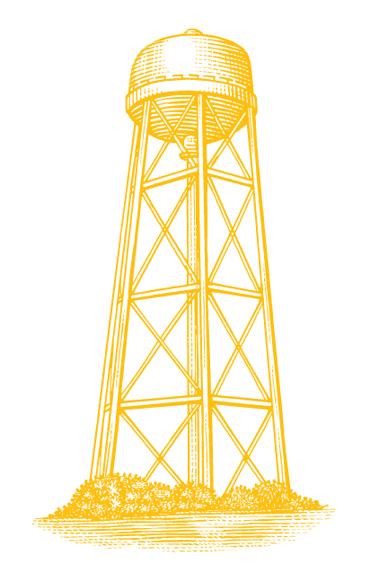

Previous Work
Han et al. proposed EIE, an efficient inference engine for compressed neural networks. Their work shows that DNN inference is both computation-intensive and memory-intensive, motivating hardware-level optimization.
Gupta et al. studied deep learning with limited numerical precision and showed that the rounding scheme plays an important role in low-precision neural network computation.
Wu et al. reviewed approximate multiplier designs for energy efficiency and showed that multiplier approximation can trade numerical accuracy for reductions in energy, area, and delay.
Sayadi et al. explored layer-specific approximate multipliers for neural networks, showing that different layers can tolerate different levels of arithmetic approximation.

Slide 4
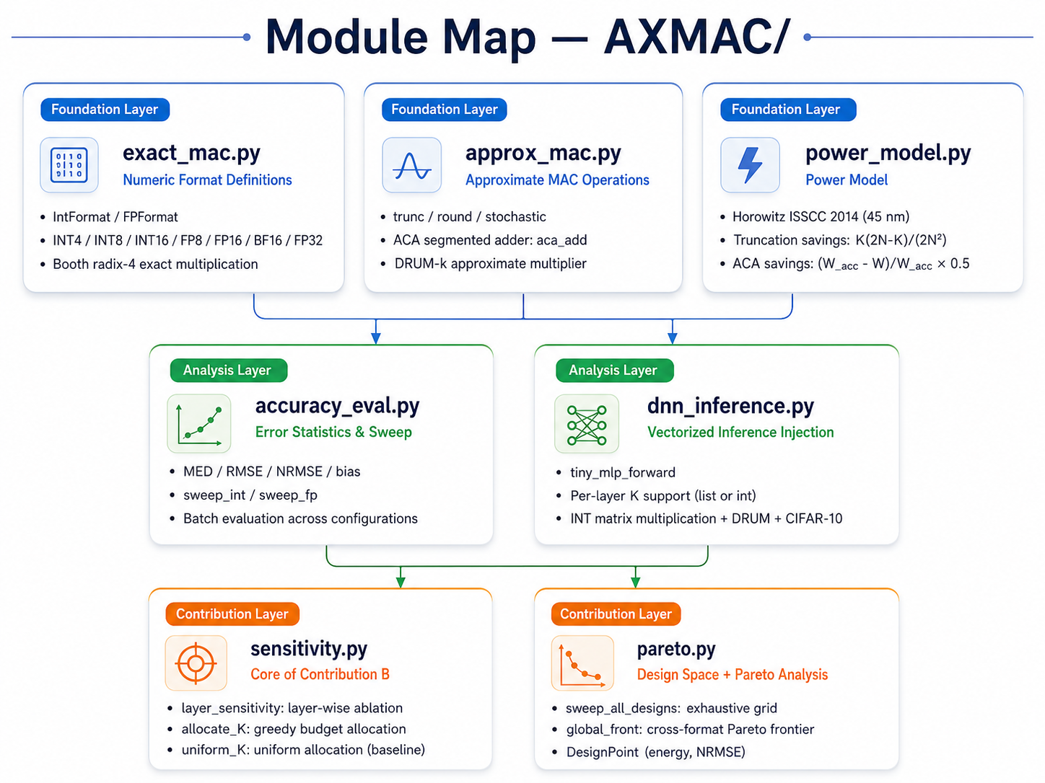

Slide 5

exact_mac.py
Exact MAC Baseline
Foundation
What this module defines
• Numeric formats: IntFormat and FPFormat
• INT4 / INT8 / INT16 and FP8 / FP16 / BF16 / FP32
• Exact INT MAC using Booth radix-4 partial products
• Exact FP MAC using sign, exponent, and mantissa paths
Core reference path
a, b, acc
a × b
acc + product
exact output
Takeaway: all approximate results are compared against this exact baseline.

Slide 6
approx_mac.py
Approximate MAC Core
Approximation Knobs
What changes from exact MAC?
• K-bit product truncation removes low-significance bits
• Rounding modes: trunc, round, stochastic
• ACA segmented adder isolates carry propagation by window W
• K = 0 and W = None reproduce the exact MAC path
Key idea
Save energy by allowing controlled arithmetic error.
Approximate MAC flow
a × b
round_K(product)
ACA add
approx output
Takeaway: this module is the hardware approximation being evaluated.

Slide 7

dnn_inference.py
DNN-Level Approximate Inference
Inference Injection
From scalar MAC to neural-network layers
• Vectorized INT matrix multiplication and Conv2D
• Each product X[i,k] × W[k,j] is truncated before accumulation
• tiny_mlp_forward supports scalar K or per-layer K list
• Optional PyTorch autograd wrapper for approximate linear layers
DNN evaluation path
input + weights
quantize
approx layer
DNN output
Takeaway: this is where MAC-level errors become DNN output errors.

Slide 8

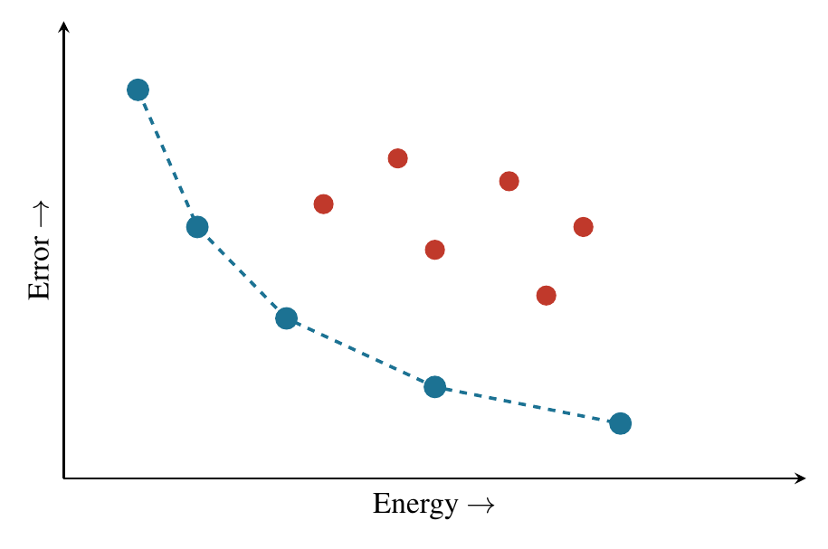
What Is Pareto Analysis?
Picking the “non-losing” designs under two conflicting goals
• Two conflicting goals: energy (lower is better) and error (lower is better). You cannot minimize both at once.
• Domination: design A dominates B if A is no worse on both axes and strictly better on at least one — B is discarded.
• Pareto front = the boundary of “mutually non-dominated” designs left after removing all dominated ones.
• A general multi-objective tool, not a greedy algorithm: dominates() compares pairs, global_front() extracts the front.
Energy – Error plane (schematic)
Green = Pareto front (kept) Red = dominated (discarded)
Lower-left = cheaper & more accurate = better

Slide 9

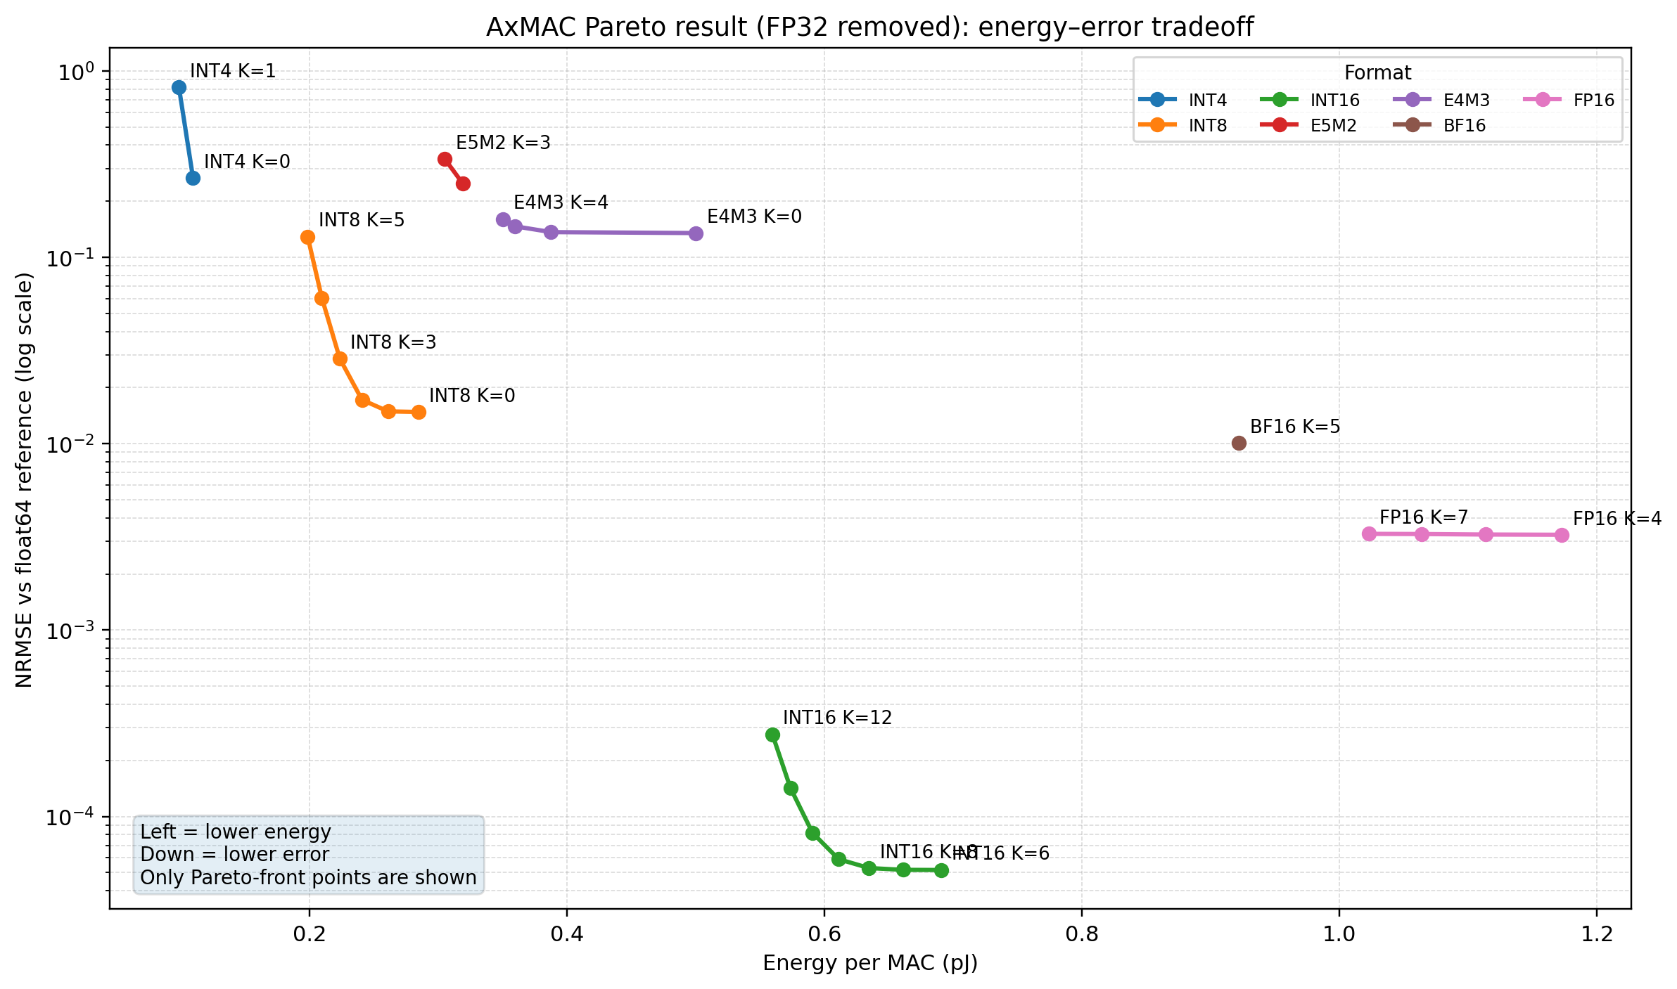
Results: Energy–Error Across Precisions & K
INT4 / INT8 / INT16 separate into distinct energy bands
How to read it
• Each dot = one config (a precision + a K). Labels show the K value.
• Three precisions occupy different energy bands: INT4 cheapest, INT16 most accurate.
The flatter the curve, the stronger the robustness (as K increases, energy decreases while the error changes only marginally).
FP32：K=11 E= 3.2928 pJ NRMSE=1.4077e-07

Slide 10
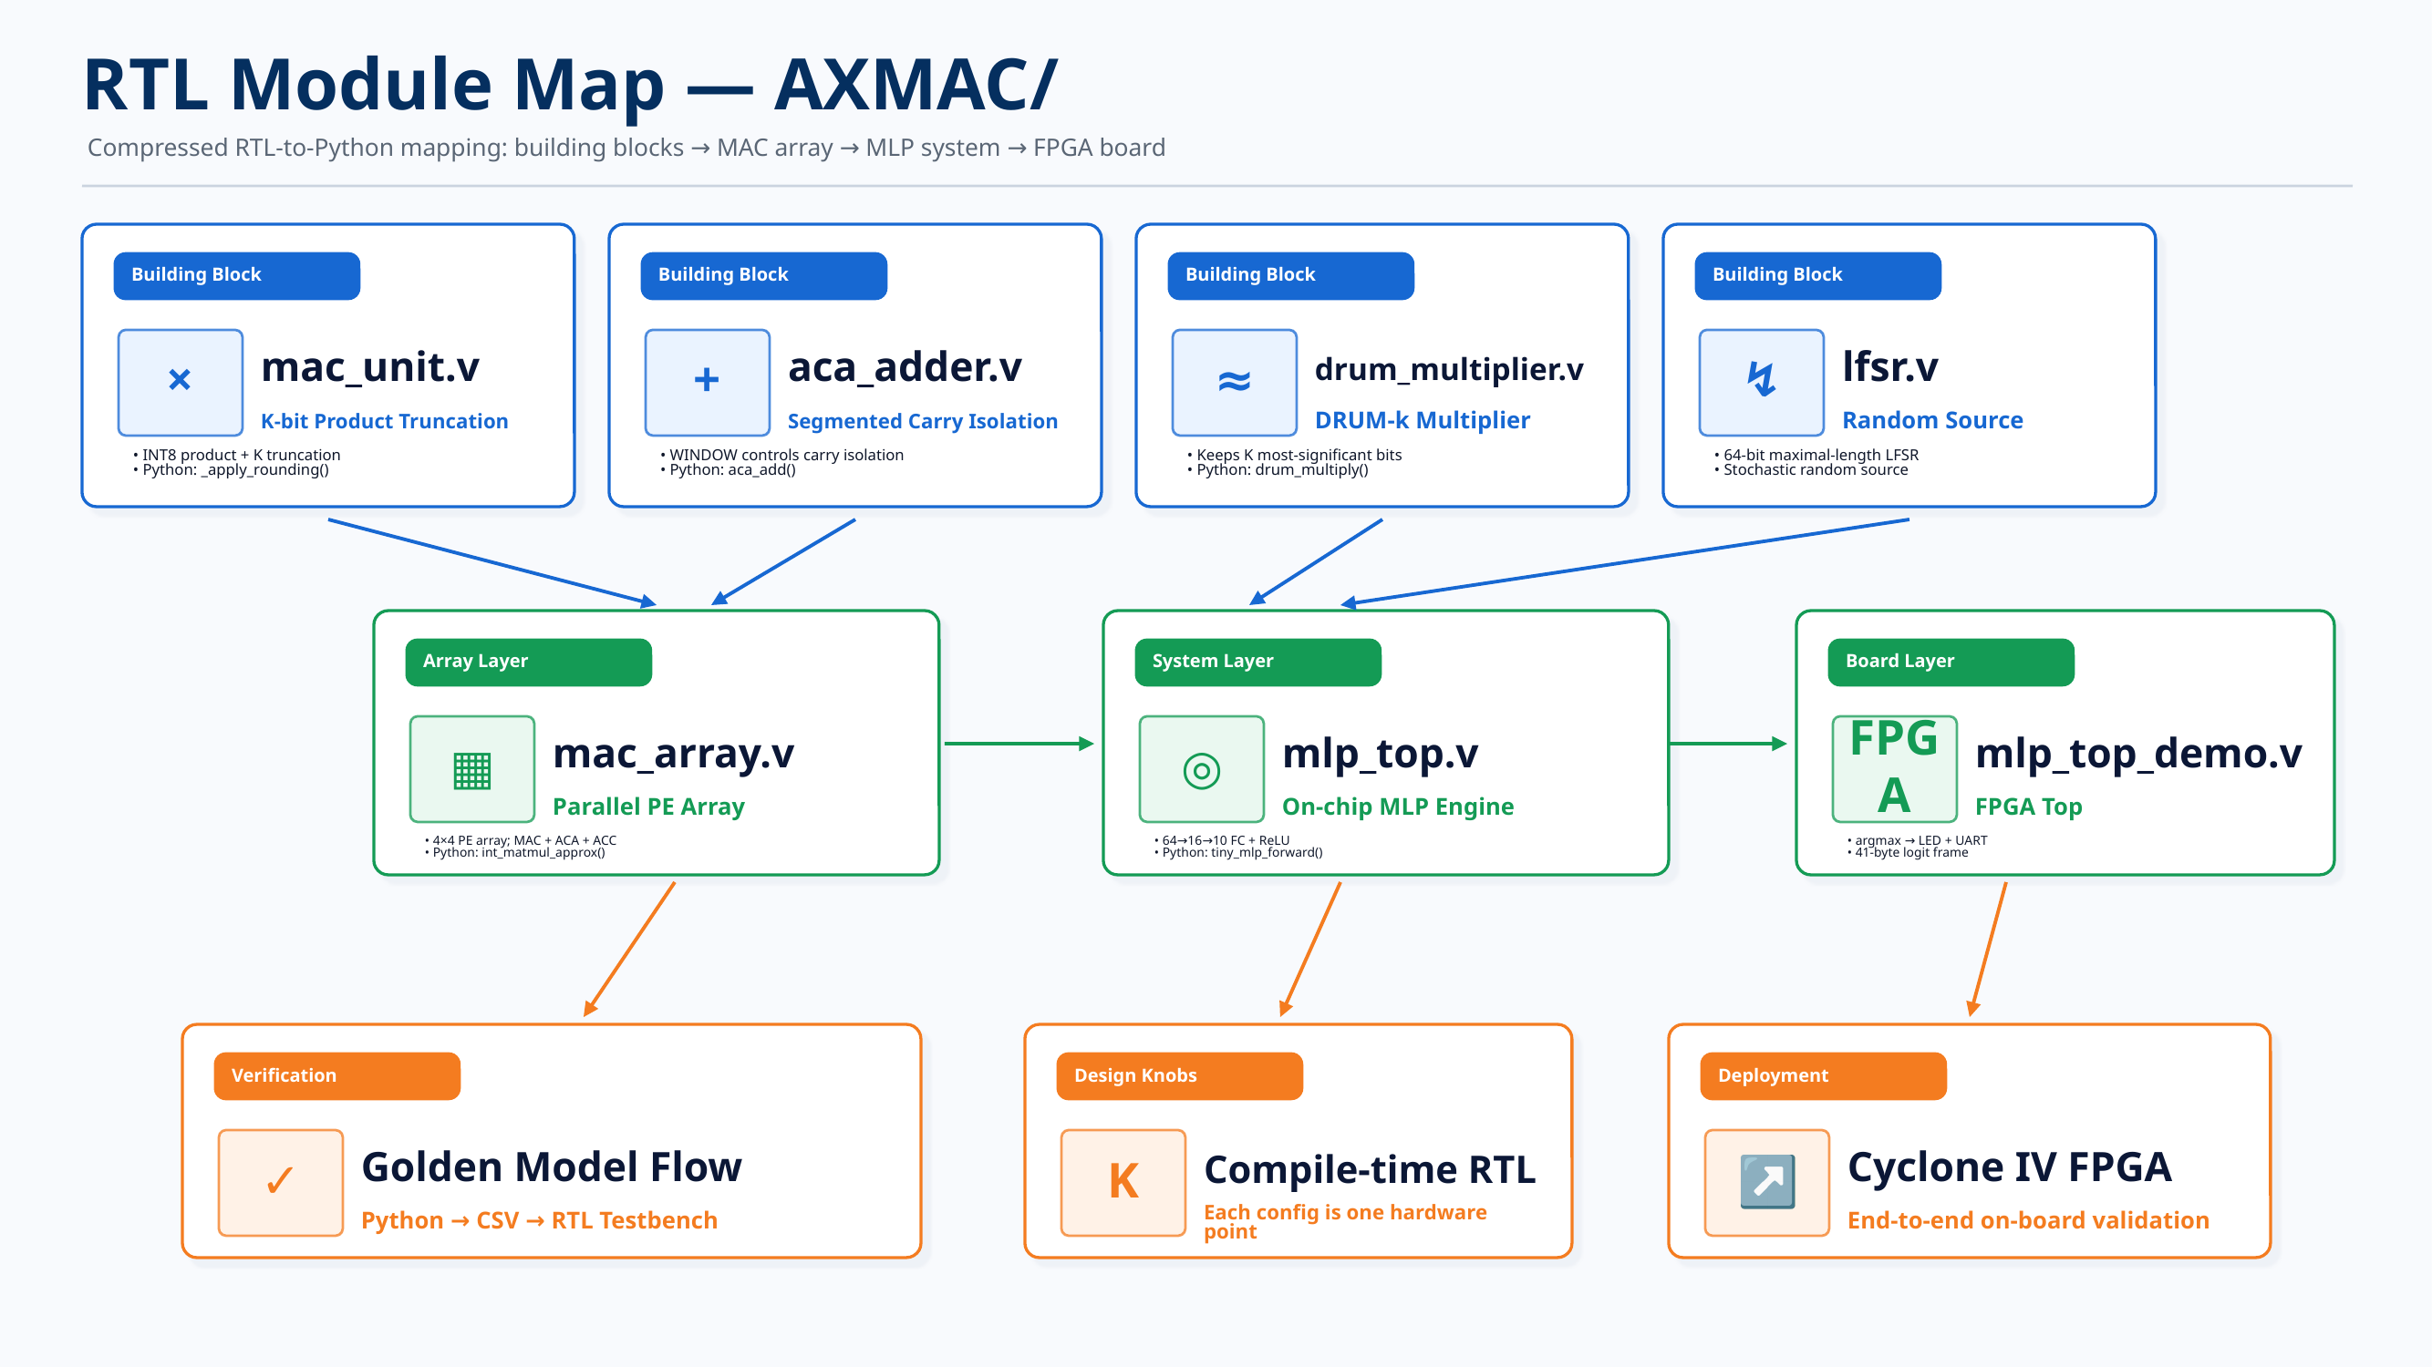

Slide 11
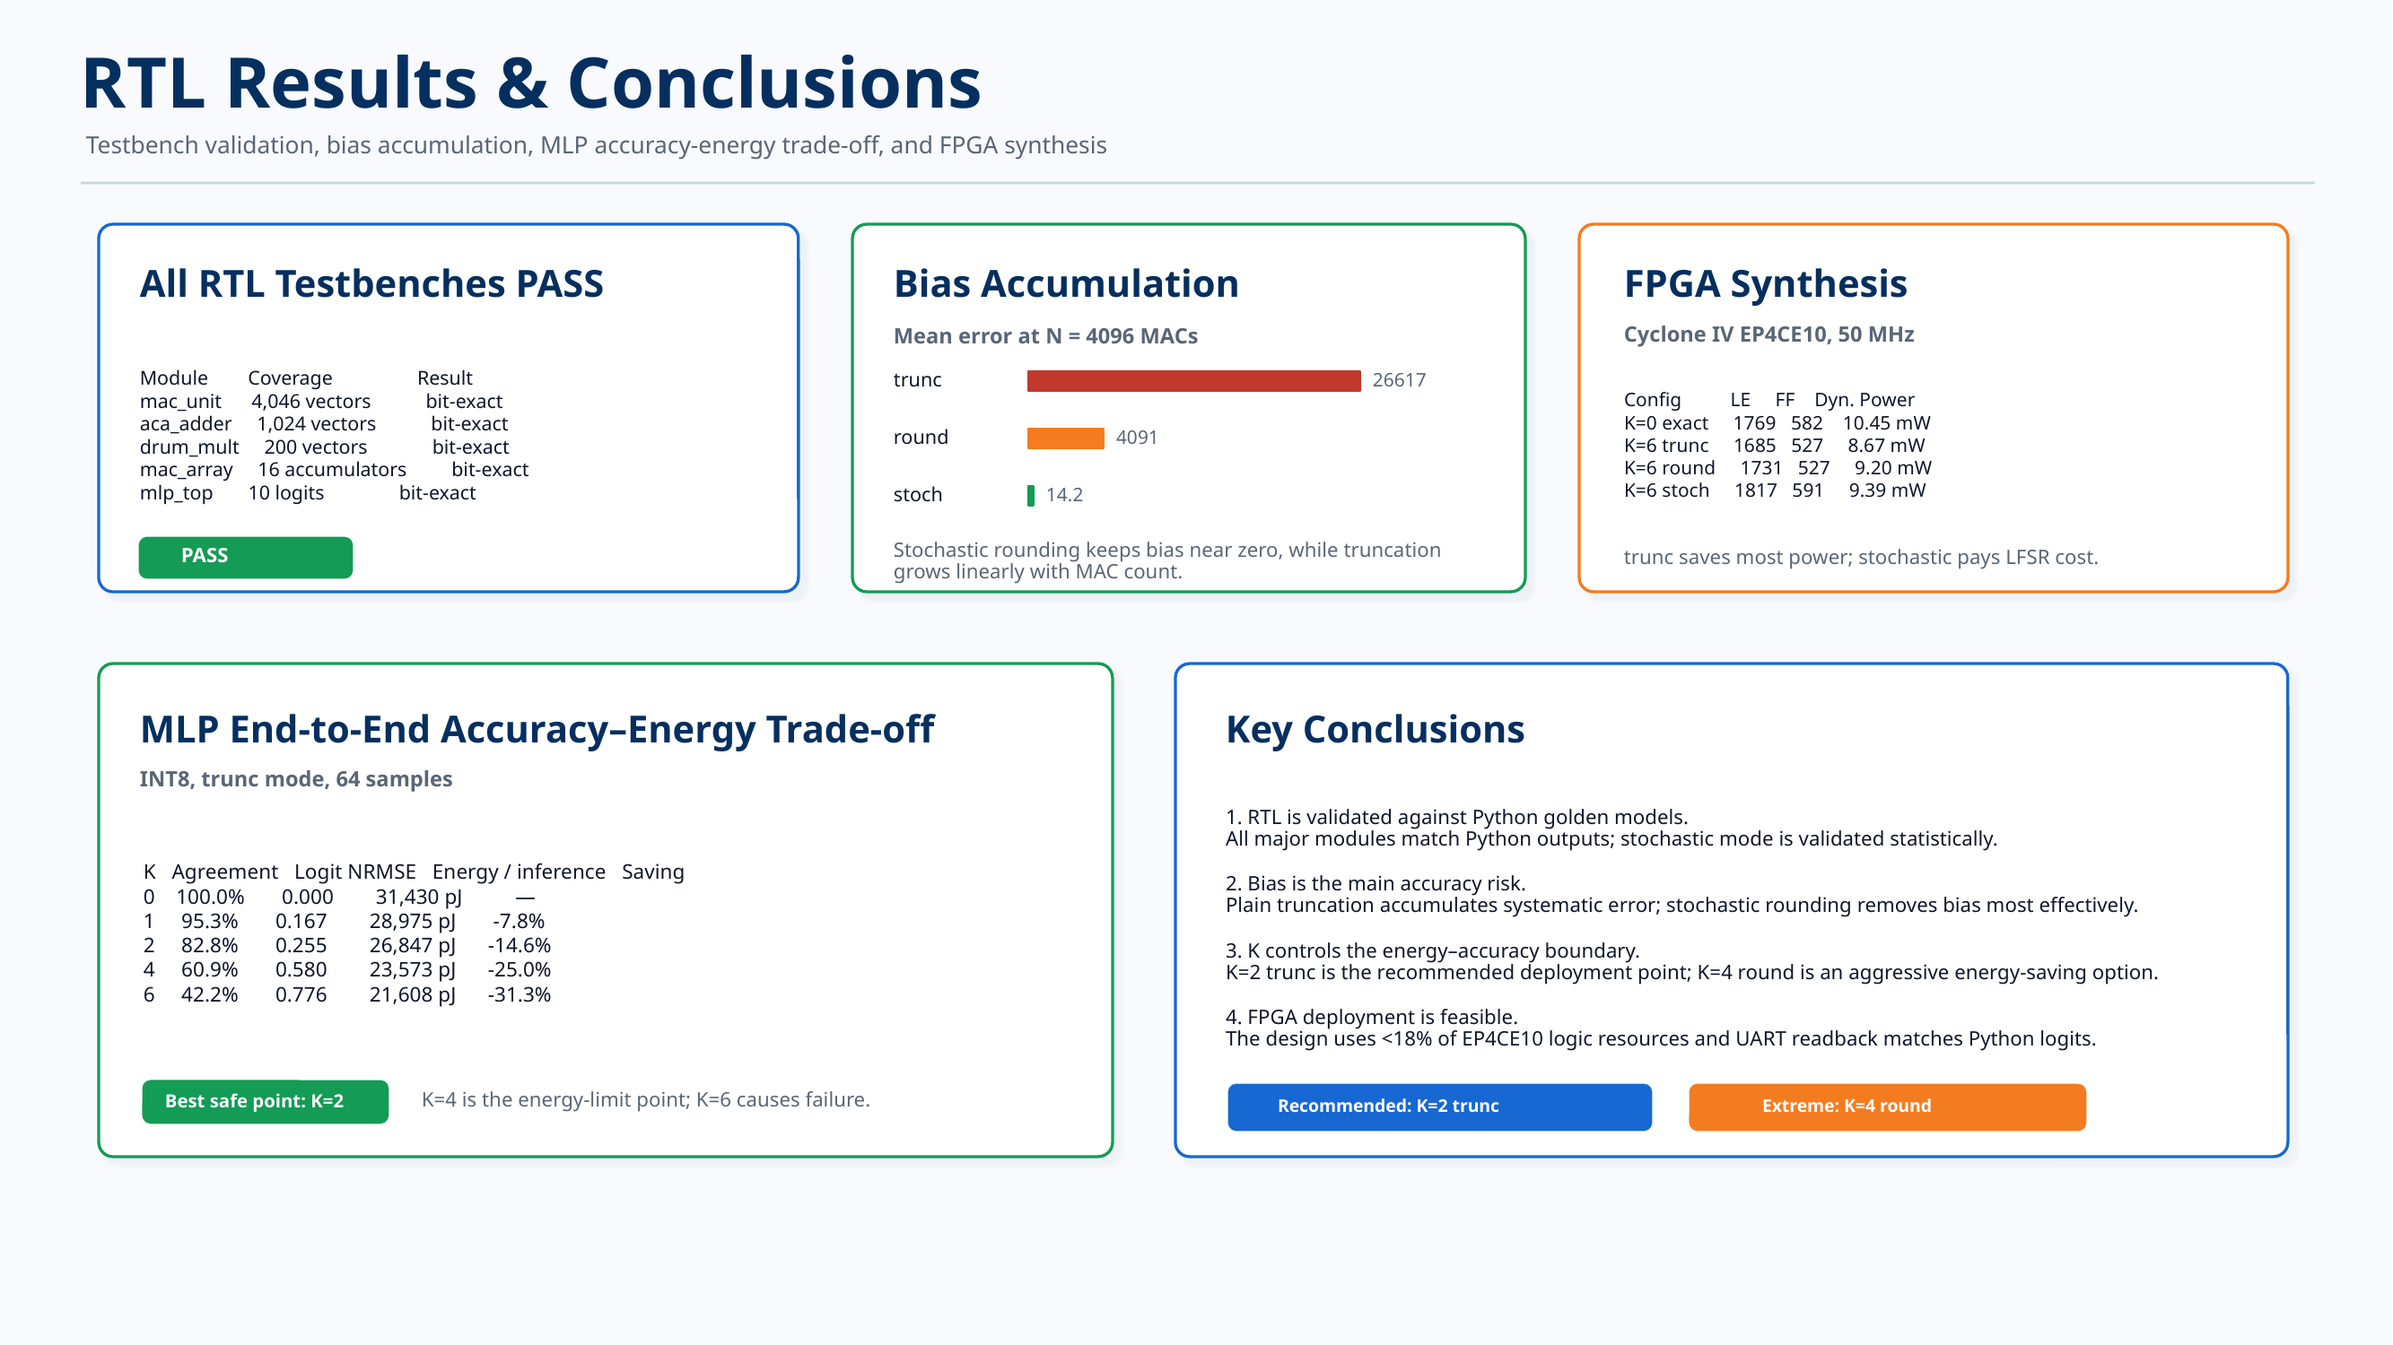

Slide 12
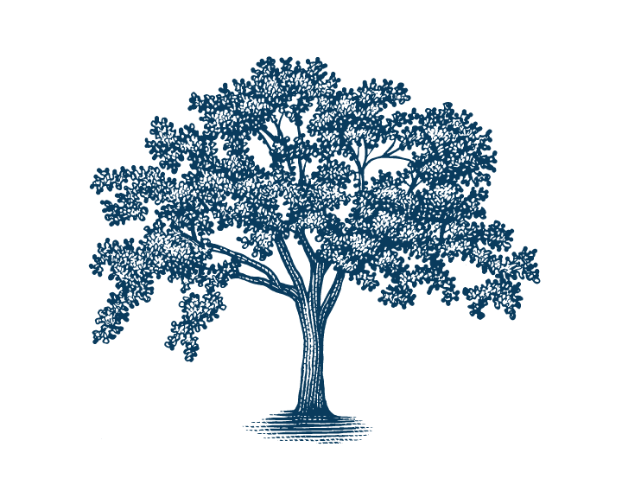

Slide 13

Title

Slide 14
Title

Slide 15
Reference
[1] S. Han, X. Liu, H. Mao, J. Pu, A. Pedram, M. A. Horowitz, and W. J. Dally, “EIE: Efficient Inference Engine on Compressed Deep Neural Network,” in Proc. 43rd Annu. Int. Symp. Comput. Archit. (ISCA), 2016.
[2] S. Gupta, A. Agrawal, K. Gopalakrishnan, and P. Narayanan, “Deep Learning with Limited Numerical Precision,” in Proc. 32nd Int. Conf. Mach. Learn. (ICML), 2015.
[3] Y. Wu, C. Chen, W. Xiao, X. Wang, C. Wen, J. Han, X. Yin, W. Qian, and C. Zhuo, “A Survey on Approximate Multiplier Designs for Energy Efficiency: From Algorithms to Circuits,” ACM Trans. Des. Autom. Electron. Syst., 2023.
[4] L. Sayadi, M. H. Moaiyeri, and S. Timarchi, “Layer-Specific Approximate Multipliers for Energy–Precision Trade-Offs in Convolutional Neural Networks,” Sci. Rep., vol. 15, Art. no. 39482, 2025.

Slide 16
Thank You!

Slide 17
Contribution A: Error-Compensated Rounding
Truncation introduces systematic bias growing O(N) — round eliminates it at near-zero hardware cost
⚠ The Deficiency: Coherent Bias Accumulation
Bias at N = 4096 (INT8, K = 6)
Truncation maps product p → p − r, r ∈ [0, 2^K) Each MAC: mean error = 2^(K−1) After N MACs: E[bias] = N × 2^(K−1) → O(N), not O(√N) Measured INT8, K=6, N=4096: trunc ≈ 26,617 | round ≈ 4,091 | stochastic ≈ 14 trunc vs. stochastic ratio: 1,900×
[ Bias Accumulation Bar Chart trunc / round / stochastic at N = 4096 ]
Theorem 1 — Formal Bias Accumulation Bounds
Truncation mode:
E[bias_N] = N · 2^(K−1) [linear in N]
3-Mode Comparison
Round mode:
E[bias_N] = 0 for any N ✓ Var unchanged
Mode
Bias at N=4096
HW Cost
Recommended Use
Transformer Corollary:
trunc
≈ 26,617
0
Baseline only
d_head=64, INT8, K=4 → 512 LSB bias per attention score Exceeds INT8 range (±127) × 4 → softmax saturation, silent degradation
round
≈ 0 ✓
+0.53 mW const
✓ Default choice
stochastic
≈ 0 ✓
+64 LFSR regs
Max accuracy, costly

Slide 18
CIFAR-10: round vs. trunc — Accuracy Collapse at K = 6
SimpleCNN · INT8 PTQ · 10,000 test images · Exact INT8 baseline: 82.94%
round K = 6
trunc K = 6
Accuracy Gap at K = 6
83.0%
vs
10.83%
72.1 pp
Matches exact baseline ✓
≈ random guessing (10 classes) ✗
Same K knob · Same hardware Only rounding mode differs
Accuracy vs. K (round / trunc / DRUM)
Full Results Table
K
round (%)
trunc (%)
DRUM (%)
1
83.04
82.97
—
2
83.07
82.74
—
[ CIFAR-10 Accuracy vs. K experiments/results/figures/fig_design_space.png ]
3
83.12
82.88
—
4
82.96
79.54
82.36
5
83.07
56.80
—
6
83.03
10.83 ✗
83.14 ✓
round achieves 83.0% at K=6 (+0.1 pp vs. exact baseline). trunc collapses: K=5 → 56.8%, K=6 → 10.83% (near-random). DRUM-6 → 83.1% (competitive). Same hardware knob; only rounding changes.

Slide 19
Contribution B: Layer-wise Non-Uniform K Allocation
Sensitivity-driven budget achieves up to 10.9× lower NRMSE at identical energy
Why Uniform K is Suboptimal
NRMSE vs. Budget B: Uniform vs. Sensitivity
Demo MLP (784→256→128→64→10): • Layer 1: 200,704 MACs = 95.8% of total — low sensitivity • Output: 640 MACs — HIGH sensitivity to truncation Uniform K truncates all layers equally → output layer over-truncated at effectively zero energy benefit
[ K Allocation Comparison experiments/results/figures/fig_k_allocation_compare.png ]
Method: sensitivity.py
1. Probe each layer individually with K injection 2. Measure logit_nrmse → per-layer sensitivity score 3. Greedy allocator: score_i = mac_count_i / (sensitivity_i × (K_i + 1)) 4. Increment K for highest-score (most tolerant) layer Output layer always preserved at K = 0
Optimal K per Layer (Budget B = 4)
Layer
MACs
Sensitivity
Opt K
Key Result (B=1, INT8, 4-layer MLP)
L1: 784→256
200,704
Low
0
Sensitivity NRMSE = 0.035 vs. Uniform NRMSE = 0.385 → 10.9× lower NRMSE at identical energy budget
L2: 256→128
32,768
Medium
1
L3: 128→64
8,192
Medium
3
L4: 64→10
640
HIGH
0 ✓
Optimal pattern at B=4: K = [0, 1, 3, 0] Middle layers (L2, L3) absorb budget. Uniform allocation NRMSE barely improves as B increases.
Recommended configs: INT8 K=1 round → 95.3% acc, −7.8% energy | INT8 K=2 round → 82.8% acc, −14.6% (knee point)

