Slide 1
Welcome!
Making Game with Python (2)
Zhihong (John) Zeng & Andrew Zeng

Slide 2
Today
Course info
Computer fundamentals
Python basics
Mathematical operations
Python variables and types
Install software

Slide 3
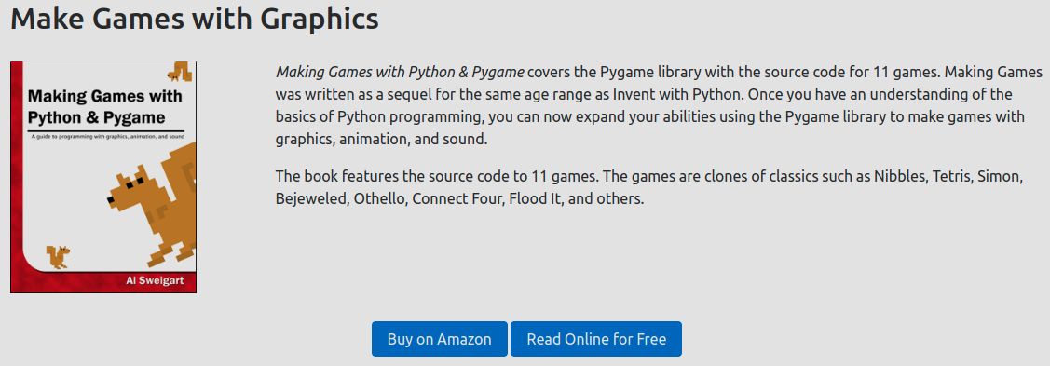
Course Info

Slide 4
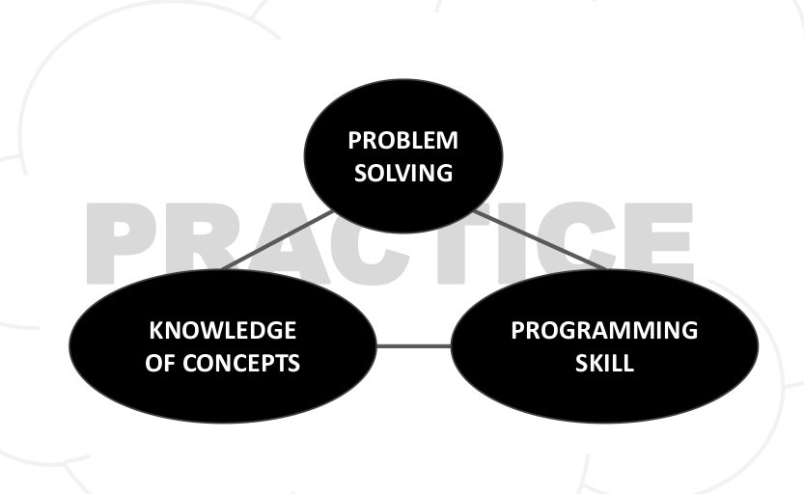
Course Info

Slide 5
Computer Fundamentals

Slide 6
What does a Computer do?
Fundamentally:
Performs calculations
Remembers results
What kinds of calculations:
Built-in to the language
Ones that you define as the programmer
Computers only know what you tell them

Slide 7
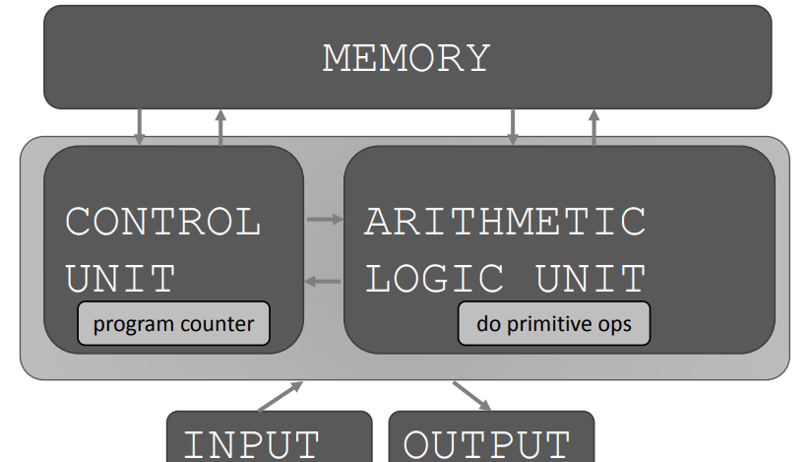
Basic Computer Architecture

Slide 8
A Numerical Example
Positive integer multiplication by using addition: A = x*y
Recipe for deducing multiplication of x and y (sequence of simple steps)
Start with integers x and y, and A=0
If y is 0, stop and return A
Otherwise y = y-1 and A = A+x, and continue Step 2.2
x | y | A
2 | 3 | 2
2 | 2 | 2+2=4
2 | 1 | 4+2=6
2 | 0 | 6

Slide 9
What is a programming recipe
Sequence of simple steps
Flow of control process that specifies when each step is executed
A means of determining when to stop
1+2+3 = an algorithm

Slide 10
Stored Program Computer
Sequence of instructions stored inside computer
Built from predefined set of primitive instructions
Arithmetic and logic
Simple tests
Moving data
Special program (interpreter) executes each instruction in order
Change flow of control though sequence
Stop when done

Slide 11
Basic Primitives
Tuning showed that you can compute anything using 6 primitives (left, right, scan, print, erase, and do nothing)
Modern programming languages have more convenient set of primitives
Use abstract methods to create new primitives
Anything computable in one language is computable in any other programming language

Slide 12
Create Recipes
A programming language provides a set of primitive operations
Expressions are complex combination of primitives in a programming language
Expressions and computations have values and meanings in a programming language

Slide 13
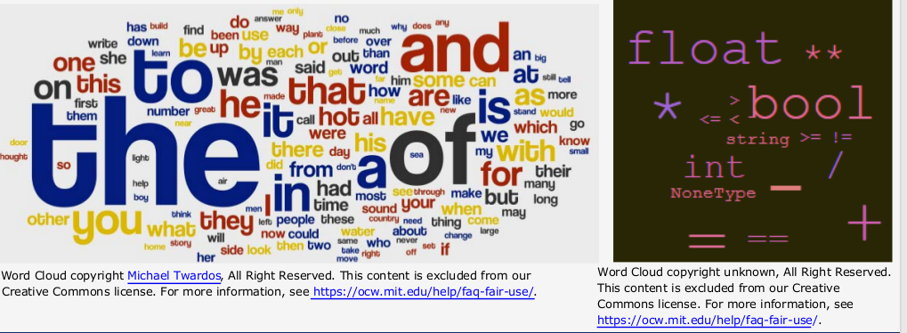
Aspects of Languages
Primitive constructs
English: words
Programming language: numbers, strings, simple operators

Slide 14
Aspects of Languages
Syntax
English:
“Cat dog boy” -> not syntactically valid
“Cat hugs boy” -> syntactically valid but
Programming language
“hi” 5 -> not syntactically valid
3.2*5 -> syntactically valid

Slide 15
Aspects of Languages
Language meaning
English: Can have many meaning
“Flying planes can be dangerous”
Programming language: can have only one meaning but may not be what a programmer intend

Slide 16
Where Things Go Wrong
Syntactic error
Common and easily caught
Static semantic errors
Some languages check for these before running program
No semantic errors but different meaning from what a programmer intended
Program crashes, stop running
Program run forever
Program gives an answer but different from expected

Slide 17
Python Basics

Slide 18
Python Programs
A program is a sequence of definitions and commands
Definitions evaluated
Commands executed by Python interpreter in a shell
Commands (statements) instruct interpreter to do something
Can be typed directly in a shell or stored in a file that is read into the shell and evaluated intended

Slide 19
Objects
Programs manipulate data objects
Objects have a type that defines the kinds of things program can do to them
Andrew is a human so he can walk, speak English, etc.
Chewbacca (Star wars) is a wookie so he can walk, “mwaaarhrhh”, etc.
Objects are
Scalar (cannot be subdivided)
Non-scalar (have internal structure that can be accessed)

Slide 20
Scalar Objects
int -- represent integers, ex. 5
float -- represent real numbers, ex. 3.27
bool -- represent Boolean values True and False
NoneType -- special and has no value, None
Can use type() to see the type of an object
>>>type(5) -->int
>>>type(3.0) -->float

Slide 21
Type Conversions (Cast)
Can convert object of one type to another
float(3) converts integer 3 to float 3.0
int(3.9) truncates float 3.9 to integer 3
int(‘321’) converts string ‘321’ to integer 321
str(123) converts integer 123 to string ‘123’

Slide 22
Printing to Console
To show output from code to a user, use print command
print(3)
print(3+2)
print(‘ABC’)

Slide 23
Expressions
Combine objects and operators to form expressions
An expression has a value, which has a type
Syntax for a simple expression
<object> <operator> <object>

Slide 24
Operators on ints and floats
i + j → sum
i - j → difference
i * j → product
Note: if both are ints, result is int. If either or both are floats, result is float
i / j → division. result is float
i % j → remainder when i is divided by j
i ** j → i to the power of j

Slide 25
Operation precedence (order)
Parentheses used to tell Python to do these operations first
Operator precedence without parentheses
**
*
/
+ and - executed left to right, as appear in expression

Slide 26
Binding Variables and Values
Equal sign is an assignment of a value to a variable name
Pi = 3.14
Pi_approx = 22/7
Value stored in computer memory
An assignment binds name to value
Retrieve value associated with name or variable by invoking the name

Slide 27
Abstracting Expressions
Why give names to values of expressions
To reuse names instead of values
Easier to change code later
pi = 3.14
radius = 2.2
area = pi * (radius ** 2)

Slide 28
Programming vs Math
In programming, you do not “solve for x”
Programming:
Expression on the right
Variable name on the left
Bonus: Equivalent expression to radius = radius + 1 is radius += 1
Python:
pi = 3.14
radius = 2.2
area = pi * (radius ** 2)
Math:
pi = 3.14
radius = 2.2
pi * (radius ** 2) = area

Slide 29
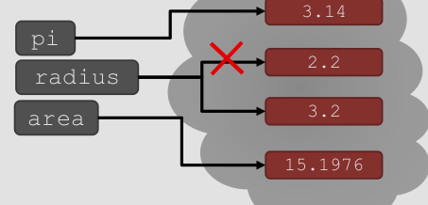
Changing Bindings
Can re-bind variable names using new assignment statements
Previous value may still stored in memory but lost the handle for it
Value for area does not change until you tell the computer to do the calculation again
pi = 3.14
radius = 2.2
area = pi * (radius ** 2)
radius = radius + 1

Slide 30
Install Software
Install python 3.6.1 or greater (latest 3.7.2)
www.python.org
Install pygame:
python3 -m pip install -U pygame --user
python3 -m pygame.examples.aliens

