Slide 1
eBay Cloud CMS based on nosql
Xu Jiang
eBay COE

Slide 2
Agenda
What’s eBay Cloud CMS?
Why is CMS based on nosql?
How does CMS overcome the challenges of nosql?

Slide 3
What is eBay Cloud CMS?
CMS is “Configuration Management System”
CMS manages the state of all resources in eBay cloud environment
Metadata:
Data Dictionary
Runtime Data
Stable State
Current State
Future State
Transient State

Slide 4
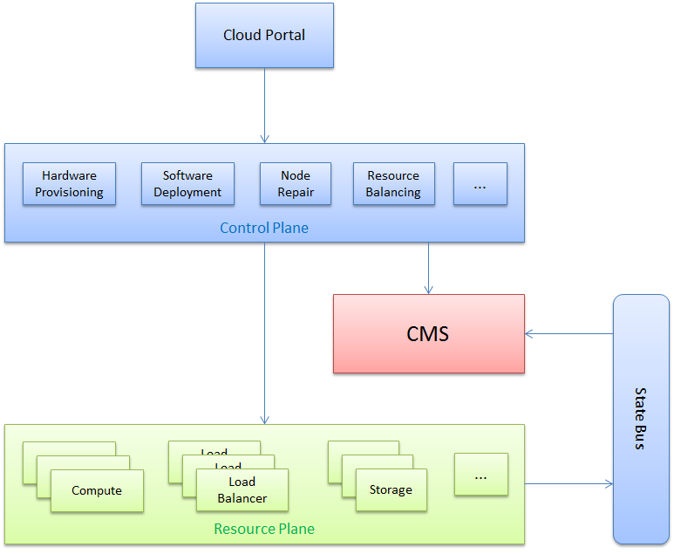
Role of CMS in eBay Cloud

Slide 5
CMS Design Goals
High Performance & High Availability & High Scalability
Network partition tolerated distributed architecture
Flexible data model that support graph model
Declarative query language that support filter, join and projection
Multi-row transactional data consistency
Concurrency control
Access control

Slide 6
Relational DB vs. Nosql DB
 | RDB (i.e. MySQL) | Document Store (i.e. MongoDB) | Column Family Store (i.e. HBase)
DB Schema | Relational Model, Hard for graph model | Complete schema-less | Semi schema-less
Performance | Too many join for graph model | High read performance; Potential write performance bottleneck | High write performance Fast key based read & Slow range query
Scalability | Difficult to scale-out (manual sharding) | Auto-sharding on pre-defined shard key | Horizontally scalable by tablet
Query | SQL | Limited query language (no join) | Key-value access; Pig & Hive based on MapReduce
Consistency | ACID Transactional | Eventual Consistency | No multi-row transaction
Concurrency Control | Locking or MVCC | node-level locking & atomic operation | row-based atomic
Security | AuthZ & AuthN | Basic security | Basic security
Notification Mechanism | Trigger | No build-in notification | No build-in notification

Slide 7
Solution To Nosql Challenge – No Metadata Management
Metadata-Driven Object Oriented Model
Use object reference to define relationship in graph model
Support inherit attributes and virtual expression attributes
Support metadata extension & versioning
Support runtime data migration
Notes:
Data model & query to explain

Slide 8
Solution To Nosql Challenge – Limited Query Language
RESTful query language
Resource Path
Implicit Join
Expression Filter
Attribute Selection
CMS Query Engine
AST
Exec Plan
Parser
Translator & Optimizer
Executor
Notes:
Add complex query

Slide 9
Solution To Nosql Challenge – No Multi-Row Transaction
Two Phase Commit
It’s not distributed 2PC ☺
Phase 1 : Pre-Commit
Optimistic Concurrency Control: check timestamp of each entity to detect writing conflict
Phase 2 : Commit
Write Ahead Log: writing log before writing data
Recovery
Records all updates in transaction logs
Background thread checks transaction logs to rollback the pending transaction

Slide 10
Solution To Nosql Challenge – No Concurrency Control
Hierarchy locking for tree model
Resource has hierarchy
Locking one resource will check all ancestors
Advisory locking for application-defined meanings
Advisory locking is not mandatory
User can use advisory locking to emulate 'pessimistic locks'
Lease locking for distributed environment
In a distributed environment, it is always possible that a process can die and never release a lease
Process must renew the lease before it’s expired.

Slide 11
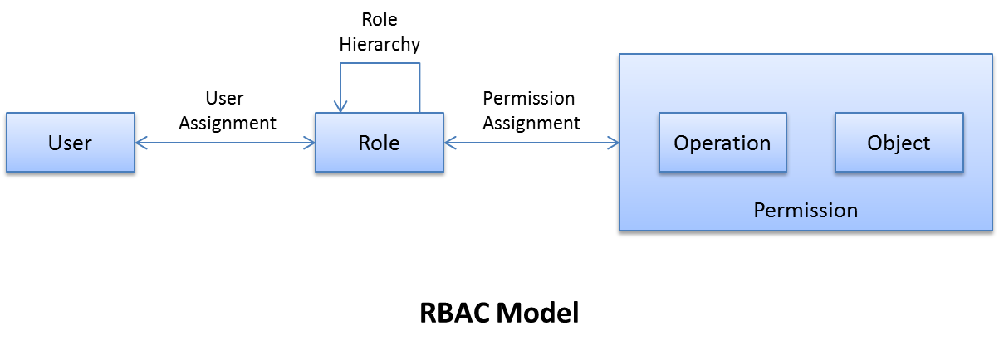
Solution To Nosql Challenge – No Access Control
Role Based Access Control
ACL Based Authorization
Define permission in ACL
LDAP Based Authentication
Maintain user/group/role relationships in LDAP

Slide 12
Solution To Nosql Challenge – No Notification Mechanism
We use asynchronous publish/subscribe as notification mechanism that is more scalable and loosely decouple.
By introducing change log, we can decouple the change generation and change notification.
We can provide some advanced features, e.g. changes collapse and multi-thread processing
Change Subscriber 1
Persistence Manager
Change Logger
Change log
Change Poller
Change Publisher
Change Subscriber N
Data Store
Registration

Slide 13
Solution To Nosql Challenge – Potential Writing Bottleneck
Document DB may have writing bottleneck. Column DB has limited query language
We use document store(e.g. MongoDB) as the storage of stable data, and use column store (e.g. HBase) as the storage of transient data.
We use a data access layer to hide the different data storage.
Query Engine
Data Access Layer
MongoDB
(stable data)
HBase
(transient data)

Slide 14
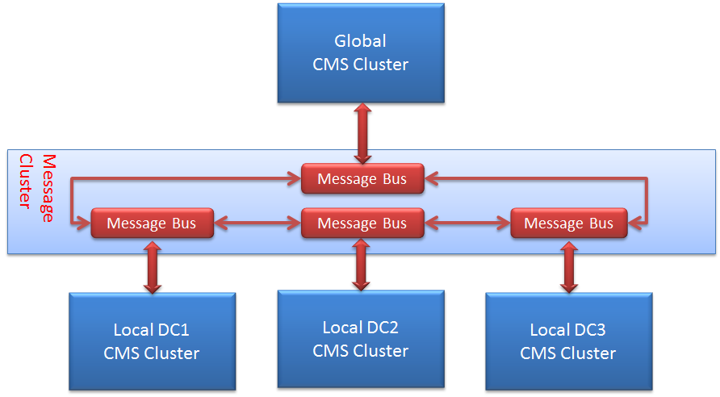
Solution To Nosql Challenge – Distributed Architecture
Isolation domain based distributed architecture
Network partition tolerance
Runtime data partition
Metadata replication
Message-based data replication

