Slide 1
eBay Cloud Configuration Management System
Xu Jiang, Tony Ng
Platform Infrastructure Engineering

Slide 2
Agenda
eBay Cloud Overview
Why eBay Need Cloud?
eBay Cloud Tech Overview
CMS - Configuration Management System
Architecture
Try Me Page
Functionality & Demo
Performance Test
NoSQL in CMS
Why CMS choose NoSQL?
Overcome NoSQL Design Challenges
Resolve Open Source NoSQL Issues

Slide 3
Why eBay need cloud?

Slide 4
eBay Scale
Data
Analytics
Search
Infrastructure
Front
End
2B page views/day
500M live listings
14,000 application servers
5B queries/day
100M active users
9PB of data
44M line of code
10M items added/day
75B database calls/day

Slide 5
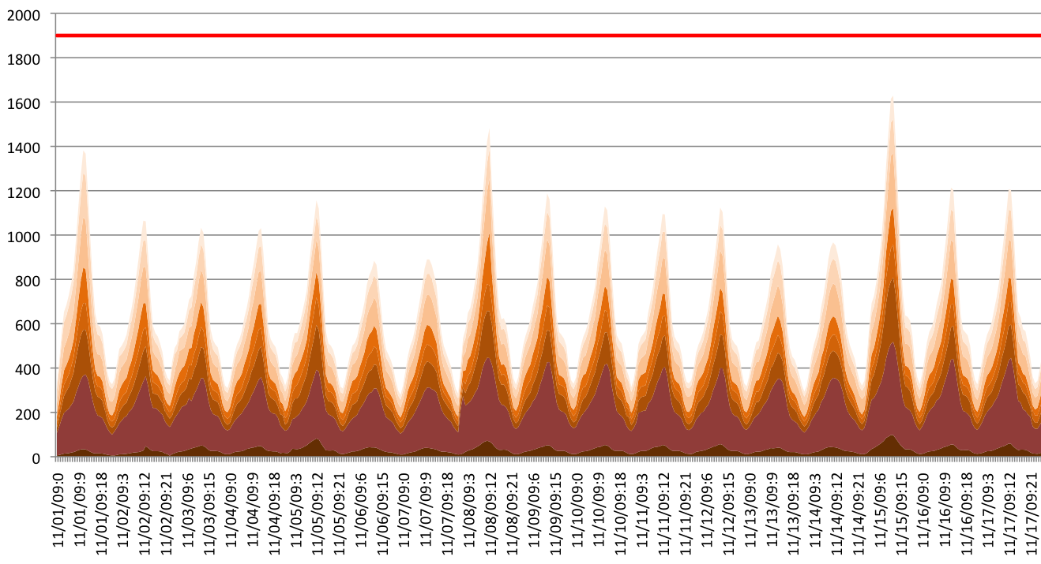
eBay Utilization
Number of servers required based on utilization for 8 pools

Slide 6

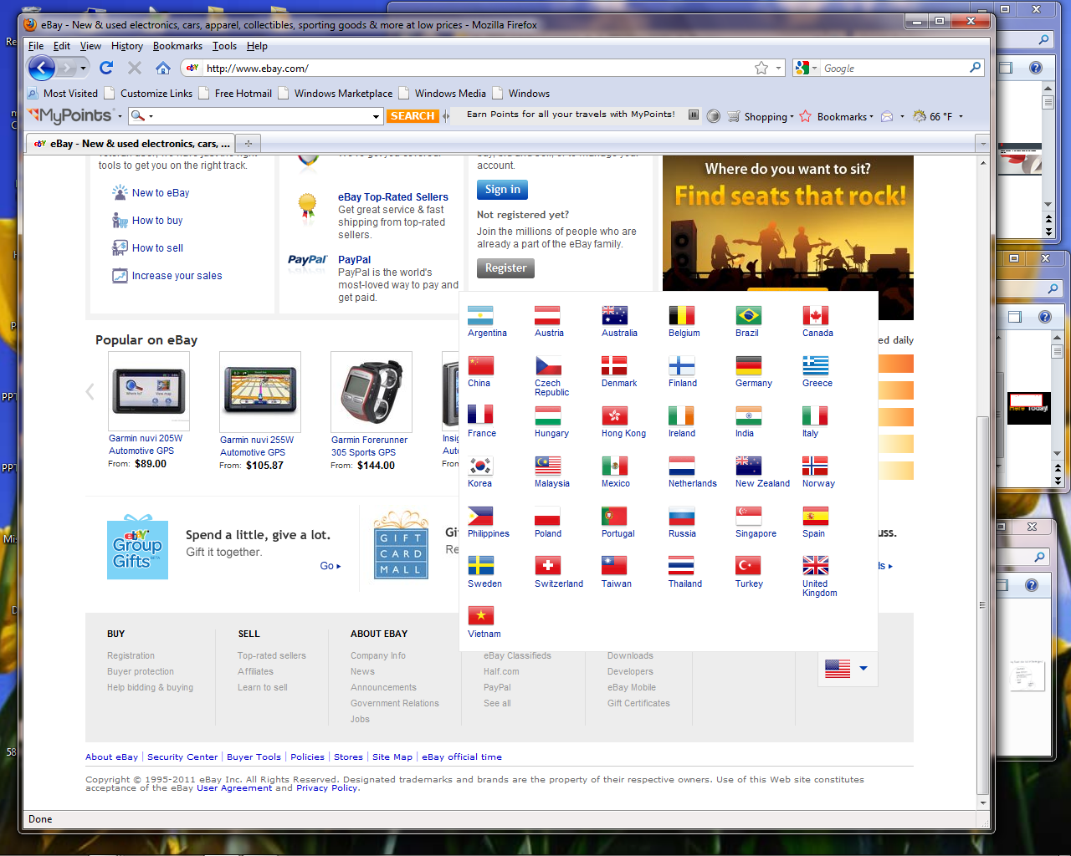








eBay Global Brands

Slide 7
eBay Cloud Tech Overview

Slide 8
eBay Cloud Technology Stack
Service Catalog
REST APIs
Ticket driven run book automation
Model Driven Close Loop
Automation
Monitoring
Complex Event Processing
Configuration Management
Database (CMDB)
Distributed State Management
Chargeback
Pay As You Go

Slide 9
eBay Cloud Architecture Overview
REST API
Queue API
REST API
Configuration
Management
Service
Current/expected
state
Cloud
Manager
Thresholds/topology
Control
Discovery
Events &
alerts
REST API
Queue API
REST API
Queue API
Monitoring
Infrastructure &
Platform
Mgt Services
Cloud Infrastructure
metrics
Control
Agent

Slide 10
Model Driven Automation
Desired configuration is specified in the expected state and persisted in CMS
Upon approval, the orchestration will configure the site to reflect the desired configuration.
Updated site configuration is discovered based on detection of configuration events
Reconciliation between the expected and current state allows to verify the proper configuration.
LB
Pool
LB
Pool
Server
Server
Server
Server
Server
Server
Expected
State
Reconciliation
Current
State
Comparison
Orchestration
Discovery
Site

Slide 11
Configuration Management System (CMS)

Slide 12
CMS - Overview
CMS (Configuration Management System) is a high-performance metadata-driven persistence and query service for configuration data with supporting of RESTful API and client lib (Java, Python).
CMS is a generic system that be used for cloud configuration, as well other software needs for configuration.
As a by-product, CMS can be a persistence solution for real-time state data as well.
CMS supports multiple data repositories for desired data isolation.

Slide 13
CMS - Architecture
REST Request
REST API
Metadata Service
Query Engine
Entity Manager
Parser
Branch Service
History Service
Translator & Optimizer
Entity Service
Executor
Entity Mapper
Data Access Layer
Search Service
Persistence Service
MongoDB

Slide 14
CMS Functionality & Demo

Slide 15
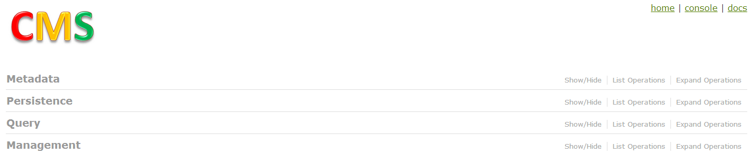
CMS Functionality – Try Me Page
https://github.scm.corp.ebay.com/pages/cloud-cms/

Slide 16
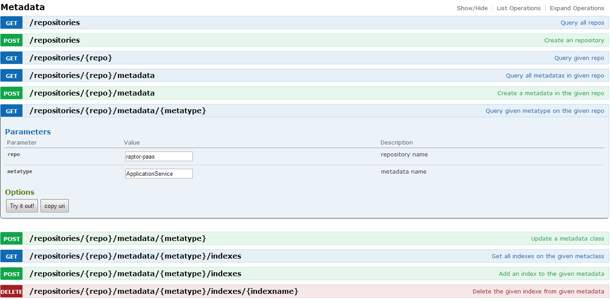
Metadata Model – Try Me Page

Slide 17
Metadata Model – Basic Feature
The metadata model is based on object-oriented paradigm that can support graph/tree data model
MetaClass define the meta type of runtime data (i.e. entity)
Entity represent one node in graph
Relationship between entity represent the edge in graph
The metadata can contain two types of field:
Attribute field define payload of entity
String, Boolean, Double, Integer, Long, Date
Json
Relationship field define relationship between entity.
Reference
Embedded

Slide 18
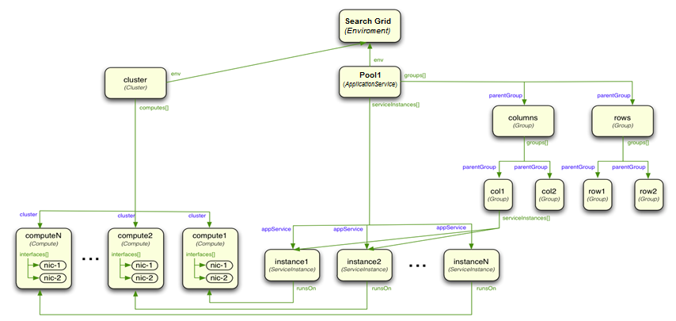
Metadata Model – Sample

Slide 19
Metadata Model – Advanced Feature
Metadata Inheritance (parent & child)
Reference Integrity (strong & weak)
Expression Defined Field Value
Index Support on Metadata (unique contraints & query optimizer)
Mongodb Collection Split by Metadata (break 64 index limitation)

Slide 20
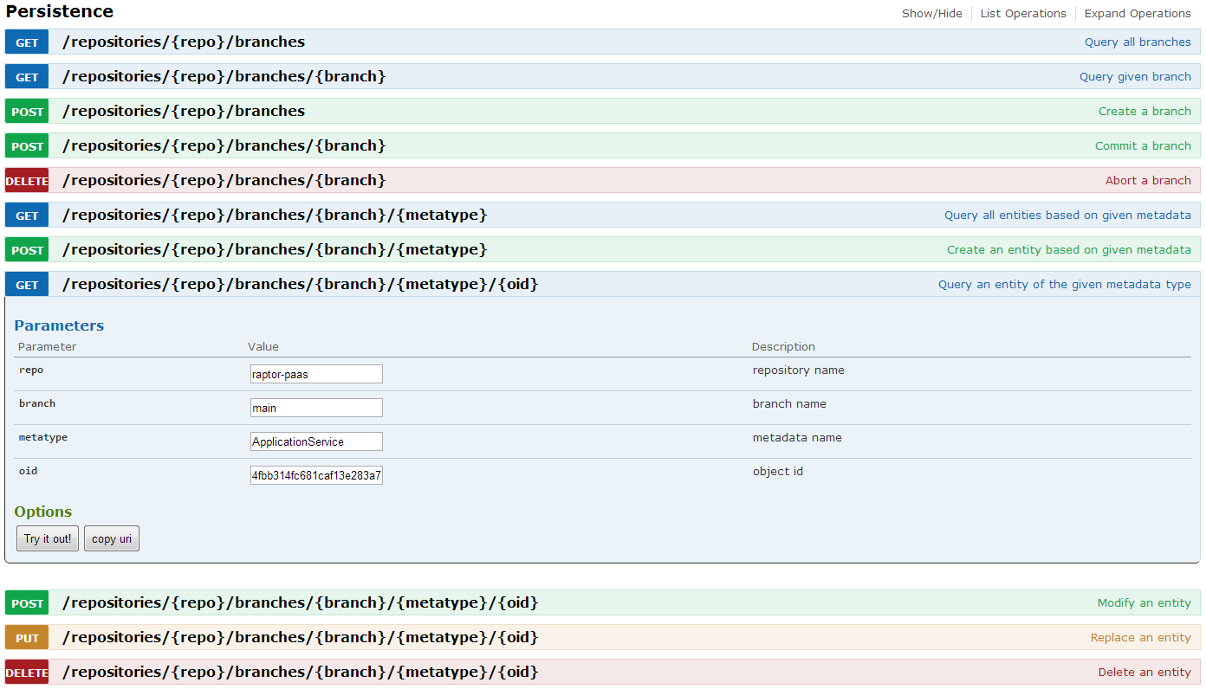
Persistence Service – Try Me Page

Slide 21
Persistence Service – Basic Feature
The persistence service provides CRUD API for the runtime data (i.e. entity) of metadata.
Create
Retrieval
Update
Delete
The entity can be flat-structure or nested-structure that conformed to the metadata definition
For reference relationship, entity is flat-structure
For embedded relationship, entity is nested-structure

Slide 22
Persistence Service – Advanced Feature
Branching (main & sub & merge)
Audit Tracing (entity change history)
Reference Integrity (strong & weak)
Conditional Update (version based optimistic locking)
Security Access Control

Slide 23
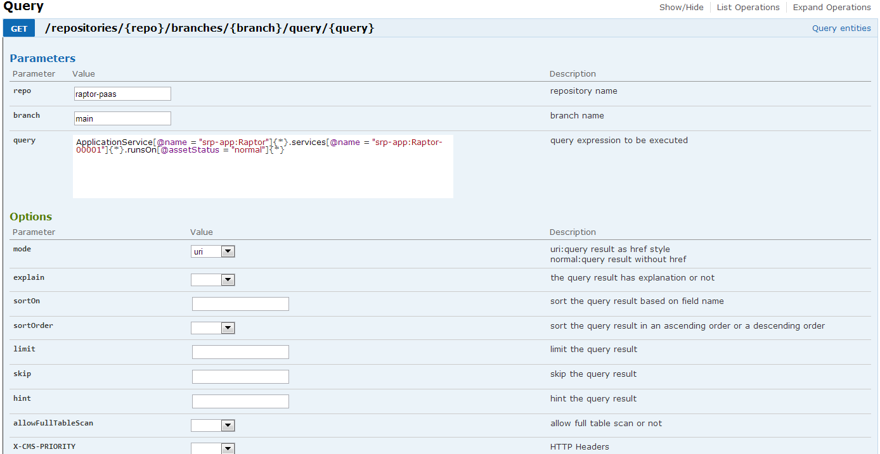
Query Service – Try Me Page

Slide 24
Query Service – Basic Feature
The query service provides an declarative style query language that defines the traversal path of graph/tree data model and will extract a sub-tree result from graph data set
The query language will support the following operators:
Selection
ServiceInstance[@name =~ "srp.*" and @activeManifestDiff = true]
Projection
ApplicationService{@name, @activeManifestDiff, @updateStrategies}
Join
ApplicationService[@name = "srp-app:Raptor"]{*}.services[@name = "srp-app:Raptor-00001"]{*}.runsOn[@assetStatus = "normal"]{*}
Grouping + Aggregation
ServiceInstance<@healthStatus>{@healthStatus, $count()}

Slide 25
Query Service – Advanced Feature
Query Optimizer (cost & hint)
Result Pagination (sort / limit / skip)
Full Table Scan Check (query filter & index info)
Query Explanation (execution plan)

Slide 26
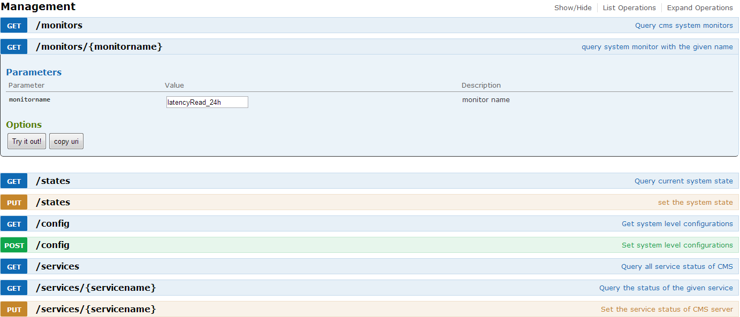
System Management – Try Me Page

Slide 27
System Management - Features
Monitoring (approximate bucketing window & accurate sliding window)
State Management (normal / maintain / overload)
Healthy Model (formula based on qps & latency -> overload state)
API Throttling (overload state -> priority throttling)

Slide 28
Performance Test - Simple Read（By ID/Name）

Slide 29
Performance Test - Write Capacity & Latency
Capacity Acceptances:
95% percentile<100ms

Slide 30
Performance Test - Complex Query Capacity & Latency
NOTE: CMS reach bottleneck when the client threads is 100.
The bottleneck is CPU of CMS server reach 100%.
The CPU of mongodb server is very low
Since the performance test use only 1 CMS server, we can add more CMS server to improve the QPS.

Slide 31
Open Source Strategy
Plan to open source the core functionality of CMS
Separate the ebay-related code (e.g. security) from open source code
Welcome to adopt and contribute!

Slide 32
NoSQL in CMS

Slide 33
CMS Requirements
The primary goal of CMS is to efficiently manage the configuration data
The characteristic of configuration data
data model is very complex and flexible
access pattern is reading >> writing
need to support very complex query
Non-functional requirements
High Performance
High Availability
High Scalability
Access Control

Slide 34
Relational DB vs. Nosql DB
 | RDB (i.e. MySQL) | Document Store (i.e. MongoDB) | Column Store (i.e. Cassandra)
DB Schema | Rigid Schema | Schema Free | Flexible Schema
Performance | Too many join for graph model | High read performance; Potential write performance bottleneck | High write performance Fast key based read & Slow range query
Scalability | Not scale-out | horizontally scalable | horizontally scalable
Metadata | DB Schema | No metadata | No metadata
Query | SQL | Limited query language | Limited query language
Consistency | Transactional | Eventual Consistency | Eventual Consistency
Security | AuthZ & AuthN | Basic security | Basic security
Concurrency Control | Locking or MVCC | database-level locking & atomic operation | row-based atomic

Slide 35
Why CMS choose MongoDB?
High Performance
In-Memory Storage (if work set fit in memory)
B-Tree Index
High Availability & High Scalability
Replication Set
Flexible Schema
JSON-Based Document Model
Query Support
Rich, document-based queries.

Slide 36
Overcome NoSQL Design Challenges
No Metadata Management
Metadata Driven
Limit Query Language
Declarative Query Language
Data Integrity
Strong Reference Integrity & Data Validation Rules
No Multi-Row Transaction
Branching & Merge
No Access Control
Security Model

Slide 37
Resolve MongoDB Issues
Open source software is great, but isn’t bug-free to use.
Sometime, we may need to dig into source code or OS kernel to find the root cause and do some enhancement by ourselves
Case Study
Case 1: High system CPU for high concurrent full table scan query
Case 2: High system CPU for high concurrent large result set query

Slide 38
Resolve MongoDB Issues – Case Study I
Case 1: High system CPU for high concurrent full table scan query
Symptom:
When there are 100+ concurrent client to execute full table scan on a 100K+ collection, the system cpu is 80%+.
Analysis:
gdb sampling show that lost of samples are on pthread_mutex_lock & pthread_mutex_unlock that is called mongo::ps::Rolling::access()
strace sampling show 80%+ syscall are futex
After we study the mongodb code, mongo::ps::Rolling::access() will check whether the record is in memory or not; if it’s out of memory, it will load it into memory.
The problem is that mongo::ps::Rolling::access() will acquire a pthread_mutex for each record that trigger high lock contention.
Solution
We add “full table scan” checking in query engine. And we will reject “full table scan” query when system is in unhealthy state
We have a JIRA CS-3969 opened with 10gen

Slide 39
Resolve MongoDB Issues – Case Study II
Case 2: High system CPU for high concurrent large result set query
Symptom:
When there are 100+ concurrent client to execute large query that return 1K+ result set, the system cpu is 90%+.
Analysis:
gdb sampling show that most samples is on socket recv() and many samples is on malloc mutex that is used in allocate string for query result.
Since recv is io-bound that should not cause high system cpu, so we suspect malloc mutex __lll_lock_wait_private()
oprofile profiling show that 95% sample is futex_wait & futex_wake
Since glibc mutex is implemented by futex, it’s very likely that malloc mutex cause high system cpu
Solution
We use google tcmalloc to replace the default glibc ptmalloc by LD_PRELOAD. The query latency is reduced from 3 second to 300ms
Since mongodb 2.2 already use tcmalloc as default memory allocator, you can use mongodb 2.2 directly.

Slide 40
Q & A
Thanks!

