Slide 1

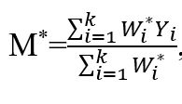
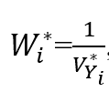

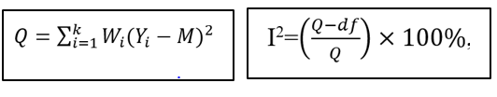
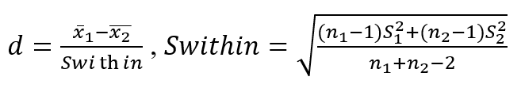


META-ANALYSIS PROCEDURES IN EDUCATIONAL RESEARCH
A Meta-analysis of Information and Communication tools in Second Language Acquisition
Steve (Songtao) Wang University of Victoria songtaowang@uvic.ca
ABSTRACT
META-ANALYSIS PROCEDURES
This poster provides an example of meta-analysis procedures on the topic of the effectiveness of technological tools in second language acquisition research.
Meta-analysis is a set of statistical methods for combining quantitative results mathematically from multiple studies to produce a summary of empirical knowledge on the given topic (Glass, McGaw, & Smith, 1981).
Meta-analysis Procedures (using ICT Tools in SLA research as an example):
Identification:
A random-effects model assumes true effect size varies from one study to the others.
The first step of research synthesis is to develop a set of specific, answerable questions focusing on a group of objectives, and so that generate proper hypothesis to answer such questions. A systematic literature search for all related studies is critical as it decides the quality of results.
Ex. Electronic databases using Boolean syntax is popular to researchers to identify literatures
Data Anslysis
INTRODUCTION
Meta-analysis is a popular research method in second language acquisition (SLA) research due to its ability to aggregate and examine empirical data from previous studies on the same topic. Results and implications from the secondary data analysis hold the potentiality to critique existed studies, examine current theories and possibly indicate future research agenda.
The use of information and communication technology (ICT) tools in second language acquisition (SLA) has been a social and sociological concern yet the effect of types of technological tools in various learning contexts remain unclear. This research uses a method of meta-analysis to synthesize empirical research on the topic of using ICT tools in SLA by retrieving, integrating and interpreting empirical results from primary studies, as well as providing a view to minimizing publication bias.
Research Design
Topic Formulation: this meta-analysis study examines the effectiveness of ICT tools in SLA research across various learning contexts
Screening:
Moderator analysis
The test of heterogeneity explains the variation of pooled effect sizes which allows researchers to estimate whether the calculated effect is based on a single population or due to chances.
A written protocol including Inclusion and exclusion criteria is crucial to narrow down studies which resonate with research questions. Included studies should be relatively on the same topic (homogeneous), otherwise the meta-analysis might be too diffuse to be interpreted (Littell et.al, 2008).
Ex. Presented study includes returned research with experimental , address ICT in the L2 classroom, and provide results with sufficient details for statistical calculation.
Sampling: Research sampling steps include identification and screening
Coding: included studies are coded by technological tools used in the study.
Data Anslysis
Publicationl Bias
Publication bias refers to the issue that included studies in a meta-analysis are a biased sample of studies with positive results, hence the results of meta-analyses are also illicitly positive (Dickersin, 2006).
Effect size is a measure of strength and direction of a relationship between variable, which could be influenced by the purpose and design of a study and the format of the data.
Hedges’g is due to the flaw of small sample sample bias of Cohen’s d.
BIBLIOGRAPHY
Dickersin, K. (2006). Publication bias: Recognizing the problem, understanding its origins and scope, and preventing harm. In Publication Bias in Meta-Analysis: Prevention, Assessment and Adjustments (pp. 11–34). John Wiley & Sons.
Glass, G. V., McGaw, B., & Smith, M. L. (1981). Meta-analysis in social research. Sage Publications.
Littell, J. H., Corcoran, J., & Pillai, V. K. (2008). Systematic reviews and meta-analysis. Oxford ; New York: Oxford University Press.

