Slide 1
Analytic Programming
Final project
Zhijing Zhang
Predictive Modeling of Camp Town fire Using fire Data

Slide 2
Cape Town is a very beautiful city but the bush fire is the very important part of there.
About 10% of bush fire are caused by certain environmental factors, including hurricanes, high temperatures, excessive dryness, Seasonal climate change, lightning and more.
bush fire could cause irreversible losses.Predicting in advance can reduce casualties and property damage
Topic

Slide 3
Using weather data from Cape Town ’s historical bush fire, the main problem I study for this project is to create a model of provide for Cape Town locals or tourists who have plans to go to Cape Town.
It can predict whether a bush fire may occur in today(time when you use this model) or within five days (timed from the time you use this model), and contains an analysis of trends ( For seasons, months and certain days, etc.).
Research Questions

Slide 4
1. Dataset:
original data from [City of Cape Town Open Data Portal-Fire incidence] (https://web1.capetown.gov.za/web1/OpenDataPortal/DatasetDetail?DatasetName=Fire%20incidence):
2. API:
openWeather API used to get the current weather condition, or the future five days' .
input name of the city, return real-time weather conditions. The return value is a json file containing a description of the weather conditions, temperature, humidity, wind speed, wind direction, visibility and other information
Data

Slide 5
1. Import and read CSV file
2. Clean 'Description_of_Incident', 'Wind', 'Temperature' column to remove whitespaces and special characters.
3. Drops extra and unnecessary columns from new dataframe
4. Transform Datetime columns from string to Date and Time to be able to next analysis
5. Extract month, weekday and replace columns to the names of the actual months and weekdays
6. Devide the months into four seasons
7. Replace the Temperature column into number string
Data Prepare

Slide 6
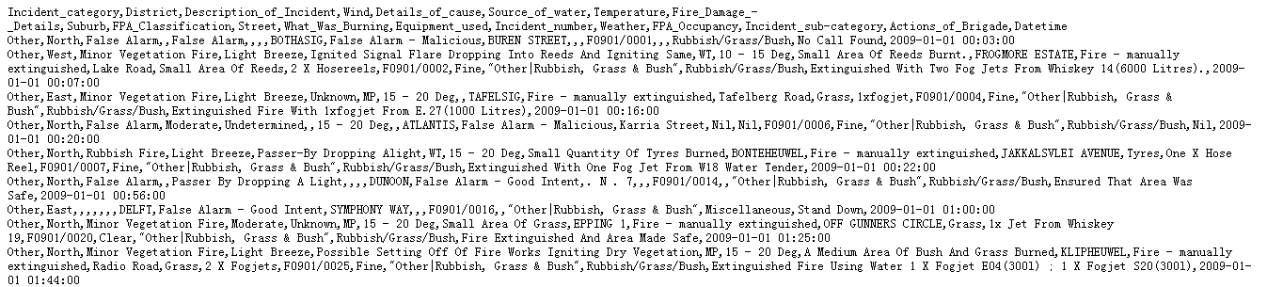
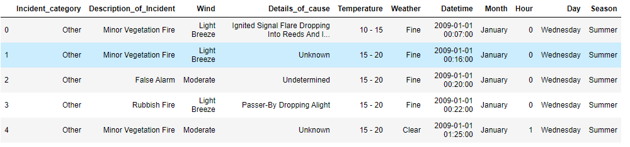
before
after

Slide 7
1.Do describe() for the discrete values
Although most of my data exists in the form of discrete values, it does not affect our analysis of the data and subsequent predictions, because the discrete values also exist in the form of intervals. Enough to learn from
2.Show the distribution of data for each of the columns：Season, Month, weekday, Wind, Temperature, for the fire number and vegetation fire number
3.Show combined distribution
4.Analyze every predictors
EDA

Slide 8
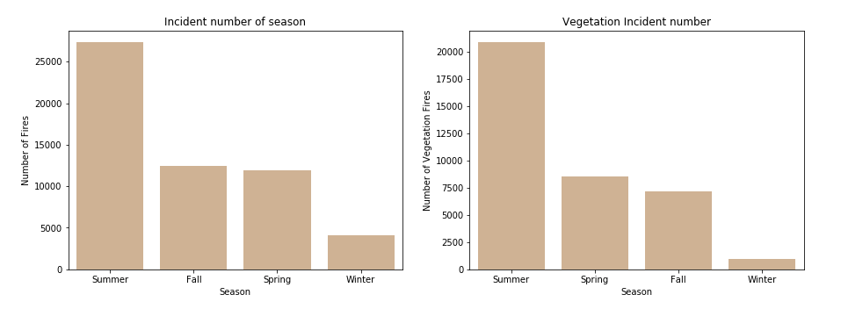
examples of EDA

Slide 9
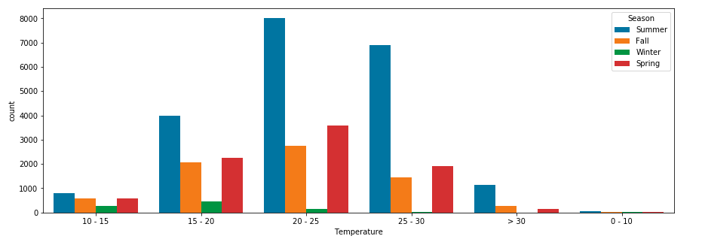

Slide 10
Summer
20-25
Light Breeze
Wind Speed（Scale）
Gale-Force （8） 17-20m/s
Strong （6） 11-13.5m/s
Moderate （4） 5.5-8m/s
Light Breeze （2） 2-3m/s
Nil <（0） 0.5-1.5m/s
Result

Slide 11
1. create a new dataframe to do the preidiction
2. get_dummies() to create a new "0/1" binary indicator variable for some categorical data value
3. import statsmodels.api as sm（new part）
OLS
Linear Regression Modeling:

Slide 12
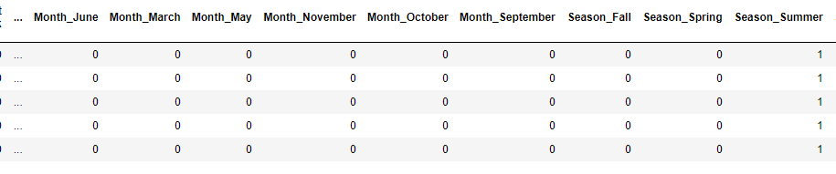
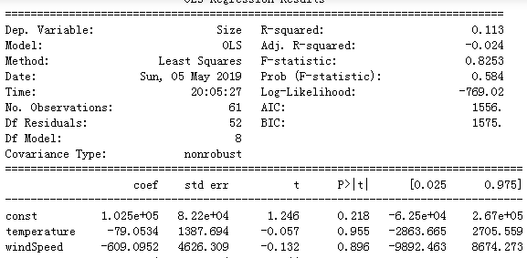

Slide 13
Example:
2019-12-16 16:02:18.151377
Cape Town's temperature: 18.28°C
Wind speed: 4.1 m/s
Description: overcast clouds
Possibility of vegeetation fire < 1%
API

Slide 14
1. totally different from the proposal
2. the dataset has two parts, before 2016: csv
2016-2017: sql
so i managed it manually.
Challenge

Slide 15
THANK YOU

