Slide 1
Choose Neighborhoods in Toronto to
Open a Sushi Restaurant
Zhilin Zheng
Jun27, 2021

Slide 2
Agenda
Problem
Approach
Data
Results
Conclusion

Slide 3
Problem
Very few Sushi restaurants in Toronto neighborhoods: 59 out of 102 do NOT have a Sushi restaurant
Comparing to New York City, Sushi restaurants have become top 10 venues across its 22 neighborhoods
A market gap for Sushi restaurants business

Slide 4
Approach
Compare neighborhoods in two selected cities: Toronto and New York City
Select candidate neighborhoods in Toronto where do not have Sushi restaurants but share the common venue patterns with New York City neighborhoods in which Sushi restaurants have become the top venues (specifically, a clustering algorithm is used to find similarities)

Slide 5
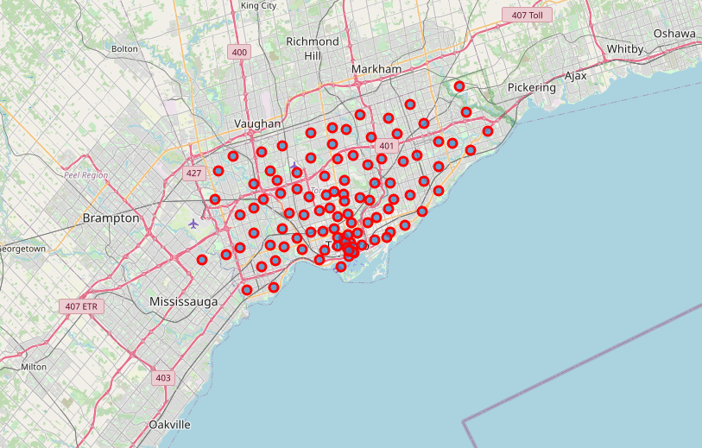
Data
Toronto neighborhoods

Slide 6
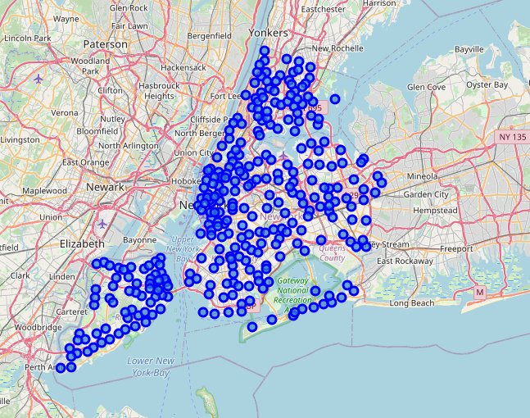
Data
NYC neighborhoods

Slide 7
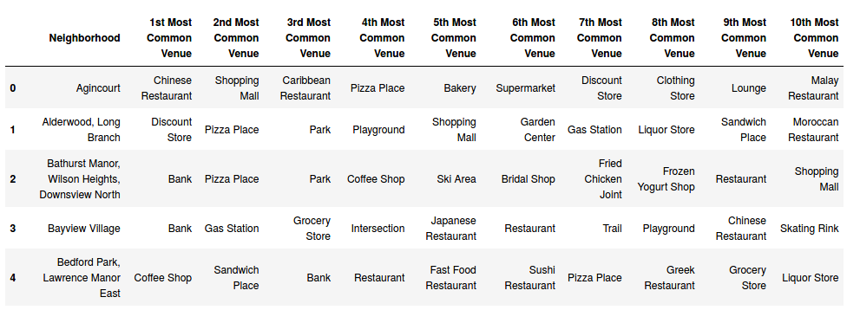
Data (Toronto venues)

Slide 8
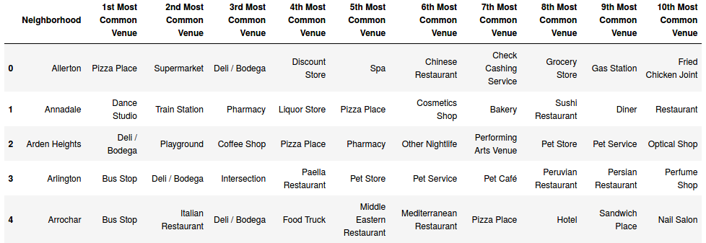
Data (NYC venues)

Slide 9
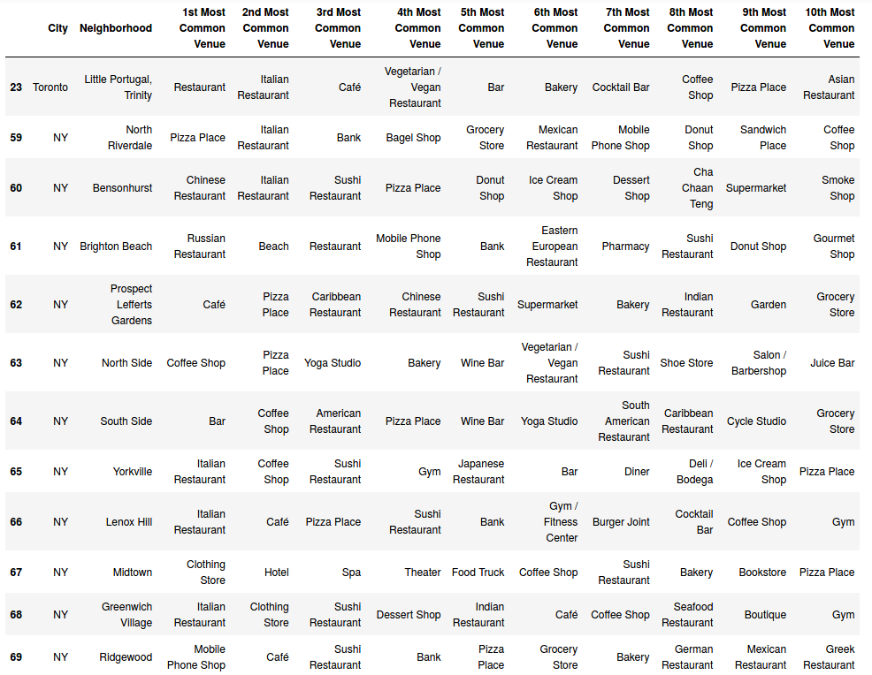
Results

Slide 10
Conclusions
the Toronto neighborhood Little Portugal, Trinity should be selected as a candidate to open a new Sushi restaurant

