Slide 1
Emotion Garden
Project journal
Short notes written after class or after work on the sketch. Each week contains a goal, what happened and one thing I learned.

Slide 2
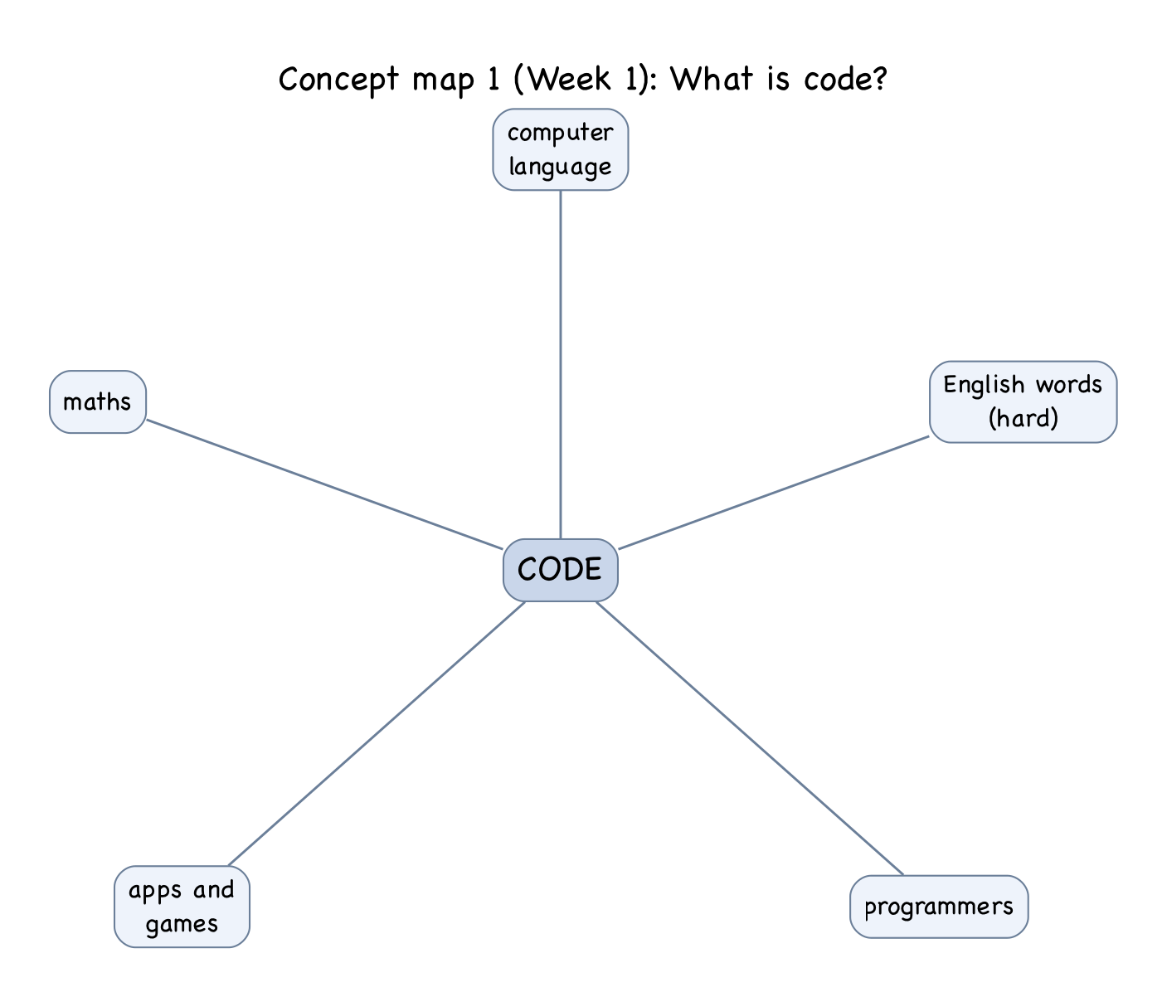
WEEK
1
concept map 1
Goal: tutorial activity: draw a map of "what is code".
What happened: In the centre of the map I wrote CODE and around it I wrote: computer language, English words, Programmers, Apps & Games, Maths. Lines all went out from the centre. I completely ignored art or drawing on the map.
Learnt: I had no idea about code. It was something other people do and had nothing to do with pictures.

Slide 3
WEEK
3
pitch
Goal: pitch my idea.
What happened: Emotion Garden: Four scenes (Happy, Calm, Sad, Angry) made in Processing using colour, nature and movement to represent emotions. My plan was six weeks: research, drawing objects, animation, interaction, testing and improvements.
Learnt: The idea was easy to say but I had no idea how to make even one flower move.

Slide 4
WEEK
7
research, and a lot of searching
Goal: get a window with something in it.
What happened: Before I even wrote a single line of code I spent a good amount of time reading the Processing Reference and watching lots of relevant YouTube videos. I copied the animation code from the Week 4 lecture: setup() runs once, draw() runs again and again. My first sketch was a blue background with a yellow circle to represent the sun.
I wanted the sun at the top, but at (450, 500) the circle was in the bottom centre. In Processing (0, 0) is the top left corner and y gets bigger going down. In the Week 2 graph, like maths, (0, 0) was at the bottom, so I had it upside down in my head.
Learnt: searching gave me code, but I could not tell what each line was doing.

Slide 5
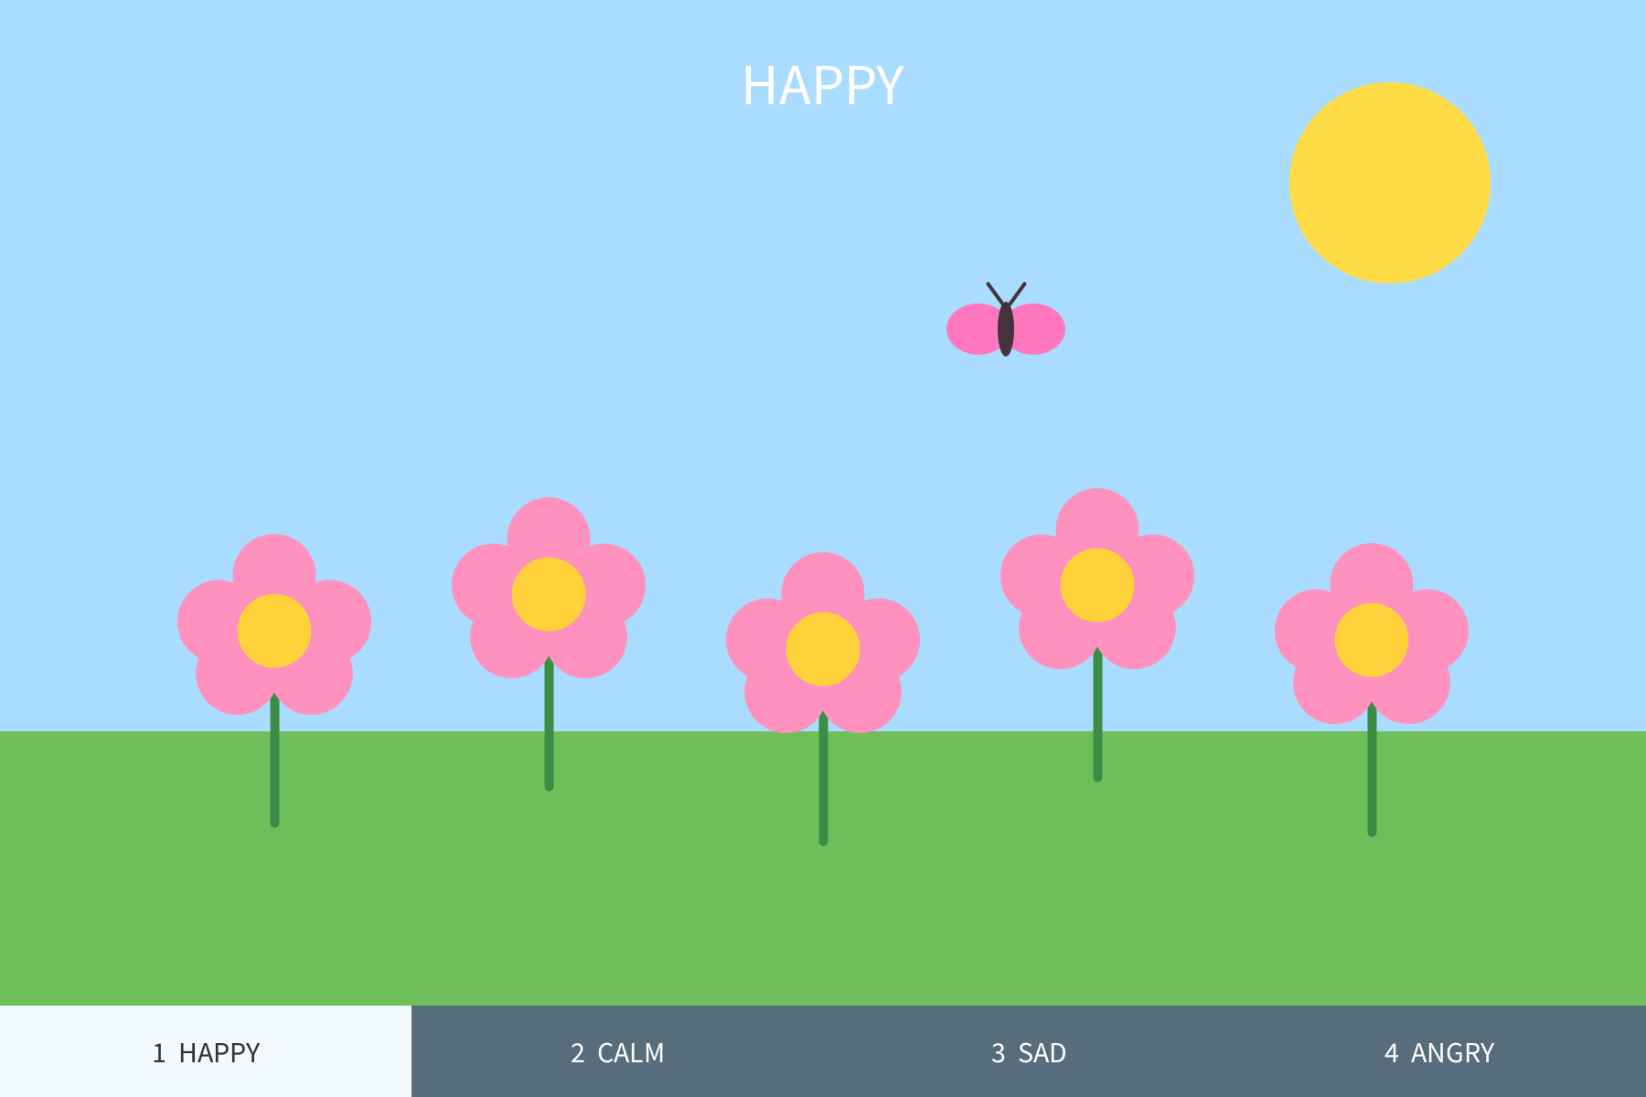
WEEK
8
drawing the objects
Goal: flower, cloud, butterfly, leaf.
What happened: one flower is five pink circles and a yellow circle in the middle. Drawing five circles five times is too long, so I made a function drawHappyFlower(x, y). Now one line draws one flower in a new place:
drawHappyFlower(150, 450);
drawHappyFlower(300, 430);
The same thing for drawing clouds, which are three circles, drawCloud(x, y).
Learnt: x and y in the brackets are what make the same function draw in a different place.

Slide 6
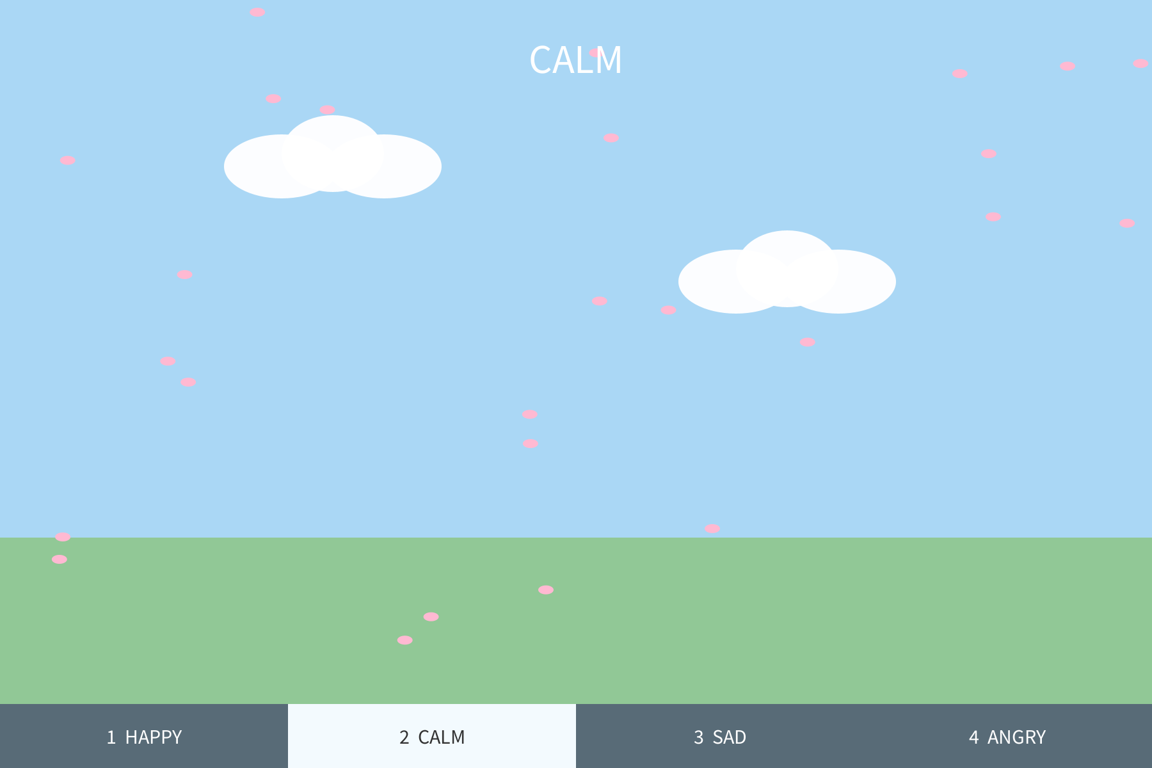
WEEK
9
animation
Goal: make things move.
What happened: The butterfly is made by butterflyX = butterflyX + 2; and it moves right. When it goes off the edge I put it back to -50, so it comes again from the left.
I had trouble with the petals. One needs x, y and speed. To move 35 petals I used three arrays (petalX[i], petalY[i], petalSpeed[i]) and a for loop which moves each petal. Rain and angry leaves are made the same way, but the leaves have an angle. All 80 raindrops are made in setup() with random(), so they do not all start in the same place.
Petals fell like stones. I found sin() in the Processing Reference and added sin(petalY[i] * 0.02) * 0.5 to x. Now they move a little left and right as they fall.
Learnt: an array is like a list of boxes, one for each petal, and i is which box.

Slide 7
WEEK
10
buttons and keys, testing in class
Goal: let people choose the feeling.
What happened: int scene = 1; remembers which scene to display. draw() checks if scene is 1, 2, 3 or 4 and then displays that scene. The 1–4 keys (in keyPressed()) and the buttons at the bottom (in mousePressed()) change the scene. The buttons check where mouseX is to know which scene to change to.
Two classmates tried it in the tutorial.
• Classmate A: "Angry looks like a sunset to me. Is it supposed to be scary?"
• Classmate B: "When I go back to Happy the flowers are already big. I missed the growing part."
Learnt: B was right. bloomSize only grew once. I made changeScene() and when it goes to Happy, I set bloomSize to 0 and butterflyX to -50, so the flowers bloom again every time.

Slide 8
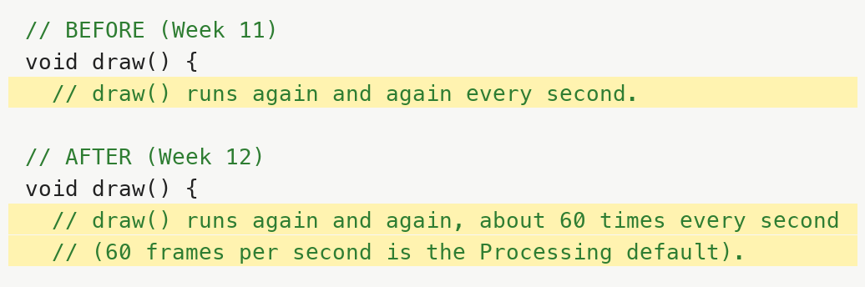
WEEK
11
testing and comments
Goal: test all four scenes and explain my code.
What happened: My tutor said my comments were too short, for example // loop above a for loop. I went through the whole program and wrote what each variable, loop and function does.
Above draw() I wrote "draw() runs again and again every second." I looked at the bloom: +0.01 each time, from 0 to 1, means it should take 100 seconds to bloom, but in my program it takes about 2 seconds. This means draw() does not run once a second. The Week 4 slide says animations run 30–60 times per second. Processing runs 60 times per second if nothing stops it. So the butterfly moves +2 each frame, which is 120 pixels per second.
Learnt: My comment was wrong but the program still worked. Making the comment was what showed me I did not understand it.
About classmate A, I kept red for angry, and A is right that orange suns and red skies also look like a sunset. So the colour does not carry the feeling alone.

Slide 9
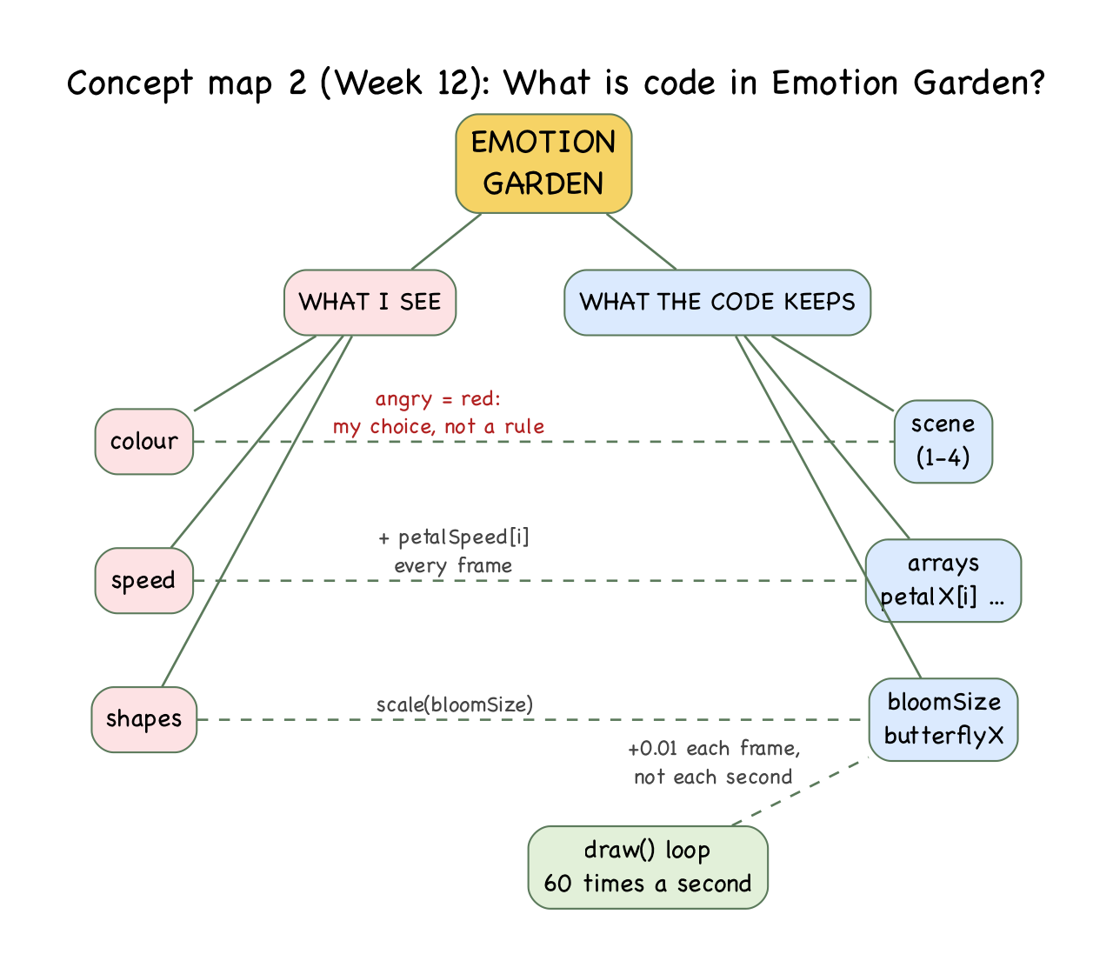
WEEK
12
concept map 2
Goal: finish, second concept map, GitHub.
What happened: fixed the draw() comment. Put the sketch in a folder with the same name (EmotionGarden/EmotionGarden.pde) because Processing will not open it otherwise. Wrote the README with instructions on how to run it.
Concept map 2 has EMOTION GARDEN at the top, with two sides: what I see and what the code keeps. What I see includes colour, speed, and shape. The code keeps scene, arrays, bloomSize, and butterflyX. At the bottom is the draw() loop which happens 60 times a second. Dashed lines show connections such as speed -> arrays: "+ petalSpeed[i] every frame", and colour -> scene: "angry = red: my choice, not a rule".
Learnt: My first concept map had no art on it. Almost every line of this map goes between art and code.
Still to do: More smooth transitions between scenes, using more than one colour for each feeling, and asking more people what they feel.

