Slide 1

NTD/NTM DATA AUTO FETCH SYSTEM
Task 3: Transportation Data Discovery, Evaluation, Compilation, and Publication

Slide 2
Task 3: Transportation Data Discovery, Evaluation, Compilation, and Publication
USER CASE ANALYSIS
User
Data Collection
Data Compilation
Analyst
Data Analysis
Data Publication
Admin
Data Visualization

Slide 3
NTD/NTM DATA AUTO FETCH APPLICATION ARCHITECTURE
WEB UI
Django (MVT)/Python/JavaScript/HTML/etc.
Data Collection
Data Compilation
Data Analysis
Data Publication
Data Visualization
Public Web Server
Data Model
Data View
ArcGIS JavaScript API
ArcGIS Server
Tableau Server
Staging SQLite/MongoDB
ETL
Prod DB Server /GeoDB

Slide 4
Data Flow Logic
DATA COLLECTION
DATA COMPILATION
DATA ANALYSIS
DATA PUBLICATION
Export to Other Formats or Provide DB Connections to Other Software (ArcGIS, Tableau etc.) to Generate Data Visualization Products (Maps, Charts, etc.) and Reports
Publish GTFS Data and Analytical Results to Public Websites to Allow Users to View or to Download etc.
GTFS Data Web Scraping
GTFS Processing (QA/QC)
Feed Tracking
Name Matching
(Standarzition, ML/NLP)
GTFS Downloading
GTFS Spatial/Table Builds
GTFS Uploading to DB
Save Processed Results to GeoDB or DB
DATA VISUALIZATION

Slide 5
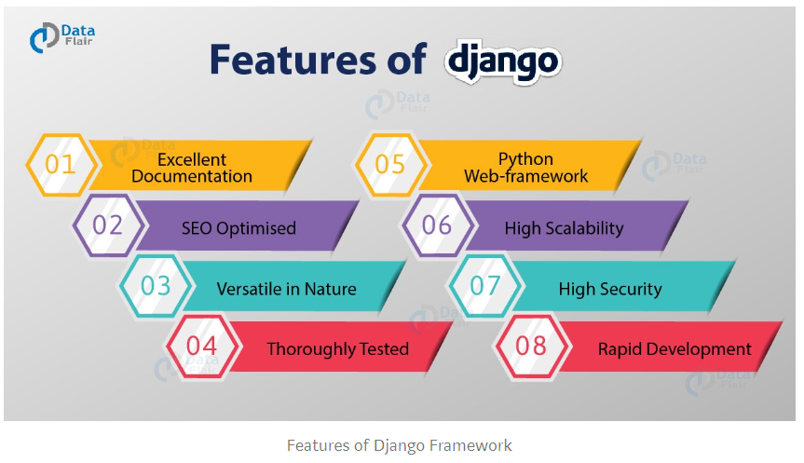
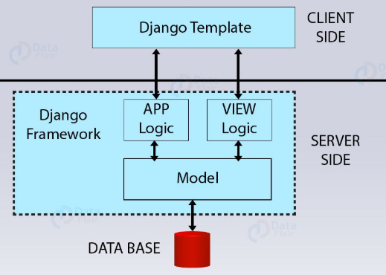
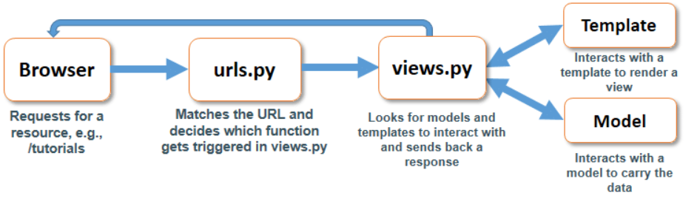
Django MVT Framework

Slide 6
Dev Environments
PyCharm (IDE, 2019.3.1)
Python (3.7)
Django (2.1)
SQLite3 (3.27.2)
MongoDB (1.19.12)
ML Packages for Python (Mahout with Python API)
NLP Package for Python (Natural language toolkit (NLTK))
JavaScript (datatable JQuery etc.)
CSS
HTML
Jupyter Notebook (5.7.8)
ArcGIS Server
ArcGIS Desktop
Tableau Desktop and Server
SQL DB Server
GitHub

Slide 7
Runtime Architecture
Client : Web Bowsers (Chrome, FF, IE, etc.)
App: Django (2.1), Python (3.7), Beautifulsoup, Mahout with Python API, NLTK, JavaScript, CSS, HTML, JavaScript API for ArcGIS, ArcPy, datatable, etc.
Servers: ArcGIS server (10.7), Tableau
Database: SQLit3 (3.27.2), MongoDB (1.19.12), SQL (GeoDB), etc.

Slide 8
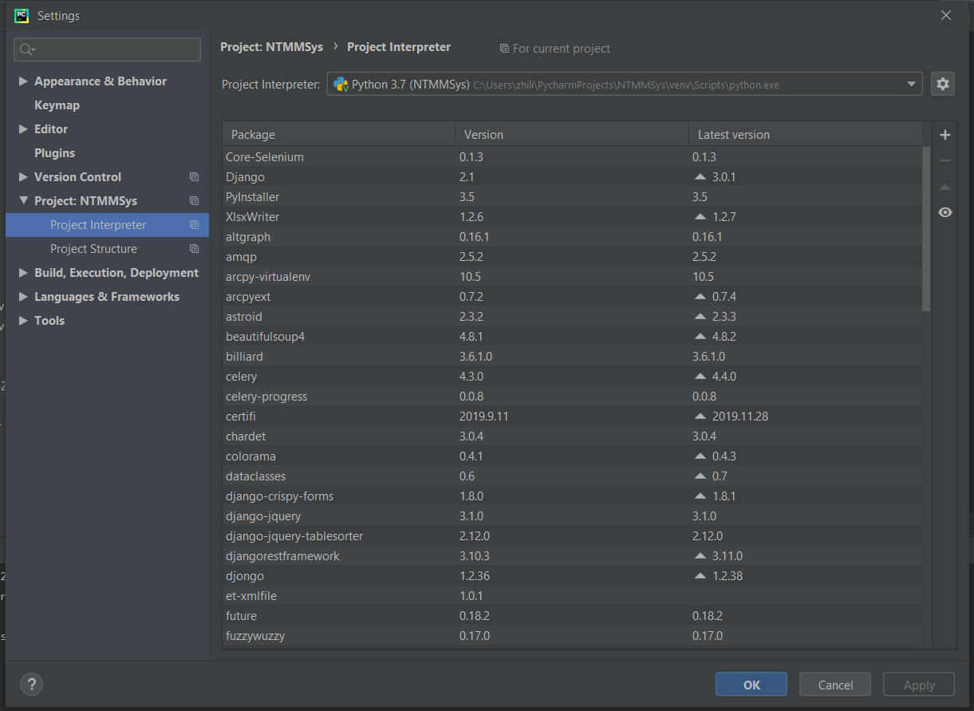
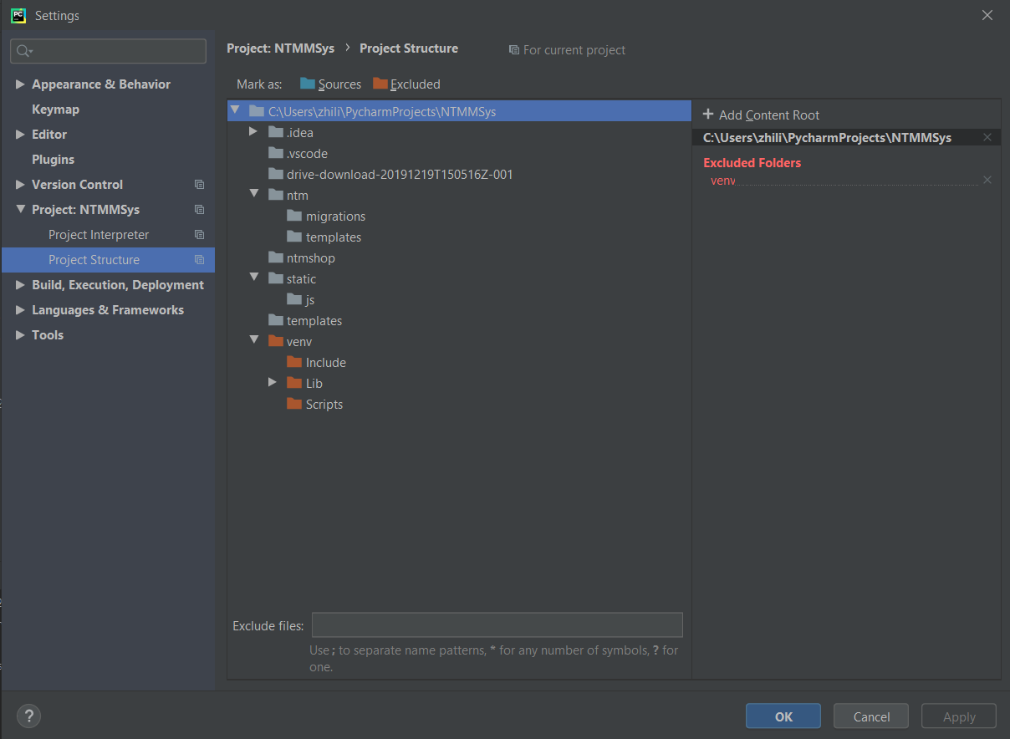
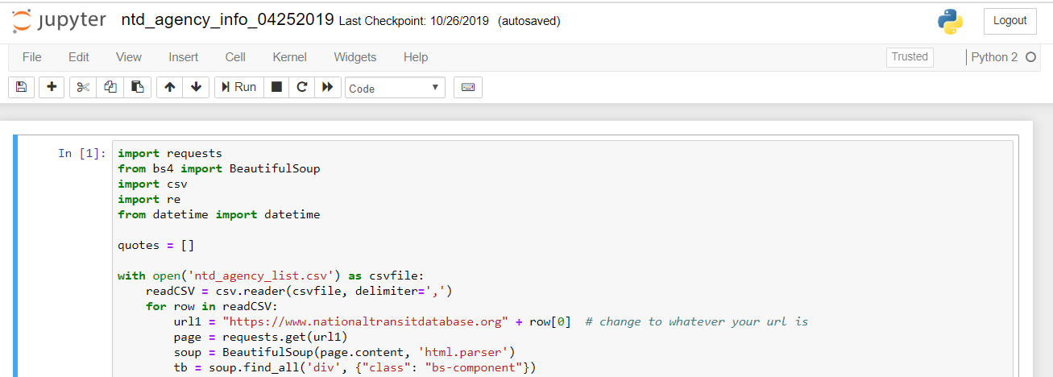
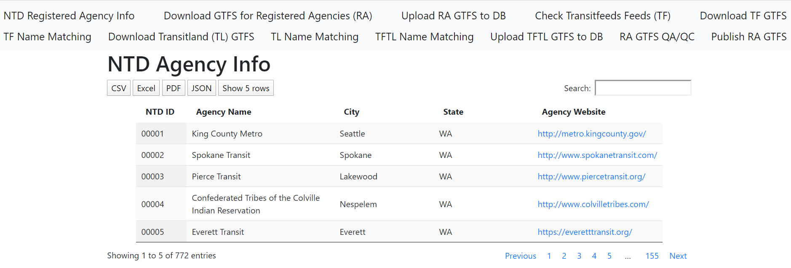
Dev Environments (screenshots)

Slide 9
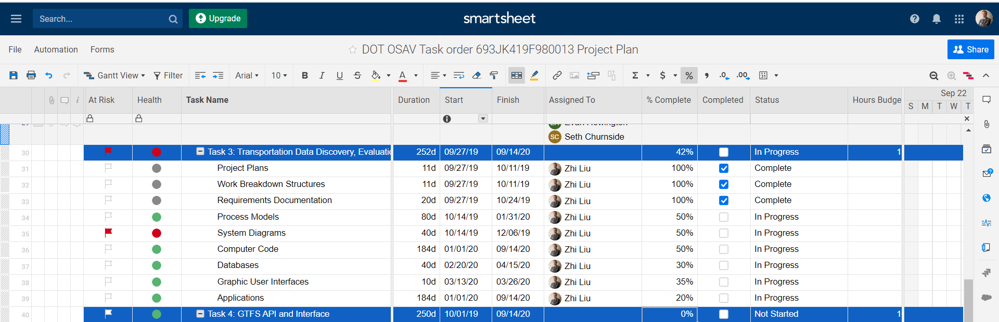
Requirements Traceability Matrix (RTM)
Task Plan in Smartsheet

Slide 10
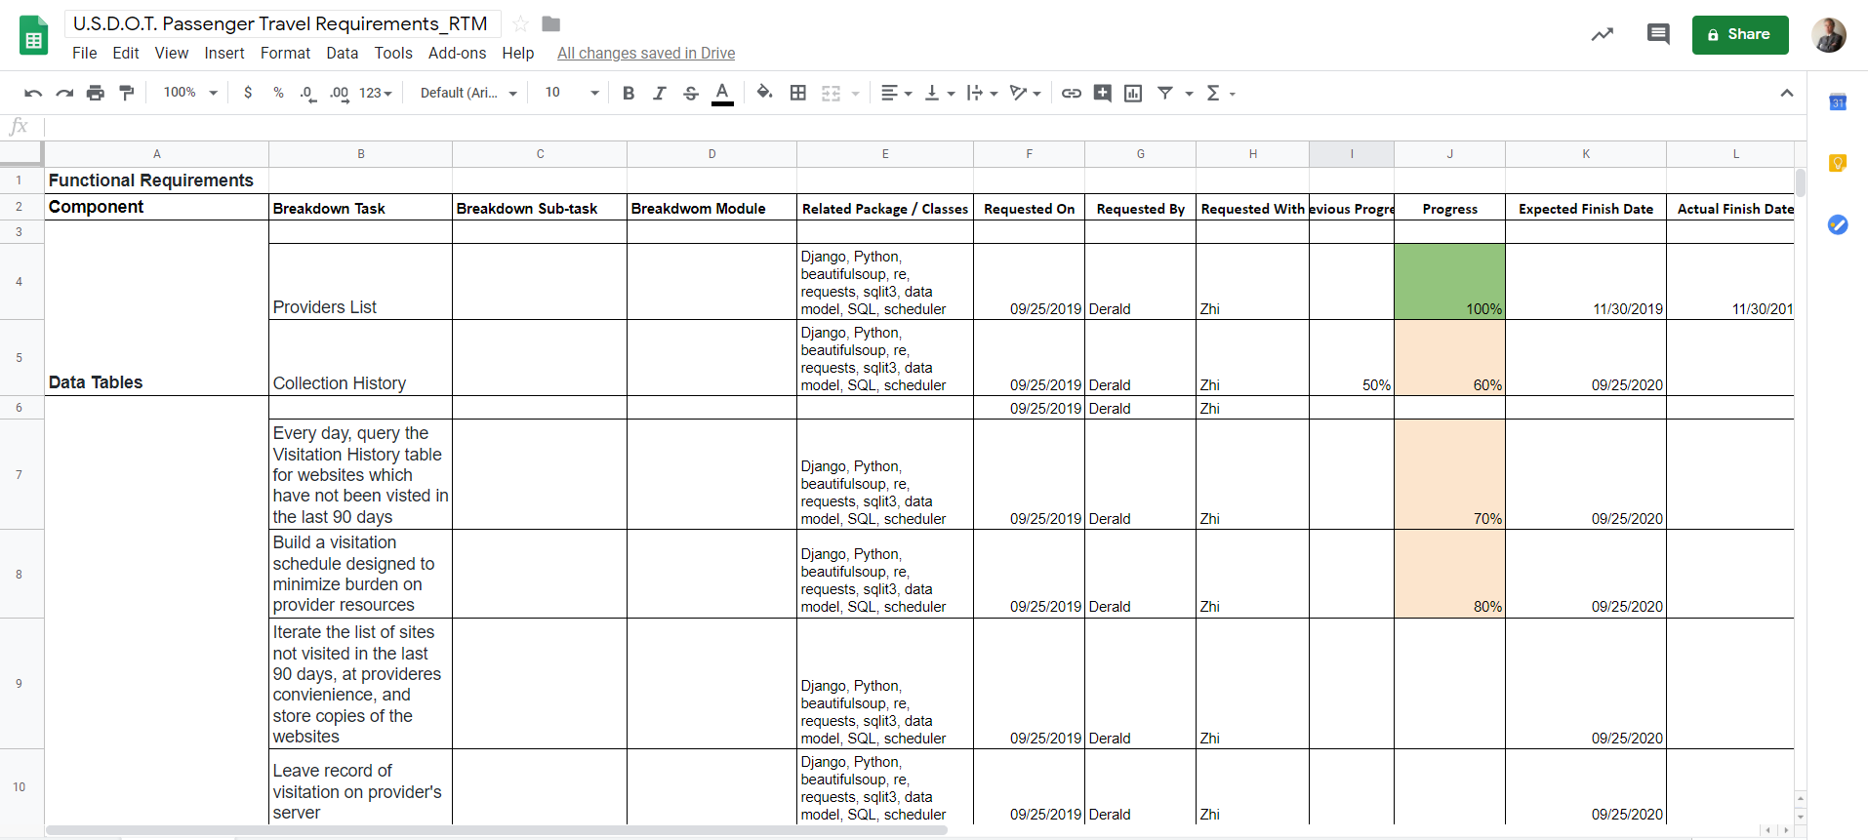
Requirements Traceability Matrix (RTM)
Task Breakdown Progress Tracking Sheet

Slide 11
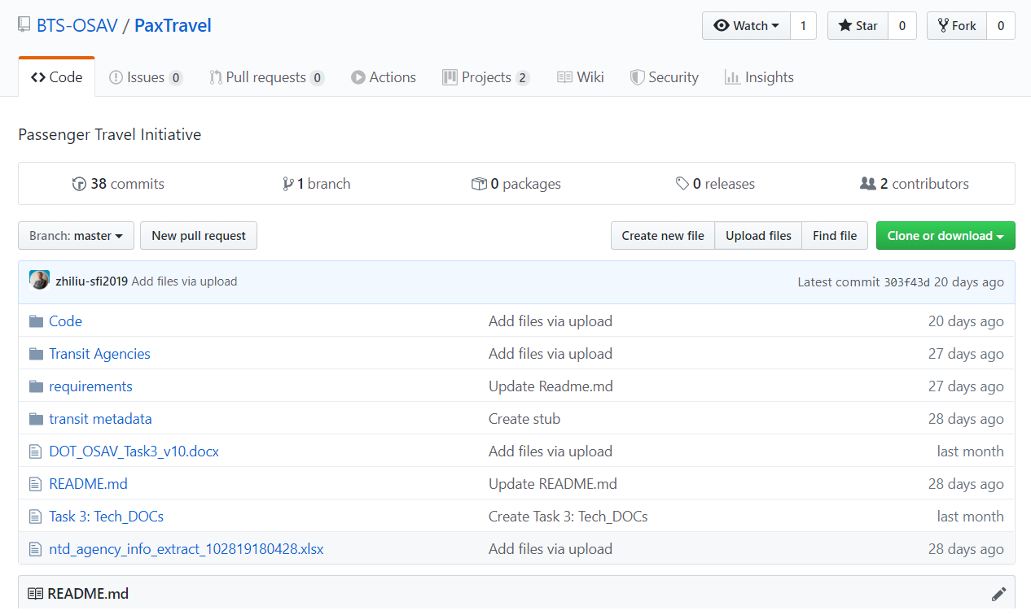
Technical Requirements Document (TRD)
PaxTravel GitHub (code, DOCs etc.)

Slide 12
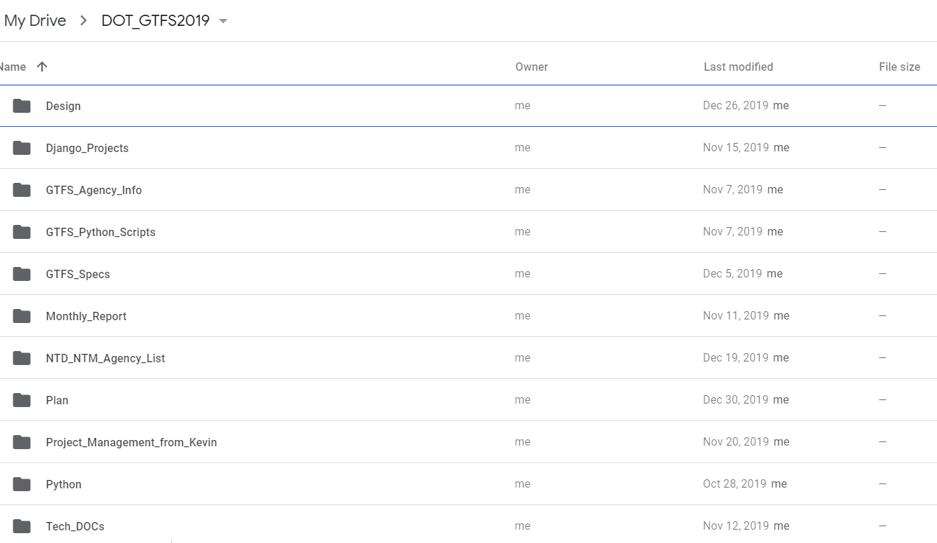
Technical Requirements Document (TRD)
Task DOCs in Google Drive

Slide 13
Demo and Questions

