Slide 1
ES简介
马可阳

Slide 2
ES practices in JD
60 clusters
15T * 2
Many use cases
Online Document store with aggs
Offline analysis with aggs

Slide 3
Agenda
Inside cluster
Inside ES index
How index performed
How search & aggregation performed
Things need attention

Slide 4
Can VS can not
Can
Search engine for TB data
Database for TB data
Cat not
Real time
Transaction
PB data
100% reliability

Slide 5
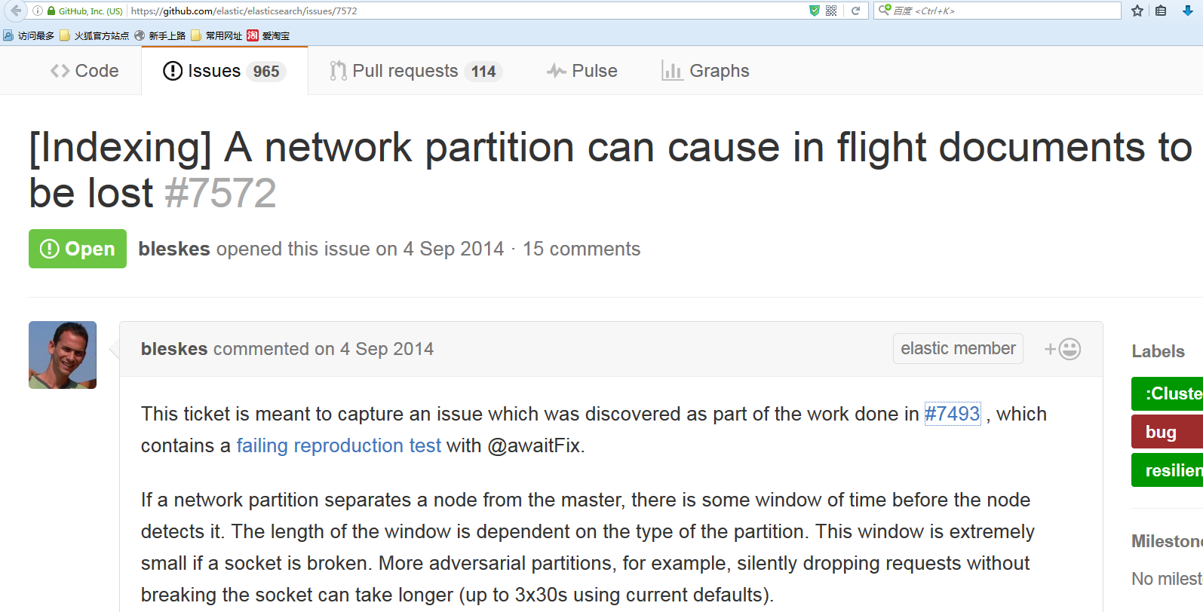

Slide 6
Resiliency
https://www.elastic.co/guide/en/elasticsearch/resiliency/current/index.html
https://github.com/elastic/elasticsearch/labels/resiliency

Slide 7
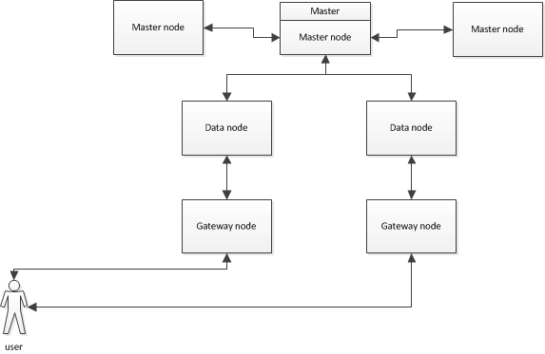
Es cluster

Slide 8
Cluster roles
Master node
Cluster state management
version
routingtable
nodes
Metadata
Settings
Indices
index
version
state
aliases
settings
mappings
customs
totalNumOfShards
requireFilters
includeFilters
excludeFilters
templates
blocks
customs
clusterName
routingNodes
settingsFilter
master_node
status
Master operation
Mapping/template/alias/index/repository/snapshot
etc

Slide 9
Cluster roles
Data node
Index
Search/Agg
Gateway node
Coordinator
Tribe node

Slide 10
Inside ES data
Elasticsearch index/Type
Shard/replica
Lucene index

Slide 11
Elasticsearch index/type
Table VS index
Table VS type
field1:int | field2:char(255) | … | fieldN:_blob | _source | _all | _type | …
X1 | X2 | X… | XN | X | X | X | X…
Y1 | Y2 | Y… | YN | Y | Y | Y | Y…
Z1 | Z2 | Z… | ZN | Z | Z | Z | Z…

Slide 12
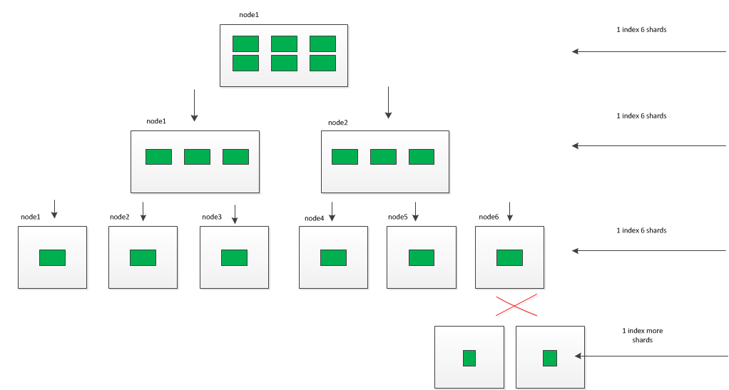
Static sharding, dynamic replicaing

Slide 13

Shard problem
Don’t bother to much
Better practice:
alias

Slide 14
Lucene index VS database data struture
B+tree VS invert index
Logical table VS stored fields

Slide 15
Inverted index
Doc1:Apple iPhone 6s Plus (A1699) 64G.
Doc2:三星 Galaxy S7 edge（G9350）32G版.
Doc3:华为 Mate 8 3GB+32GB版 月光银.
Analyzer1:{apple iPhone 6s plus a1699 64g}
Analyzer2: {三星 galaxy s7 edge g9350 32g 版}
Analyzer3:{mate 8 3gb 32gb 版 月光银}

Slide 16
Inverted index
Invert: merge: sort: freq:
term | documents
apple | d1
iPhone | d1
6s | d1
plus | d1
a1699 | d1
64g | d1
三星 | d2
galaxy | d2
s7 | d2
edge | d2
g9350 | d2
32g | d2
版 | d2
mate | d3
8 | d3
3gb | d3
32gb | d3
版 | d3
月光银 | d3
term | documents
apple | d1
iPhone | d1
6s | d1
plus | d1
a1699 | d1
64g | d1
三星 | d2
galaxy | d2
s7 | d2
edge | d2
g9350 | d2
32g | d2
版 | d2,d3
mate | d3
8 | d3
3gb | d3
32gb | d3
月光银 | d3
term | documents
32g | d2
32gb | d3
3gb | d3
64g | d1
6s | d1
8 | d3
a1699 | d1
apple | d1
edge | d2
g9350 | d2
galaxy | d2
iPhone | d1
mate | d3
plus | d1
s7 | d2
三星 | d2
月光银 | d3
版 | d2,d3
term | freq | documents
32g | 1 | d2
32gb | 1 | d3
3gb | 1 | d3
64g | 1 | d1
6s | 1 | d1
8 | 1 | d3
a1699 | 1 | d1
apple | 1 | d1
edge | 1 | d2
g9350 | 1 | d2
galaxy | 1 | d2
iPhone | 1 | d1
mate | 1 | d3
plus | 1 | d1
s7 | 1 | d2
三星 | 1 | d2
月光银 | 1 | d3
版 | 2 | d2,d3

Slide 17
Stored fields
1:_source={“content”:” Apple iPhone 6s Plus (A1699) 64G.”}
2:_source={“content”:”三星 Galaxy S7 edge（G9350）32G版.”}
3:_source={“content”:”华为 Mate 8 3GB+32GB版 月光银.”}

Slide 18
Fielddata & doc_value
Doc1:Apple iPhone 6s Plus (A1699) 64G. CC: 55560
Doc2:Doc2:三星 Galaxy S7 edge（G9350）32G版.CC:14336
Doc3:华为 Mate 8 3GB+32GB版 月光银. CC:11967
Doc1: 55560
Doc2:14336
Doc3:11967
In memory, fielddata
Doc1: 55560
Doc2:14336
Doc3:11967
In disk, doc_value

Slide 19
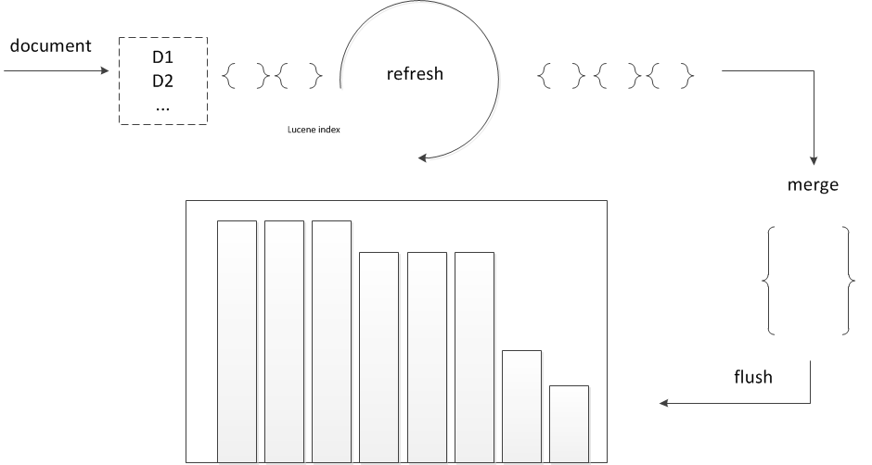
Refresh & flush & merge

Slide 20
Memory cost
For fast searching, Lucene loads certain data structures entirely into RAM:
Term dictionary
Deleted docs file

Slide 21
Lucene query
Term query/filter
Boolean query/filter
Range query/filter
Prefix(suffix) query/filter
Fuzzy query

Slide 22
Index a document
curl -XPUT 'http://localhost:9200/twitter/tweet/1?op_type=create &consistency=all&routing=kimchy&refresh=true' -d '{
"user" : "kimchy",
"post_date" : "2009-11-15T14:12:12",
"message" : "trying out Elasticsearch"
}'

Slide 23
Index parameters
op_type
routing
Consistency
Refresh
timeout

Slide 24
Put a mapping
"mappings": {
"storeCommentTime": {
"properties": {
"updatePin": {
"type": "string",
"store" : true,
"index": "not_analyzed“
},
"yn": {
"type": " string ",
"store" : true,
"index": "analyzed“
}
}
}
}

Slide 25
Data types and parameters
String type:
index
analyzer
store
doc_values
Fielddata
Numeric
Datetime
…

Slide 26
Analyzer
Standard
Standard Analyzer
Simple Analyzer
Whitespace Analyzer
Stop Analyzer
Keyword Analyzer
Pattern Analyzer
Language Analyzers
Snowball Analyzer
Extended
Smartcn
Ik
…

Slide 27
Chinese analyzer
Deal it by yourself
“content“:[termA,termB…]
“Content”:”termA termB …”
“content": {
"type": "string",
"store" : true,
"index": "analyzed“
“analyzer”: “Whitespace Analyzer”
},

Slide 28
Put a template
_template/o2ocomment_20151008
{
"template" : "o2ocomment*",
"settings" : {
"number_of_shards" : 5,
"number_of_replicas" : 1
},
"mappings": {
...
}
}

Slide 29
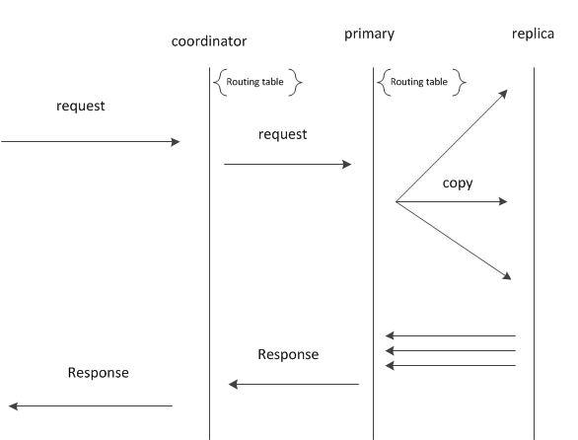
Index process

Slide 30
Search & aggregration
POST /books/book/_search
query:
filtered:
filter:
term:
tag: python
query:
multi_match:
query: Holy Grail
fields: [title^5, description]
aggregations:
author_id:
terms:
field: author_id
size: 10
shard_size: 100
size: 10

Slide 31
Query phase
TermFilter:
tag:python
BooleanQuery
Should
Termquery:
title:holy
Title: grail
Description: holy
Description: grail
Aggregration:author_id

Slide 32
Fetch phase
Merge
Sort
Drop
fetch

Slide 33
Things need attention
Schemaless VS careful schema
Fielddata VS doc_value
Deep pagination search VS iteration
One big index VS many small indices
1000 shards VS Small shards
Multi dimension VS reducing dimension agg
update heavily VS daily rolling

Slide 34
Q & A
中英文带数字的全文搜索
ES的三种客户端使用感受
深度分页
ES的数据量跟响应时间之间的实战经验与关系
ES批量添加数据，添加完立马执行删除操作，会出现Es中添加数据操作还没执行完，就开始删除了

