Slide 1
Music Library System
Yuan Ma

Slide 2
Overview
Implement a music library site using AMP(Apache, MySQL, PHP ) Stack
Data source: iTunes Library
User can edit existing music information
User can add new information record
Implementation details will be introduced later

Slide 3
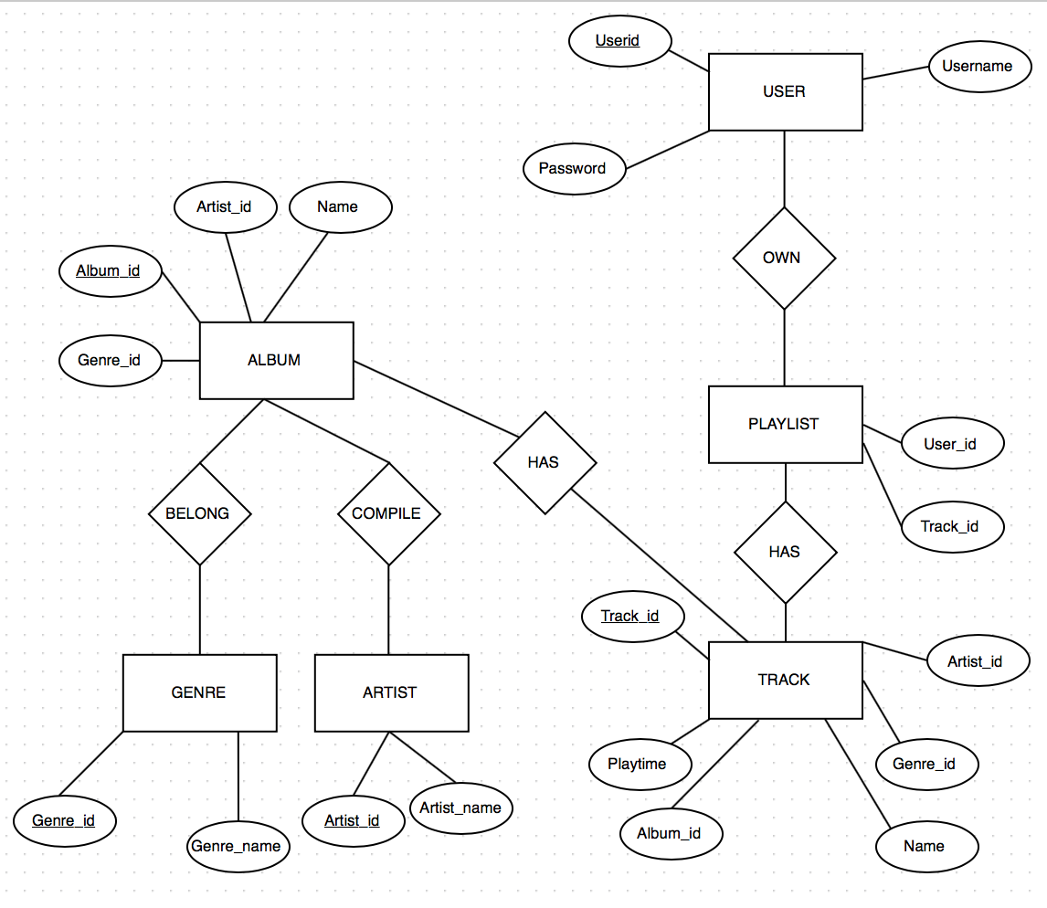
ER-diagram

Slide 4
Schemas
Artist(id, name)
Album(id, name, artist_name, genre_id)
Track(id, name, album_id, artist_id, play_time, genre_id)
Genres(id, name)
User(id, username, password)
Playlist(user_id, track_id)

Slide 5
Things I finished
New user registration
Logging in/ Logging
Query certain keywords from the field of Album, Artist, or Track
Add new artist/album/track
Edit existing track information
Create personal music list
Add/Delete tracks in music list

Slide 6
Things I didn’t do as expected
Only running in localhost
Didn’t get data from Spotify or other sources
Didn’t provide registration and login service Using Facebook or Twitter
Only support one music list right now
Didn’t implement the part as Administrator

