Slide 1
The root cause of all security failures
Roger L. Costello
March 29, 2018

Slide 2
I think I understand the root cause of all security failures
It all boils down to sets, binary relations, and whether binary relations have or doesn’t have a certain property.

Slide 3
The following graphic depicts two customers of an online store and their passwords:
Alice
knows
Password0
Eve
knows
Password1
Password0 is known only to Alice. Password1 is known only to Eve. This represents a secure system.

Slide 4
Password0 is known by both Alice and Eve:
Alice
knows
Password0
knows
Eve
Password1
knows
This represents a system that is not secure because Eve knows Alice’s password.

Slide 5
There is an analogous set of graphics for hotel guest keys and rooms

Slide 6
Room0 can only be unlocked by Guest0’s key and Room1 can only be unlocked by Guest1’s key:
Guest0
key
unlocks
Room0
Guest1
key
unlocks
Room1
This represents a secure system.

Slide 7
Room0 can be unlocked by both Guest0’s key and Guest1’s key:
Guest0
key
unlocks
Room0
unlocks
Guest1
key
Room1
unlocks
This represents a system that is not secure.

Slide 8
A pattern has emerged
Take two sets and a binary relation between the two sets.
For binary relations where each value in the second set (the range) is mapped to by at most one value from the first set (the domain), then the system is secure.
For binary relations where a value in the range is mapped to by more than one value from the domain, then the system is not secure.

Slide 9
Summary
set 1
value 1
relation
set 2
value 1
set 1
value 1
relation
set 2
value 1
relation
set 1
value 2
relation
set 2
value 2
set 1
value 2
set 2
value 2
relation
secure
not secure

Slide 10
Binary relation
The examples shown on the previous slides show binary relations:
Online store: a binary relation “knows” between customer and password, e.g., Eve knows password0
Hotel: a binary relation “unlocks” between guest and room access, e.g., guest0 unlocks room0

Slide 11
Binary relations are well-studied
Mathematicians and computer scientists have studied sets and binary relations extensively.
Certain properties arise over and over in binary relations, and have been given names.
The property that binary relations must have for a system to be secure is the injective property.
The injective property is the most important property for security.

Slide 12
Here is the injective property:
Injective
Not Injective
1
2
1
2
3
4
3
4
5
A binary relation is injective if each value in the range is mapped to by at most one value in the domain.

Slide 13
Injective
1
2
At most one value is mapped to each of these
3
4
5

Slide 14
Injective means secure. Not injective means not secure.
Injective
Not Injective
1
2
1
2
3
4
3
4
5
Binary relations with the injective property are secure
Binary relations without the injective property are not secure

Slide 15
Security and the injective set property
So, the entire issue of security boils down to this:
There are two sets
There is a binary relationship between the two sets
If the relation is injective, then you have a secure system
If the relation is not injective, then you have a system that is not secure

Slide 16
So simple, why so many security breaches?
Why are there so many security breaches, given how simple the issue is?

Slide 17
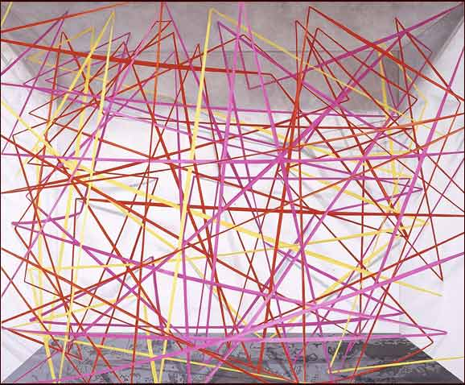
Because systems are built like this:
A
B
There is a binary relation between A and B. Is it injective?

Slide 18
Too much complexity for the human brain
A and B have too many interactions with too many other sets to know whether the binary relation is injective or not.
What to do?

Slide 19
Need a tool
We need a tool that, when given a tangled web of connections as shown above, can analyze the entire space of connections and determine whether the binary relation is injective.
That’s what Alloy gives us.
Want security in your system? Then use Alloy to check for the presence (or absence) of the injective property.

Slide 20
Alloy implementation of the injective property
// A binary relation that maps at most one atom
// to each atom is injective.
pred injective (A: set univ, R: univ->univ) {
no disj x, y, z: A | ((y -> x) in R) and ((z -> x) in R)
}

