Slide 1
Object model versus Event model
Roger L. Costello
March 26, 2018

Slide 2
Remember the desktop model
Desktop0
Desktop1
Desktop2
init
cut
paste
icon1
icon3
icon2
icon3
icon3
paste
Desktop4
Desktop3
icon1
cut
icon0
icon1
icon3
icon3

Slide 3
init, cut, and paste are “operations”
Desktop0
Desktop1
Desktop2
init
cut
paste
icon1
icon3
icon2
icon3
icon3
paste
Desktop4
Desktop3
icon1
cut
icon0
icon1
icon3
icon3

Slide 4
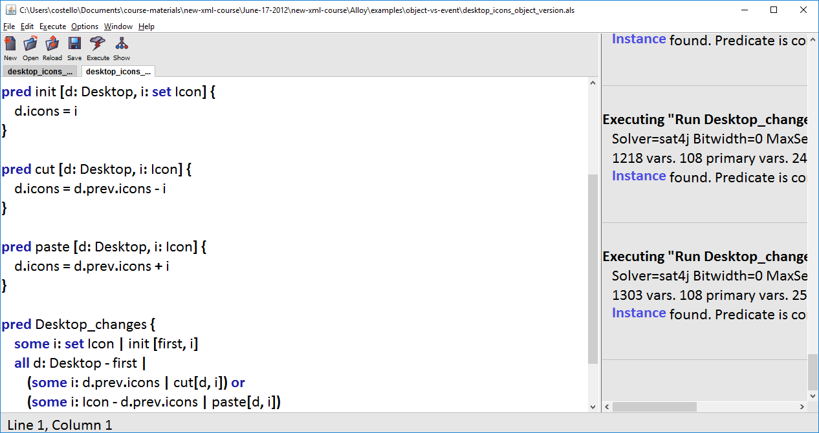
I reimplemented the model, using pred (instead of fact):

Slide 5
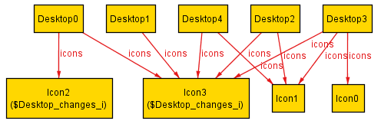
Here’s an instance, displayed with the Alloy visualizer (VIZ):

Slide 6
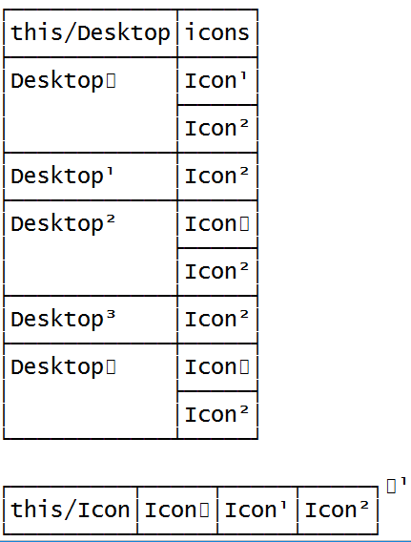
Table view:

Slide 7
Where are the operations? What operation occurred between Desktop i and Desktop i+1? The absence of a visual display of the operations makes it difficult to understand instances.

Slide 8
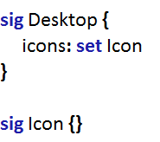
Only signatures are displayed (as boxes), with lines for the fields (relations).

Slide 9
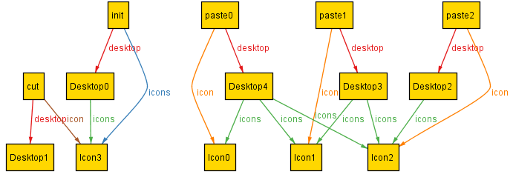
For Desktop0 the init operation was performed, Icon3 was placed on the desktop

Slide 10
For Desktop1 the cut operation was performed, Icon3 was removed from the desktop

Slide 11
For Desktop2 the paste operation was performed, Icon2 was added to the desktop

Slide 12
How to see the operations?
The previous slides showed the operations in boxes. How was that accomplished?
Answer: I converted the operations to signatures.

Slide 13
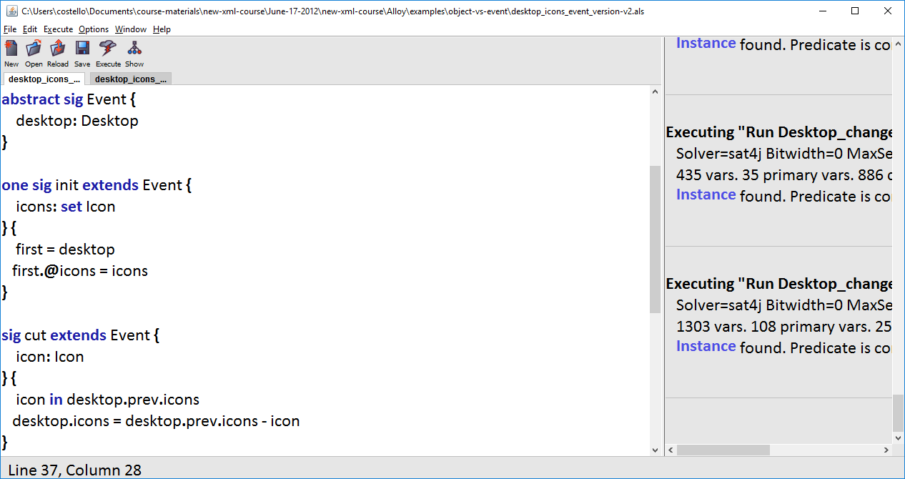
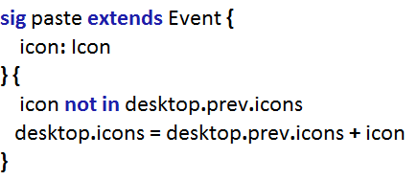
Event-based model:
Event
init
cut
paste

Slide 14
Object Model
Event Model

Slide 15
Object Model
Event Model
Turn predicate into signature. Turn parameters into fields.

Slide 16
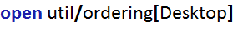
The set of Desktop members are ordered: Desktop0, Desktop1, etc.
There is one member in the set named init. There is a relation, icons, which maps init to a set of Icon. There is a second relation, desktop, which maps icon to a Desktop.
The first desktop, Desktop0, is the desktop in init. The icons in the first desktop are the icons in init.icons
The reserved symbol @ says “don’t implicitly expand icons”
This is implicitly expanded to init.icons

