Slide 1
Model Land and Seafloor Surfaces using Alloy
Roger L. Costello
May 14, 2018

Slide 2

The material in these slides come from this paper
http://www4.ncsu.edu/~jwb/papers/baugh-scp-2018.pdf

Slide 3
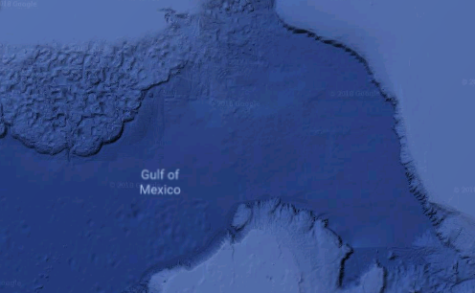
How to model continuous surfaces?
The subject matter of scientific programs often concerns the physical processes that surround us, where space and time are traditionally viewed as being continuous.

Slide 4
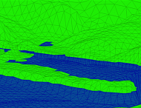
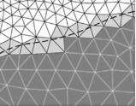
Discretize the continuous surface
Discretize time and space. Decompose land and seafloor surfaces into triangles. The land and seafloor surfaces are represented as a collection of contiguous, non-overlapping triangles. The resulting mesh of triangles and vertices can be thought of as a triangulation of a surface, with every vertice located in a 3-D space. While spatial attributes and physical quantities are important, we separate concerns here and begin with a representation of mesh topology alone—with triangles and vertices as basic components—that can later be embellished with other attributes.

Slide 5
Finite Element Analysis
Finite Element Analysis is a field of study in which you take a continuous thing and decide how to decompose it into a collection of things.
“To solve the problem, it [Finite Element Analysis] subdivides a large problem into smaller, simpler parts that are called finite elements. The simple equations that model these finite elements are then assembled into a larger system of equations that models the entire problem.” [Wikipedia]

Slide 6
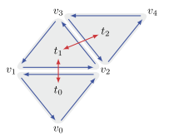
We want the Alloy model to produce instances like this
Obviously, the Alloy Analyzer won’t generate a graphic that looks like this. This is a meaningful interpretation of the instance (i.e., a meaningful interpretation of the sets that the Alloy Analyzer generates).
The red lines show adjacent triangles.

Slide 7
This is called a mesh
Triangle mesh: a set of triangles that are connected by their common edges or corners.

Slide 8
We want a set of meshes
sig Mesh {
…
}

Slide 9
Each mesh has a set of triangles
sig Mesh {
triangles: some Triangle
…
}

Slide 10
sig Mesh {
triangles: some Triangle
…
}
sig Triangle {
…
}

Slide 11
For each mesh, record which triangles are adjacent
sig Mesh {
triangles: some Triangle,
adj: Triangle -> Triangle
}
sig Triangle {
…
}

Slide 12
Each triangle has edges, represented by pairs of vertices
sig Mesh {
triangles: some Triangle,
adj: Triangle -> Triangle
}
sig Triangle {
edges: Vertex -> Vertex
}

Slide 13
sig Mesh {
triangles: some Triangle,
adj: Triangle -> Triangle
}
sig Triangle {
edges: Vertex -> Vertex
}
sig Vertex {}

Slide 14
Mesh m
m.triangles
edges
t₀
t₀
v₀
v₂
t₁
t₀
v₂
v₁
t₂
t₀
v₁
v₀
t₁
v₂
v₃
m.adj
t₁
v₃
v₁
t₀
t₁
t₁
v₁
v₂
t₁
t₀
t₂
v₂
v₄
t₁
t₂
t₂
t₁
t₂
v₄
v₃
t₂
v₃
v₂
sig Mesh {
triangles: some Triangle,
adj: Triangle -> Triangle
}
sig Triangle {
edges: Vertex -> Vertex
}
sig Vertex {}

Slide 15
A brief detour …
The next step is to identify constraints on the signatures.
Prior to that, however, let’s play with the signatures and see how to navigate through them using Alloy expressions.

Slide 16
What triangles is triangle t adjacent to?
t.(m.adj)
t
m.adj
t₀
t₁
t₀
t₁
t₂
t₁
t₀
t₁
t₂
t₂
t₁
Mesh m

Slide 17
Are triangles t’ and t adjacent?
t in m.adj[t’]
m.adj
t'
true
t₁
t₀
t₁
t
t₁
t₀
t₀
t₁
t₂
t₂
t₁
Mesh m

Slide 18
What vertex follows vertex v in triangle t?
edges
t₀
v₀
v₂
t.edges[v]
t
t₀
v₂
v₁
v₁
t₀
v
t₀
v₁
v₀
v₂
t₁
v₂
v₃
t₁
v₃
v₁
Mesh m
t₁
v₁
v₂
t₂
v₂
v₄
t₂
v₄
v₃
t₂
v₃
v₂

Slide 19
What vertices can be reached from vertex v in triangle t?
edges
t₀
v₀
v₂
v.^(t.edges)
v₂
t
t₀
t₀
v₂
v₁
v₁
v
t₀
v₁
v₀
v₀
v₂
t₁
v₂
v₃
t₁
v₃
v₁
Mesh m
t₁
v₁
v₂
t₂
v₂
v₄
t₂
v₄
v₃
t₂
v₃
v₂

Slide 20
What are the vertices in triangle t?
edges
t₀
v₀
v₂
dom[t.edges]
v₀
t
t₀
t₀
v₂
v₁
v₂
t₀
v₁
v₀
dom (domain) returns the first column in a binary relation.
v₁
t₁
v₂
v₃
t₁
v₃
v₁
Mesh m
t₁
v₁
v₂
t₂
v₂
v₄
t₂
v₄
v₃
t₂
v₃
v₂

Slide 21
Is triangle t a ring (cyclic)?
edges
t₀
v₀
v₂
all v: dom[t.edges] |
one v.(t.edges) and
dom[t.edges] in v.^(t.edges)
t
t₀
t₀
v₂
v₁
t₀
v₁
v₀
true
t₁
v₂
v₃
“Vertex v in triangle t has exactly one successor vertex and all of t’s vertices can be reached from v. Ditto for all vertices in t.”
t₁
v₃
v₁
Mesh m
t₁
v₁
v₂
t₂
v₂
v₄
t₂
v₄
v₃
t₂
v₃
v₂

Slide 22
What are the edges of triangles t?
edges
t₀
v₀
v₂
v₀
v₂
t
t.edges
t₀
v₂
v₁
v₂
v₁
t₀
t₀
v₁
v₀
v₁
v₀
t₁
v₂
v₃
t₁
v₃
v₁
Mesh m
t₁
v₁
v₂
t₂
v₂
v₄
t₂
v₄
v₃
t₂
v₃
v₂

Slide 23
Does triangle t have 3 edges?
edges
t₀
v₀
v₂
#t.edges = 3
t
t₀
t₀
v₂
v₁
true
t₀
v₁
v₀
t₁
v₂
v₃
t₁
v₃
v₁
Mesh m
t₁
v₁
v₂
t₂
v₂
v₄
t₂
v₄
v₃
t₂
v₃
v₂

Slide 24
What edge does triangle t and t’ have in common?
edges
t₀
v₀
v₂
~(t.edges) & t’.edges
t
v₁
v₂
t₀
t₀
v₂
v₁
t'
t₀
v₁
v₀
t₁
t₁
v₂
v₃
t₁
v₃
v₁
Mesh m
t₁
v₁
v₂
t₂
v₂
v₄
t₂
v₄
v₃
t₂
v₃
v₂

Slide 25
Are triangles t and t’ adjacent?
edges
t₀
v₀
v₂
t in m.adj[t’] iff one ~(t.edges) & t’.edges
t
t₀
v₂
v₁
true
t₀
t'
t₀
v₁
v₀
t₁
t₁
v₂
v₃
m.adj
t₁
v₃
v₁
t₀
t₁
Mesh m
t₁
v₁
v₂
t₁
t₀
t₂
v₂
v₄
t₁
t₂
t₂
v₄
v₃
t₂
t₁
t₂
v₃
v₂

Slide 26
What are the internal edges?
edges
sig Mesh {
triangles: some Triangle,
adj: Triangle -> Triangle
}
t₀
v₀
v₂
~(m.triangles.edges) & m.triangles.edges
t₀
v₂
v₁
sig Triangle {
edges: Vertex -> Vertex
}
t₀
v₁
v₀
v₂
v₁
t₁
v₂
v₃
sig Vertex {}
v₁
v₂
t₁
v₃
v₁
v₂
v₃
Mesh m
t₁
v₁
v₂
v₃
v₂
t₂
v₂
v₄
t₂
v₄
v₃
t₂
v₃
v₂

Slide 27
In the Alloy model to the right, Test.t maps A to B, B to A, and C to A.
The following expression takes the intersection of Test.t with its transpose:
Test.t & ~(Test.t)
The result is: A->B + B->A
Here’s why.
The expression produces this:
{A->B, B->A, C->A} & {B->A, A->B, A->C}
Clearly, that yields: {A-B, B->A}
one sig Test {
t: Letter -> Letter
}
enum Letter { A, B, C }
fact { Test.t = A->B + B->A + C->A }
run {}

Slide 28
How many undirected edges?
Treat these (internal) edges as one each.

Slide 29
How many undirected edges? (cont.)
The number of undirected edges is the number of edges minus the result of dividing the number of internal edges by 2.

Slide 30
How many undirected edges? (concluded)
Mesh m
minus[#m.triangles.edges, div[#(~(m.triangles.edges) & m.triangles.edges), 2]]

Slide 31
Okay, back to building the model
We just saw some ways to navigate through the signatures.
Now let’s see what constraints are needed to have meaningful instances.

Slide 32
Other instances produced by Alloy may satisfy these signatures …
sig Mesh {
triangles: some Triangle,
adj: Triangle -> Triangle
}
sig Triangle {
edges: Vertex -> Vertex
}
sig Vertex {}
… without having a valid interpretation, so we need to apply constraints.

Slide 33
What constraints do we want each mesh to satisfy?

Slide 34
Constraint 1: Every triangle must have three (directed) edges
Triangle t₀ must have 3 directed edges

Slide 35
Alloy code for Constraint 1
// Every triangle must have three (directed) edges
fact { all t: Triangle | #t.edges = 3 }
sig Mesh {
triangles: some Triangle,
adj: Triangle -> Triangle
}
sig Triangle {
edges: Vertex -> Vertex
}
sig Vertex {}

Slide 36
Constraint 2: The adjacency relation m.adj is defined over the mesh’s set of triangles
sig Mesh {
triangles: some Triangle,
adj: Triangle -> Triangle
}
These must come from this

Slide 37
Alloy code for Constraint 2
// The adjacency relation m.adj is defined over its
// own set of triangles
fact { all m: Mesh | dom[m.adj] + ran[m.adj] in m.triangles }
dom (domain) returns the first column in a binary relation.
ran (range) returns the second column in a binary relation.
They are functions (fun), provided by util/relations.
sig Mesh {
triangles: some Triangle,
adj: Triangle -> Triangle
}
sig Triangle {
edges: Vertex -> Vertex
}
sig Vertex {}

Slide 38
Constraint 3: Each triangle’s edge set forms a ring
Triangle t₀’s edges must form a ring

Slide 39
Alloy code for Constraint 3:
// Each triangle’s edge set forms a ring
fact { all t: Triangle | ring[t.edges] }
sig Mesh {
triangles: some Triangle,
adj: Triangle -> Triangle
}
sig Triangle {
edges: Vertex -> Vertex
}
sig Vertex {}

Slide 40
Alloy code for Constraint 3 (cont.):
// Each triangle’s edge set forms a ring
fact { all t: Triangle | ring[t.edges] }
// The term v.e is the set of successors of v, and the
// quantifier "one" requires that there be exactly
// one such successor v. The term v.^e denotes all
// the vertices reachable from v.
pred ring [e: Vertex -> Vertex] {
all v: dom[e] | one v.e and dom[e] in v.^e
}
sig Mesh {
triangles: some Triangle,
adj: Triangle -> Triangle
}
sig Triangle {
edges: Vertex -> Vertex
}
sig Vertex {}

Slide 41
Constraint 4: No triangle lies on top of another triangle, i.e., each edge is unique

Slide 42
Alloy code for Constraint 4
// No triangle lies on top of another triangle,
// i.e., each edge is unique
fact { all m: Mesh | all disj t, t': m.triangles | no t.edges & t'.edges }
sig Mesh {
triangles: some Triangle,
adj: Triangle -> Triangle
}
sig Triangle {
edges: Vertex -> Vertex
}
sig Vertex {}

Slide 43
Triangles = basic building blocks
Triangles are the basic building blocks of a mesh.
The triangles are glued together edge-to-edge, and the edges point in opposite directions (anti-parallel edges).

Slide 44
Constraint 5: Triangles t and t' are adjacent if and only if they share a common edge pointing in opposite directions (anti-parallel edges)
t₀ and t₁ are adjacent iff they share one edge and the arrows point in opposite directions (the transpose of t₀’s edge equals t₁’s edge).

Slide 45
Alloy code for Constraint 5:
// Triangle t is adjacent to t’ iff they have one common
// edge pointing in opposite directions (anti-parallel edges)
fact { all m: Mesh, t, t': m.triangles | t in m.adj[t'] iff one ~(t.edges) & t'.edges }
triangle t is in the triangle t’ adjacency list iff t and t’ have one edge that is the same (after transposing t.edge)
sig Mesh {
triangles: some Triangle,
adj: Triangle -> Triangle
}
sig Triangle {
edges: Vertex -> Vertex
}
sig Vertex {}

Slide 46
m.adj is a binary relation
m.adj
t₀
t₁
t₁
t₀
t₁
t₂
t₂
t₁
Certain properties of binary relations are so frequently encountered that they have been given names, including reflexive, symmetric, transitive, and connected.

Slide 47
Reflexive
Transitive
Symmetric
Connected
1
2
3
4
1
2
3
1
8
2
1
2
7
3
3
6
4
Nontransitive
Nonsymmetric
5
Nonreflexive
1
2
3
4
1
2
3
Nonconnected
1
2
1
8
2
3
7
3
Intransitive
Asymmetric
6
Irreflexive
4
1
2
3
4
3
5
1
2
1
2
3

Slide 48
Constraint 6: The m.adj binary relation must have these properties
If triangle t is adjacent to triangle t’, then triangle t’ is adjacent to triangle t. Therefore, the m.adj binary relation must have the symmetric property.
Triangle t cannot be adjacent to itself. Therefore, the m.adj binary relation must have the irreflexive property.
Triangle t can reach (via m.adj) all other triangles in the mesh. Therefore, the m.adj binary relation must have the strongly connected property.

Slide 49
Alloy code for Constraint 6:
// The m.adj binary relation must have the symmetric
// property, the irreflexive property, and the strongly
// connected property
fact { all m: Mesh |
let r = m.adj, s = m.triangle |
symmetric[r] and irreflexive[r] and stronglyConnected[r, s] }
Already implemented in the util/relation module
sig Mesh {
triangles: some Triangle,
adj: Triangle -> Triangle
}
sig Triangle {
edges: Vertex -> Vertex
}
sig Vertex {}

Slide 50
Alloy code for Constraint 6 (cont.):
// The m.adj binary relation must have the symmetric
// property, the irreflexive property, and the strongly
// connected property
fact { all m: Mesh |
let r = m.adj, s = m.triangles |
symmetric[r] and irreflexive[r] and stronglyConnected[r, s] }
// A strongly connected digraph is a directed graph in which it is
// possible to reach any node starting from any other node by traversing
// edges in the direction(s) in which they point.
pred stronglyConnected[r: univ -> univ, s: set univ] {
all x, y: s | x in y.*r
}

Slide 51
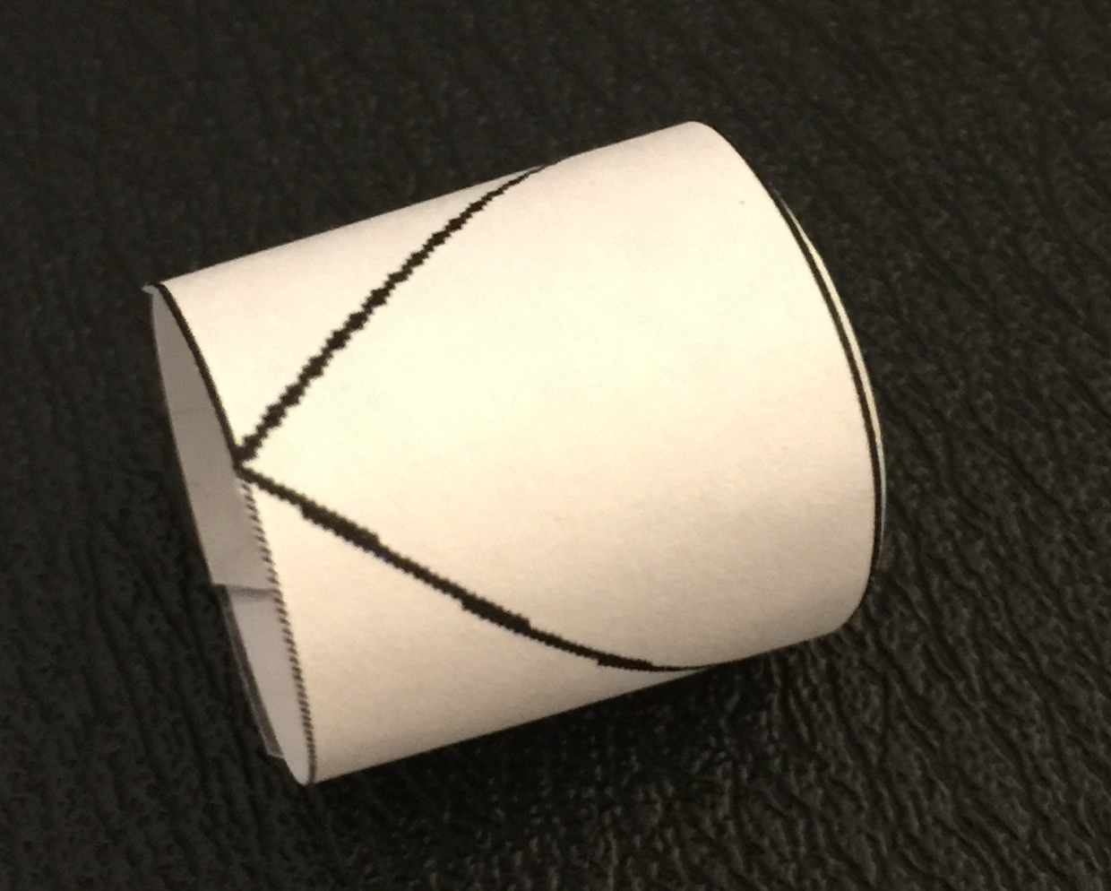
Constraint 7: The triangles must lie flat (planar), not loop around
Imagine printing out the figure to the left, and then cutting along lines AB, BC, CD, and DA to form a little strip of paper that can be looped around to form a little bracelet. This can be done by making lines AB and CD meet together and taping them. The little bracelet satisfies all of the other constraints in the model (note, e.g., that for a counterclockwise orientation, edge (A, B) and edge (C, D) are anti-parallel), but it doesn't satisfy Euler's formula (i.e., the Euler characteristic is no longer 1).
So if you comment out Euler's formula, you'll get instances like the little bracelet (and many others) that don't have a planar embedding.
A
D
B
C
John Baugh
Don’t want triangles to loop around like this.

Slide 52
Euler’s formula
Euler’s Formula: The number of vertices (V) and faces (T) together is exactly one more than the number of (undirected) edges (E).
V + T = 1 + E

Slide 53
Euler’s formula applies to undirected edges
Directed Edges
Undirected Edges
v₃
v₄
t₂
t₁
v₁
v₂
t₀
v₀

Slide 54
v₃
v₄
t₂
t₁
v₁
v₂
t₀
Each triangle is a face.
v₀

Slide 55
v₃
v₄
t₂
t₁
For this mesh:
Number of faces (T) = 3
Number of vertices (V) = 5
Number of edges (E) = 7
v₁
v₂
t₀
V + T = 1 + E
5 + 3 = 1 + 7
8 = 8
v₀

Slide 56
Alloy code for Constraint 7:
// The number of undirected edges is the number of edges
//minus the number of internal edges.
fun undirectedEdges [m: Mesh]: Int {
let e = m.triangles.edges | minus[#e, div[#(~e & e), 2]]
}
sig Mesh {
triangles: some Triangle,
adj: Triangle -> Triangle
}
sig Triangle {
edges: Vertex -> Vertex
}
sig Vertex {}

Slide 57
Alloy code for Constraint 7 (cont.):
// The triangles must lie on a plane - they must not
// loop around and connect one edge to another.
// Euler's formula prevents the triangles from looping
// around. Euler’s Formula: The number of vertices (V)
// and faces (T) together is exactly one more than the
// number of (undirected) edges (E).
fact { all m: Mesh |
let T = #m.triangles, E = undirectedEdges[m], V = #dom[m.triangles.edges] |
minus[T, 1] = minus[E, V] }

Slide 58
Summary of the constraints
Constraint 1: Every triangle must have three (directed) edges
Constraint 2: The adjacency relation m.adj is defined over the mesh’s set of triangles
Constraint 3: Each triangle’s edge set forms a ring
Constraint 4: No triangle lies on top of another triangle, i.e., each edge is unique
Constraint 5: Triangles t and t' are adjacent if and only if they share a common edge pointing in opposite directions (anti-parallel edges)
Constraint 6: The m.adj binary relation must have the symmetric and irreflexive properties and must be strongly connected
Constraint 7: The triangles must lie flat (planar), not loop around (i.e., must conform to Euler’s formula)

Slide 59
Let’s run the model
The model counts the number of items in various sets, e.g., #m.triangles #dom[m.triangles.edges] div[#(~e & e), 2] Some of those counts could get fairly large. So, in the run command it is important to set an appropriate value for Int (even though Int is not directly used in the model).
pred show {
#Mesh = 1
#Triangle = 3
#Vertex = 6
}
run show for 6 but 8 Int

Slide 60
Here are a few of the instances that the Alloy Analyzer generates
v₂
v₃
v₂
v₃
t₂
v₅
t₂
t₁
v₄
t₀
t₁
t₂
v₂
v₂
v₄
v₁
v₄
v₁
v₅
v₃
v₅
t₁
t₂
t₁
v₃
t₀
t₂
v₁
v₅
t₀
v₃
v₄
v₄

Slide 61
No “cut points”
One property we might like to check is that the model prevents the possibility of cut points, such as this:
v₃
v₂
t₂
v₁
v₄
t₃
t₁
v₅
cut point (not allowed)
v₀
A cut-point is a point of a connected space such that its removal causes the resulting space to be disconnected.

Slide 62
There are no cut points if …
… each vertex has the proper number of non-parallel mates.
There are two types of vertex: border vertex and interior vertex

Slide 63
Two types of vertices
There are two types of vertices:
border vertex
interior vertex
v₂
interior
vertex
border
vertex
t₂
t₁
v₅
t₀
v₃
v₄

Slide 64
Terminology: a vertex’s incident edges
The edges into and out of a vertex are its incident edges.

Slide 65
There are no cut points if …
v₂
interior
vertices have zero incident edges with non-parallel mates
t₂
t₁
border
vertices have two incident edges with non-parallel mates
v₅
t₀
v₃
v₄

Slide 66
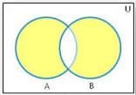
Terminology: symmetric difference
Symmetric difference is the set of all those elements which belongs either to A or to B but not to both.

Slide 67
This region is the union of A and B minus the intersection of A and B, i.e., (A + B) – (A & B).

Slide 68
Alloy function that returns the symmetric difference of two sets
// This function returns the members of "a" and "b"
// that correspond to the symmetric difference of
// the two sets
fun symDiff [a, b: univ]: univ { (a + b) - (a & b) }

Slide 69
Let a = the set of vertices pointing to vertex v, and let b = the set of vertices pointed to by v
vertices pointed to by v
vertices pointing to v

Slide 70
v₂
t₂
t₁
this border
vertex has two vertices pointing to it (v₂, v₅) and it points to two vertices (v₃, v₅)
v₅
t₀
v₃
v₄
v₂
v₅
v₃
(A + B) – (A & B) = {v₂, v₃}
The symmetric difference of the arrows pointing into and out of vertex v₄.

Slide 71
Every legal border vertex has two elements in the symmetric difference set.

Slide 72
v₂
t₂
t₁
this internal
vertex has three vertices pointing to it (v₂, v₃, v₄) and it points to three vertices (v₂, v₃, v₄)
v₅
t₀
v₃
v₄
v₂
v₃
(A + B) – (A & B) = {}
v₄
The symmetric difference of the arrows pointing into and out of the v₅ vertex.

Slide 73
Every legal internal vertex has zero elements in the symmetric difference set.

Slide 74
This vertex has two vertices pointing to it (v₂, v₃) and it points to two vertices (v₀, v₄)
v₃
v₂
t₂
v₁
v₄
t₃
t₁
v₅
v₀
v₂, v₃
v₀, v₄
(A + B) – (A & B) = {v₂, v₃, v₀, v₄}
Not allowed by the model!

Slide 75
// A border vertex has a symmetric difference of 2.
pred borderVertex [m: Mesh, v: Vertex] {
let e = m.triangles.edges | #symDiff[e.v, v.e] = 2
}
// An interior vertex has a symmetric difference of 0.
pred interiorVertex [m: Mesh, v: Vertex] {
let e = m.triangles.edges | no symDiff[e.v, v.e]
}

Slide 76
assert NoCutPoints {
all m: Mesh, v: Vertex | borderVertex[m, v] or interiorVertex[m, v]
}
check NoCutPoints for 1 Mesh, 6 Triangle, 9 Vertex, 8 Int
“No counterexamples found”

Slide 77
The model is an abstraction for any analysis that requires planar triangles
Packaged as a module, the mesh model shown in these slides can serve as an abstraction for finite element analysis and other computations that work on planar triangulations, where its components—triangles and vertices—are given interpretations appropriate for the intended application domain.
Stay tuned … the next slide deck will show how the paper (see slide 2) extends the mesh module with x, y, z coordinates and with quanties like water surface elevation, wet-dry state that vary with time, among others.

Slide 78
Build on top of the model
These slides described an Alloy model of a planar mesh of triangles in which the triangles fit together edge-to-edge. In the next slide-deck we will use this model and build upon it, adding some of the attributes that appears in the coastal water-level model ADCIRC (Advanced Circulation).
Model
coastal water-level
Model
planar mesh of triangles

