Slide 1
Registering students for courses, assigning lecturers to courses
Roger L. Costello
July 21, 2018

Slide 2
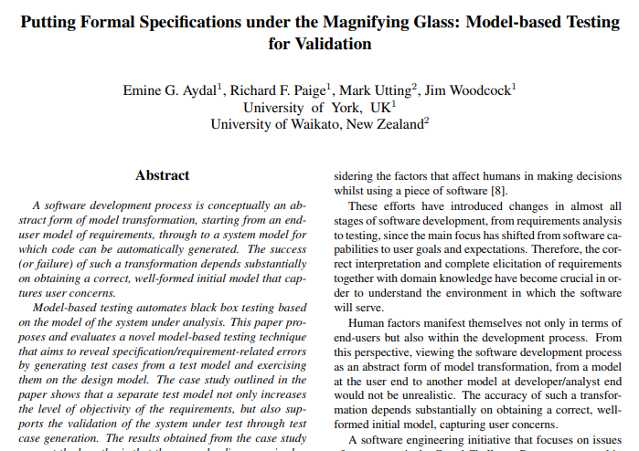
The material in these slides come from this paper
https://ieeexplore.ieee.org/document/4815345/

Slide 3
Req. No. | Requirement Description
R0 | The system consists of courses, students and lecturers.
R1 | Each course must be subscribed by at least one student.
R2 | Each course can only be subscribed by students from certain years of their degree and this information is associated to each course.
R3 | The total number of students for a course cannot exceed 7.
R4 | Only one lecturer must be assigned to each course.
R5 | Course ID must be unique.
R6 | The lecturer assigned to a course must have at least 3 years of experience.
R7 | A student must subscribe to at least 1 course.
R8 | A student cannot subscribe to more than 6 courses.
R9 | In his/her 4th year, the student cannot subscribe to more than 4 courses.
R10 | The age of the students taking a course must be less than the age of the lecturer assigned to that course.
R11 | A lecturer can be assigned to 3 courses at most.

Slide 4
-- This records the state of the department
-- as students subscribe to courses and lecturers
-- are assigned to teach courses.
sig DepartmentState {
CourseAssignment: Student -> Course,
TeachingAssignment: Lecturer -> Course
}

Slide 5
-- Each lecturer has a number of years experience
-- teaching and is of a certain age.
sig Lecturer {
yearsExperience: Int,
age: Int
} {
yearsExperience >= 0
age > 0
}

Slide 6
-- Each student has a year of student (1 to 4)
-- and an age.
sig Student {
year: Int,
age: Int
} {
year in {i: Int | i >= 1 and i =< 4}
age > 0
}

Slide 7
-- Each course has a required year, i.e.,
-- a student may not take the course until
-- he/she is of the required year.
sig Course {
requiredYear: Int,
} {
requiredYear in {i: Int | i >= 1 and i =< 4}
}

Slide 8
-- R3: The total number of students for a course
-- cannot exceed 7.
pred HasSpace [c: Course, d: DepartmentState] {
# d.CourseAssignment.c =< 7
}

Slide 9
-- R8: A student cannot subscribe to more than 6
-- courses.
fun callMax_CourseSubscription: Int { 6 }

Slide 10
-- R2: Each course can only be subscribed by
-- students from certain years of their degree
pred IsElegible [s: Student, c: Course] {
s.year = c.requiredYear
}

Slide 11
Subscribe operation. Register a student for a class.
-- The state of the department is updated between
-- state d and d.next to assign student s to course c.
pred Subscribe (d, d': DepartmentState, s: Student, c: Course) {
-- Precondition: The student is not already registered
-- for the course.
not c in d.CourseAssignment [s]
-- Precondition: There is space available in the course.
HasSpace [c, d]
-- Precondition: The student has registered for less than
-- the maximum allowed number of courses.
# d.CourseAssignment [s] =< callMax_CourseSubscription
-- Precondition: The student is elegible (Each course can
-- only be subscribed by students from certain years of their degree)
IsElegible [s, c]
-- Assuming all the preconditions are met, update
-- the assignment of student to class.
d'.CourseAssignment = d.CourseAssignment + s->c
-- No change to the lecturer for the course
d'.TeachingAssignment = d.TeachingAssignment
-- Postcondition: The number of students assigned
-- to the course is increased by 1.
# d'.CourseAssignment [s] = plus[# d.CourseAssignment [s], 1]
}

Slide 12
-- The state of the department is updated between
-- state d and d.next to assign student s to course c.
pred Subscribe (d, d': DepartmentState, s: Student, c: Course) {
-- Precondition: The student is not already registered
-- for the course.
not c in d.CourseAssignment [s]
-- Precondition: There is space available in the course.
HasSpace [c, d]
-- Precondition: The student has registered for less than
-- the maximum allowed number of courses.
# d.CourseAssignment [s] =< callMax_CourseSubscription
-- Precondition: The student is elegible (Each course can
-- only be subscribed by students from certain years of their degree)
IsElegible [s, c]
-- Assuming all the preconditions are met, update
-- the assignment of student to class.
d'.CourseAssignment = d.CourseAssignment + s->c
-- No change to the lecturer for the course
d'.TeachingAssignment = d.TeachingAssignment
-- Postcondition: The number of students assigned
-- to the course is increased by 1.
# d'.CourseAssignment [s] = plus[# d.CourseAssignment [s], 1]
}
Each time Subscribe is called, no changes are made to the teaching assignment. So, the lecturers must be assigned to courses before students start subscribing. So, I assign lecturers to courses in the init predicate.

Slide 13
Initialize operation. Assign lecturers to courses.
pred init [d: DepartmentState] {
-- Initially, no students have subscribed
no d.CourseAssignment
-- R11: A lecturer can be assigned to 3 courses at most.
all lecturer: d.TeachingAssignment.Course |
# d.TeachingAssignment[lecturer] < 4
-- R6: The lecturer assigned to a course must have
-- at least 3 years experience
all lecturer: d.TeachingAssignment.Course |
lecturer.yearsExperience >= 3
-- R4: Only one lecturer must be assigned to each course.
all course: d.TeachingAssignment[Lecturer] |
# d.TeachingAssignment.course = 1
}

Slide 14
pred init [d: DepartmentState] {
-- Initially, no students have subscribed
no d.CourseAssignment
-- R11: A lecturer can be assigned to 3 courses at most.
all lecturer: d.TeachingAssignment.Course |
# d.TeachingAssignment[lecturer] < 4
-- R6: The lecturer assigned to a course must have
-- at least 3 years experience
all lecturer: d.TeachingAssignment.Course |
lecturer.yearsExperience >= 3
-- R4: Only one lecturer must be assigned to each course.
all course: d.TeachingAssignment[Lecturer] |
# d.TeachingAssignment.course = 1
}
pred trace {
init [first]
…
}

Slide 15
These are the final constraints that must be satisfied, after all the students have subscribed.
pred final [d: DepartmentState] {
-- R10: The age of the students take a course must
-- be less than the age of the lecturer assigned
-- to that course.
all s: d.CourseAssignment.Course |
all c: d.CourseAssignment[s] |
s.age < d.TeachingAssignment.c.age
-- R9: In his/her 4th year the student cannot subscribe to
-- more than 4 courses.
all s: Student |
(s.year = 4) =>
# d.CourseAssignment[s] < 5
-- R7: A student must subscribe to at least one course.
all s: Student |
s in d.CourseAssignment.Course
-- R1: Each course must be subscribed by at
-- least one student.
all course: d.TeachingAssignment[Lecturer] |
# d.CourseAssignment.course > 0
}

Slide 16
pred final [d: DepartmentState] {
-- R10: The age of the students take a course must
-- be less than the age of the lecturer assigned
-- to that course.
all s: d.CourseAssignment.Course |
all c: d.CourseAssignment[s] |
s.age < d.TeachingAssignment.c.age
-- R9: In his/her 4th year the student cannot subscribe to
-- more than 4 courses.
all s: Student |
(s.year = 4) =>
# d.CourseAssignment[s] < 5
-- R7: A student must subscribe to at least one course.
all s: Student |
s in d.CourseAssignment.Course
-- R1: Each course must be subscribed by at
-- least one student.
all course: d.TeachingAssignment[Lecturer] |
# d.CourseAssignment.course > 0
}
pred trace {
…
final [last]
}

Slide 17
pred trace {
init [first]
all d: DepartmentState - last |
some s: Student, c: Course |
Subscribe [d, d.next, s, c]
final [last]
}

Slide 18
pred trace {
init [first]
all d: DepartmentState - last |
some s: Student, c: Course |
Subscribe [d, d.next, s, c]
final [last]
}
The trace predicate animates the execution of the subscribe operation.

