Slide 1
Navigating Alloy relations
Roger L. Costello
May 7, 2018

Slide 2
What company does John work at?
John
employer
John$0
John$0
Google$0
Bill$0
Apple$0
Mary$0
Oracle$0

Slide 3
What company does John work at?
John
employer
John$0
John$0
Google$0
Bill$0
Apple$0
Mary$0
Oracle$0
John.employer
Evaluating this Alloy expression returns this:
Google$0

Slide 4
John.employer
join operator

Slide 5
Join operator
The join operator combines two relations
The result of a join is the concatenation of the matching parts of the two relations, minus the matching parts

Slide 6
John
employer
Google$0
John$0
John$0
Google$0
Bill$0
Apple$0
Mary$0
Oracle$0

Slide 7
Quintessential
Of the pure and essential essence of something.
Of or relating to the most perfect embodiment of something.

Slide 8
The quintessential relational operator is join.

Slide 9
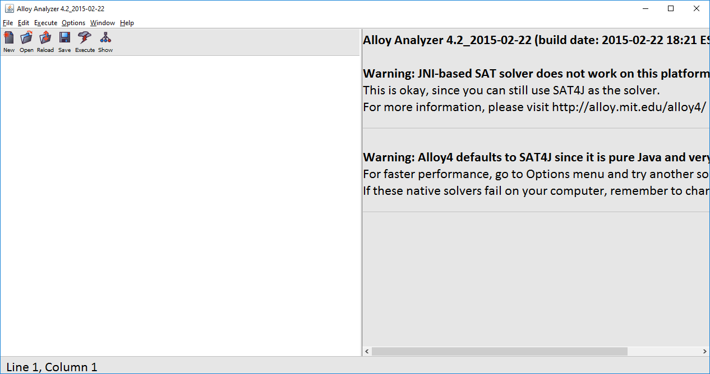
This is the Alloy tool

Slide 10
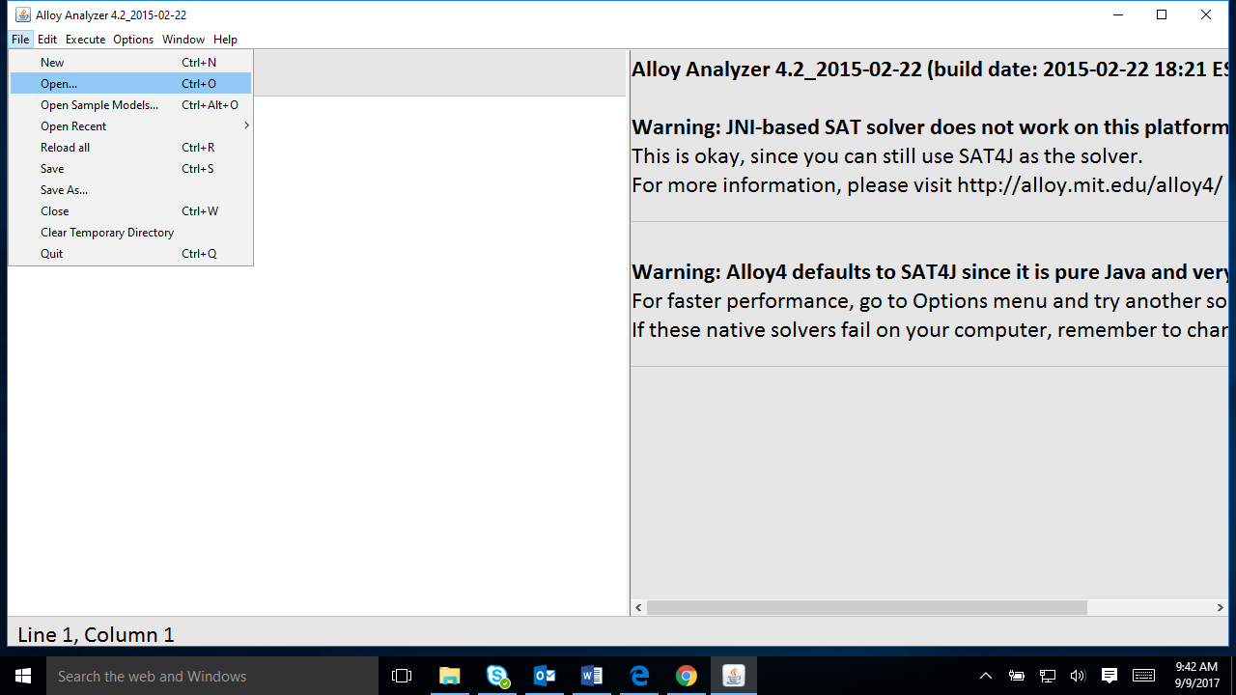
Select File >> Open …

Slide 11
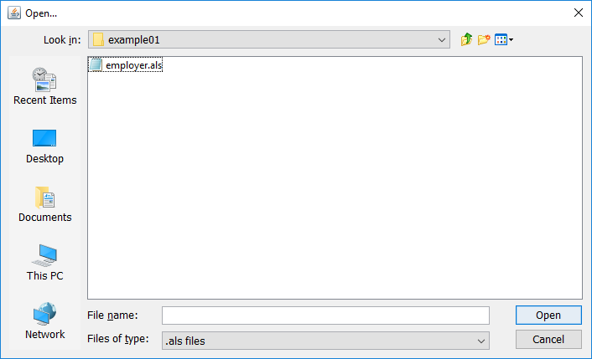
Select employer.als (in examples/navigation/example01)

Slide 12
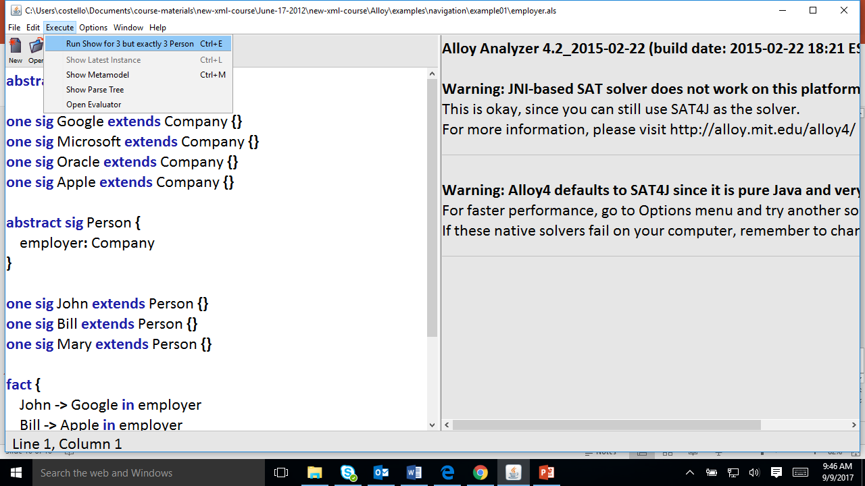
Select Execute >> Run Show for 3 but exactly 3 Person

Slide 13
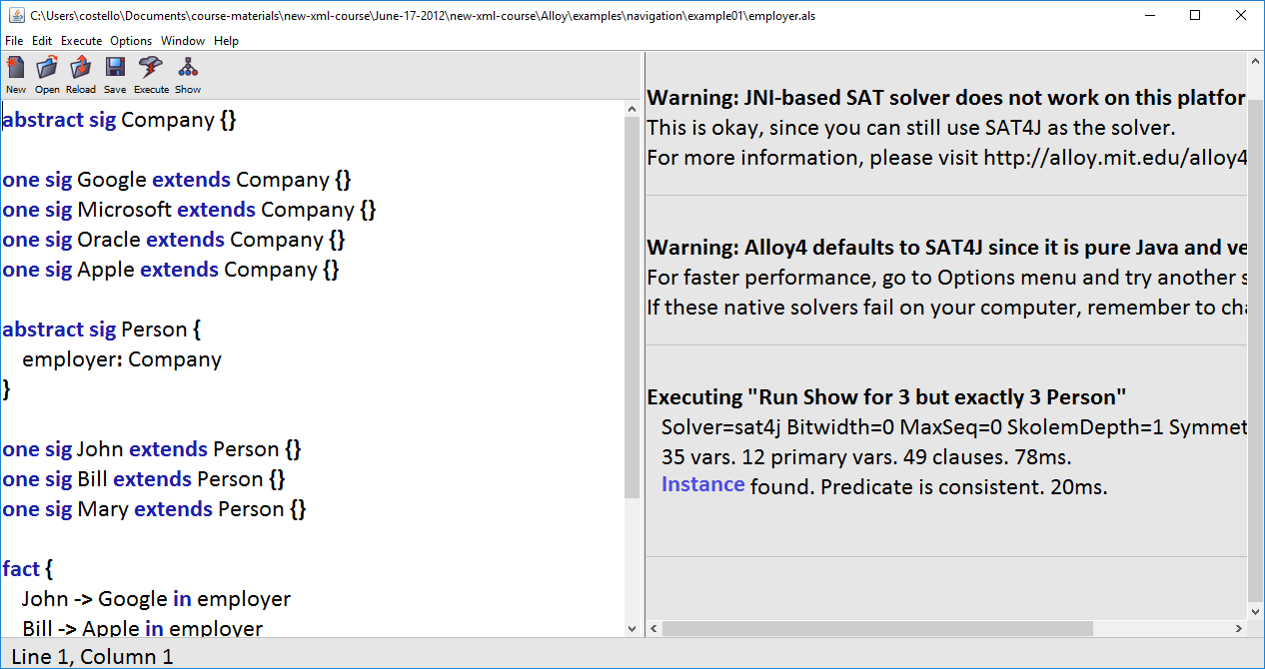
Click on Instance

Slide 14
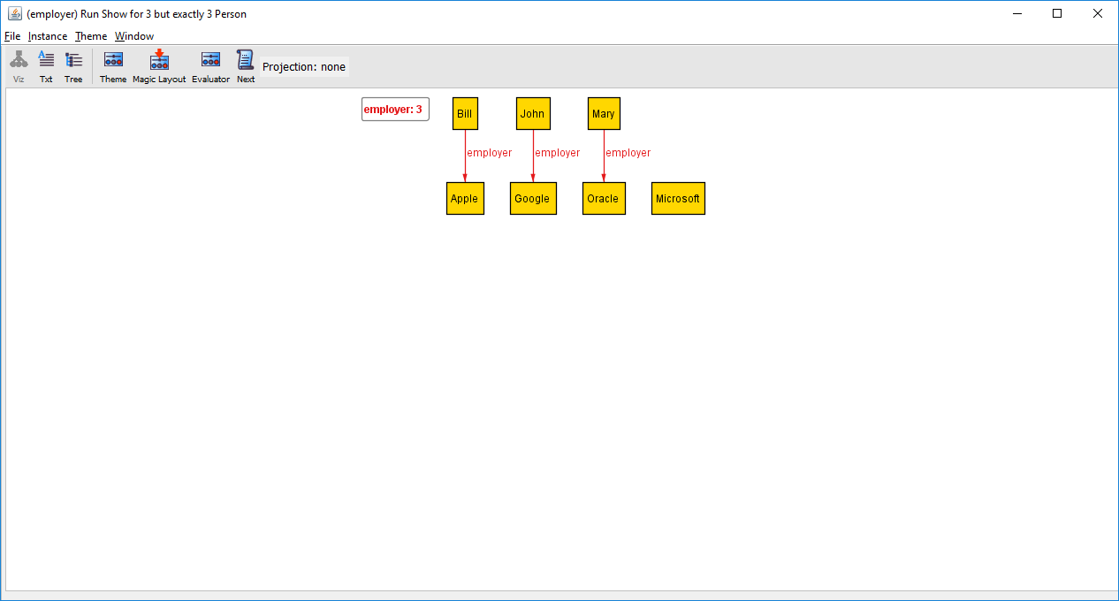
Click on Evaluator

Slide 15
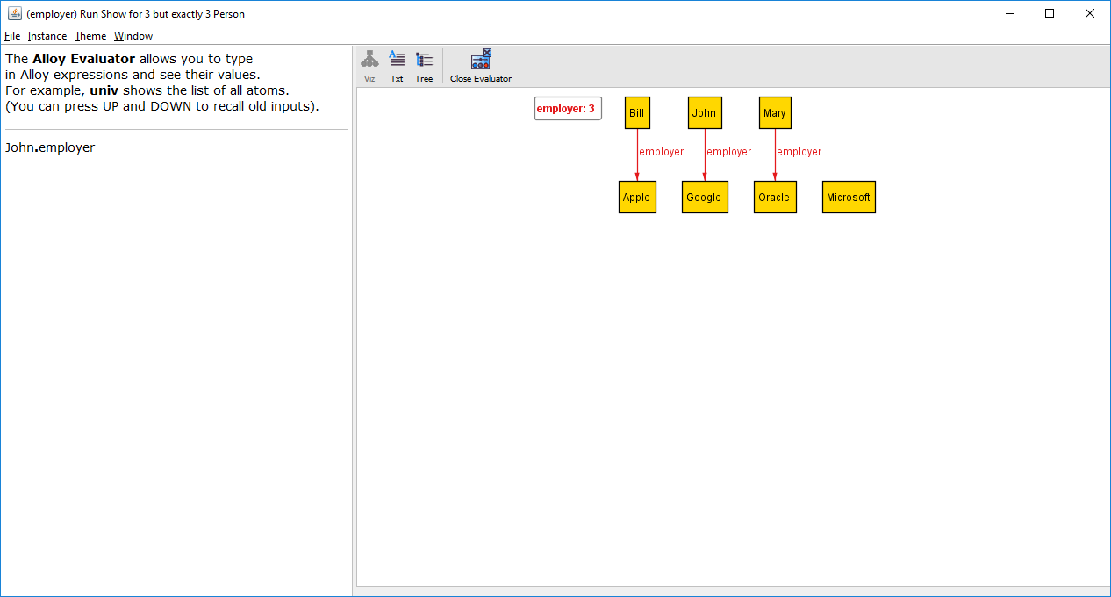
Type this expression

Slide 16
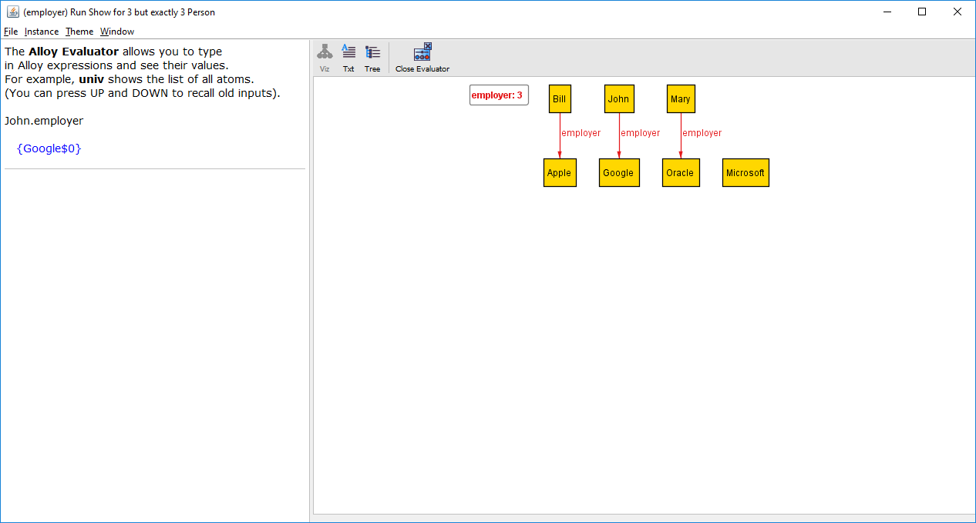
Alloy evaluated the expression and this is the result

Slide 17
Google$0
equivalent

Slide 18
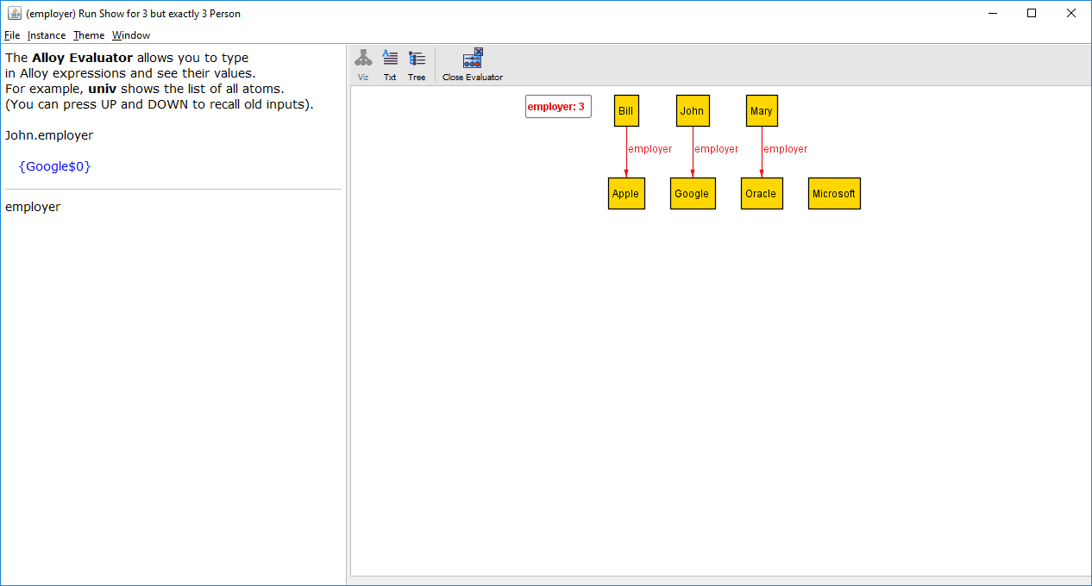
Type this expression (the expression is just the name of the binary relation)

Slide 19
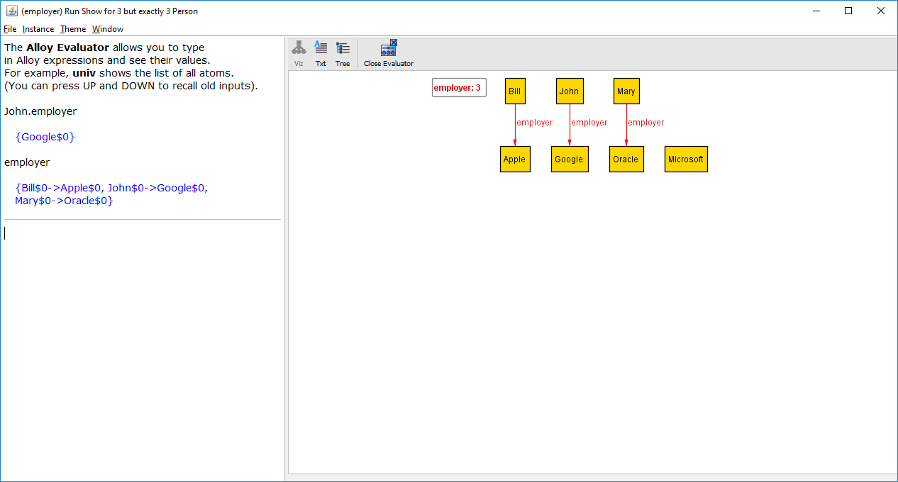
Bill works at Apple, John works at Google, Mary works at Oracle

Slide 20
John$0
Google$0
Bill$0
Apple$0
equivalent
Mary$0
Oracle$0

Slide 21
Internally, Alloy represents relations as sets

Slide 22

Type this

Slide 23
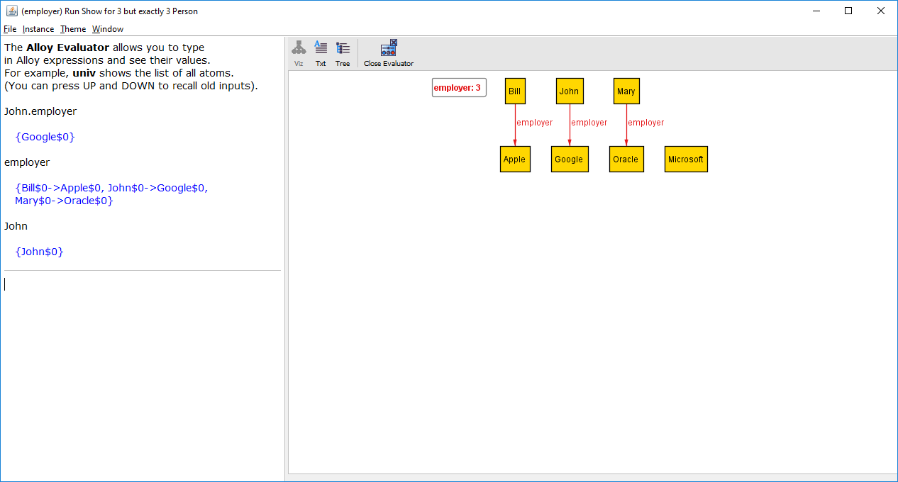
John is a singleton relation

Slide 24

Type this

Slide 25
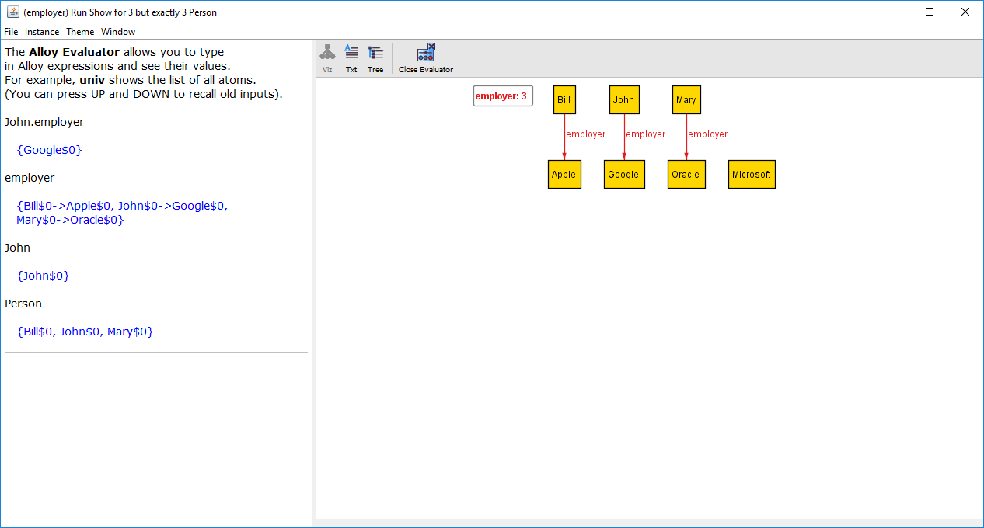
Person is a set consisting of 3 persons

Slide 26
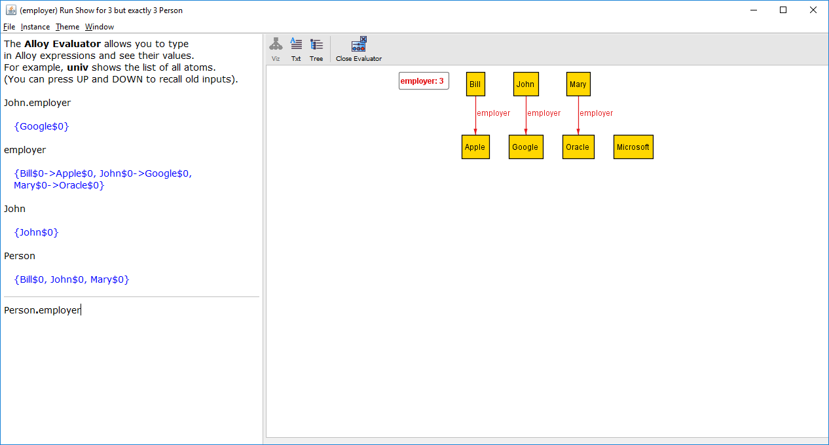
This expression is a join between all persons and employer (which has person/company mappings)

Slide 27
Google$0
Person
employer
Apple$0
John$0
John$0
Google$0
Oracle$0
Bill$0
Bill$0
Apple$0
Mary$0
Mary$0
Oracle$0
The set of employers for all persons.

Slide 28
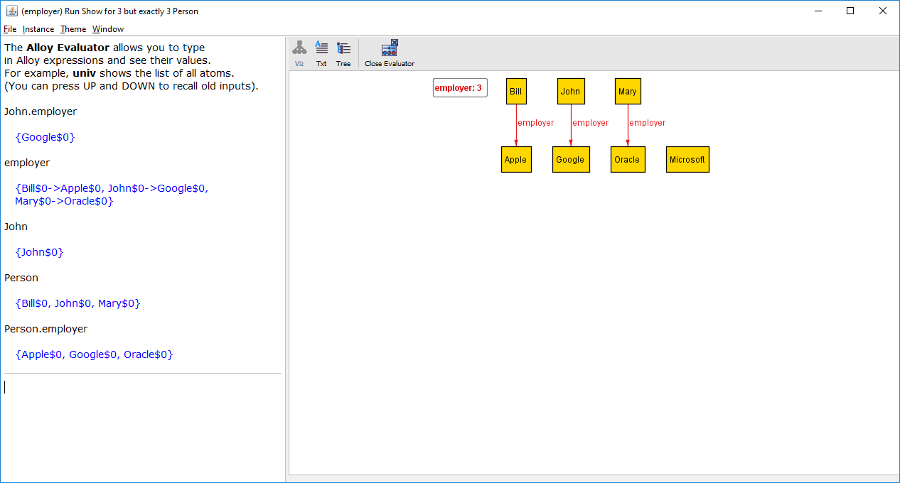
Result of Alloy evaluating the expression. Bill works at Apple, John works at Google, and Mary works at Oracle

Slide 29
This is the VIZ (visualization) view. For this tutorial we will just use the Evaluator.

Slide 30
Who works at Google?
employer
Google
John$0
Google$0
Google$0
Bill$0
Apple$0
Mary$0
Oracle$0

Slide 31
Who works at Google?
employer
Google
John$0
Google$0
Google$0
Bill$0
Apple$0
Mary$0
Oracle$0
employer.Google

Slide 32
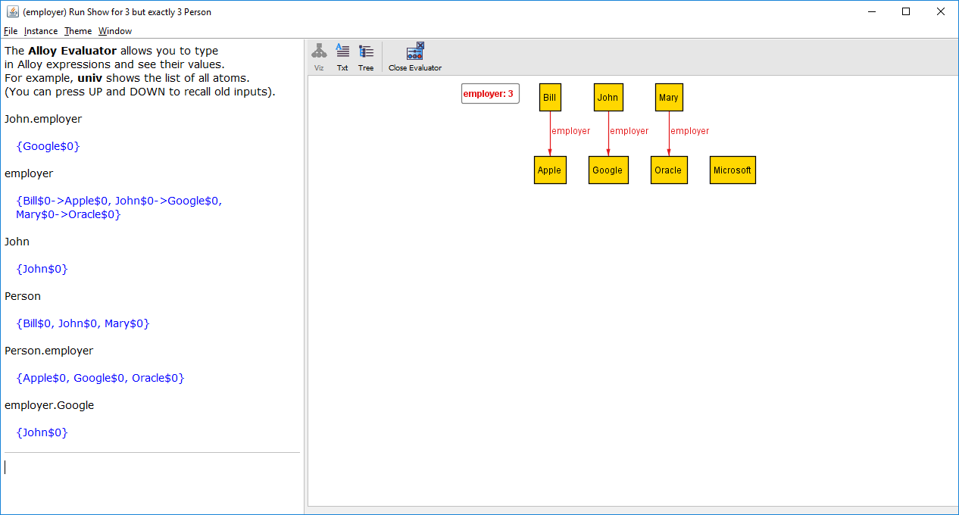
Result of Alloy evaluating the expression. John works at Google

Slide 33
Forward navigation (navigate through the employer relation in a forward direction)
John
employer
John$0
John$0
Google$0
Bill$0
Apple$0
Mary$0
Oracle$0
John.employer

Slide 34
Backward navigation (navigate through the employer relation in a backward direction)
employer
Google
John$0
Google$0
Google$0
Bill$0
Apple$0
Mary$0
Oracle$0
employer.Google

Slide 35
Transpose operator ~
The transpose of a binary relation is the flipping of the columns: the second column becomes the first, the first column becomes the second.
employer
~employer
John$0
Google$0
Google$0
John$0
Bill$0
Apple$0
Apple$0
Bill$0
Mary$0
Oracle$0
Oracle$0
Mary$0

Slide 36
Equivalent
employer
Google
John$0
Google$0
Google$0
John$0
Bill$0
Apple$0
Mary$0
Oracle$0
Google
~employer
Google$0
Google$0
John$0
John$0
Apple$0
Bill$0
Oracle$0
Mary$0

Slide 37
Who is the occupant of Room$1 at Time$2?
FrontDesk
occupant
FrontDesk$0
FrontDesk$0
Room$0
Guest$2
Time$0
FrontDesk$0
Room$0
Guest$2
Time$1
FrontDesk$0
Room$0
Guest$2
Time$2
FrontDesk$0
Room$1
Guest$1
Time$0
FrontDesk$0
Room$1
Guest$1
Time$1
FrontDesk$0
Room$1
Guest$1
Time$2
FrontDesk$0
Room$2
Guest$0
Time$0
FrontDesk$0
Room$2
Guest$0
Time$1
FrontDesk$0
Room$2
Guest$0
Time$2

Slide 38
Who is the occupant of Room$1 at Time$2?
FrontDesk
occupant
FrontDesk$0
FrontDesk$0
Room$0
Guest$2
Time$0
FrontDesk$0
Room$0
Guest$2
Time$1
FrontDesk$0
Room$0
Guest$2
Time$2
FrontDesk$0
Room$1
Guest$1
Time$0
FrontDesk$0
Room$1
Guest$1
Time$1
FrontDesk$0
Room$1
Guest$1
Time$2
FrontDesk$0
Room$2
Guest$0
Time$0
FrontDesk$0
Room$2
Guest$0
Time$1
FrontDesk$0
Room$2
Guest$0
Time$2
FrontDesk.occupant

Slide 39
Who is the occupant of Room$1 at Time$2?
Room$0
Guest$2
Time$0
Room$0
Guest$2
Time$1
Room$0
Guest$2
Time$2
Room$1
Guest$1
Time$0
Room$1
Guest$1
Time$1
Room$1
Guest$1
Time$2
Room$2
Guest$0
Time$0
Room$2
Guest$0
Time$1
Room$2
Guest$0
Time$2
Room$1.(FrontDesk.occupant)

Slide 40
Who is the occupant of Room$1 at Time$2?
Guest$1
Time$0
Guest$1
Time$1
Guest$1
Time$2
Room$1.(FrontDesk.occupant).Time$2

Slide 41
Recap: Who is the occupant of Room$1 at Time$2?
FrontDesk
occupant
FrontDesk$0
FrontDesk$0
Room$0
Guest$2
Time$0
FrontDesk$0
Room$0
Guest$2
Time$1
FrontDesk$0
Room$0
Guest$2
Time$2
FrontDesk$0
Room$1
Guest$1
Time$0
FrontDesk$0
Room$1
Guest$1
Time$1
Alloy expression that navigates through the relations to obtain the answer
FrontDesk$0
Room$1
Guest$1
Time$2
FrontDesk$0
Room$2
Guest$0
Time$0
FrontDesk$0
Room$2
Guest$0
Time$1
FrontDesk$0
Room$2
Guest$0
Time$2
Room$1.(FrontDesk.occupant).Time$2

Slide 42
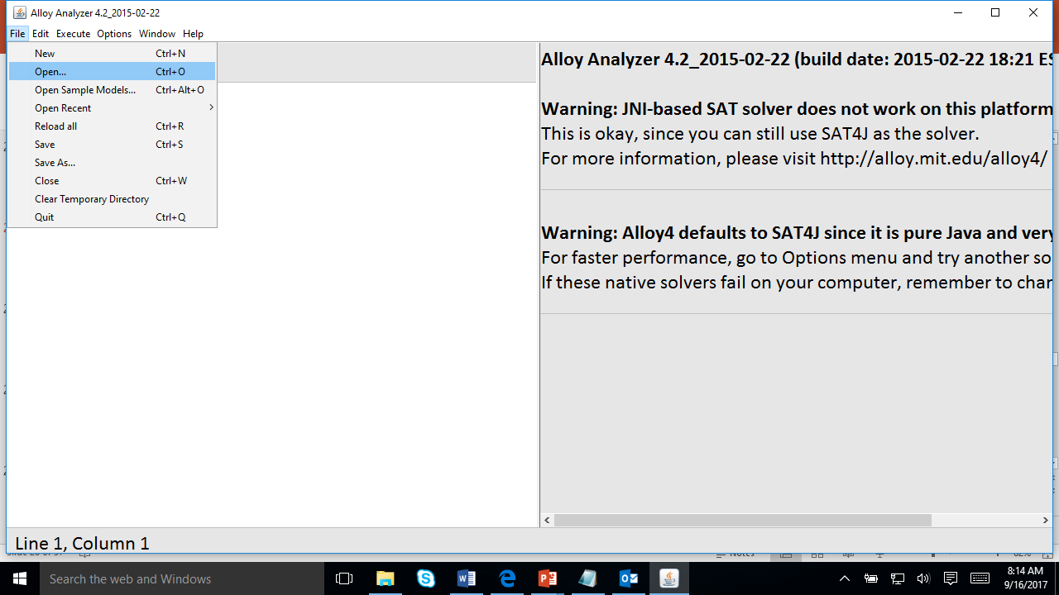
Select File >> Open …

Slide 43
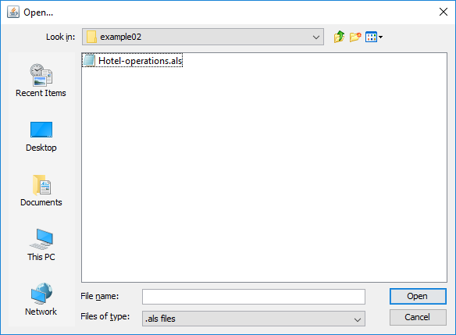
Select Hotel-operation.als (in examples/navigation/example02)

Slide 44
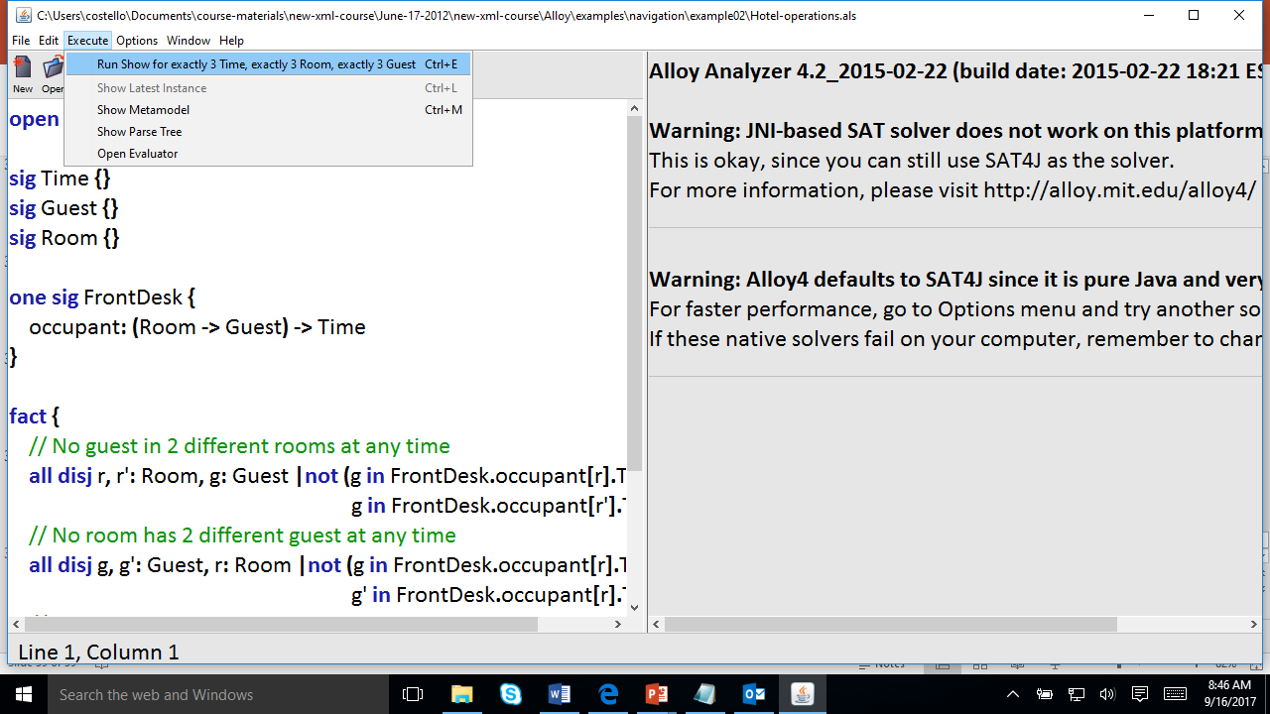
Select Execute >> Run Show for exactly 3 Time, exactly 3 Room, …

Slide 45
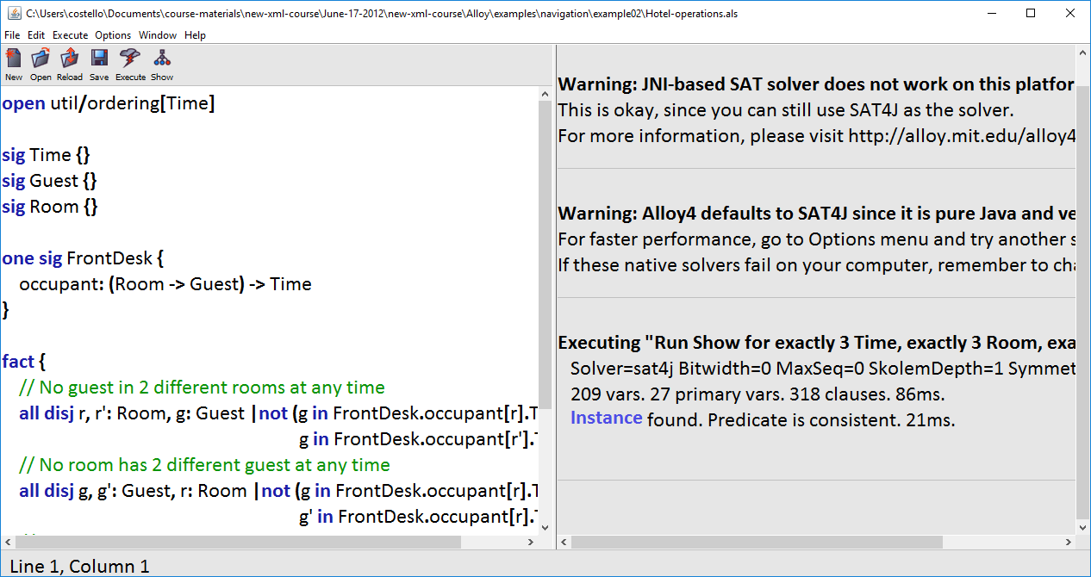
Click on Instance

Slide 46
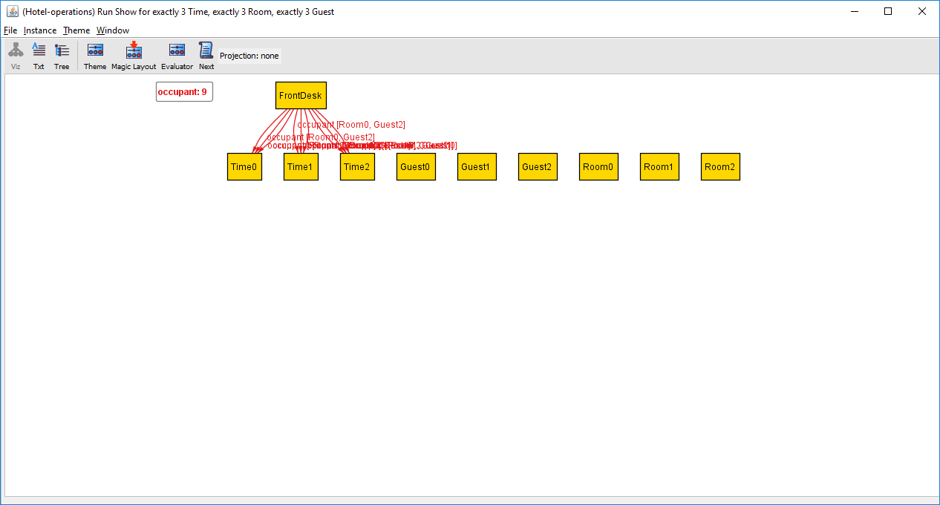
Click on Evaluator

Slide 47
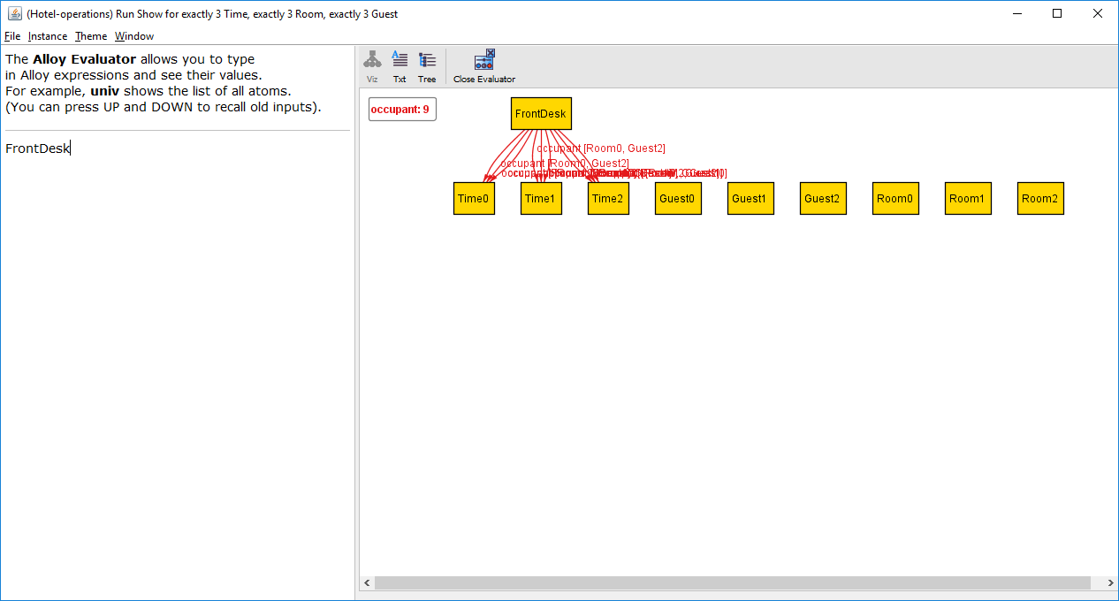
Type this expression

Slide 48
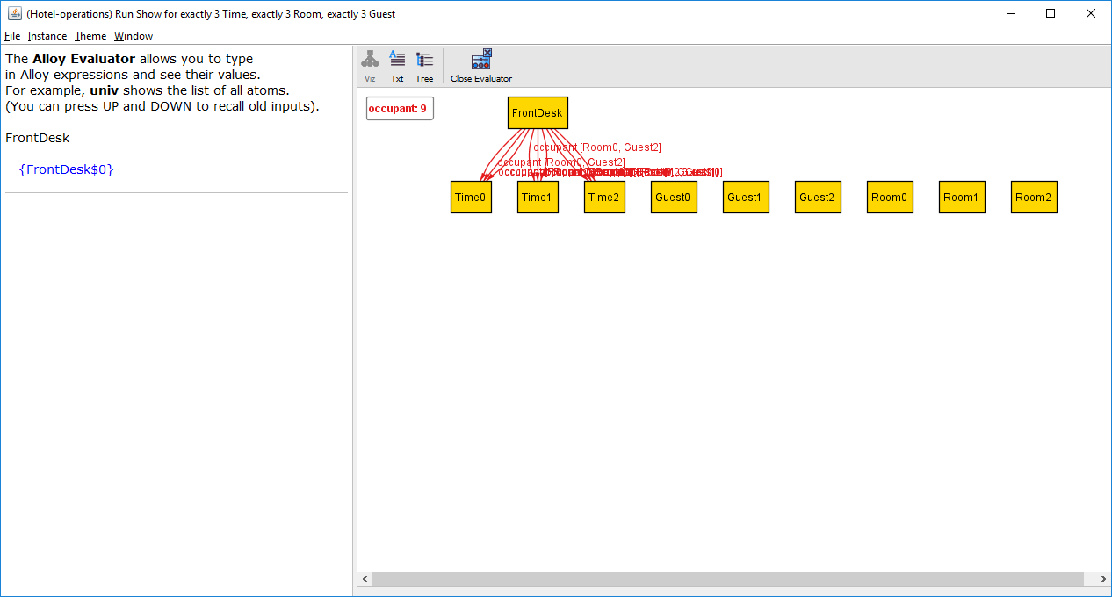
Alloy evaluated the expression and this is the result (a singleton relation)

Slide 49

Type this expression

Slide 50
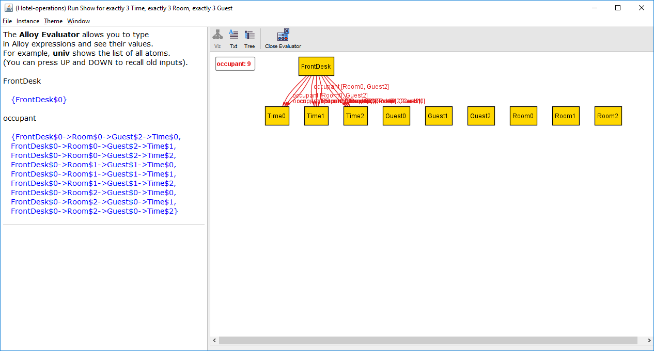
Alloy evaluated the expression and this is the result (a quaternary relation)

Slide 51

Type this expression

Slide 52

Alloy evaluated the expression and this is the result (a singleton relation)

Slide 53
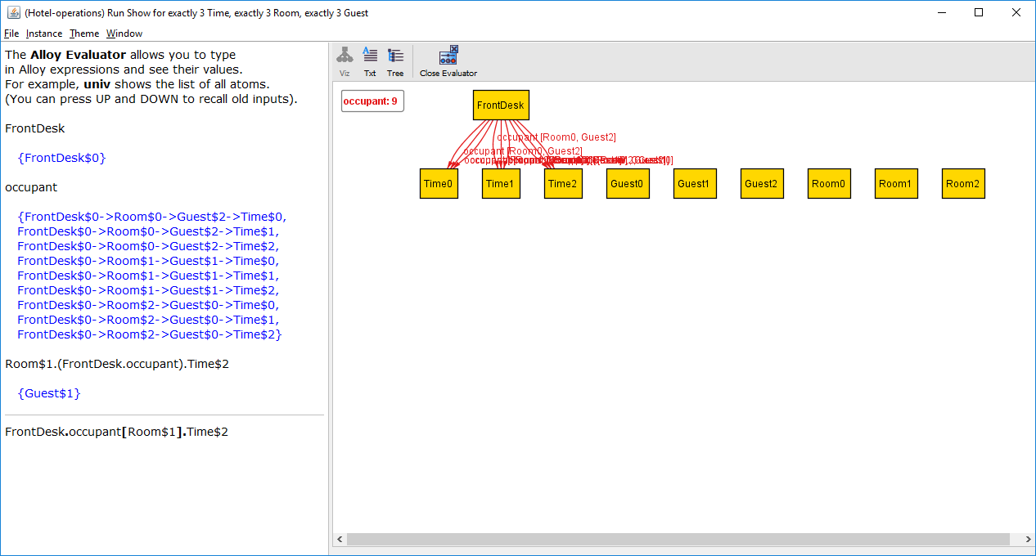
Type this expression

Slide 54
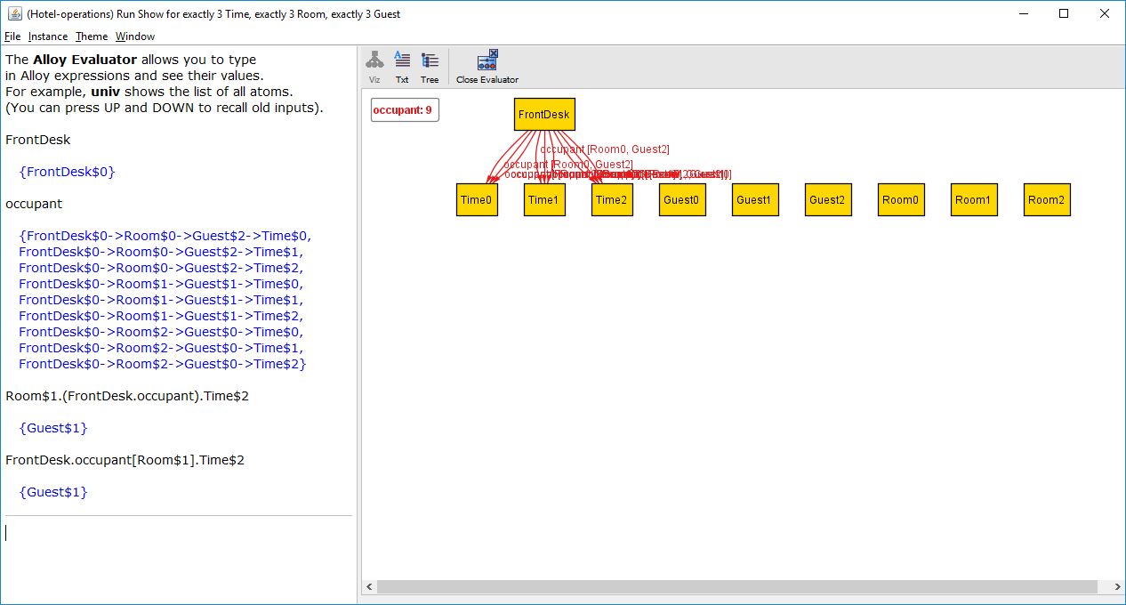
Same result as the previous expression!

Slide 55
Room$1.(FrontDesk.occupant).Time$2
equivalent
FrontDesk.occupant[Room$1].Time$2

Slide 56
Box operator
The box operator [ ] is semantically identical to join, but takes its arguments in a different order. The expression
e1 [e2]
has the same meaning as
e2.e1

Slide 57
Operator precedence: dot has higher precedence than box
Dot binds more tightly than box, so
a.b.c [d]
is evaluated as
(a.b.c) [d]
which is equivalent to
d.(a.b.c)

Slide 58
What processes can Process$0 reach?
succ
Process$0
Process$2
Process$1
Process$0
Process$2
Process$1

Slide 59
What processes can Process$0 reach?
succ
Process$0
Process$2
Process$1
Process$0
Process$2
Process$1

Slide 60
What processes can Process$0 reach?
succ
Process$0
Process$2
Process$1
Process$0
Process$2
Process$1
Process$0 can directly reach Process$2, which can reach Process$1, which can reach Process$0. So, Process$0 can reach all processes, including itself.

Slide 61
succ
Process$0
Process$2
Process$1
Process$0
Process$2
Process$1
In fact, each process can reach all other processes.

Slide 62
The processes are cyclic:
Process$1
succ
Process$0
Process$2
succ
Process$1
Process$0
Process$0
succ
Process$2
Process$1
succ
Process$2
Example: Process$0.succ = Process$2

Slide 63
What processes can Process$0 reach?
succ
Process$0
Process$2
Process$1
Process$0
Process$2
Process$1
Process$0.^succ returns all the processes reachable from Process$0.

Slide 64
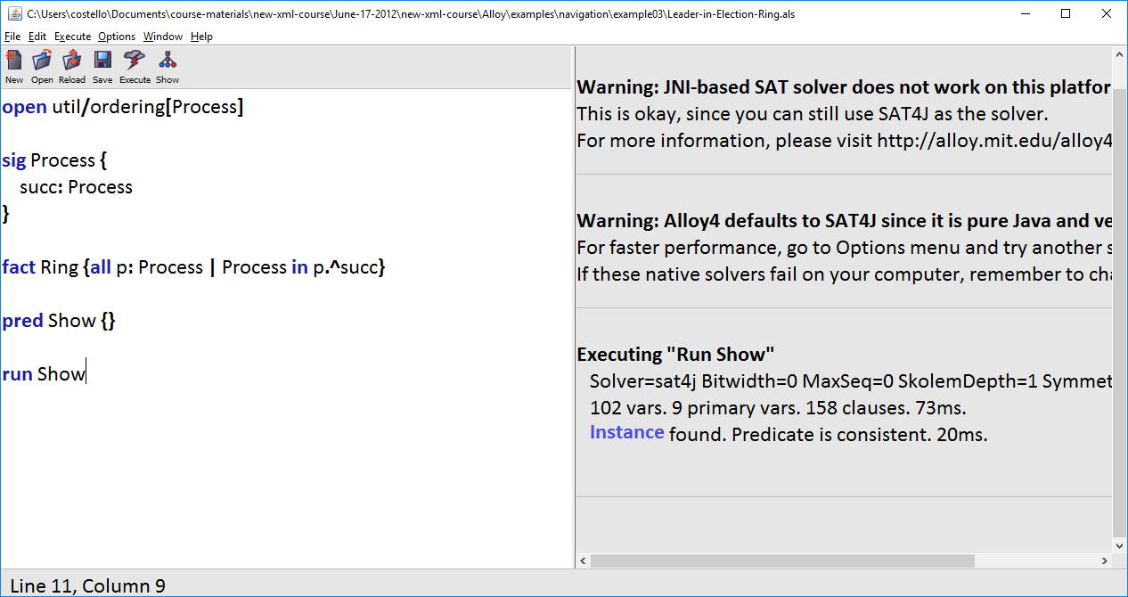
Open Leader-in-Election-Ring.als in the navigation/example03 folder. Then select Execute >> Show. Then click on Instance.

Slide 65
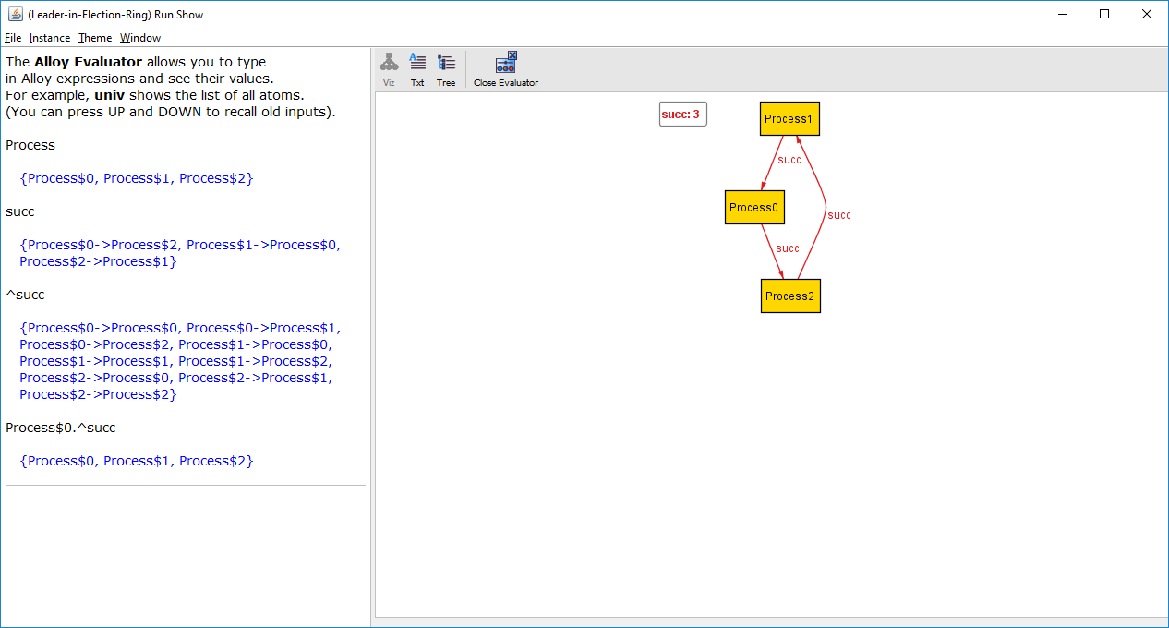

Slide 66
The set of processes

Slide 67
succ is a binary relation, mapping each process to a process

Slide 68
^succ is the transitive closure of the binary relation. That is, for each process, the processes it can reach.

Slide 69
Transitive closure operator ^
The transitive closure operator is applied to binary relations.
If a binary relation contains a -> b and b -> c, then the transitive closure returns a -> b, b -> c, and a -> c.

Slide 70
succ
^succ
Process$0
Process$2
Process$0
Process$0
Process$1
Process$0
Process$0
Process$1
Process$2
Process$1
Process$0
Process$2
Process$1
Process$0
Process$1
Process$1
Process$1
Process$1
Process$2
Process$2
Process$2
Process$0
Process$2
Process$1
Process$2
Process$2

Slide 71
succ
Process$0
Process$2
Process$1
Process$0
Process$2
Process$1
^succ
Process$0.^succ
Process$0
Process$0
Process$0
Process$0
Process$0
Process$1
Process$0
Process$1
Process$0
Process$2
Process$0
Process$2
Process$1
Process$0
Process$1
Process$0
Process$1
Process$1
Process$1
Process$1
Process$1
Process$2
Process$2
Process$0
Process$1
Process$2
Process$2
Process$0
Process$2
Process$1
Process$2
Process$1
Process$2
Process$2
Process$2
Process$2

Slide 72
Lab 2.1
Load the Alloy model of the Einstein puzzle into the Alloy tool. Run the model. Open the instance. Click on Evaluator. Now, create Alloy expressions for these:
Show the list of Houses.
What is the color of the third House?
Which House has a bird?
What are the Nationalities?
What are the Houses that are green and blue? (Use one expression only!)
Is the last House red? Is the first House yellow?
What Houses can be reached from the first House? (Recall that the Houses are ordered)
What Houses can be reached from the last House?

Slide 73
Which House has a bird?
sig House { color: Color, nationality: Nationality, drink: Drink, cigarette: Cigarette, pet: Pet }
pet
House$0
cat$0
House$1
horse$0
House$2
bird$0
House$3
fish$0
House$4
dog$0

Slide 74
Backward navigate through the pet relation
pet
bird
House$0
cat$0
bird$0
House$1
horse$0
House$2
bird$0
House$3
fish$0
House$4
dog$0

Slide 75
House$2 (the third house) has the bird
pet.bird
House$2
pet
bird
House$0
cat$0
bird$0
House$1
horse$0
House$2
bird$0
House$3
fish$0
House$4
dog$0

Slide 76
What processes can Process$0 reach?
succ
Process$0
Process$1
Process$1
Process$2

Slide 77
What processes can Process$0 reach?
succ
Process$0
Process$1
Process$1
Process$2

Slide 78
What processes can Process$0 reach?
succ
Process$0
Process$1
Process$1
Process$2
Process$0 can directly reach Process$1, which can reach Process$2. So, Process$0 can reach all processes, excluding itself.

Slide 79
What processes can Process$0 reach?
succ
Process$0
Process$1
Process$1
Process$2
In fact, each process can reach its successor processes.

Slide 80
The processes are linear:
Process$0
succ
Process$0
Process$1
succ
Process$1
Process$2
Process$1
succ
Process$2
Example: Process$0.succ = Process$1
Example: Process$2.succ = none

Slide 81
What processes can Process$0 reach?
succ
Process$0
Process$1
Process$1
Process$2
Process$0.^succ returns all the processes reachable from Process$0.

Slide 82
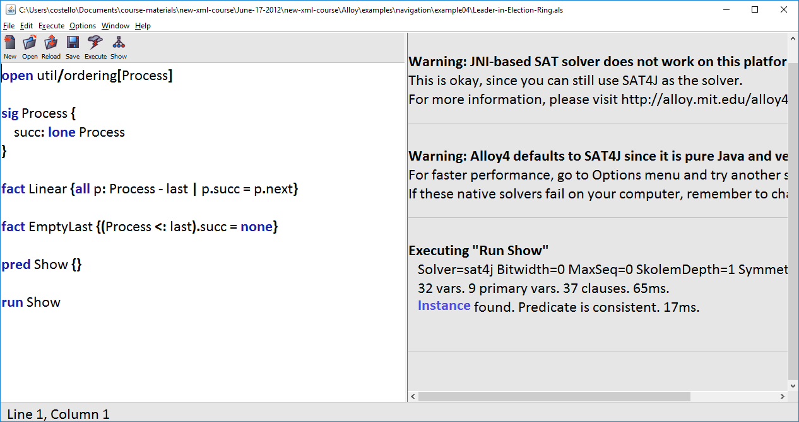
Open Leader-in-Election-Ring.als in the navigation/example04 folder. Then select Execute >> Show. Then click on Instance.

Slide 83
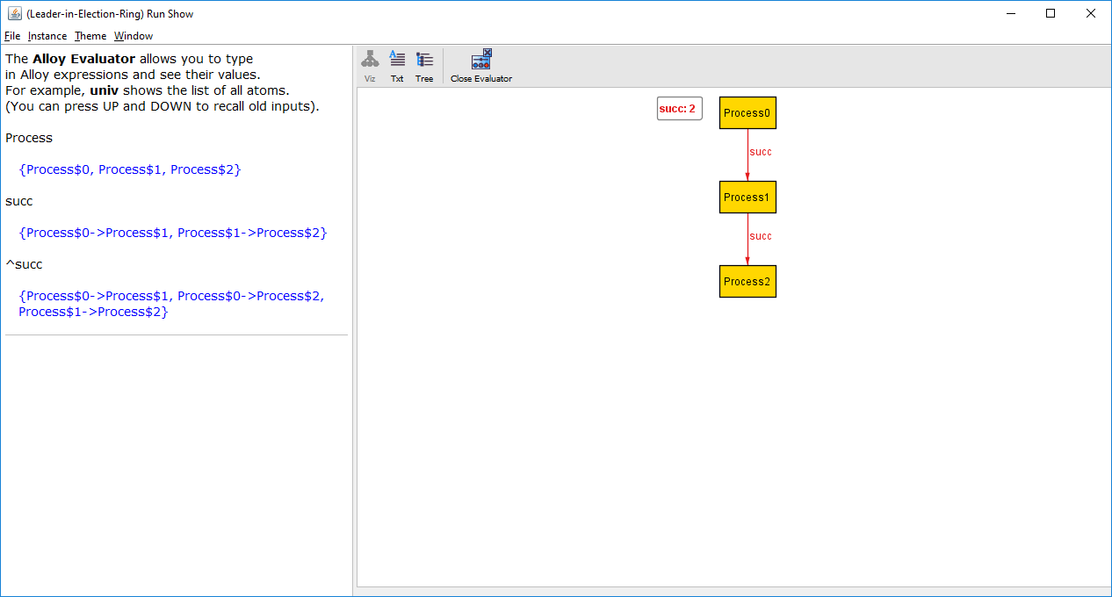
succ
^succ
Process$0
Process$1
Process$0
Process$1
Process$1
Process$2
Process$0
Process$2
Process$1
Process$2

Slide 84
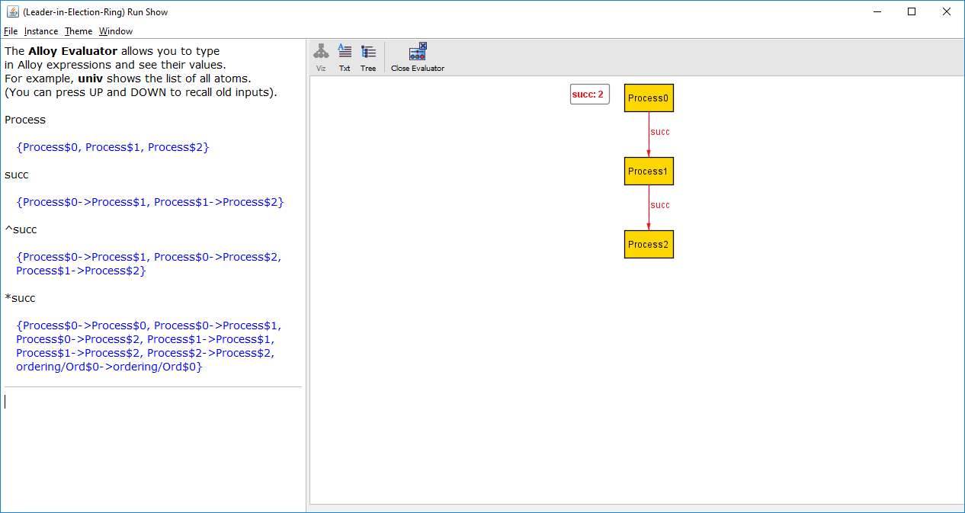
Type this expression

Slide 85
succ
*succ
Process$0
Process$1
Process$0
Process$0
Process$1
Process$2
Process$0
Process$1
Process$0
Process$2
Process$1
Process$1
Process$1
Process$2
Process$2
Process$2

Slide 86
What’s this? See the bottom of page 65 of Software Abstractions. The value ordering/Ord$0 comes from the ordering/util module. For this tutorial we will ignore this.

Slide 87
^succ
*succ
Process$0
Process$1
Process$0
Process$0
Process$0
Process$2
Process$0
Process$1
Process$1
Process$2
Process$0
Process$2
Process$1
Process$1
Process$1
Process$2
Process$2
Process$2

Slide 88
Reflexive transitive closure operator *
The reflexive transitive closure operator is applied to binary relations.
If a binary relation contains a -> b and b -> c, then the reflexive transitive closure returns a -> a, a -> b, b -> c, and a -> c.
That is, * is exactly like ^ except * also returns each value mapped to itself.

Slide 89
What properties does Component$1 in iCalendarObject have?
iCalendarObject
properties
iCalendarObject$0
Component$0
dtstamp$0
Component$0
version$0
Component$1
dtstamp$0
components
Component$1
version$0
iCalendarObject$0
Component$0
Component$2
dtstamp$0
iCalendarObject$0
Component$1
Component$2
version$0
iCalendarObject$0
Component$2

Slide 90
What properties does Component$1 in iCalendarObject have?
iCalendarObject
properties
iCalendarObject$0
Component$0
dtstamp$0
Component$0
version$0
Component$1
dtstamp$0
components
Component$1
version$0
iCalendarObject$0
Component$0
Component$2
dtstamp$0
iCalendarObject$0
Component$1
Component$2
version$0
iCalendarObject$0
Component$2
iCalendarObject.components

Slide 91
What properties does Component$1 in iCalendarObject have?
iCalendarObject
properties
iCalendarObject$0
Component$0
dtstamp$0
Component$0
version$0
Component$1
dtstamp$0
components
Component$1
version$0
iCalendarObject$0
Component$0
Component$2
dtstamp$0
iCalendarObject$0
Component$1
Component$2
version$0
iCalendarObject$0
Component$2
iCalendarObject.components.Component$1

Slide 92
components
iCalendarObject$0
Component$0
iCalendarObject$0
Component$1
Component$1
none
iCalendarObject$0
Component$2

Slide 93
components
iCalendarObject$0
Component$0
iCalendarObject$0
Component$1
Component$1
none
iCalendarObject$0
Component$2
We don’t want that

Slide 94
components
iCalendarObject$0
Component$0
iCalendarObject$0
Component$1
?
Component$1
Component$1
iCalendarObject$0
Component$2
We want this

Slide 95
components
iCalendarObject$0
Component$0
iCalendarObject$0
Component$1
:>
Component$1
iCalendarObject$0
Component$1
iCalendarObject$0
Component$2

Slide 96
components
iCalendarObject$0
Component$0
iCalendarObject$0
Component$1
:>
Component$1
iCalendarObject$0
Component$1
iCalendarObject$0
Component$2
restricted range operator: the pairs in the binary relation that have range Component$1

Slide 97
iCalendarObject
properties
iCalendarObject$0
Component$0
dtstamp$0
Component$0
version$0
Component$1
dtstamp$0
components
Component$1
version$0
iCalendarObject$0
Component$0
Component$2
dtstamp$0
iCalendarObject$0
Component$1
Component$2
version$0
iCalendarObject$0
Component$2
iCalendarObject.(components :> Component$1)

Slide 98
What properties does Component$1 in iCalendarObject have?
iCalendarObject
properties
iCalendarObject$0
Component$0
dtstamp$0
Component$0
version$0
Component$1
dtstamp$0
components
Component$1
version$0
iCalendarObject$0
Component$0
Component$2
dtstamp$0
iCalendarObject$0
Component$1
Component$2
version$0
iCalendarObject$0
Component$2
iCalendarObject.(components :> Component$1).properties

Slide 99
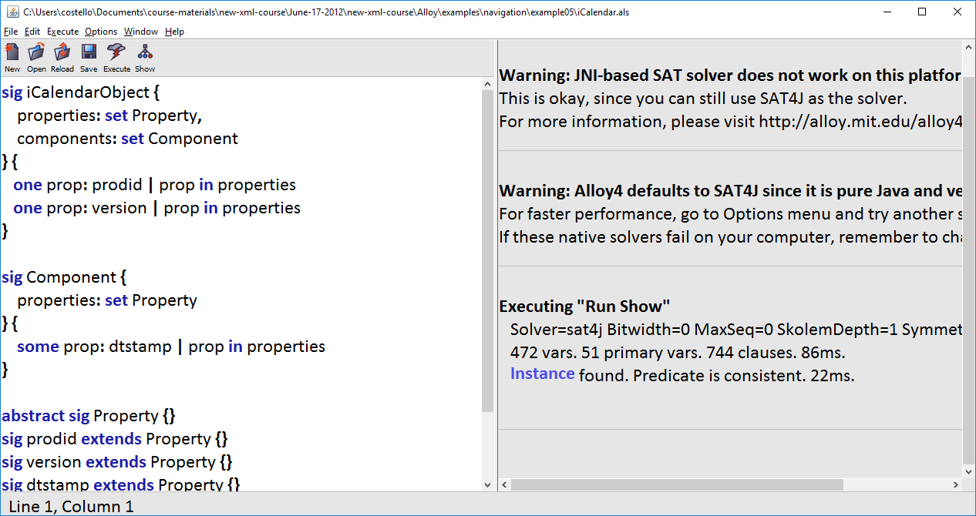
Open iCalendar.als in the navigation/example05 folder. Then select Execute >> Show. Then click on Instance.

Slide 100
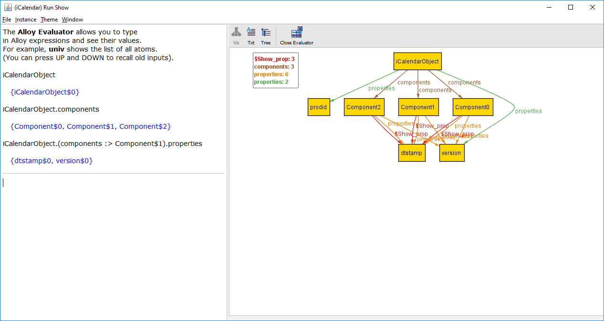

Slide 101
components
iCalendarObject$0
Component$0
iCalendarObject$0
Component$1
iCalendarObject$0
Component$2
As we learned earlier, this is a binary relation.

Slide 102
components
These are range values
iCalendarObject$0
Component$0
iCalendarObject$0
Component$1
iCalendarObject$0
Component$2

Slide 103
These are domain values
components
iCalendarObject$0
Component$0
iCalendarObject$0
Component$1
iCalendarObject$0
Component$2

Slide 104
Range restriction operator :> Domain restriction operator <:
binaryRelation :> rangeValue
Returns the pairs in binaryRelation that have a range matching rangeValue
domainValue <: binaryRelation
Returns the pairs in binaryRelation that have a domain matching domainValue

