Slide 1
Can the constraints be satisfied?
Roger L. Costello
March 21, 2018

Slide 2

10 people coming over for dinner
You are in charge of the seating arrangement. There are numerous constraints: Grandma and Grandpa must sit close to the bathroom. Aunt Nelly and Aunt Jane must be seated as far apart of possible. Uncle Jim’s children must be seated close to him. The hosts must be seated at the heads of the table. Etc.

Slide 3
10 people coming over for dinner
This is an example of a “constraint satisfaction” problem. Given a bunch of constraints, what instances (seating arrangements) satisfy the constraints?
You are in charge of the seating arrangement. There are numerous constraints: Grandma and Grandpa must sit close to the bathroom. Aunt Nelly and Aunt Jane must be seated as far apart of possible. Uncle Jim’s children must be seated close to him. The hosts must be seated at the heads of the table. Etc.

Slide 4
Revolution in constraint satisfaction algorithms
In the last 20 years a revolution has occurred in constraint satisfaction algorithms.
The improvement in algorithms has resulted in solving problems that 20 years ago would have taken a supercomputer days to solve, can now be solved on an ordinary laptop in a few seconds.

Slide 5
Here’s what Donald Knuth says:
Enormous technical breakthroughs in recent years have led to amazingly good ways to approach the satisfiability problem. We now have algorithms that are much more efficient than anyone had dared believe possible before the year 2000. These so-called “SAT solvers” are able to handle industrial-strength problems, involving millions of variables.
Donald Knuth, Satisfiability and the Art of Computer Programming

Slide 6
Simply list the constraints?
Can you simply list the constraints:
Grandma and Grandpa must sit close to the bathroom.
Aunt Nelly and Aunt Jane must be seated as far apart of possible.
Uncle Jim’s children must be seated close to him.
The hosts must be seated at the heads of the table.
Etc.
and hand the list off to a SAT tool?
No. More info is needed.

Slide 7
Need “structural” info
What’s a chair? How are the chairs arranged? What’s a person? How are chairs and persons related?
A description of the structural parts is needed:
There are 10 things that we will call “chairs.”
There are 10 things that we will call “persons.”
A person will be paired to a chair.
Each chair has left and right neighboring chairs.
The set of chairs form a circle.
There is a thing that we will call a “bathroom.”
Each chair has a proximity to the bathroom.
“person” is a generic (abstract) term. Grandma and Grandpa are a type of person. Aunt Nelly, Aunt Jane, and Uncle Jim are a type of person.

Slide 8
A “model” is a description of the structural parts plus a list of constaints on those structural parts.

Slide 9
Alloy = modelling language + tool
Alloy is a modeling language. Express your models in the Alloy language.
Alloy is also a tool. The Alloy Analyzer takes your model, translates it into a boolean expression that the SAT tool understands, hands the boolean expression off to the SAT tool which returns the set of instances that satisfy the constraints.
Model
(expressed using the Alloy language)
Alloy Analyzer
COTS
SAT
solver

Slide 10
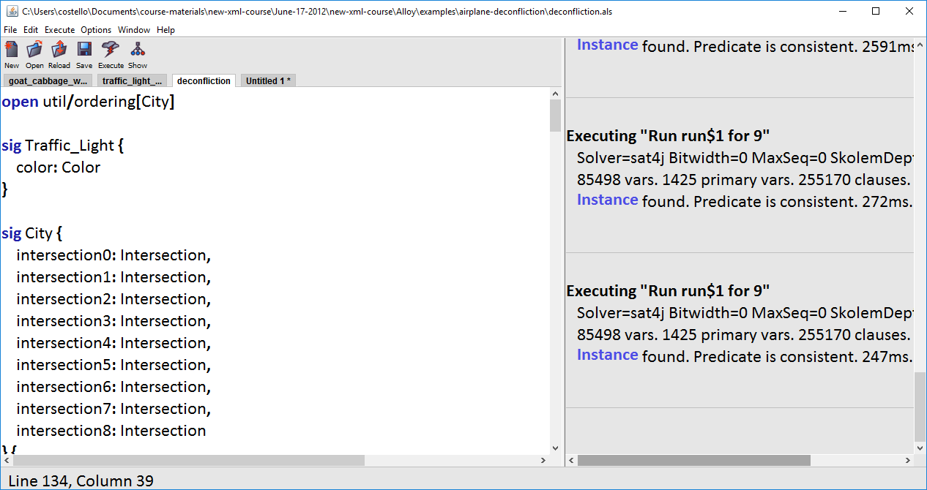
Here’s a peek at the Alloy tool in use:
A model, expressed in the Alloy language
Boolean expression contains 85,498 variables

Slide 11
Recap: What is Alloy?
Use the Alloy language to express the structural components and the constraints on those components.
Use the Alloy Analyzer to tell you if the constraints can be satisfied and, if so, what instances satisfy the constraints.

Slide 12
Download Alloy
We will be using two versions of Alloy.
Alloy 4.2 is the latest stable release: http://alloy.csail.mit.edu/alloy/downloads/alloy4.2.jar
Peter Kriens is working on the next version of Alloy. He has added very useful enhancements to Alloy. At the time of writing, it is at the beta stage. We will use it whenever possible, because the enhancements, such as the “Table” output format, will greatly accelerate understanding. It may be downloaded from here: https://github.com/AlloyTools/org.alloytools.alloy/releases/tag/v5.0.0-markdown (we want org.alloytools.alloy.dist.jar )
To run Alloy, simply double-click the jar file.

