Slide 1
What is your universe?
Roger L. Costello
March 24, 2018

Slide 2
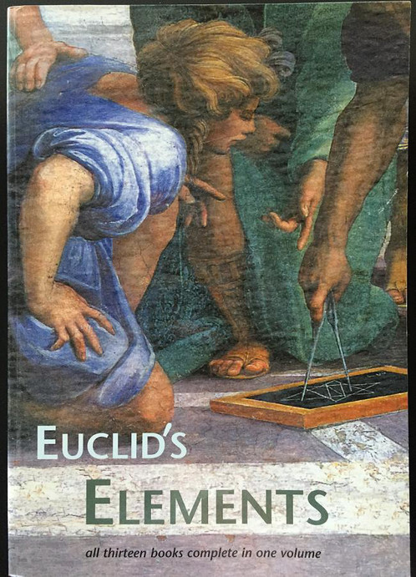
Written in ancient Greece by a fellow named Euclid, Elements is widely considered one of the most important books ever written.

Slide 3
Build from a small set of axioms
The book starts with a small set of statements (called axioms) that Euclid (and others) considered to be self-evident.
From these axioms he derived a great many statements that were known to be true about geometrical figures.
In this way he systematized the field of geometry (now known as Euclidean Geometry).

Slide 4
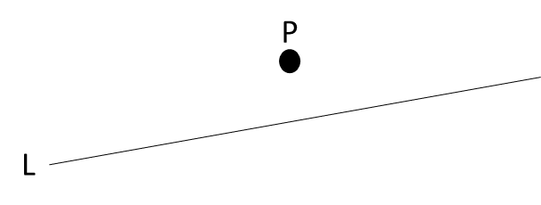
Here is one of the axioms
Parallel Postulate: Given a line L and a point P not on L, one and only one line L’ can be drawn through P parallel to the line L (i.e., not intersecting no matter how far extended).
That makes sense, right? Pretty obvious, right?

Slide 5
But what is Euclid assuming?
Answer: He is assuming a plane, that goes on indefinitely.
That is Euclid’s universe.

Slide 6
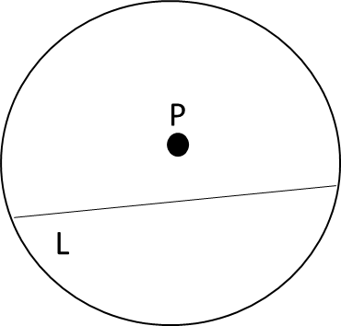
There are other ways to view the universe
In the 19th century N. Lovachevsky and J. Bolyai decided to use a different universe. Their universe was a circle. In the circle they drew a line L from one side to the other and a point P not on the line:
How many lines are parallel to L? That is, how many lines go through P without intersecting L?

Slide 7
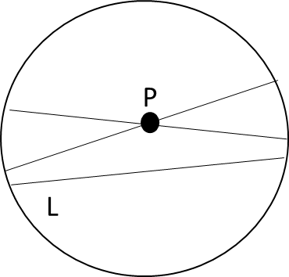
Answer: lots of lines! Here are two such lines:
In this universe there can be many parallel lines. Starting with this universe, Lovachevsky and J. Bolyai derived many other things. This became known as non-Euclidean geometry.

Slide 8
What does this have to do with Alloy?
When you create an Alloy model, what is your universe?
Answer: your universe is finite, it is comprised of the atoms in the signatures in your model. The keyword univ returns all the atoms in the universe (that is, all the atoms in your model’s signatures).
Here is an Alloy model, what is its universe?
sig A { field1: B, field2: C }
sig B {} sig C {}

Slide 9

The univ keyword
The Alloy Analyzer generates instances.
Each instance may contain different numbers of atoms for each signature.
I ran the model on the previous slide and for one instance, univ has this:
sig A { field1: B, field2: C }
sig B {} sig C {}
univ = {A0, A1, B0, B1, C0, C1}

Slide 10
pred with univ arguments
The following is a pred that has two arguments: (1) a set of values from the universe and (2) a set of pairs (x, y) where x and y are values from the universe.
// Given a set A and a relation R in A, R is transitive // if and only if for all ordered pairs (x, y) and (y, z) in R, // the pair (x, z) is also in R. pred transitive (A: set univ, R: univ->univ) { all x, y, z: A | (((x ->y) in R) and ((y -> z) in R)) => ((x -> z) in R) }

Slide 11
The iden keyword
In addition to the keyword univ, there is another important keyword, iden. It is the set of (x, x) pairs for all the values in the universe, e.g.,
iden = {A0->A0, A1->A1, B0->B0, B1->B1, C0->C0, C1->C1}
Do Lab5

